Slide 1
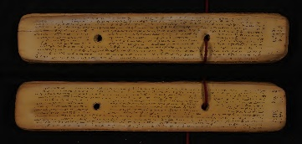

Character Recognition from Tamil Palm Leaves: A Comparative Analysis of Different Classification Models
Submitted By:
Nandhitha Ravishankar – BL.EN.U4AIE20041
P Sadhana – BL.EN.U4AIE20047

Slide 2

Introduction
Palm leaf manuscripts, being historical documents prone to damage, require preservation to prevent further deterioration
Deciphering the handwritten content within these damaged manuscripts is a time-consuming task. In order to understand the handwriting, characters can be extracted and trained using models.
In this work, characters have been extracted from the palm leaf manuscripts using connected component analysis and they are manual segregated
A comparative analysis of deep learning models, including ResNet-50, VGG-16, VGG-19, DenseNet, MobileNet, LeNet-5, Custom CNN, and AlexNet has been done

Slide 3
Novelty
Firstly, it aligns with Goal 4 of the Sustainable Development Goals (SDGs), which focuses on quality education and aims to promote inclusive and accessible learning opportunities
Unlike most existing works that rely on grayscale and binarized images, this project utilizes the original palm leaf images for character extraction
The project implements LIME (Local Interpretable Model-Agnostic Explanations) for explainable AI
The project stands out by incorporating a comparative study of eight different classification models

Slide 4
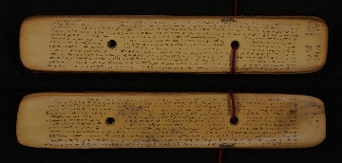



Dataset
100 palm leaves were obtained
Each individual letter present on the palm leaves has been extracted and processed

Slide 5
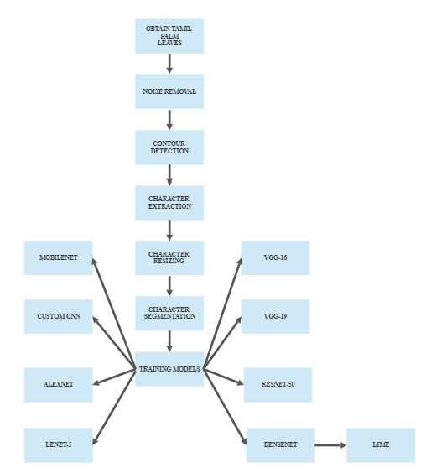
Methodology
fastNlMeansDenoisingColored method from OpenCV is employed for noise removal
To identify and isolate individual characters, contour detection was performed on the filtered images, locating the boundaries of distinct objects within the images
Using the connected compound analysis method, a staggering number of 12,56,343 images were extracted from the palm leaves
Approximately 8,56,237 images were discarded based on their size
The extracted images were resized to a dimension of 224x224 pixels with 3 colour channels
the remaining images were carefully examined, and 21 distinct characters were manually segregated, resulting in the creation of 21 classes
The dataset was utilized to conduct a comparative analysis of various deep learning models for character recognition
the model with the highest accuracy was selected for further analysis

Slide 6
Results
S.No | Model | No. of Epochs | Time Taken | Accuracy
1 | VGG -16 | 50 | 1261m 20.6s | 12.2807
2 | VGG-19 | 50 | 1411m 19.5s | 12.2807
3 | ResNet-50 | 50 | 132m 6.6s | 96.2962
4 | AlexNet | 50 | 63m 49.5s | 9.6296
5 | LeNet-5 | 50 | 38m 22.9s | 87.9629
6 | MobileNet | 50 | 31m 40.2s | 90.1851
7 | DenseNet | 50 | 281m 48.1s | 97.8070
8 | CustomCNN | 50 | 96m 31.3 s | 35.7407

Slide 7
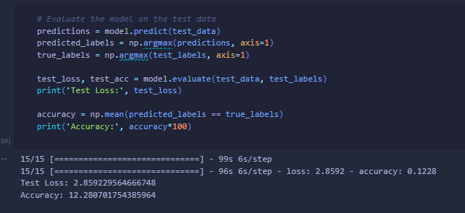
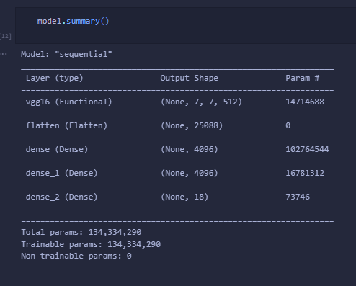
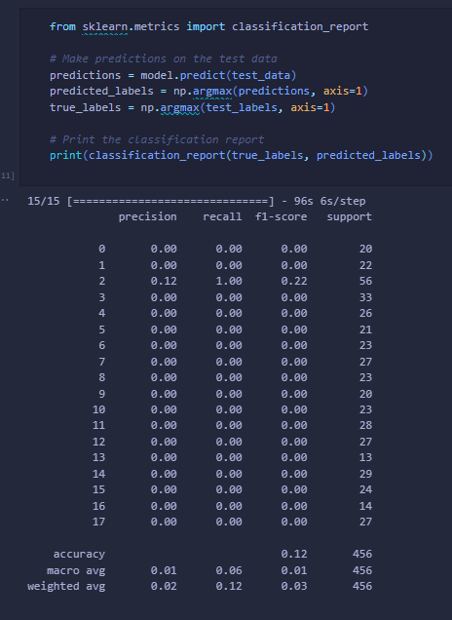
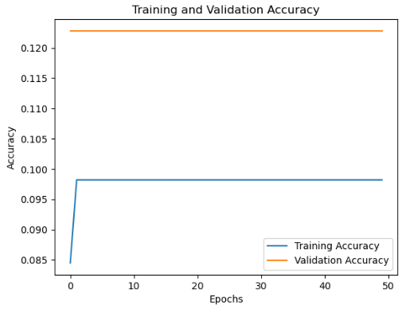
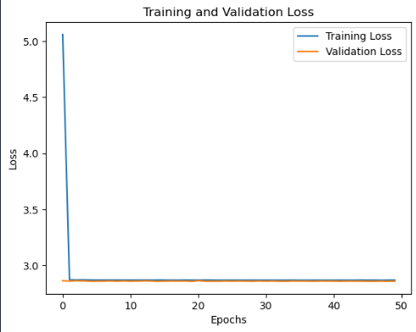
VGG-16

Slide 8
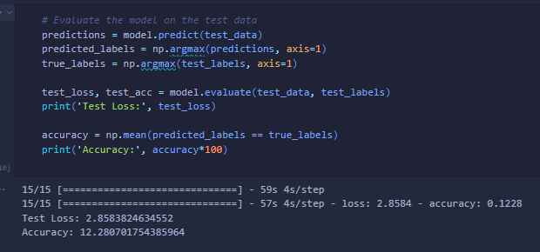
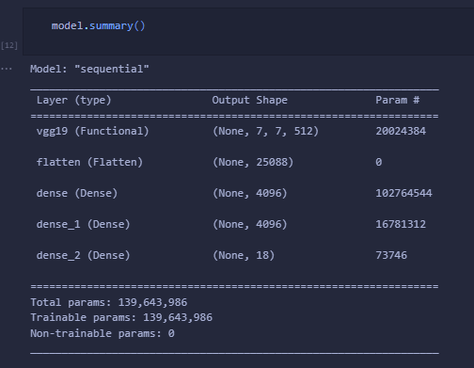
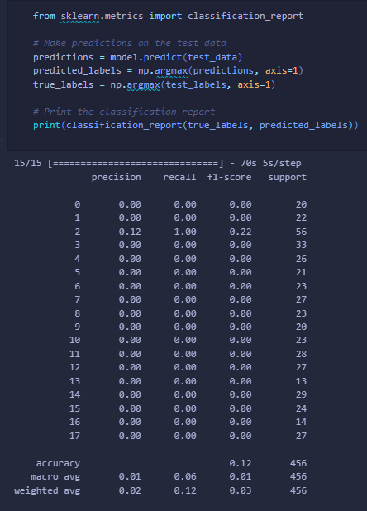
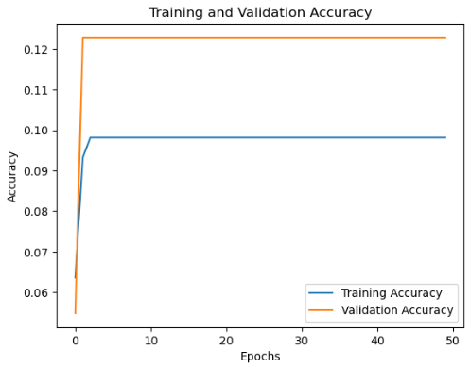
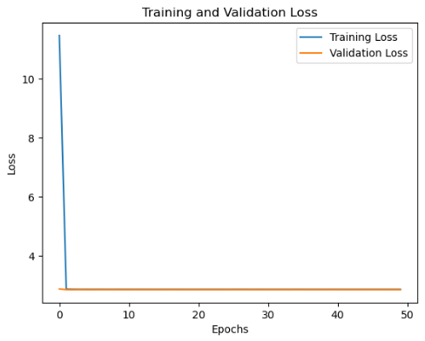
VGG-19

Slide 9
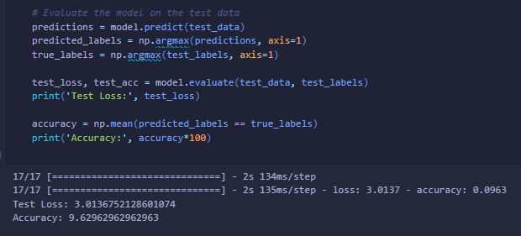
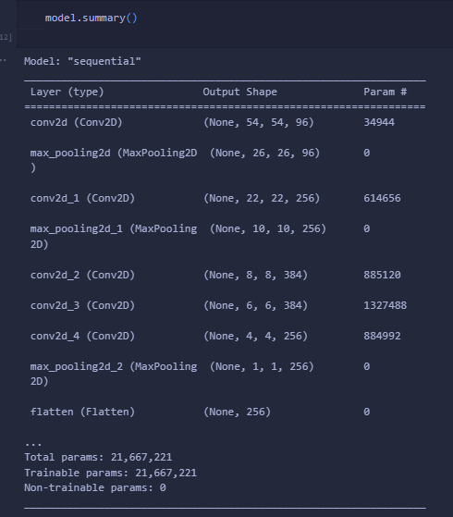
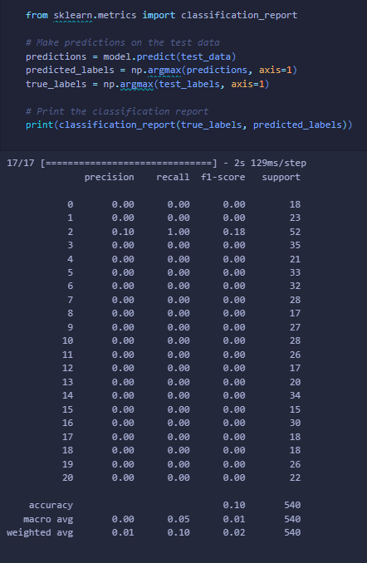
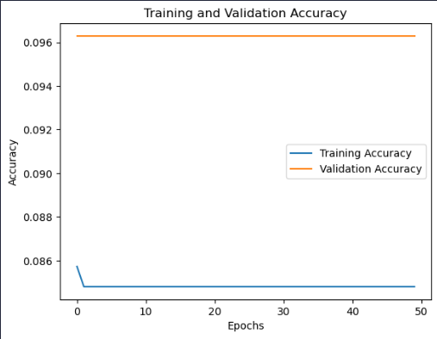
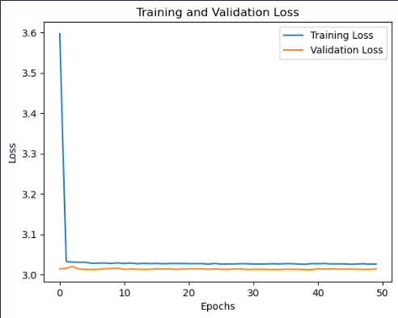
AlexNet

Slide 10
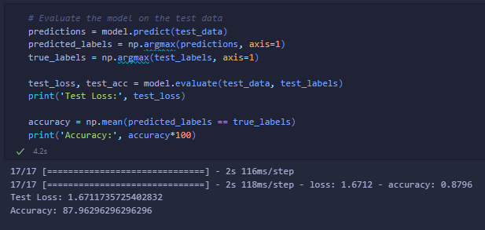
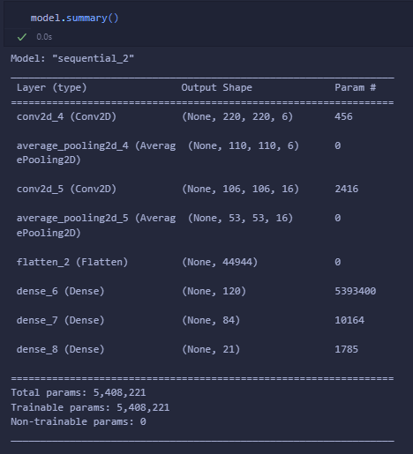
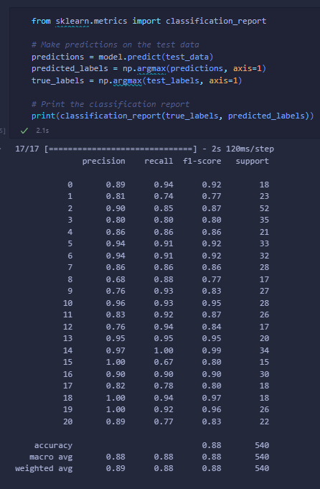
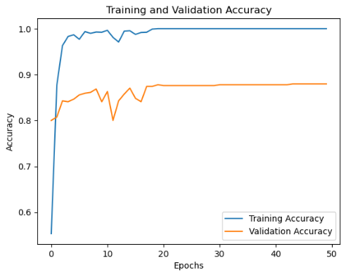
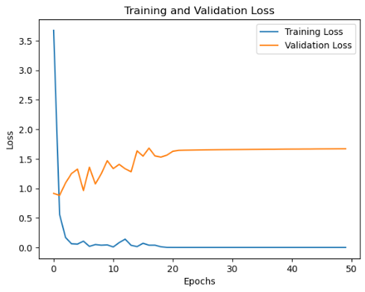
LeNet - 5

Slide 11
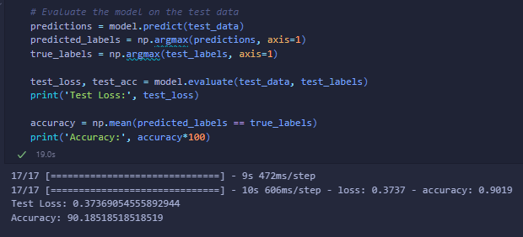
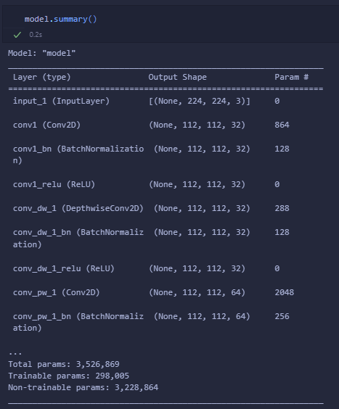
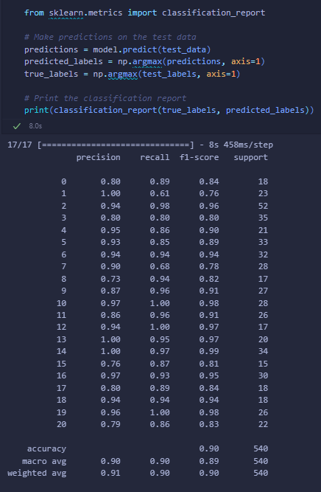
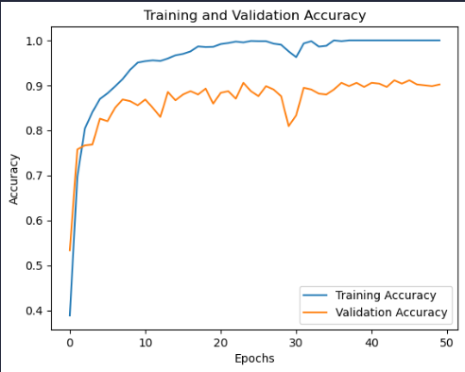
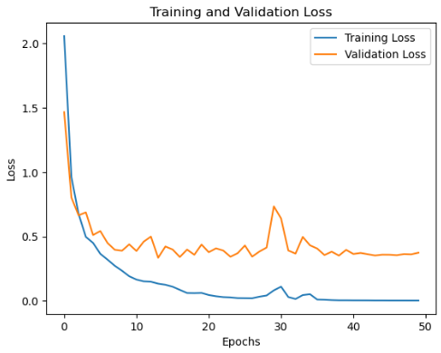
MobileNet

Slide 12
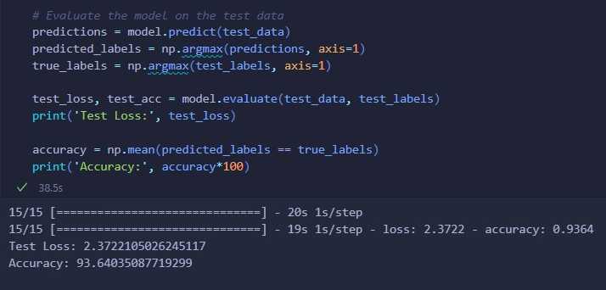
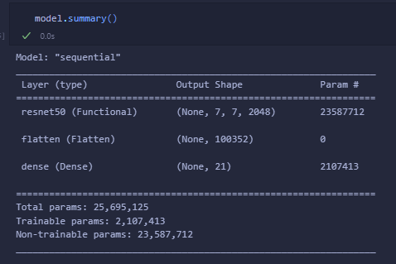
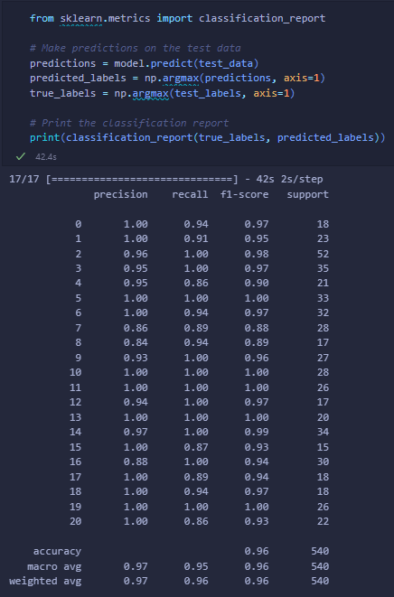
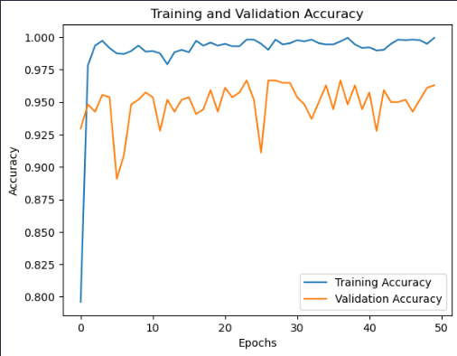
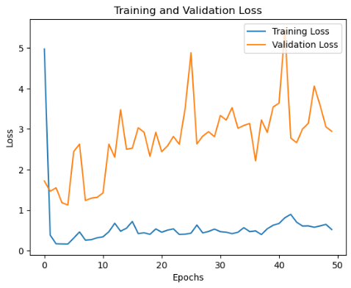
ResNet - 50

Slide 13
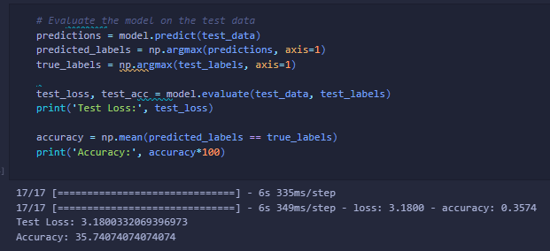
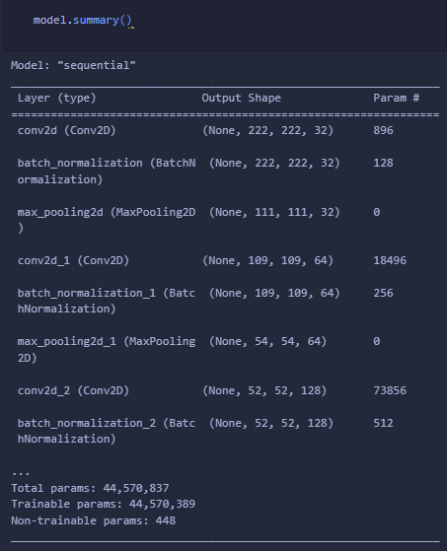
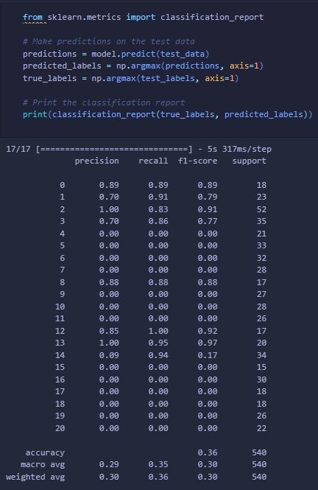
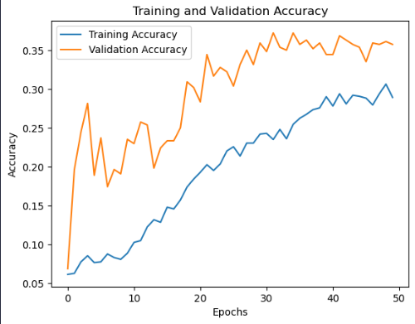
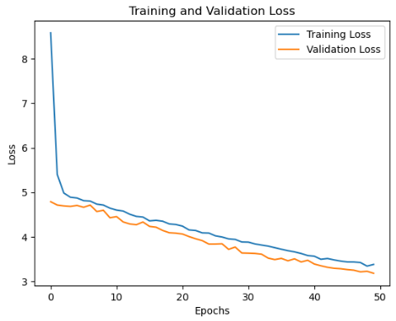
Custom CNN

Slide 14
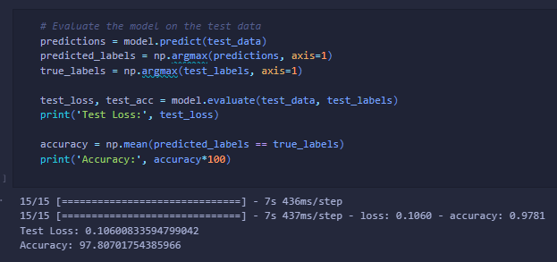
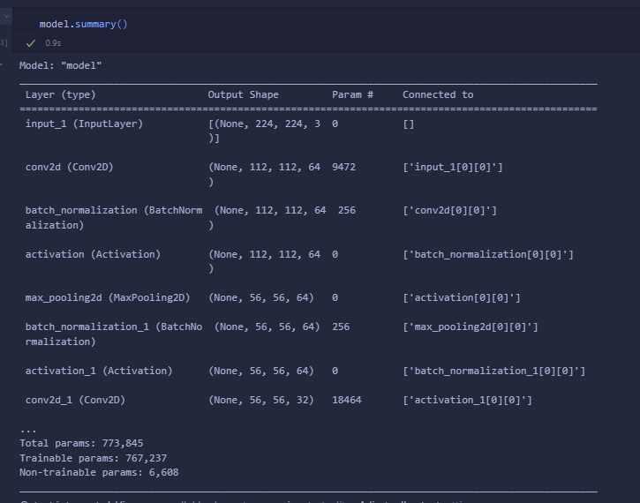
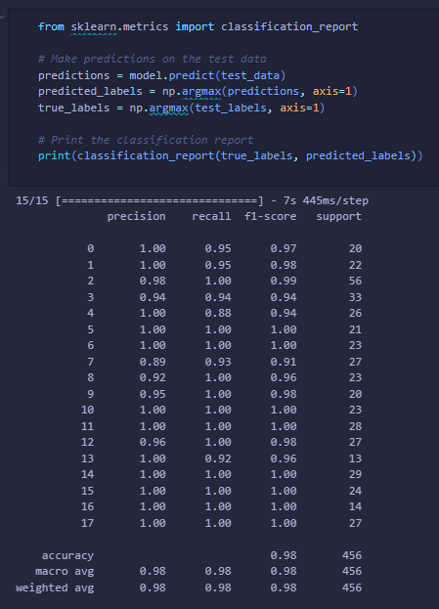
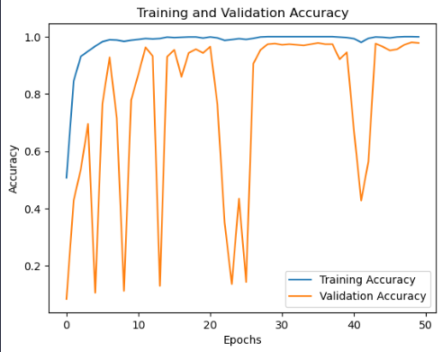
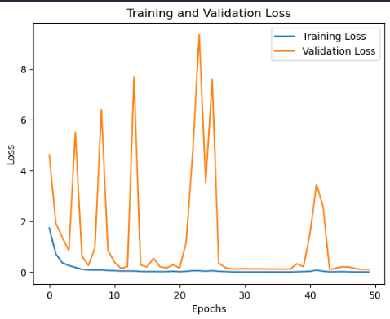
DenseNet

Slide 15
Lime
LIME stands for “Local Interpretable Model-Agnostic Explanations”
The goal of LIME is to provide local explanations for individual predictions, explaining why a model made a particular decision for a specific instance
It aims to identify and highlight the important features or regions in the input data that influenced the model's prediction

Slide 16
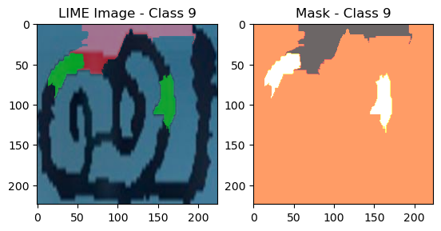
Lime
Visualization that highlights the important regions in the image for the specific class being analyzed
The green and red patches on the character indicate the regions that contribute positively or negatively to the prediction of that class. Green patches represent the regions that positively influence the prediction, while red patches represent the regions that negatively influence it.
The mask image (mask) is a binary image that shows the segmented regions of the image that are considered important for the prediction of the given class. The mask is visualized using a colormap ('hot') where hotter regions (brighter colors) indicate higher importance.

Slide 17
Conclusion
The work aims to create a system that can recognize Tamil characters from manuscripts written on palm leaves
The project successfully achieved its goal of extracting and segmenting 21 Tamil characters from palm leaf images
Among the eight models trained, the DenseNet model demonstrated the highest accuracy, reaching an impressive 97.8%

Slide 18
Thank You

