Slide 1
IEEE International
Conference on Latest Innovations in Computing and Knowledge 2026
CLICK2026
Paper ID: CLICK2167
Title: Ontology-Driven Deep Learning Framework for Intelligent Traffic Congestion Control
Author 1: Mr. G. David Raj
Author 2: Nandhagopal R

Slide 2
Introduction
Urban traffic congestion increases travel time, fuel use, and pollution, and delays emergency vehicles.
Existing systems rely on traditional traffic-management approaches and conventional ML, missing the semantic relationships between roads, vehicles, weather conditions, traffic volume, and temporal patterns.
This work proposes an Ontology-Driven Deep Learning framework combining CNN, Bi-LSTM, multimodal fusion, and semantic reasoning.
The framework predicts congestion and detects emergency vehicles, and generates explainable traffic-control decisions.

Slide 3
Research Motivation
Traditional ML (SVM, Decision Tree, Random Forest) captures only numerical patterns, not relationships among traffic factors.
Most models fail to capture long-term temporal dependencies and are not designed for prediction.
Black-box predictions lack interpretability, reducing trust in traffic-control decisions.
Poor scalability on large, dynamic datasets and limited emergency-vehicle awareness.
Need for an accurate, interpretable, and semantically aware traffic-management system.

Slide 4
Related Work / Literature Review
Year | Work / Method | Key Limitation
2021 | Ontology Traffic Signal Control (Ghanadbashi) - Ontology + rules | Design and maintenance complexity
2022 | Congestion Prediction (Zhou) - CNN + Multimodal Fusion | High data and compute cost
2022 | ConvLSTM Traffic Flow (Wei and Liu) - LSTM + Attention | High computation cost
2022 | ST-Tensor GCN - Base Paper (Xu) - ST-TGCN | Complex, tuning-sensitive
2023 | Explainable AI for ITS (Adadi) - SHAP / LIME | Survey only, no implementation
Sources: Ghanadbashi et al. (2021), Zhou et al. (2022), Wei and Liu (2022), Xu et al. (2022), Adadi et al. (2023)

Slide 5
Proposed Methodology
Emergency-vehicle traffic images (Emergency / Normal) and the Metro Interstate Traffic Volume structured/tabular dataset are collected; images are resized and normalized, and the tabular data is scaled and split into 5-step temporal windows.
CNN extracts spatial features from traffic images - vehicle density and emergency-vehicle presence.
Bi-LSTM learns temporal congestion patterns from the Metro Interstate structured/tabular data (5-step temporal windows).
Multimodal fusion combines CNN spatial + Bi-LSTM temporal features for higher accuracy.
Ontology-based semantic layer performs rule-based IF-THEN decision-making.
Grad-CAM and SHAP generate explainable outputs - heatmaps, feature importance, congestion and risk analysis.

Slide 6
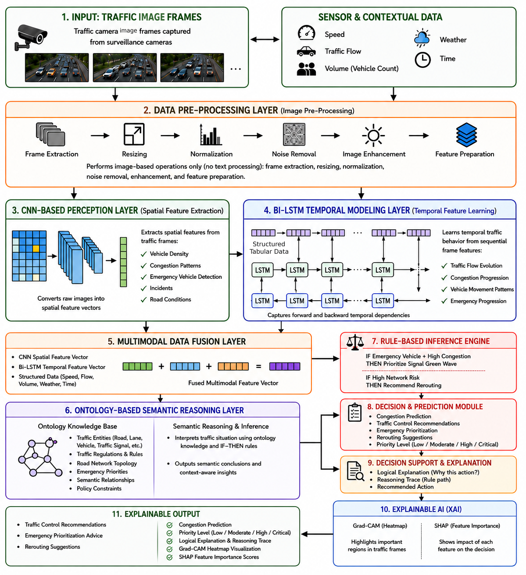
Architecture Diagram
Traffic Images → CNN (Spatial) + Structured/Tabular Data → Bi-LSTM (Temporal) → Multimodal Fusion → Ontology Reasoning → SHAP / Grad-CAM → Decision

Slide 7
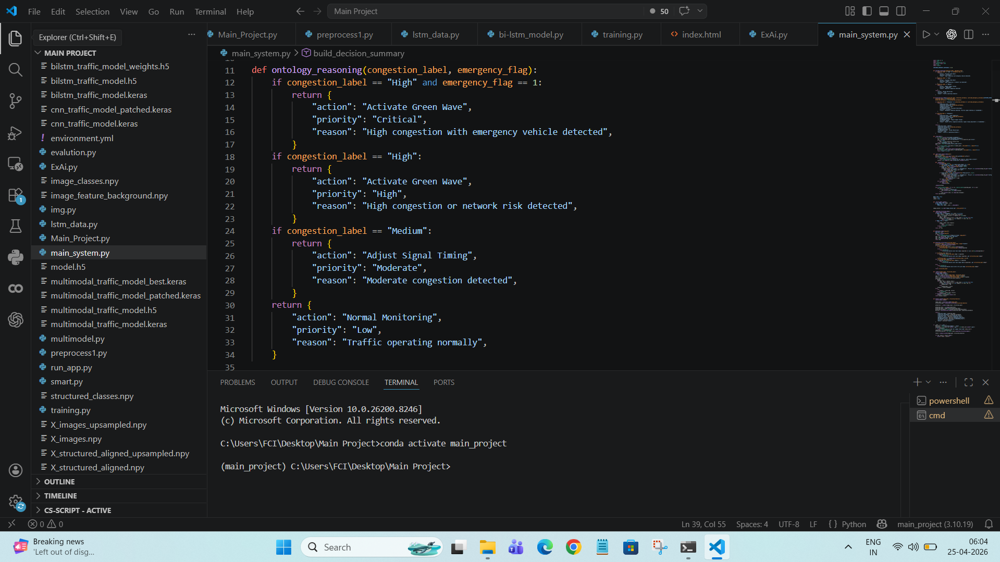
Implementation
M1 - Emergency Detection (CNN, EfficientNetB0 backbone): spatial features, vehicle density, ambulance detection -> Normal / Emergency.
M2 - Temporal Prediction (Bi-LSTM on structured/tabular 5-step temporal windows): temporal patterns -> congestion (Low / Medium / High) and risk.
M3 - Multimodal Fusion: concatenate CNN + Bi-LSTM features -> robust, low-bias prediction.
M4 - Ontology Explainable Engine: IF-THEN reasoning + Grad-CAM / SHAP -> action, priority, explanation.
Stack: Python, TensorFlow / Keras, EfficientNetB0 CNN + Bi-LSTM, ontology rule base.

Slide 8
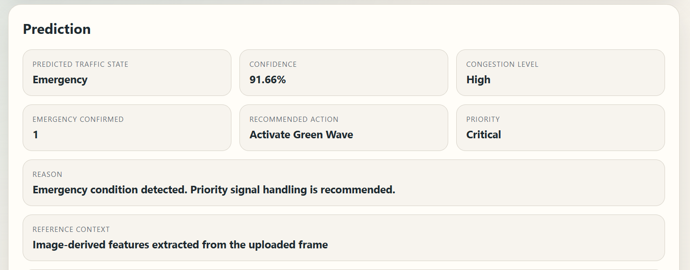
Results and Discussion
Sample output: emergency vehicle detected with 91.66% confidence, High congestion level, Priority = Critical, Recommended action = Activate Green Wave - with a rule-based reason for the decision.

Slide 9
Performance Evaluation
Proposed Ontology + CNN + Bi-LSTM - classification performance on the held-out test set:
High precision (96.6%) and recall (96.9%) - reliable detection with minimal false alarms.
Consistent congestion classification across Low / Medium / High.
Outperforms all classical and deep-learning baselines.
Metric | Value
Accuracy | 97.2%
Precision | 96.6%
Recall | 96.9%
F1-Score | 96.7%

Slide 10
Comparative Analysis
Model | RMSE | MAE | Accuracy (%) | R² | Var
HA | 4.295 | 2.782 | 81.2 | 0.807 | 0.80
ARIMA | 7.241 | 4.982 | 62.3 | N/A | 0.00
SVR | 4.145 | 2.623 | 88.6 | 0.842 | 0.80
CNN | 3.994 | 2.596 | 91.2 | 0.832 | 0.80
Bi-LSTM | 3.741 | 2.487 | 92.8 | 0.851 | 0.80
CNN + Bi-LSTM | 3.512 | 2.295 | 94.7 | 0.866 | 0.80
Ontology + CNN + Bi-LSTM (Proposed) | 3.106 | 2.019 | 97.2 | 0.911 | 0.90
The proposed Ontology + CNN + Bi-LSTM model achieves the best results on every metric, outperforming all baselines.

Slide 11
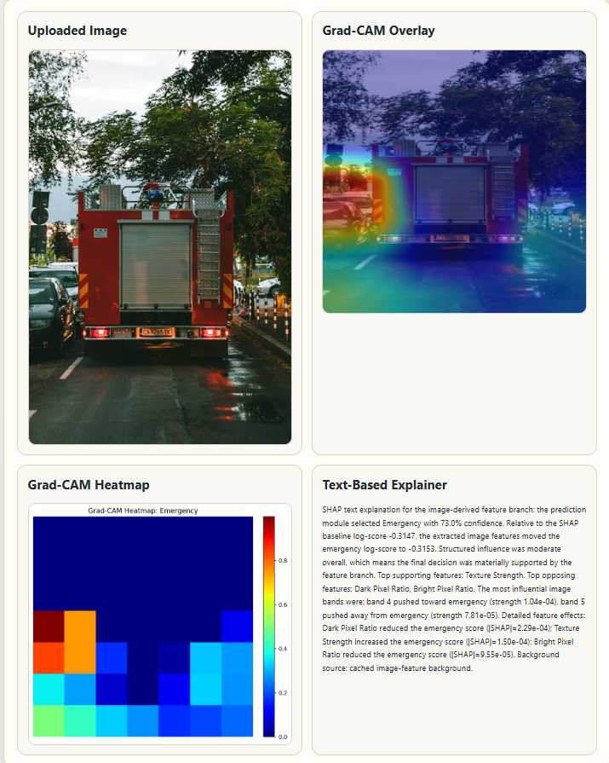
Key Insights and Discussion
Multimodal fusion combines spatial (CNN) and temporal (Bi-LSTM), context-aware representations.
Ontology layer adds context-aware, rule-based decisions (emergency prioritization, Green Wave).
Grad-CAM heatmaps localize congestion and emergency regions within traffic images.
SHAP quantifies the contribution of individual features, improving transparency and trust.
Explainable outputs support transparent, interpretable traffic-control decisions.

Slide 12
Conclusion and Future Work
Conclusion
  Integrates ontology with CNN-Bi-LSTM deep learning for interpretable congestion.
  Combines semantic knowledge with temporal modeling; predictions explained via SHAP and Grad-CAM.
  Scalable and adaptable for modern smart-city traffic management.
Future Work
  IoT sensor integration for real-time data.
  Graph Neural Networks to better model spatial road-network relationships.
  Web / mobile application and full smart-city deployment.

Slide 13
Thank You!
Questions and discussion are welcome.
nandhagopal0104@gmail.com

