Slide 1


CAPSTONE PROJECT
DATA ANALYSIS USING SQL
PRESENTED
BY
NANDHA KUMAR C

Slide 2
PROJECT OBJECTIVE
The objective of the project is to use MySQL to analyze the data of a movie rental store for further growth and improved business.

Slide 3
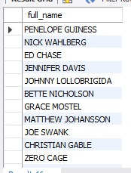
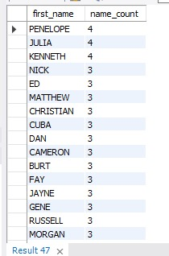
FULLNAME OF ACTOR AVAILABLE IN DATABASE
method:
Here I used SELECT comanad to select the column name
and CONCAT function to join the two column as one column
interpretation:
it shows the Fullname of actor available in database
No of times each firstname appears
method:
Here I used COUNT function used count the values GROUP BY
the column name ORDER BY the count descending
interpretation:
It shws the first name and count of first name

Slide 4
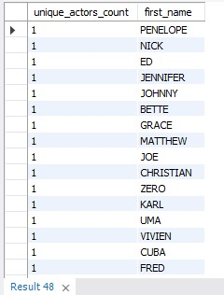
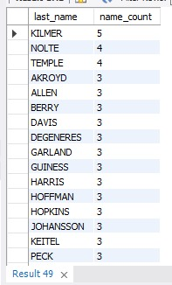
Count of actors that have unique first name
method:
Here I used DISTINCT FOR UNIQUE VALUE COUNT function used count the values and SUBQUERY
GROUP BY the column name HAVING clause filter the data
Interpretation:
it shows uniuqe actors count and tere first name
No of times each lastname appears
method:
Here I used COUNT function used count the values GROUP BY
the column name ORDER BY the count descending
interpretation:
it shows the last name and count of last name

Slide 5
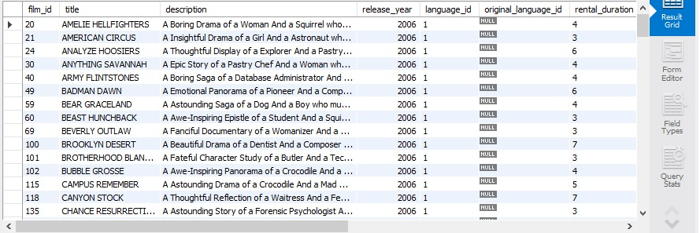
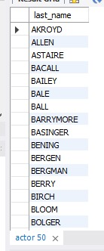
Display record of movies with the rating "R" and audience under "17" years
method:
Here I used WHERE clause for filter the rows and
using AND keyword to satisfied the both condition
interpretation:
it shows the movie records with the rating "R" and audience under "17" years
All unique last names
method:
Here I used DISTINCT for unique names
interpretation:
it shows the all umique last name

Slide 6
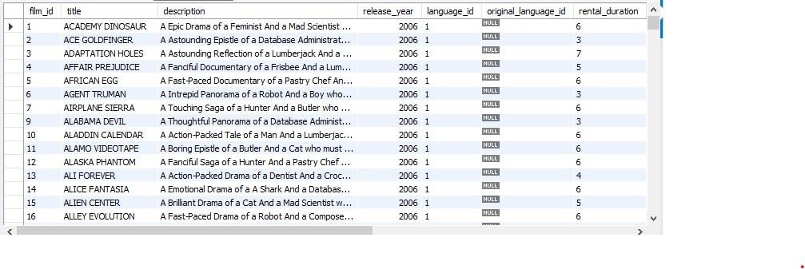
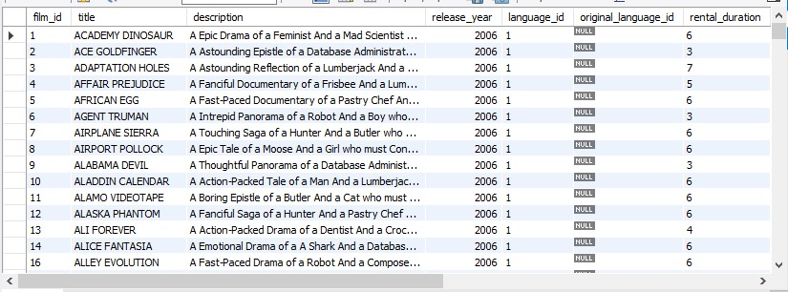
Display record of movies with not rated "R"
method:
Here I used WHERE clause for filter the rows and
used not equal keyword to satisfied condition
interpretation:
it shows the record of movies with not rated "R"
Display record of movies with that where replacement cost is upto 11
Method:
Here i used WHERE clause to filter the of relacement_cost
interpretation:
it shows the record of movies with that where replacement cost is upto 11

Slide 7
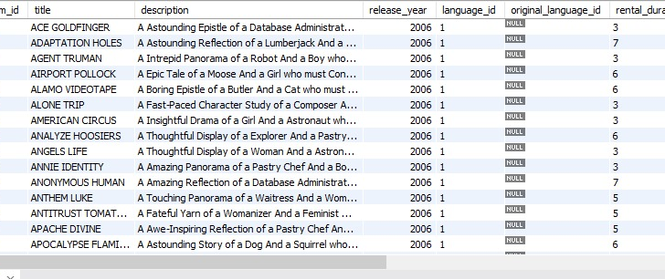
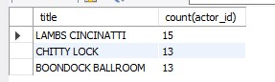
Display record of movies with that where replacement cost is between 11 and 15
method:
Here i used WHERE clause to filter the of relacement_cost and
BETWEEN and AND keyword are used to satisfied the both condition
interpretation:
it shows the record of movies with that where replacement cost is between 11 and 15
Name of the top 3 movies with greatest number of actor
method:
Here i used COUNT to count the actorid and JOIN to join the two table
and GROUP BY the column name ORDER BY the value in descending and LIMIT the value as 3
interpretation:
it shows the name of the top 3 movies with greatest number of actor

Slide 8
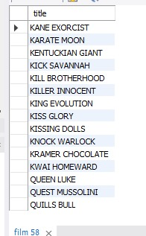
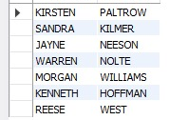
Display the movie starting letters "k"
and "q"
method:
Here i used wilcard function LIKE operator to display the starting letters
"k" and "Q"
interpretation:
it shows the the movie starting letters "k"
and "q"
Display the name of actor who appears in this film "Agent Truman"
method:
Here I used JOIN t join two table and used WHERE clause to filter the row
"Agent Truman"
interpretation:
it shows the name of actor who appears in this film "Agent Truman

Slide 9
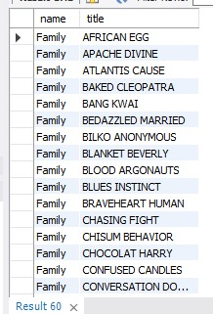
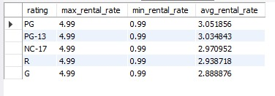
Identify the movies categorized as Family films
method:
Here I used JOIN t join two table and used WHERE clause to filter the row
"Famil" GROUP BY the column name
interpretation:
it shows the name movies categorized as Family films
Display maximum minimum and average rental rates of movie based on ratings
method:
Here I used MIN MAX and AVG function to cunt value rental_rate
GROUP BY the column name and ORDERED BY the value into descending
interpretation:
it shows the maximum minimum and average rental rates of movie based on ratings

Slide 10
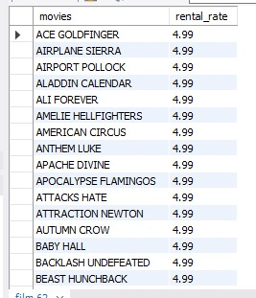
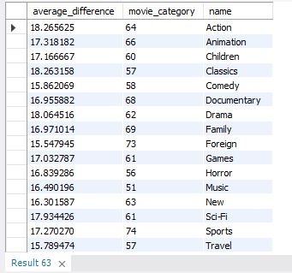
Display the movies in descending order of there rental frequencies
method:
Here I used ORDERED BY clause to display value into descending
interpretation:
it shows the movies in descending order of there rental frequencies
How many film categoeies difference between average film replacement cost
average film rental rate is greater than 15
method:
Here I used AVG to count the average value of replacement cost and COUNT function count the name and JOIN joins the two table GROUP BY the column name and HAVING clause used to filter the data
interpretation:
it shows the film categoeies difference between average film replacement cost average film rental rate is greater than 15

Slide 11

Display the film Categories inwhich no of movies greater than 70
method:
Here I used COUNT function count the name
and JOIN joins the two table GROUP BY the column name and HAVING clause used to filter the data
interpretation:
it shows the film Categories inwhich no of movies greater than 70

Slide 12
THANK YOU

