Slide 1

CAPSTONE-PROJECT
DATA ANALYSIS USING PYTHON
PRESENTED BY:
NANDHA KUMAR C

Slide 2
PROJECT-OBJECTIVE
The objective of the project is to use Python programming to analyze a movie data to perform exploratory data analysis by answering the questions in the upcoming slides.

Slide 3


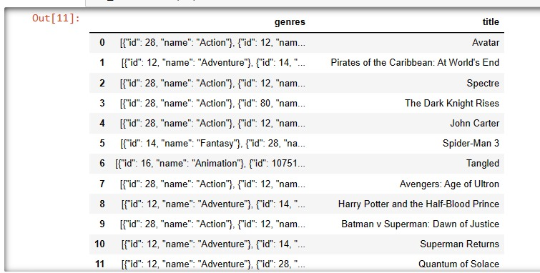
Number of rows and columns and first 50 title and genre
Method:
Here I used used shape() function and filter the column genres,title from the data set
and head() function
Interpretation:
*Here i have displayed the total number of rows and columns present in the data
* Here i loaded the data and displayed the first 50 rows from columns of genres and title

Slide 4
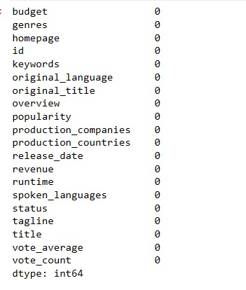
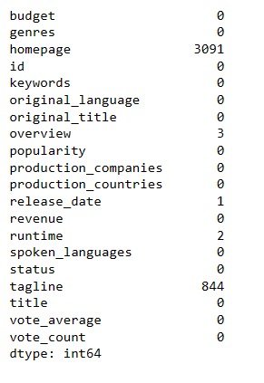
Identify the null values and perform null values treatment
Method:
Here I used isnull.sum() to find null values,mean() is use to relace null value in numerical column
mode() is use to relace null value in categorical column
Interpretation:
Here i cleaned null values for columns
All the null values presentin the data has been replaced , Now there is 0 null values in the dataset

Slide 5
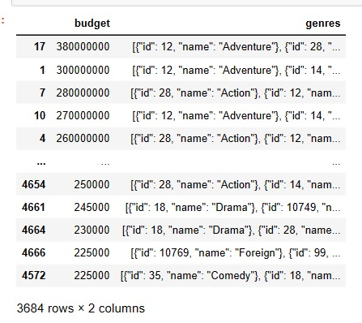
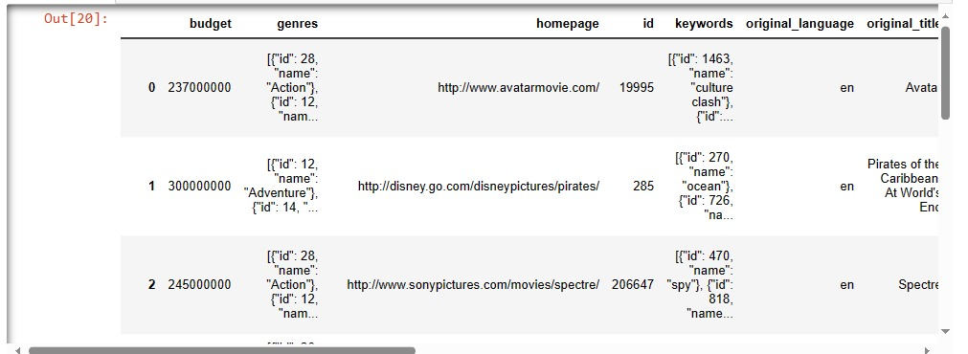
Movie category budget greater than 220000
Method:
Here I filtered the row budget > 220000 and ascending=False it display the data in descending order
Interpretation:
These are the movie categoeies whose budget is greater than $220,000
and i have arranged the data into descending order by budget of the film

Slide 6
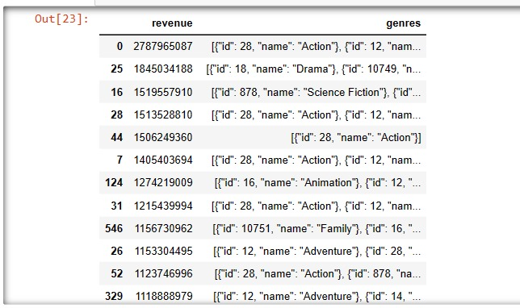
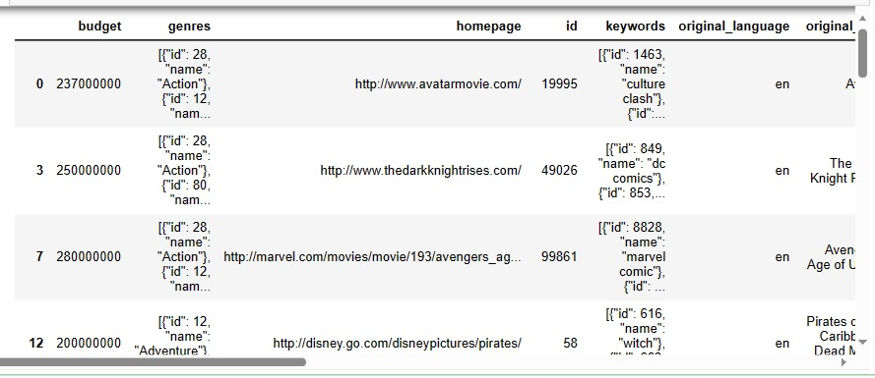
Movie category where revenue is greater than 961,000,000
Method:
Here I filtered the row budget > 961,000,000 and ascending=False it display the data in descending order
Interpretation:
These are the movies budget and genres , which has the revenue greater than $961,000,000

Slide 7
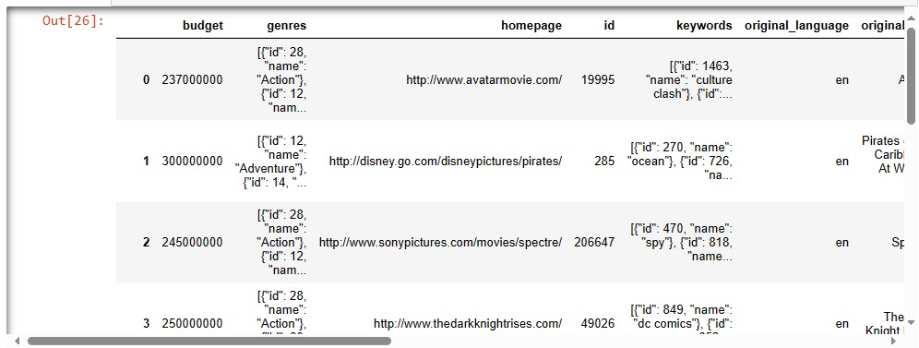
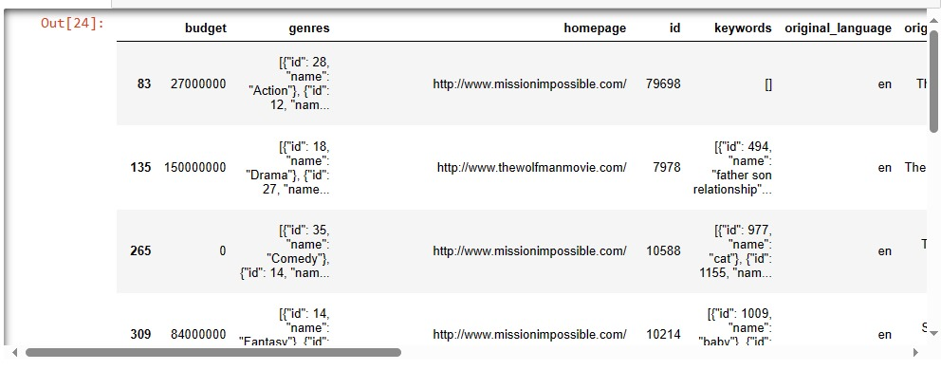
Remove the rows which has value 0 in the column of revenue and budget
Method:
Here I filtered the row budget ==0, revenue ==0 and inplace=True it permentaly change in data
Interpretation:
Here i droped the rows,which has 0 in revenue and budget columns .
Now in data we can see that no 0 will be present in the budget and revenue columns

Slide 8
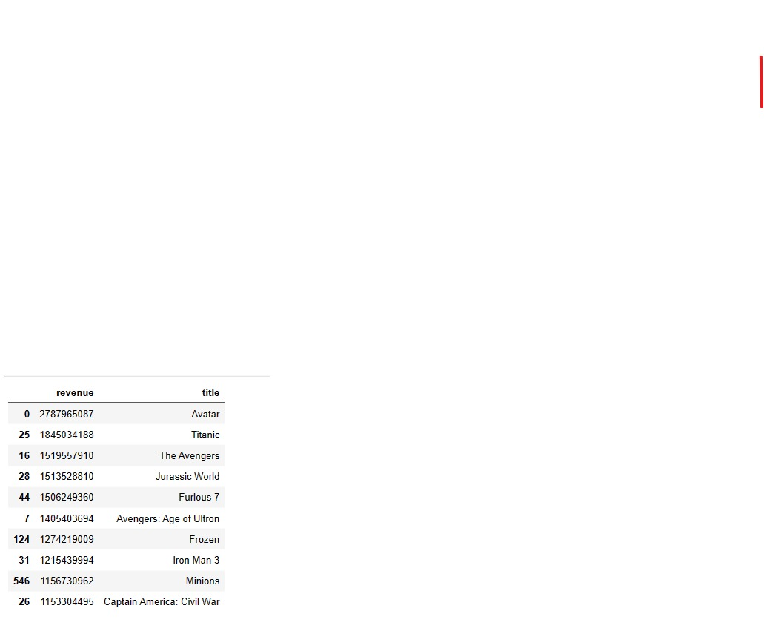
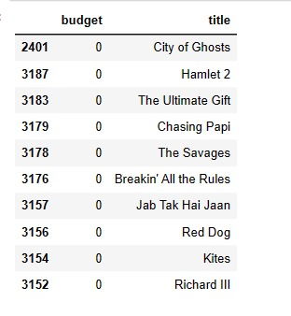
Top 10 movies with high revenue and least budget
Method:
Here I selected revenue,title column sort_values by revenue ascending=False it display the data in descending order
Interpretation:
Here I displayed .Top 10 movies based on highest revenue generated
Top 10 movies with least budget , Modern times is least among all others .

Slide 9
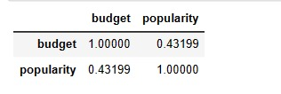
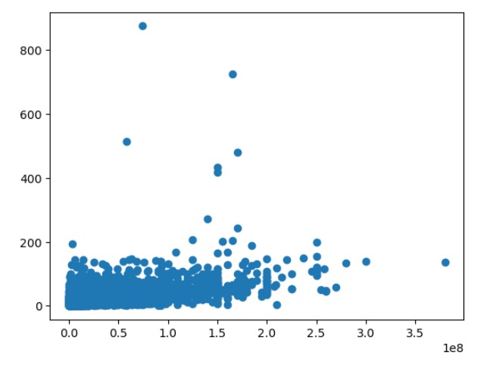
Correlation between popularities and movie budget
Method:
Here I used corr() to see the value of correlation and scatter plot graph
Interpretation:
The budget and popularit has the low correlation , correlated percent is 43.199%

Slide 10
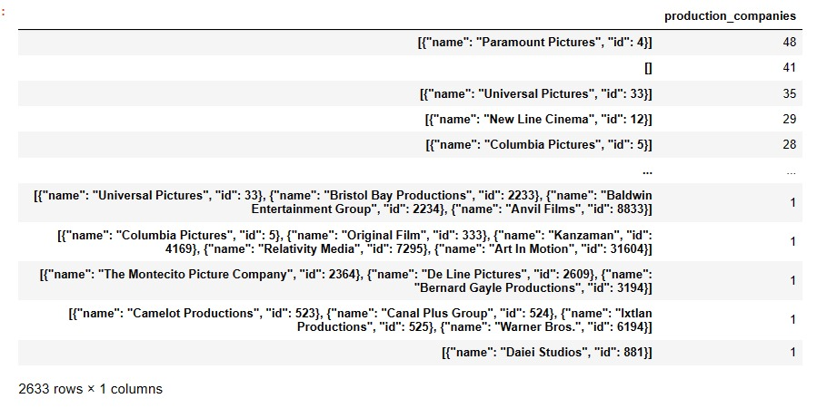
Identify production companies and number of time they appeared
Method:
Here I selected production_companies column and value_counts() to count how many time they appered
Interpretation:
Here i displayed the production companies and numberof tiems they appeared in the dataset

Slide 11
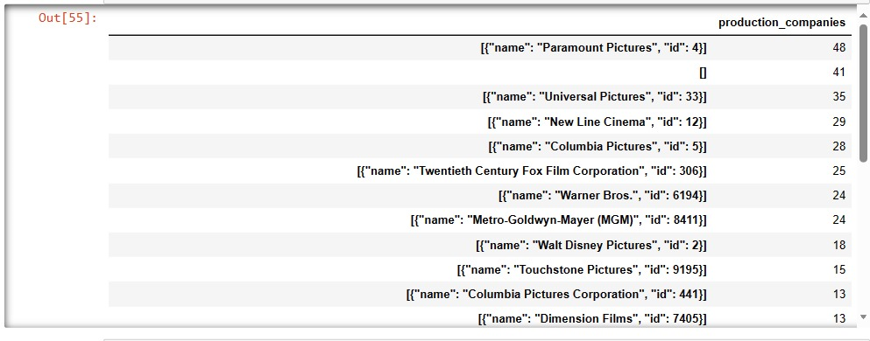
Display the top 25 production companies based on number movies they produced
Method:
here I used sort_values production_companies colum name and ascending=False it display the data in descending order
Interpretation:
In this data Paramount pictures has produce the highest number of movies

Slide 12
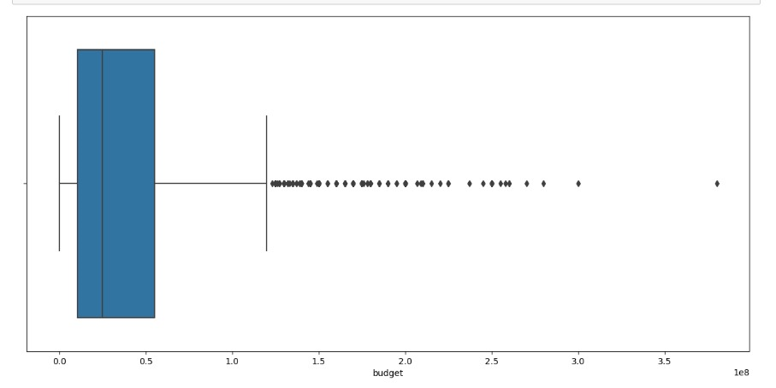
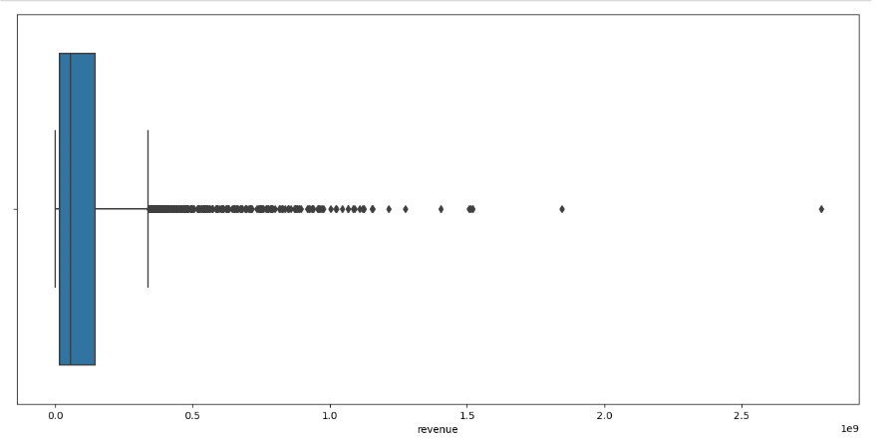
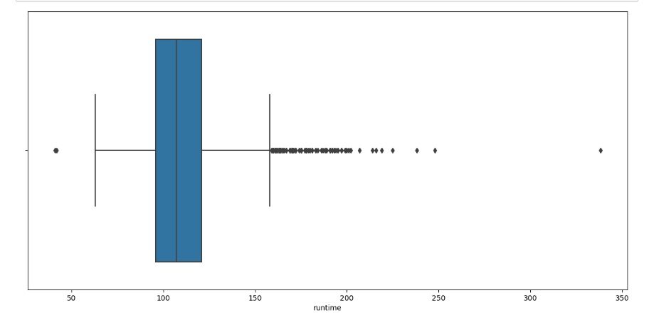
Correlation between popularities and movie budget
A) BUDGET
Method:
here I used sort_valuescolum name, ascending=False it display the data in descending order and measure of central tendancy method
analyse the mean(), median(), mode() for budget,revenue,runtime
Interpretation:
Here i display graph using boxplot budget, revenue, runtime all column have outliers.
B) REVENUE
C) RUNTIME

Slide 13
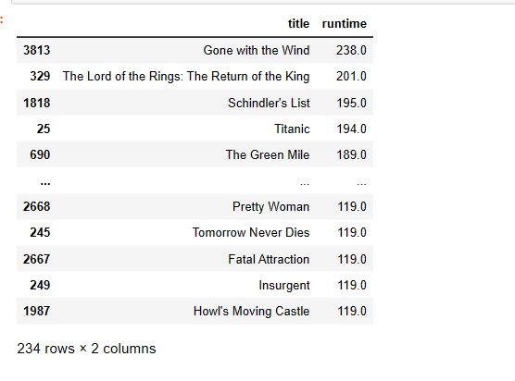
Name of the movies that run higher than the average runtime
Method:
Here i filtered the column by identifying previous task average value "runtime" > 118.72 ascending=False it display the data in descending order
Interpretation:
These are the movies , which has runtime higher than the average runtime of the movies

Slide 14
THANK-YOU

