Slide 1
ECO-FLOAT
Multispectral Edge Analytics & Autonomous Mission Telemetry

Slide 2
THE CHALLENGE
Environmental Impact
Technological Limitations
â€¢ Rapid proliferation of toxic algal blooms (Chl-a). â€¢ Influx of synthetic floating polymers. â€¢ Threat to aquatic ecosystems and municipal drinking water supplies. â€¢ Current ecological monitoring is critically slow.
â€¢ Current solutions are stationary and lack spatial granularity. â€¢ Hyperspectral drones cost upwards of ,000. â€¢ High latency in data processing. â€¢ Reliance on cloud infrastructure limits remote deployment.

Slide 3
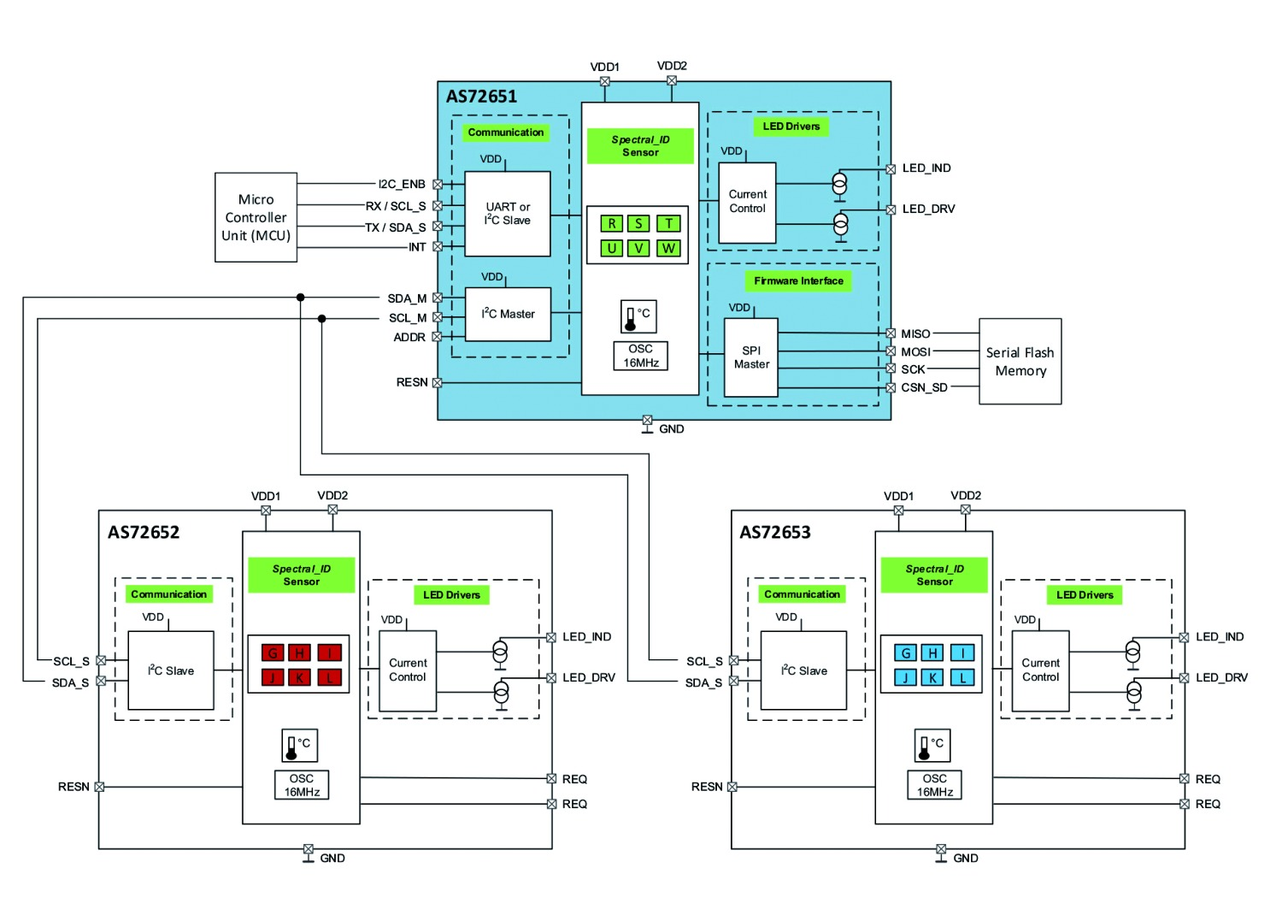
SYSTEM ARCHITECTURE
Edge Controller: ESP32 / Arduino Mega (I2C polling, MQTT)
Optical Payload: AS7265x (18-channel spectral fingerprint capture)
Propulsion: Dual BLDC differential drive (cruise + scan turns)
Positioning: NEO-6M GPS waypointing
Power Bus: 3S Li-ion 5000 mAh

Slide 4
OPTICAL ANALYTICS & ML
Math Pipeline
Validation Snapshot
â€¢ Signal Preprocessing: SNV + Savitzky-Golay â€¢ NDCI: (R730 - R680) / (R730 + R680) â€¢ FDI extracted using 860nm & 940nm baseline. â€¢ Classes: Clean water, Algal bloom, Floating polymer.
â€¢ Global Accuracy: 98.2% â€¢ F1 Score: 0.965 â€¢ Kernel: RBF Gaussian â€¢ Validation: 10-fold Cross Validation All analytics processed locally on the edge.

Slide 5
NAVIGATION & SPATIAL MAPPING
Footprint
Lane Spacing
Sensor Radius
Hotspot Trigger
50m x 50m
5m
2m
Index > 60
Boustrophedon Sweep Mapping
The vehicle systematically scans the water segment. When an anomaly index exceeds the trigger, a differential scan is initiated and a hotspot alert is transmitted via MQTT.

Slide 6
STABILITY & ENDURANCE
Catamaran vs Monohull Hydrodynamics
Catamaran (Selected)
Monohull (Rejected)
â€¢ Damping Ratio: 0.75 â€¢ Settling Time: 0.67s â€¢ Overshoot: 2.8% â€¢ Optical Uptime: 99.9%
â€¢ Damping Ratio: 0.15 â€¢ Settling Time: 7.62s â€¢ Overshoot: 62.1% â€¢ Optical Uptime: ~48%
Power Profile: 120+ minutes of endurance using smart phase-scheduled load distribution.

Slide 7
REQUIREMENTS & DISRUPTION
BOM Target:
< 15,000 INR
By leveraging the AS7265x multispectral array and edge AI, EcoFloat achieves the data granularity of ,000+ hyperspectral drones at a fraction of the cost.

Slide 8
ECO-FLOAT
Accessible. Autonomous. Essential.

