Slide 1

PUREPATH PRESENTS
ECO-FLOAT
Advanced Remediation for Stagnant Water: Solving the Invisible Crisis through Robotic Intelligence and Chemical Retreatment.

Slide 2

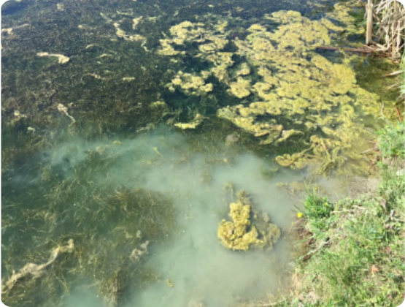
THE STAGNANT WATER CRISIS
Treating Symptoms, Not Causes
Most cleanups only target surface trash, leaving toxic chemical runoff and dense algal blooms to poison the ecosystem.
Blind Operations: Current efforts ignore invisible toxic plumes.
Reactive Dredging: Manual crews only respond after contamination peaks.
Toxic Overload: Algal blooms go undetected until they become toxic.

Slide 3




THE EXISTING TECHNOLOGY GAP
Prohibitive Costs
Lack of Autonomy
Coarse Resolution
Commercial buoys cost upwards of ₹50 Lakhs, making them inaccessible for small municipal ponds and local lakes.
Standard boats require constant human pilots, significantly increasing OPEX and safety risks in polluted waters.
Satellite data is too low-resolution (1km) to manage localized contamination in river edges or small water bodies.

Slide 4
THE SOLUTION
Autonomous Physical Remediation
ECO-FLOAT is a solar-powered rover engineered specifically for stagnant water environments. It bridges the gap between sensing and action.
Active Net Collection: A specialized rear-mounted net system continuously sweeps and harvests macro-plastics and thick chlorophyll biomass (algae) as the rover navigates.

Slide 5



INTELLIGENT NAVIGATION STACK
ROS Autonomy
Hyperspectral Data
Live Mapping
Utilizes Robot Operating System for precise GPS waypoint navigation and obstacle avoidance in complex environments.
Radiometric sensors analyze light signatures to identify exact chlorophyll levels and micro-plastic concentrations.
Integrated IoT sensors feed real-time water quality heatmaps to a cloud dashboard for municipal oversight.

Slide 6
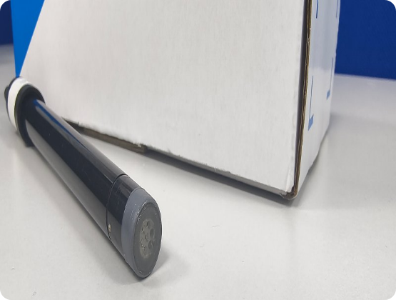
CHEMICAL RETREATMENT
Neutralizing the Invisible
Beyond physical trash, ECO-FLOAT addresses invisible chemical pollutants that manual dredging ignores.
Real-Time Sensing: Electrochemical probes monitor pH, Dissolved Oxygen (DO), and Turbidity.
Plume Neutralization: Active detection of chemical plumes allows for targeted remediation and immediate alerting.
WQI Generation: Compiles a comprehensive Water Quality Index to track remediation progress.

Slide 7

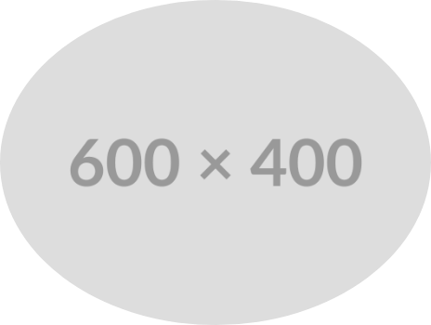
SUSTAINABLE ENDURANCE
Dawn-to-Dusk Operations
Solar Integrated Roof: Continuous trickle charging enables extended battery life for all-day navigation.
Corrosion-Proof: Modular, lightweight, and corrosion-resistant materials for toxic, stagnant water.
Swarm Deployment: Low-cost BOM (< ₹20,000) allows for multiple rovers to coordinate in large stagnant lakes.

Slide 8
UNMATCHED DATA PRECISION
Hyper-Local Resolution
100x
ECO-FLOAT provides sub-100m² resolution, identifying pollution sources with 100 times more precision than satellite imaging.
By detecting "hotspots" of chemical runoff and algal biomass, authorities can act before the entire stagnant water body becomes toxic.

Slide 9
MARKET ANALYSIS
Solution | Physical Collection | Chemical Sensing | Resolution | Cost
Satellites | No | Limited | 1 km (Coarse) | High
Manual Labor | Reactive | None | Visible Only | Recurring
Commercial Buoys | No | High | Stationary | ₹50 Lakh+
ECO-FLOAT | Autonomous Net | Real-Time Probes | Sub-100m² | < ₹20,000

Slide 10
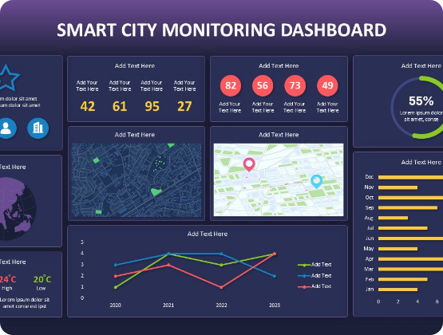
IMPACT ON STAKEHOLDERS
Empowering "Green Leaders"
Transition from manual, blind operations to cost-effective, Industry 4.0 data-driven remediation.
Public Health: Prevents community poisoning from toxic stagnant runoff.
Municipal Innovation: Sets the standard for Smart City aquatic management.
Budget Efficiency: Replaces expensive dredging with autonomous, low-cost rovers.

Slide 11



Questions?
Join us in democratizing advanced water quality remediation.
contact@purepath.eco
www.purepath.eco

Slide 12




IMAGE SOURCES
https://cleanwaterpro.ca/wp-content/uploads/2022/09/eutrophic-blog-3.jpg
Source: cleanwaterpro.ca
https://image.made-in-china.com/2f0j00vyqiwmFlpWrI/Water-Cleaning-Boat-Unmanned-Control-Robot-Water-Surface-Cleaning-Boat.jpg
Source: relong-tech.en.made-in-china.com
https://image.made-in-china.com/2f0j00GMdCRHYBgfoP/ISE-Cl-Sensors-in-Chemical-Production-Probe-Electrode-Digital-Water-Quality-Monitoring-CA43-D014-.jpg
Source: aurora-sensors.en.made-in-china.com
https://www.slidekit.com/wp-content/uploads/2025/07/Smart-City-Monitoring-Dashboard-Slide-for-PowerPoint-Google-Slides.jpg
Source: www.slidekit.com

