Slide 1



AI POWERED E-COMMERCE BUSINESS INTELLIGENCE AND PREDICTIVE ANALYSIS
Presented By
Nandhupriya N
USN: 1RF25MC062
Department of MCA
III Semester

Slide 2
Introduction
The AI-Powered E-Commerce Business Intelligence and Predictive Analytics Platform is designed to analyze e-commerce data and help businesses make better decisions. The system provides insights into sales, revenue, profit, and customer behavior using interactive dashboards. It uses machine learning to predict customer churn, forecast future sales, segment customers, and detect unusual transactions. It also includes sentiment analysis, product recommendations, and a what-if simulator to suggest effective business strategies. The platform integrates data analytics, artificial intelligence, and predictive modeling into a single application to support informed and data-driven decision-making.

Slide 3
Problem Definition
E-commerce businesses face challenges in analyzing sales, understanding customer behavior, and identifying customers likely to leave. Traditional systems provide limited predictive insights and actionable recommendations. This project addresses these challenges using AI and machine learning to analyze data, predict customer churn, forecast sales, and support better business decisions.

Slide 4
Existing System
Uses traditional Business Intelligence (BI) dashboards and basic data analysis.
Displays historical sales, revenue, and customer reports.
Has limited capabilities for predicting future sales and customer churn.
Provides limited support for detecting unusual transactions.
Lacks integrated machine learning and advanced customer segmentation.
Offers limited automated recommendations for business decisions.
Makes it difficult to identify potential business problems early.

Slide 5
Literature Survey
Akter & Fosso Wamba (2016): Studied the applications of big data analytics to improve e-commerce business performance.
RFM and K-Means (2019): Applied RFM analysis and K-Means clustering to identify customer segments based on purchasing behavior.
Machine Learning in E-Commerce (2022): Explored machine learning techniques for improving e-commerce operations and business decision-making.
E-Commerce Customer Classification (2023): Used customer purchase patterns and clustering techniques to classify e-commerce customers.
Research Gap: Existing studies focus on individual tasks such as customer segmentation, churn prediction, and sales forecasting. This project integrates customer segmentation, churn prediction, sales forecasting, anomaly detection, interactive dashboards, and automated business recommendations into a single platform.

Slide 6
Proposed System
Develops an interactive Business Intelligence platform using Python and Streamlit.
Analyzes e-commerce data to calculate key business performance indicators (KPIs).
Uses RFM analysis and K-Means clustering for customer segmentation.
Applies machine learning algorithms to predict customer churn.
Forecasts future sales using time-series analysis.
Detects unusual transactions and identifies important churn factors using explainable AI.
Provides interactive dashboards, business recommendations, and what-if analysis.
Outcome: An integrated platform that helps businesses understand customer behavior, predict future trends, detect potential issues, and make data-driven decisions.

Slide 7
Functional Requirements
Data Upload: Allows users to upload e-commerce datasets.
Data Preprocessing: Handles missing values, duplicate records, and data inconsistencies.
Business Analytics: Calculates KPIs such as revenue, orders, and average order value.
Customer Segmentation: Groups customers using RFM analysis and K-Means clustering.
Churn Prediction: Predicts customers who are likely to stop purchasing.
Sales Forecasting: Predicts future sales trends.
Anomaly Detection: Identifies unusual transactions and negative-profit records.
Interactive Dashboard: Displays KPIs, charts, and analytical results.
Decision Support: Provides business recommendations and what-if analysis.
Report Generation: Presents analytical results for business review.

Slide 8
Non-Functional Requirements
Performance: Processes datasets and generates analytical results efficiently.
Scalability: Supports increasing data volumes with appropriate resource management.
Usability: Provides a simple, interactive, and user-friendly interface.
Reliability: Produces consistent results and handles errors effectively.
Security: Protects user access and sensitive business data.
Maintainability: Supports easy updates and modifications to the application.
Compatibility: Runs on supported systems with Python and Streamlit.
Memory Efficiency: Optimizes RAM usage during data processing and model training.

Slide 9
Technologies Used
Programming Language: Python
Frontend / UI: Streamlit
Data Processing: Pandas, NumPy
Machine Learning: Scikit-learn
Customer Segmentation: RFM Analysis, K-Means Clustering
Data Visualization: Plotly, Matplotlib, Seaborn
Sales Forecasting: Time-Series Forecasting
Explainable AI: Feature Importance
Database: SQLite
Development Environment: Jupyter Notebook
Model Storage: Joblib

Slide 10
Algorithms Used
Data Preprocessing: Missing value handling, duplicate removal, and feature engineering.
Exploratory Data Analysis (EDA): Descriptive statistics, correlation analysis, and data visualization.
Customer Segmentation: RFM Analysis and K-Means Clustering.
Churn Prediction: Random Forest, Logistic Regression, and Gradient Boosting.
Model Evaluation: Accuracy, Precision, Recall, F1-Score, and ROC-AUC.
Explainable AI: Random Forest Feature Importance and SHAP.
Sales Forecasting: Time-Series Forecasting to predict future sales trends.
Anomaly Detection: Identifies unusual transactions and negative-profit orders.
Recommendation Engine: Generates personalized product recommendations and promotional offers.
Root-Cause Analysis: Identifies factors contributing to changes in business performance.
Prescriptive Analytics: Provides business recommendations and what-if analysis.

Slide 11
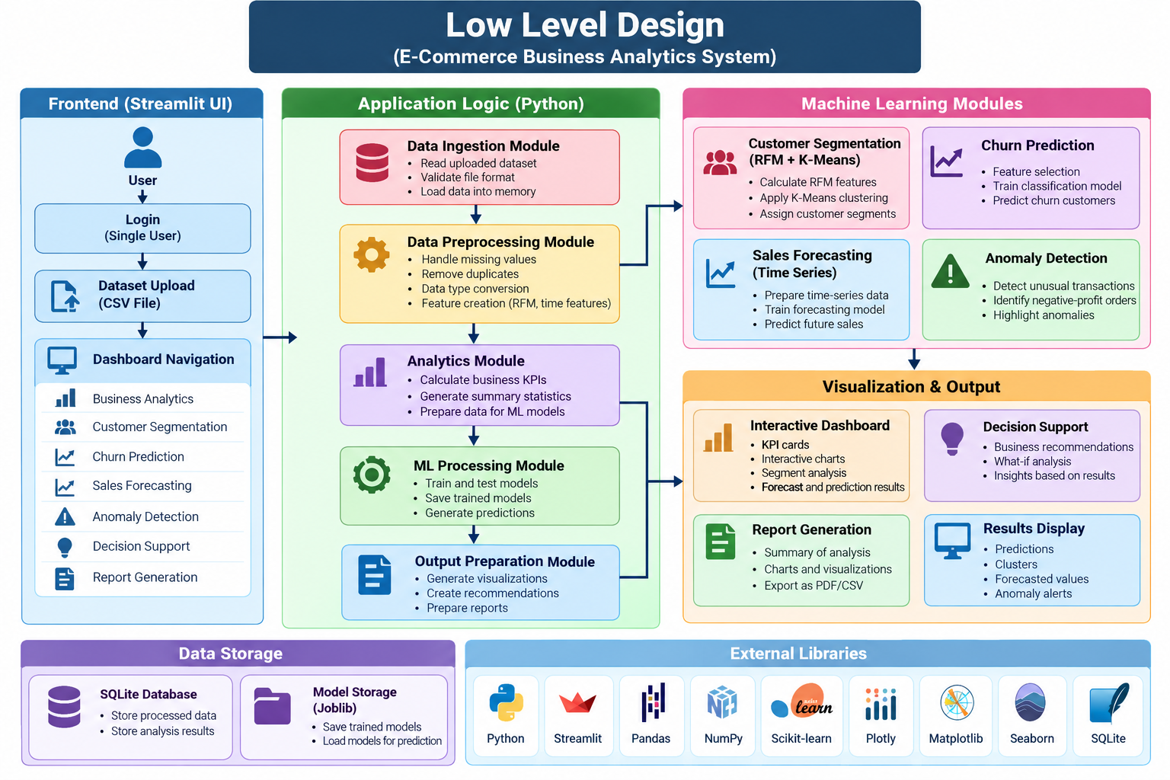
LOW
LEVEL
DESIGN

Slide 12
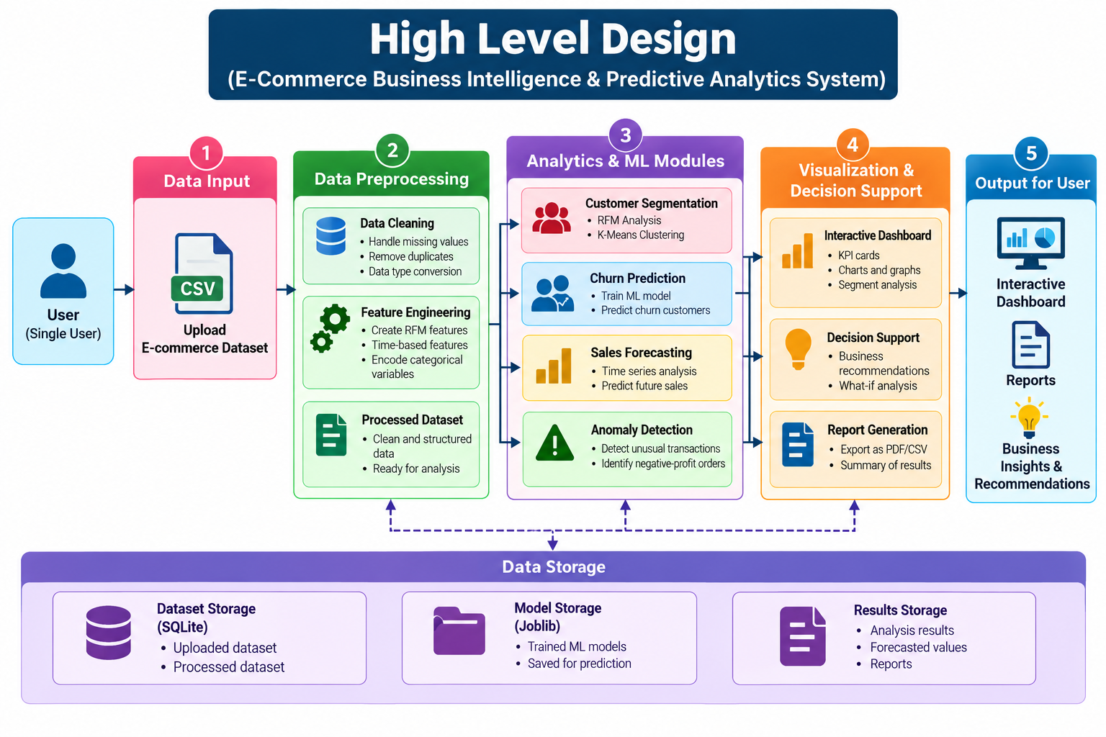
HIGH
LEVEL
DESIGN

Slide 13
Conclusion
Developed an integrated Business Intelligence platform for e-commerce data analysis.
Provides customer segmentation, churn prediction, and sales forecasting.
Detects unusual transactions and identifies important business insights.
Displays interactive dashboards and key performance indicators (KPIs).
Generates recommendations to support better business decisions.
Helps businesses improve customer retention, understand sales trends, and enhance overall performance.

Slide 14



