Slide 1


RetailIQ
AI-Powered Retail Decision Intelligence System
Presented By
T Deepti
USN: 1RF25MC104
Department of MCA
III Semester

Slide 2
Introduction
RetailIQ is a web-based application that analyses retail data and helps businesses understand their sales, products, and customers.
It uses data analysis and machine learning to predict sales and provide useful business suggestions.
It displays important results through charts and dashboards.

Slide 3
Problem Definition
Analysing large amounts of retail data manually takes time and effort.
Businesses find it difficult to understand customer behaviour and predict future sales.
RetailIQ aims to solve these problems by analysing data and providing useful insights.

Slide 4
Existing System
Many businesses use Excel and manual calculations to analyse sales.
Problems with the Existing System:
Analysis takes more time.
Manual calculations may have errors.
Finding customer patterns is difficult.
Predicting future sales is challenging.
Different tasks may need different tools.

Slide 5
Literature Survey
The literature survey studies methods used for retail data analysis.
1. Sales Analysis: Helps understand sales and product performance.
2. Customer Segmentation: Groups customers with similar buying habits.
3. Sales Prediction: Uses past sales data to estimate future sales.
4. Anomaly Detection: Finds unusual values in the data.
Research Gap: RetailIQ combines these analysis features in one application.

Slide 6
Proposed System
RetailIQ analyses retail data in one application.
Main Features:
Upload CSV and Excel files.
Check and clean data.
Analyse sales and products.
Group similar customers.
Predict future sales.
Find slow-moving products.
Show charts and business suggestions.

Slide 7
Functional Requirements
Functional requirements describe what the system does.
Allows users to access the application.
Uploads retail datasets.
Checks and prepares data.
Calculates sales and revenue.
Analyses customers and products.
Predicts future sales.
Finds unusual values.
Displays charts and recommendations.

Slide 8
Non-Functional Requirements
Non-functional requirements describe how the system should work.
Easy to Use: The application is simple.
Performance: Data should be processed efficiently.
Reliability: Results should be correct for valid data.
Security: User data should be handled safely.
Maintainability: The code should be easy to update.
Compatibility: The application should work in modern browsers.

Slide 9
Technologies Used
Category | Technology
Frontend | React ,TypeScript ,HTML ,CSS ,Tailwind CSS
Backend | Python ,FastAPI
Data Analysis | Pandas ,NumPy
Machine Learning | Scikit-learn
Algorithms | K-Means ,Linear Regression ,Random Forest ,Time-Series Forecasting

Slide 10
Algorithms Used
1. K-Means: Groups similar customers.
2. Linear Regression: Predicts sales using data patterns.
3. Random Forest: Uses multiple decision trees to predict sales.
4. Time-Series Forecasting: Uses past sales to estimate future sales.
5. Pandas: Reads and cleans data.
6. NumPy: Performs mathematical calculations.
7. MAE and RMSE: Measure prediction errors.

Slide 11
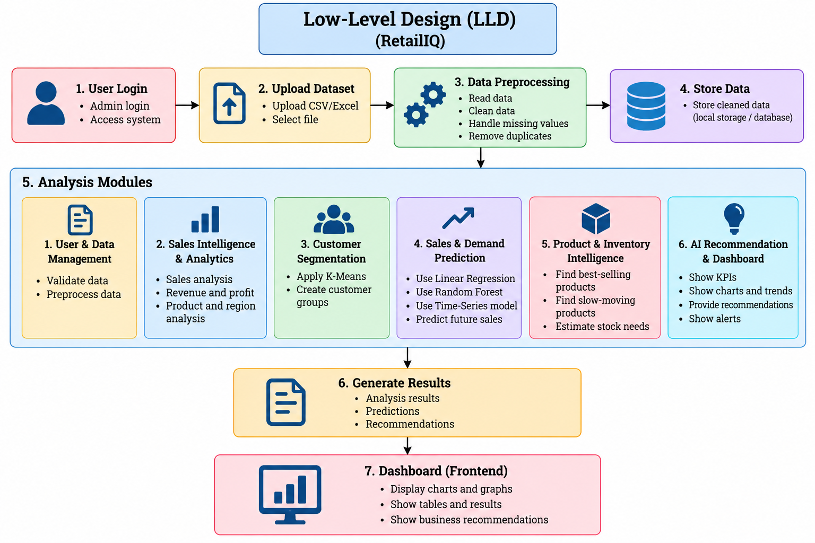

Slide 12
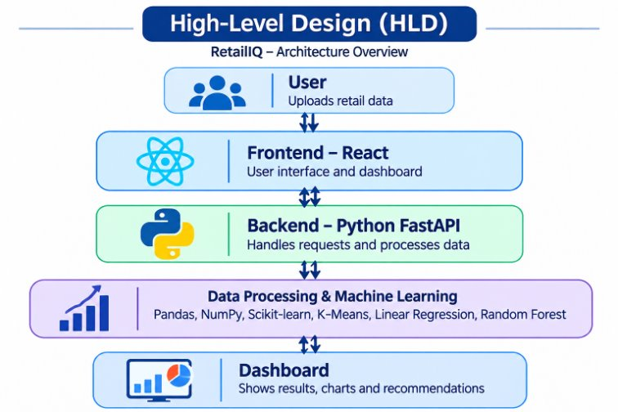

Slide 13
Conclusion
RetailIQ combines retail data processing, sales analysis, customer segmentation, prediction, and dashboard-based insights in one application.
It helps users understand business performance and supports better decision-making.

Slide 14



