Slide 1


Emerging Trends in Termination of Employment: A Review of the Recent Court Cases and Changes in Labour Laws
Presented By: Chacha Odera & Georgina Ogalo-Omondi
Date: 26th April 2019

Slide 2



About Us
Oraro & Company Advocates is a top-tier full-service law firm in Nairobi, Kenya established in 1977.
We provide specialist legal services both locally and regionally in Arbitration, Banking & Finance, Conveyancing & Real Estate, Corporate & Commercial, Dispute Resolution, Infrastructure, Projects & PPP, Restructuring & Insolvency and Tax. Through our strong ties with international law firms, we provide clients with local knowledge and global perspectives.
We have been consistently ranked and recognised by Chambers Global, IFLR 1000 and Legal 500 as a top-tier firm.

Slide 3

Our Employment and Labour Practice
Regarded as the “go-to” firm for employment work, our employment and labour practice area is well regarded by the Chambers Global Guide and Legal 500 for advising some of Kenya’s high profile employment matters.
We represent large local, regional and international organisations in all aspects of employment and labour law including: employment disputes, employment contracts, employee benefits, collective bargaining agreements, reviewing HR policies and procedures, undertaking employment audits for compliance purposes and employee stock ownership plans and pensions.

Slide 4
In this presentation
Part I: Current legal requirements in termination
  Termination on notice
  Voluntary early retirement
  Expiry of fixed-term contracts
  Redundancy
  Constructive Dismissal
  Termination Due to Incapacity
  Summary Dismissal
Part II: Developments in Kenyan Employment Law
Q&A

Slide 5

Part I: Current legal requirements in termination
Notes:
Our firm is particularly known for its formidable dispute resolution team, work on some of Kenya’s largest deals and its significant contributions to Kenya’s legal profession.

Slide 6

Termination on Notice
A contract of service may be terminated upon either party giving notice as provided for under the Act. (s. 35)
Where there is an express contract of service, termination must be guided by the agreed provisions.
An employee whose contract of service is terminable by a notice of 28 days shall be entitled to service pay for every year worked.
Notes:
Our firm is particularly known for its formidable dispute resolution team, work on some of Kenya’s largest deals and its significant contributions to Kenya’s legal profession.

Slide 7
Termination on Notice – Contd.
However, the employee will not be entitled to service pay where the employee is a member of a registered pension or provident fund scheme under the Retirement Benefits Act; a gratuity or service pay scheme established under a collective agreement; any other scheme established and operated by an employer whose terms are more favourable than those of the service pay scheme established under this section; and the National Social Security Fund.
Notes:
Our firm is particularly known for its formidable dispute resolution team, work on some of Kenya’s largest deals and its significant contributions to Kenya’s legal profession.

Slide 8
Voluntary Early Retirement (VER)
VER is not expressly provided for in the Kenyan law. It is a form of termination which is normally spoken of in the context of an organizational restructure or downsizing. It is seen as one of the alternatives to redundancy.
VER is an offer made by the employer to employees who are not yet of retirement age but who wish to retire early. The hope of the employer is for as many as are offered to take up the VER thereby to enable the employer to avoid legal risks associated with redundancies.
Like any other contract, a VER agreement can be nullified where coercion, undue influence, mistake or misrepresentation is proved. (See the case of John Mwove & 97 others v Kenya Meat Commission [2018] eKLR & National Bank of Kenya Limited v Hamida Bana & 103 others [2017] eKLR)
Notes:
Our firm is particularly known for its formidable dispute resolution team, work on some of Kenya’s largest deals and its significant contributions to Kenya’s legal profession.

Slide 9
Expiry of Fixed-term Contracts
The Employment Act contemplates that parties can enter into a fixed term contract as a valid mode of employment (s.10 (3) (c)).
The underlying understanding between the parties of fixed-term contracts is that that once the fixed period has ended, the contract is automatically terminated without any further liability on the employer's part on account of unfair termination or redundancy.
The ELRC has in many instances recognized fixed term contracts and that renewal of such contracts is discretionary (See Rajab Barasa & 4 Others v. Kenya Meat Commission (2016) eKLR)
Notes:
Our firm is particularly known for its formidable dispute resolution team, work on some of Kenya’s largest deals and its significant contributions to Kenya’s legal profession.

Slide 10
Expiry of Fixed-term Contracts - Exception
Legitimate Expectation
There are certain situations when an employees may be able to successfully claim unfair termination if a fixed-term contract is not renewed – for example, where employees can prove that they had a legitimate expectation that their contract would be renewed.
The courts have held that legitimate expectation is not a mere anticipation, wish, desire or hope. The expectation must be based on a cogent, rational and objective reason induced by the employer either expressly or by conduct. (See Teresa Carlo Omondi v Transparency International- Kenya [2017] eKLR )
Notes:
Our firm is particularly known for its formidable dispute resolution team, work on some of Kenya’s largest deals and its significant contributions to Kenya’s legal profession.

Slide 11
Expiry of Fixed-term Contracts - Exception
A probationary contract is defined under the Act to mean “a contract of employment, which is of not more than twelve months duration or part thereof, is in writing and expressly states that it is for a probationary period.”
Section 42 of the Act provides for termination probationary contracts.
Termination of Probationary Contracts – either party may give not less than a 7 days’ notice. (s. 42 (4))
Case Law
Carole Nyambura Thiga v Oxfam [2013] eKLR
Danish Jalang’o & another v Amicabre Travel Services Limited [2014] eKLR
Notes:
Our firm is particularly known for its formidable dispute resolution team, work on some of Kenya’s largest deals and its significant contributions to Kenya’s legal profession.

Slide 12

Redundancy
Redundancy has been defined as:
“The loss of employment, occupation, job or career by involuntary means through no fault of an employee, involving termination of employment at the initiative of the employer at the initiative of the employer, where the services of an employee are superfluous and the practices commonly known as abolition of office, job or occupation and loss of employment.”
(s. 2 of the Employment Act & s. 2 of the Labour Relations Act, 2007.)
Notes:
Our firm is particularly known for its formidable dispute resolution team, work on some of Kenya’s largest deals and its significant contributions to Kenya’s legal profession.

Slide 13
Cases
Kenya Union of Commercial Food and Allied Workers v British American Tobacco Kenya Ltd
The ELRC held that redundancy is a fact of life which cannot be wished away and in as much as an employer is entitled to embark on reducing its total number of employees, it must comply with the law and the collective bargaining agreement where there is a union.
Kenya Airways v Tobias Oganya Auma & 5 others
The Court of Appeal held that it is not the role of any tribunal to prevent an employer from restructuring or adopting modern technology so long as it observes all relevant regulations.
Notes:
Our firm is particularly known for its formidable dispute resolution team, work on some of Kenya’s largest deals and its significant contributions to Kenya’s legal profession.

Slide 14
Constructive Dismissal
Constructive Dismissal arises where an employee resigns in response to a fundamental breach of the contract by the employer. It is not expressly provided for in the Kenyan Employment law, but the Courts have recognized and applied it as one of the grounds for wrongful and unfair termination.
An employee is said to have been constructively dismissed if the employer is in breach of a fundamental term of the contract which makes the employment relationship untenable; and the employee resigns in response to that breach. (See Coca Cola East & Central Africa Limited v Maria Kagai Ligaga [2015] eKLR).
Notes:
Our firm is particularly known for its formidable dispute resolution team, work on some of Kenya’s largest deals and its significant contributions to Kenya’s legal profession.

Slide 15
Constructive Dismissal
The Court of Appeal in the Coca Cola case developed the main tests in proving a claim of constructive dismissal as follows:
The employer must be in breach of the contract of employment;
The breach must be fundamental as to be considered a repudiatory breach;
The employee must resign in response to that breach; and
The employee must not delay in resigning after the breach has taken place, otherwise the Court may find the breach waived.
Notes:
Our firm is particularly known for its formidable dispute resolution team, work on some of Kenya’s largest deals and its significant contributions to Kenya’s legal profession.

Slide 16
Constructive Dismissal – Contd.
Examples of conduct that have been found to lead to constructive dismissal include frequent unjustifiable transfers, forceful resignations, non-payment of salaries, unwarranted suspensions, non-consensual changes in the job descriptions and job titles, downgrades in positions, sexual harassment etc.
It has been observed that the employee must give a history of treatment that would be considered as a “hostile environment at work” to warrant a claim for summary dismissal. (See Lear Shighadi Sinoya v Avtech Systems Limited [2017] eKLR). It was however noted that the same does not justify absenteeism of the employee from work. In essence, to keep out of work and fail to serve the employer with a resignation letter or make attempts to resolve the existing conflicts may compromise a claim for constructive dismissal.
Notes:
Our firm is particularly known for its formidable dispute resolution team, work on some of Kenya’s largest deals and its significant contributions to Kenya’s legal profession.

Slide 17
Constructive Dismissal – Contd.
Constructive dismissal can only be successful if the resignation is unequivocal and originates from the employee. A claim for constructive dismissal can therefore be compromised if the employee takes steps that may be construed as intentions to remain in employment. (See Edwin Beiti Kipchumba v National Bank of Kenya Limited [2018] eKLR)
Notes:
Our firm is particularly known for its formidable dispute resolution team, work on some of Kenya’s largest deals and its significant contributions to Kenya’s legal profession.

Slide 18
Termination due to Incapacity
Termination on grounds of physical incapacity is recognized under section 41 of the Act.
Where an employee is, during the course of his employment killed or incapacitated by an injury for a period exceeding three days, his employer shall as soon as practicable, send to the labour officer or, if there is no labour officer to a district commissioner a report in the prescribed form. (See Section 24 (5) of the Employment Act, 2007)
Notes:
Our firm is particularly known for its formidable dispute resolution team, work on some of Kenya’s largest deals and its significant contributions to Kenya’s legal profession.

Slide 19
Is termination of an employee on medical grounds lawful?
Physical incapacity may be simply defined as “not being able to perform any gainful employment due to congenital disability, illness (including mental), physical injury or intellectual deficiency.”
Disputes for injuries suffered in the workplace are ordinarily filed during the subsistence of the employment relationship. An employer who terminates the services of an employee on account of being sued in this manner would be held liable for unfair termination. (See Justus Katana Charo v Ready Consultancy Company Limited [2015] eKLR)
Notes:
Our firm is particularly known for its formidable dispute resolution team, work on some of Kenya’s largest deals and its significant contributions to Kenya’s legal profession.

Slide 20
Summary Dismissal
The Act provides that summary dismissal ‘shall take place when an employer terminates the employment of an employee without notice or with less notice than that to which the employee is entitled by any statutory provision or contractual term.’ (See Section 44 (1) of the Employment Act, 2007)
The grounds upon which an employee can be summarily dismissed are set out in the Act but the list is not exhaustive. Additional grounds may be set out in the contract or the Human Resources Manual.
Before summary dismissal, an employee must be afforded an opportunity to be heard and defend himself in a disciplinary hearing. (See Fred Makori Ondari v The Management Committee of The Ministry of Works Sports Club [2013] eKLR)
Notes:
Our firm is particularly known for its formidable dispute resolution team, work on some of Kenya’s largest deals and its significant contributions to Kenya’s legal profession.

Slide 21
Procedure
Investigations
Notice to show cause
Disciplinary hearing
Recess to consider the representations made by the employee
Delivery of ruling
Employer to maintain proper minutes of the disciplinary process
Employee has the right to appeal
Notes:
Our firm is particularly known for its formidable dispute resolution team, work on some of Kenya’s largest deals and its significant contributions to Kenya’s legal profession.

Slide 22
Part II: Developments in Kenyan Employment Law

Slide 23
Recent Laws
There have been various developments in the employment law arena through Acts of Parliament, Orders and Guidelines.
Recent Laws
Finance Act, 2018 - introduced an amendment to the Employment Act (the Act) through the insertion of section 31A. This section introduced the housing levy payable to the National Housing Development Fund.
On 16th April 2019, the ELRC issued temporary orders stopping the government from implementing this new provision.
Notes:
Our firm is particularly known for its formidable dispute resolution team, work on some of Kenya’s largest deals and its significant contributions to Kenya’s legal profession.

Slide 24
Recent Laws – Contd.
The Statute Law (Miscellaneous Amendment) Act, No. 4 of 2018 & The Statute Law (Miscellaneous Amendment) Act, No. 18 Of 2018
Some notable amendments include:
Export Processing Zone Wages Council
The Council is established to regulate salaries of employees working across various industries and to ensure minimum wage requirements are met by employers.
b) Protected strikes and lock-outs
Protected limitation of constitutional right to strike for employees performing essential services for the general public such as health providers.
Notes:
Our firm is particularly known for its formidable dispute resolution team, work on some of Kenya’s largest deals and its significant contributions to Kenya’s legal profession.

Slide 25
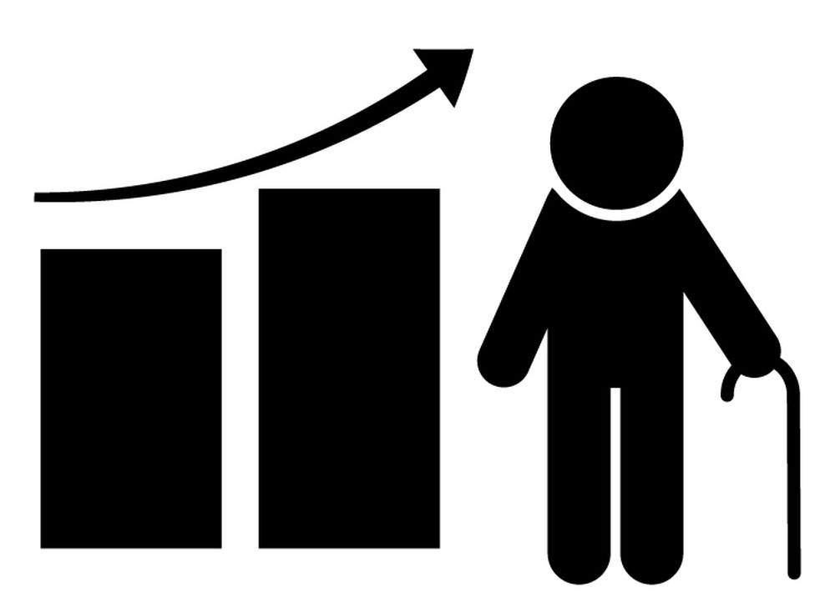
Recent Laws – Contd.
The Retirements Benefits (Post- Retirement Medical Funds) Guidelines, 2008
Issued by the Retirement Benefits Authority to facilitate the establishment, regulation and supervision of the management of post-retirement medical funds.
Notes:
Our firm is particularly known for its formidable dispute resolution team, work on some of Kenya’s largest deals and its significant contributions to Kenya’s legal profession.

Slide 26
Orders
The Kenya Union Of Domestic Hotels, Educational Institutions and Hospital Workers (Deduction Of Union Dues) Order
Made in November 2018 by the CS, Labour and Social Protection. It seeks to regulate the dues of employees where an employer employs more than 5 members of this union.
The employer ought to deduct 2% from the gross salary of an employee but not exceed Kshs. 500 and remit the same within 10 days to the Union.
The Dock Workers Union (Deduction of Union Dues) Order
Regulates the dues of employees who are members of this union. Employers are required to deduct 2% of gross salary of their employees and remit to the Union.
Notes:
Our firm is particularly known for its formidable dispute resolution team, work on some of Kenya’s largest deals and its significant contributions to Kenya’s legal profession.

Slide 27
Proposed Laws
The Breastfeeding Mothers Bill, 2017
Contains provisions on employer’s obligations towards breastfeeding mothers in the workplace. The Bill provides that a woman may breastfeed her baby or breastfeed express breast milk at a lactation place in the workplace during working hours.
The Bill proposes punitive action for employers who do not comply with its provisions. Such employers shall be liable upon conviction to a fine not exceeding Kshs. 500,000 or to an imprisonment for a term not exceeding 1 year, or both.
Notes:
Our firm is particularly known for its formidable dispute resolution team, work on some of Kenya’s largest deals and its significant contributions to Kenya’s legal profession.

Slide 28

Proposed Laws – Contd.
The Employment (Amendment) Bill, 2019
The Bill intends to amend the Employment Act, 2007 by introducing some new concepts and clarifying other issues such as:
Pre-Adoption Leave - 3 months leave with full pay for female employees and 2 weeks’ leave for their male counterparts.
Notes:
Our firm is particularly known for its formidable dispute resolution team, work on some of Kenya’s largest deals and its significant contributions to Kenya’s legal profession.

Slide 29
Proposed Laws – Contd.
Maternity leave - extended to 6 months (three months leave with pay and the remaining 3 months without pay) .The additional 3 months leave will be subject to the consent of the employer. The female employee must give her employer a 7 days’ notice of extension of leave.
Probationary Contract – the Bill attempts to distinguish the rights upon termination of an employee serving under a probationary contract and those of a permanent employee.
Notes:
Our firm is particularly known for its formidable dispute resolution team, work on some of Kenya’s largest deals and its significant contributions to Kenya’s legal profession.

Slide 30

Any Questions?

Slide 31


Slide 32
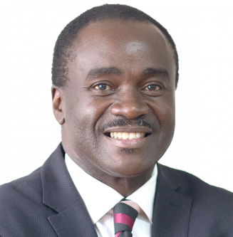

The Speakers
With over 30 years of experience, Chacha has represented local and international clients in arbitration, mediation, banking & commercial litigation, constitutional law, electoral law, employment & labour disputes and property law.
A Partner in the litigation department, Georgina specialises in Dispute Resolution and Mediation and with over seven years of experience, she has advised local and international clients in a wide variety of complex employment and labour disputes, commercial and family law.
E: chacha@oraro.co.ke
E: georgina@oraro.co.ke

Slide 33

T: +254 709 250 000
E: legal@oraro.co.ke | W: www.oraro.co.ke
Disclaimer: This presentation is intended for educational purposes only, it is not for circulation and does not constitute legal advice. Legal advice should be sought for specific queries or circumstances.

