Slide 1
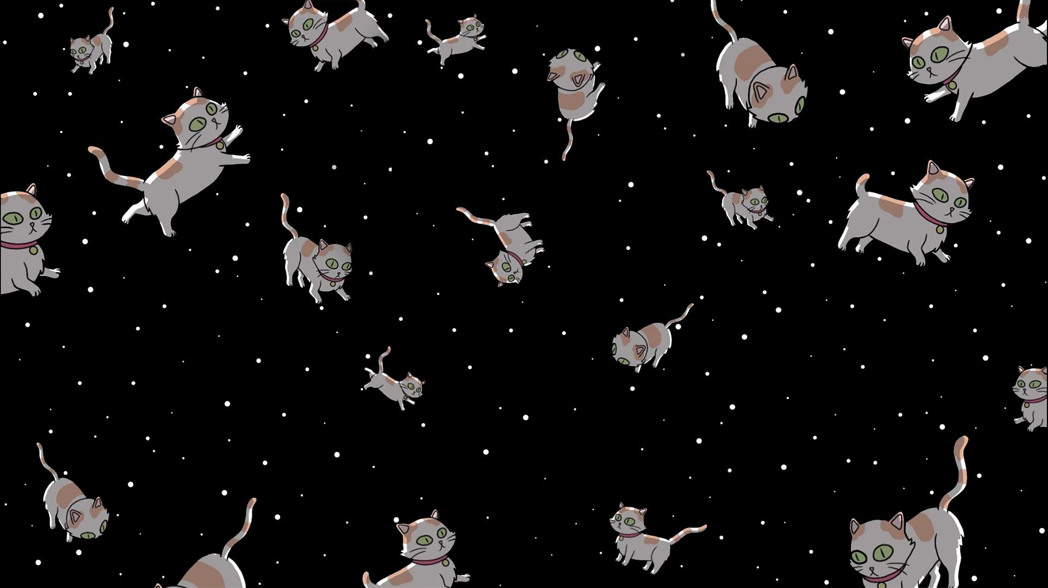
Qat the Cat – an educational game Group 32:
Siddarth Singh
Nandi Bau
Dimpho Majatladi
Daniela Adano
Ann Vuyanzi
Coach: Vicente Pina Canelles

Slide 2
Introduction
Why did we make this?
- Create a demonstration of a game as a proof of concept
- Showcase the accessibility of the IBM Qiskit API
- Inspire interest in quantum mechanics and quantum computing topics
- Expose players to basic topics in quantum mechanics

Slide 3
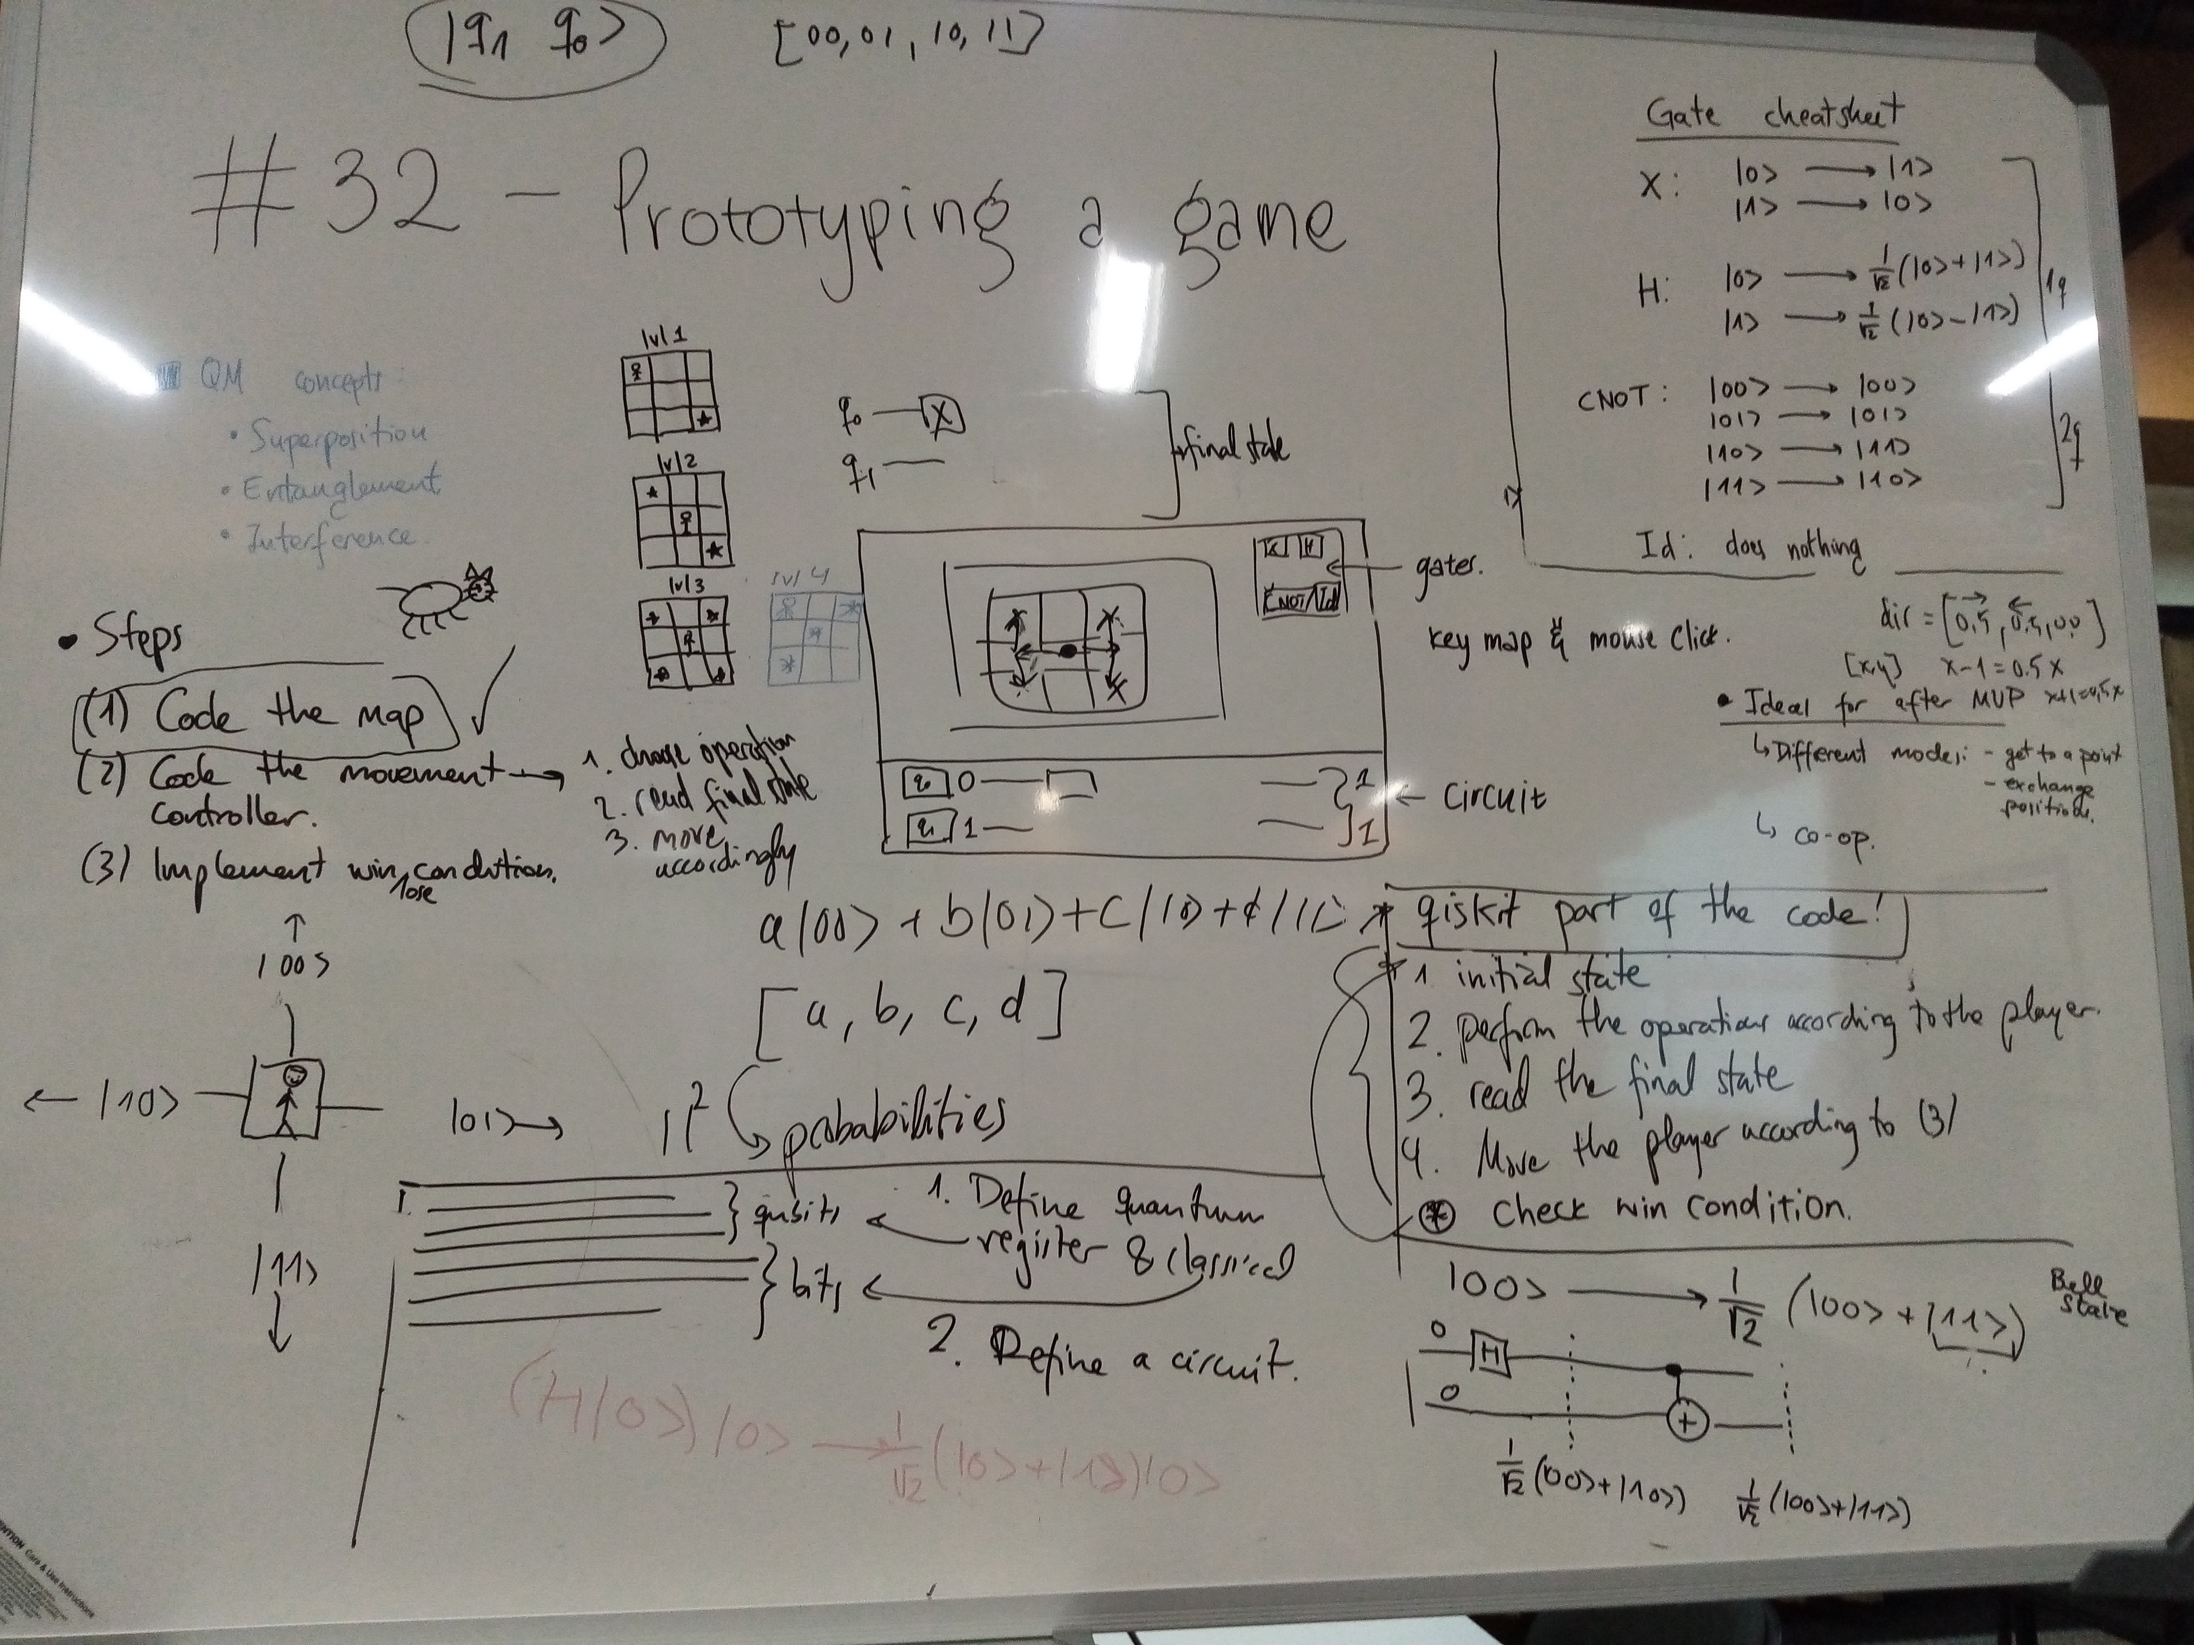
The game
Grid-based puzzle game
We used the Pygame engine for rendering and Qiskit for the mechanics
Player navigates Qat the Cat to destinations on the grid map by manipulating the quantum states of 2 qubits
Players control Qat by adding simple gates to circuits
The qubit states are encoded to the 4 directions that the player may choose to move in (up, right, down, left)
These mechanics are used to demonstrate superposition, entanglement and interference

Slide 4
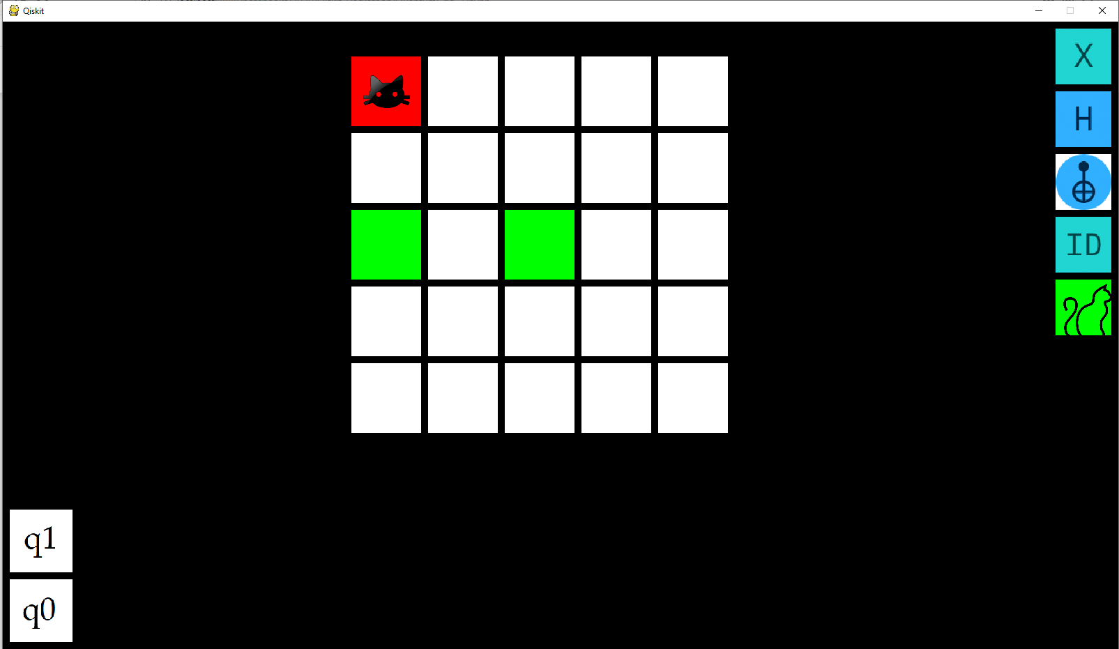
Demo

Slide 5
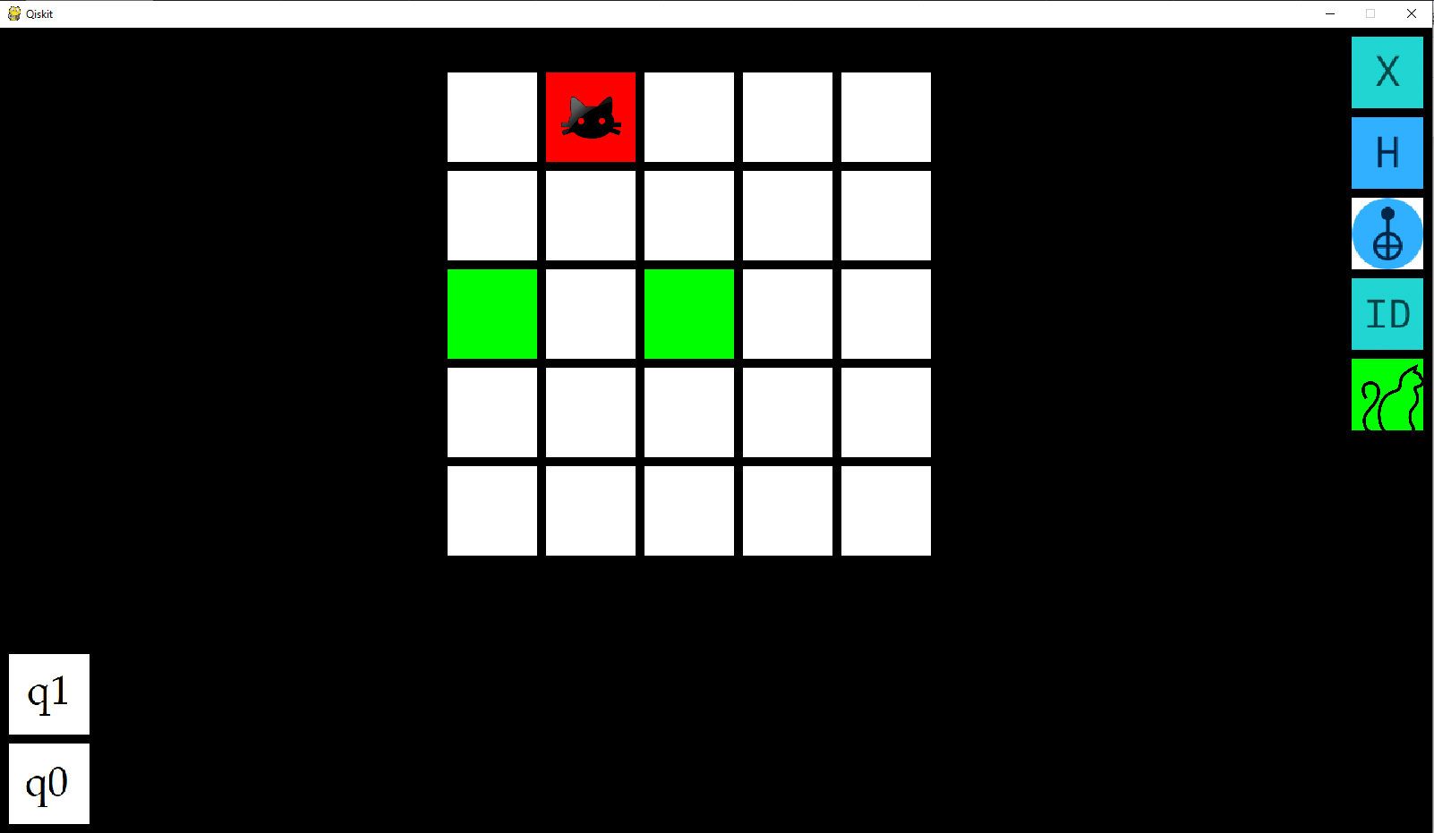
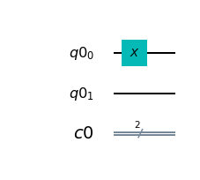
Demo

Slide 6
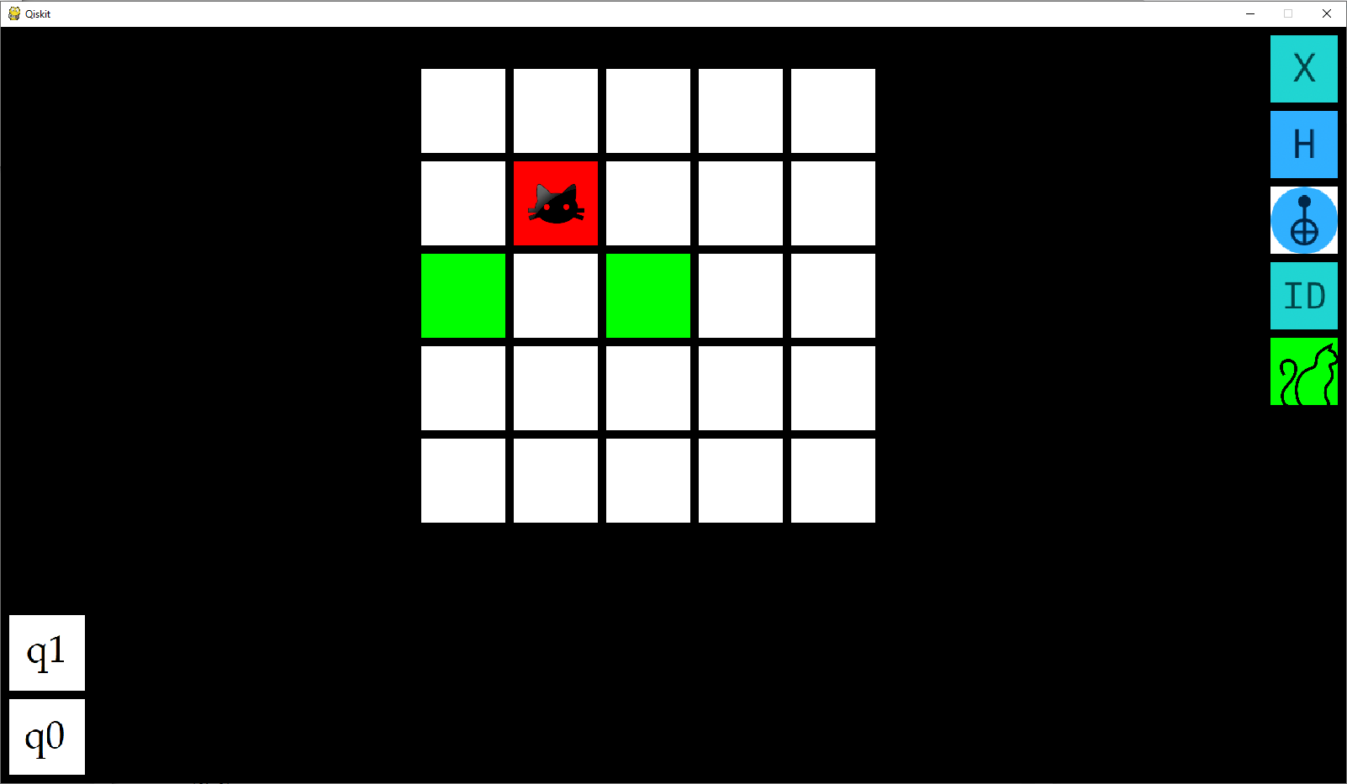
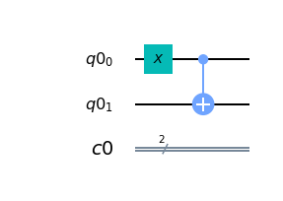
Demo

Slide 7
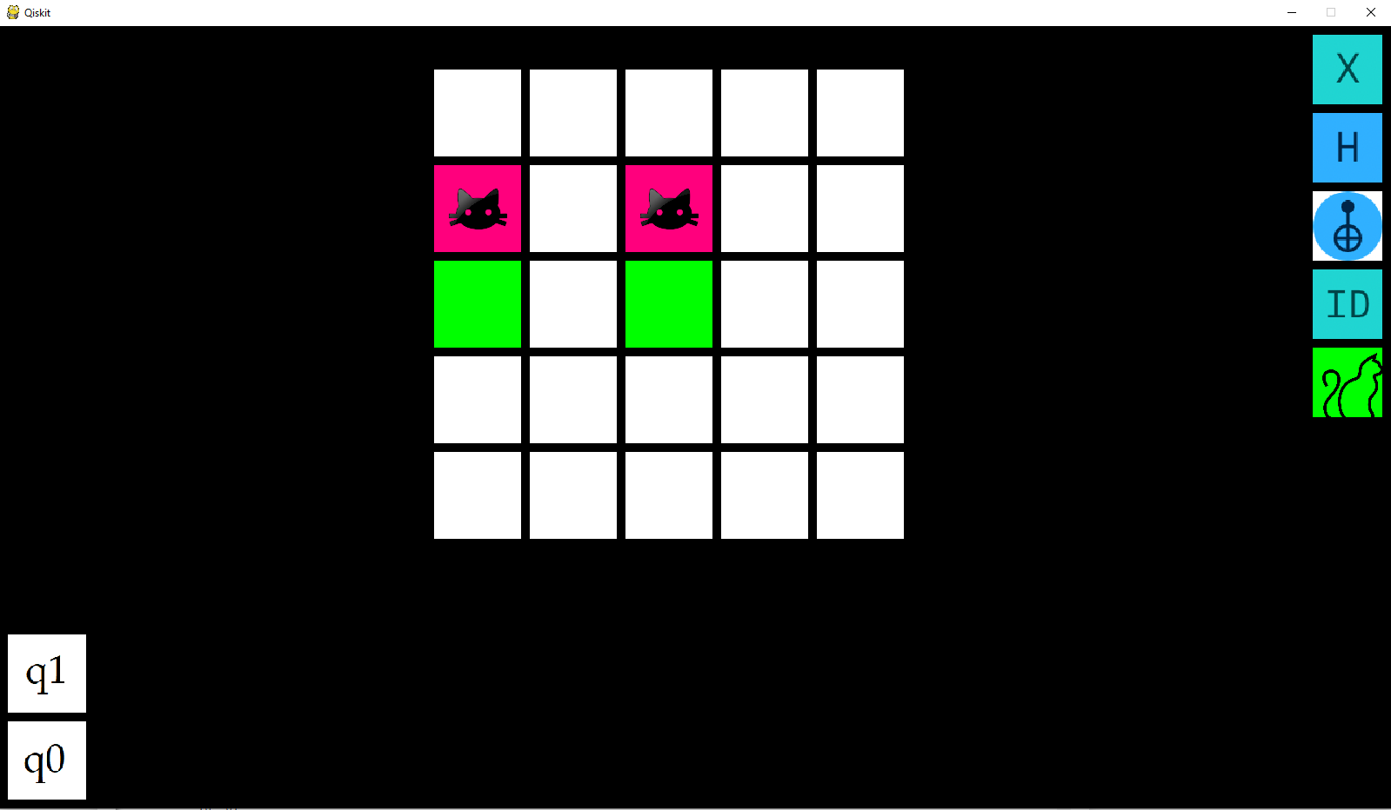
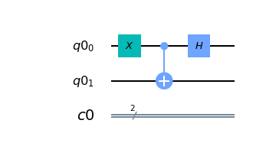
Demo

Slide 8
Current problems, future plans
UI design:
Tutorials, links to Qiskit, information tooltips and guides
Option to display the quantum states and probability amplitudes
Embed circuit diagram in game window

Slide 9
Current problems, future plans
- Mechanics:
Co-op game mode – learn together or lose
Progressive level design – easy to very difficult, engage all levels of players
Can design different map mechanics and level types
Scoring system based on time or steps taken to complete level

Slide 10
Acknowledgements!
Thanks goes to everyone who helped organise the WitsQ Summer School and all mentors and organisers from IBM.
Special thanks goes to our coach Vicente Pina Canelles for his excellent guidance. Much appreciated!

