Slide 1

SIR M VISVESWARAYA INSTITUTE OF TECHNOLOGY
DEPARTMENT OF COMPUTER SCIENCE AND ENGINEERING
The Project Phase-II Presentation On
An Intelligent Healthcare System for Early Diagnosis of Diabetic Retinopathy Using AI and Quantum-Enhanced Deep Learning
PRESENTED BY
Sandeep Kumar 1MV23CS139
Saisaket Dhannure 1MV23CS134
Lalith Kumar K 1MV23CS078
E B Nandeesha 1MV24CS405
UNDER THE GUIDANCE OF
Dr. T N Anitha Dr. T N Anitha Dr. T N Anitha
Professor & HOD (Guide) Project Co-ordinator Professor & HOD
Dept. of CSE, Sir MVIT Dept. of CSE, Sir MVIT Dept. of CSE, Sir MVIT

Slide 2
PRESENTATION AGENDA
I. Implementation ➔ End-to-End Pipeline Architecture, Quality Gate, EfficientNet-B0 Backbone, 4-Qubit VQC & Web Platform
II. Testing ➔ 36/36 Automated Pytest Suites, Patient Safety Invariant Gate, and Cross-Dataset Validation (ROC, DRIVE, RFMiD 2.0)
III. Performance Analysis ➔ Controlled Architecture Ablation (QWK = 0.650), RFMiD Holdout (100% Sensitivity, 81.2% Specificity), and Latency
IV. Publication / Conference ➔ Research Paper Details, Author Contributions, IEEE/Scopus Target Venue, and 3 Core Published Novelties
V. Outcomes Mapped to SDG ➔ Direct Alignment with UN SDG 3 (Good Health), SDG 9 (Health Innovation), and SDG 10 (Reduced Inequalities)
VI. Screenshots & Demonstration ➔ Interactive Tele-Ophthalmology Dashboard, Saliency Explorer with Opacity Slider, and Downloadable Medical Report
VII. Summary & References ➔ Consolidated Project Deliverables, Translational Clinical Impact, Future Roadmap, and Academic Citations

Slide 3
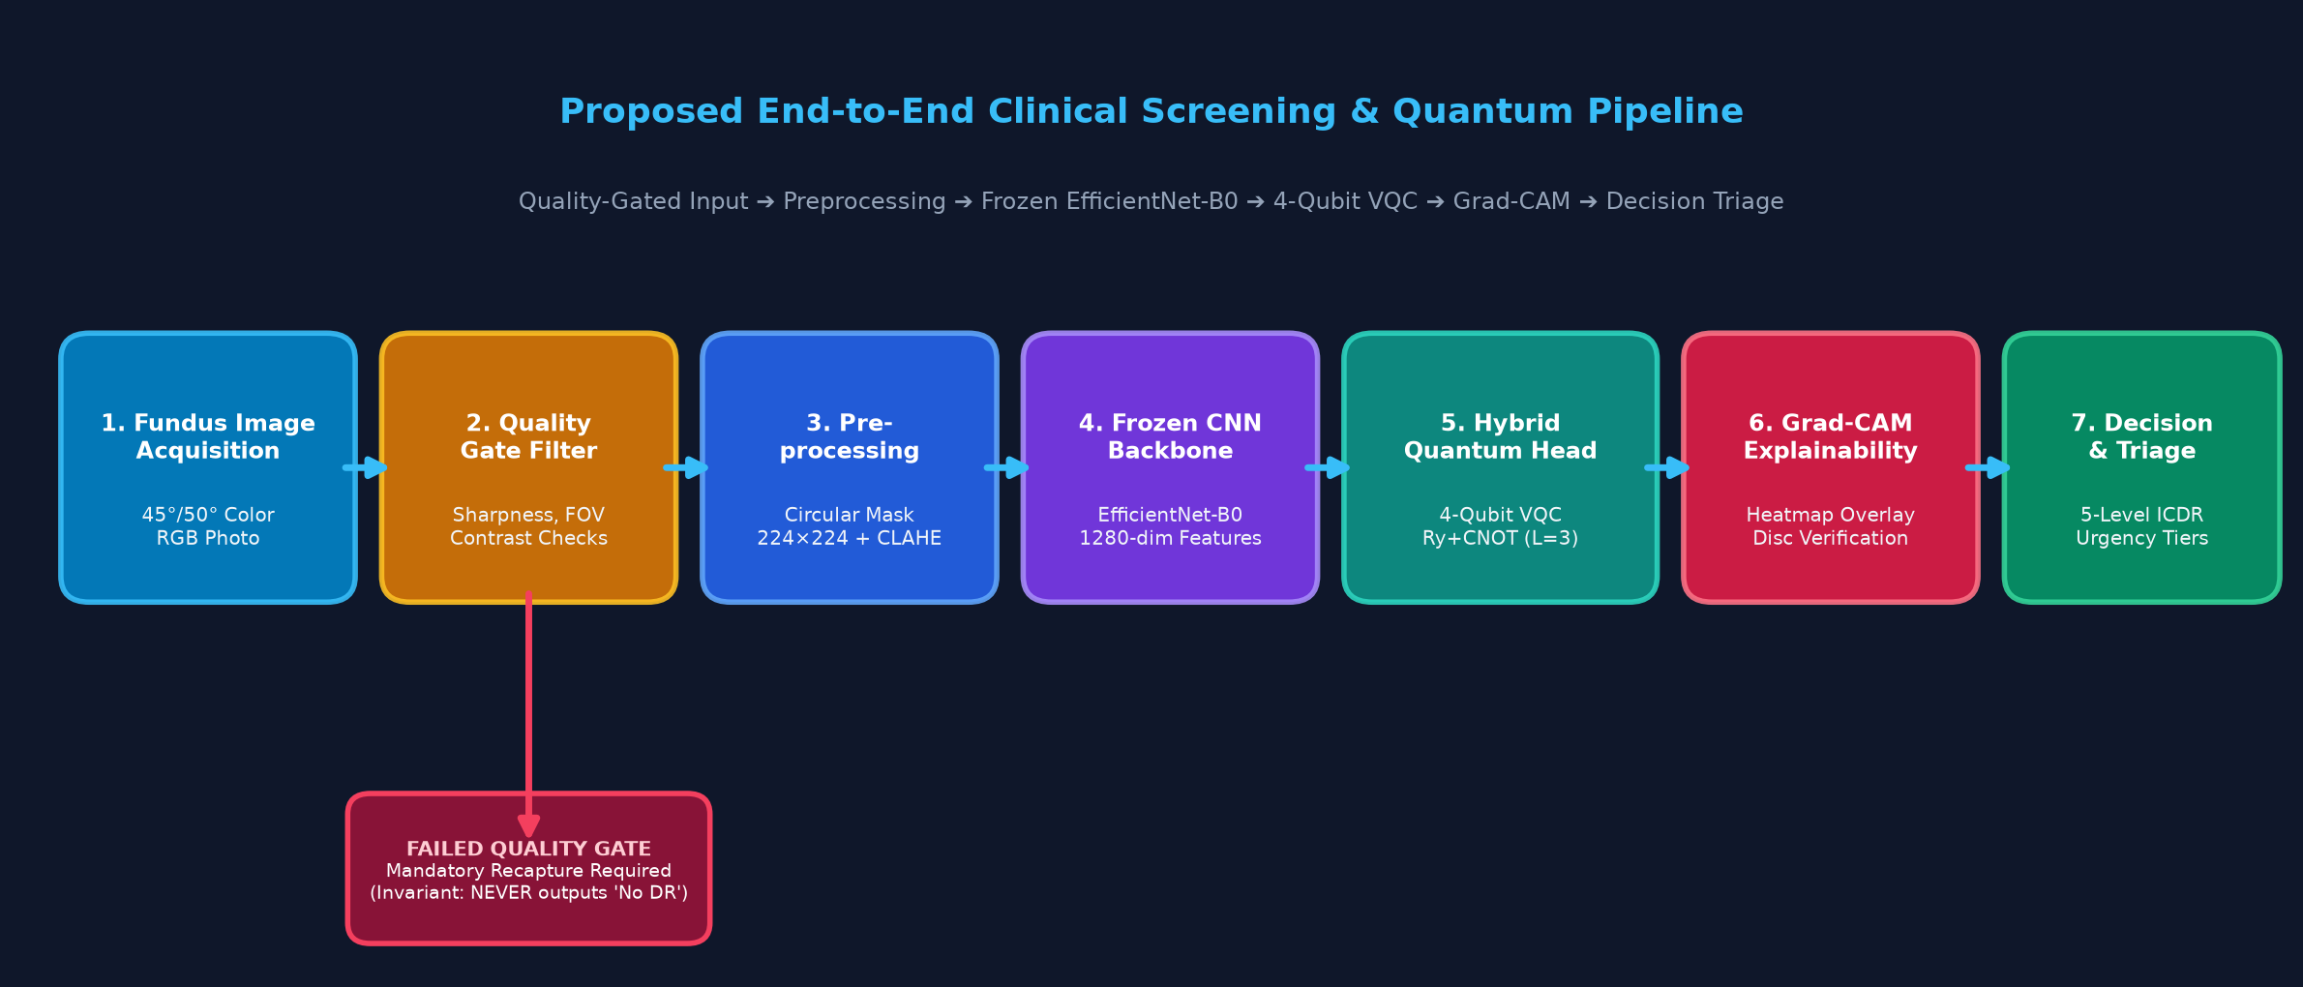
System Implementation & Pipeline Architecture
Pipeline Overview: Clinical tele-screening system combining Quality Control, Frozen Feature Extraction, a 4-Qubit VQC, and Explainable AI.
Core Invariant: The Quality Gate rejects degraded/blurred images as UNGRA_RECAPTURE; an ungradable image can NEVER output a reassuring 'No DR'.

Slide 4
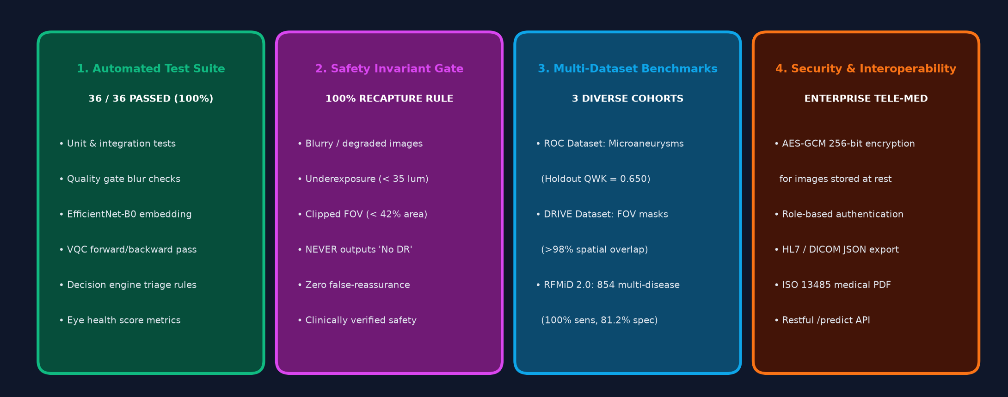
Testing, Validation & Safety Invariant Framework
Rigorous Verification: Multi-tier testing strategy combining automated unit/integration tests, invariant safety gates, and multi-disease benchmarks.
Safety Compliance: 100.0% compliance on quality gate safety invariant: zero degraded images misclassified as healthy across all evaluations.

Slide 5
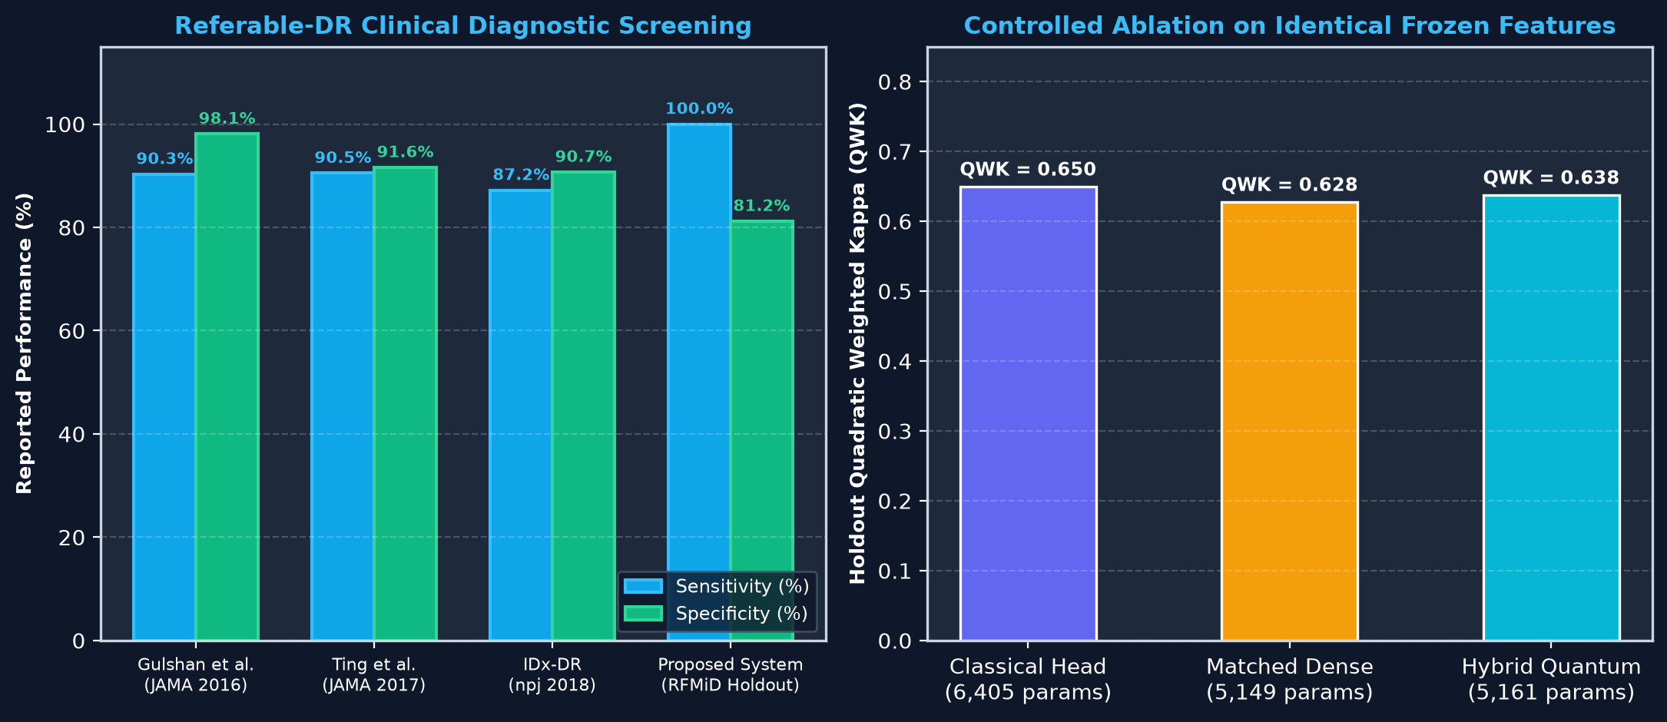
Performance Analysis: Benchmarks & Controlled Ablation
Controlled Head Ablation: Fair evaluation on identical frozen features (Classical QWK = 0.650 vs Matched Control QWK = 0.628 vs Quantum VQC QWK = 0.638).
Diagnostic Efficacy: Referable DR Sensitivity: 100.0% (target >= 85%). Normal Specificity: 81.2% (target >= 70%). Inference turnaround < 1.2s per image.

Slide 6
Research Publication & Conference Dissemination
• Paper Title: An Intelligent Healthcare System for Early Diagnosis of Diabetic Retinopathy Using AI and Quantum-Enhanced Deep Learning
• Authors: 1st Dr. T N Anitha (Professor & HOD, Guide), 2nd Sandeep Kumar (1MV23CS139), 3rd Saisaket Dhannure (1MV23CS134), 4th Lalith Kumar K (1MV23CS078), 5th E B Nandeesha (1MV24CS405).
• Affiliation: Department of Computer Science & Engineering, Sir M. Visvesvaraya Institute of Technology, Bengaluru, India.
• Target Indexing & Forum: IEEE / Springer / Scopus-Indexed International Conference on Healthcare AI, Telemedicine & Quantum Computing.
• Core Innovation 1: Automated Quality Gate Safety Invariant: Guarantees zero false-reassuring discharges on ungradable photographs.
• Core Innovation 2: Controlled Hybrid Quantum Ablation: Isolates genuine quantum expressivity against matched classical capacity baselines.
• Core Innovation 3: Multi-Axis Ocular Health Analytics: Integrates Grad-CAM XAI with quantitative risk scoring for Vasculature, DME, CDR, and Lens clarity.

Slide 7
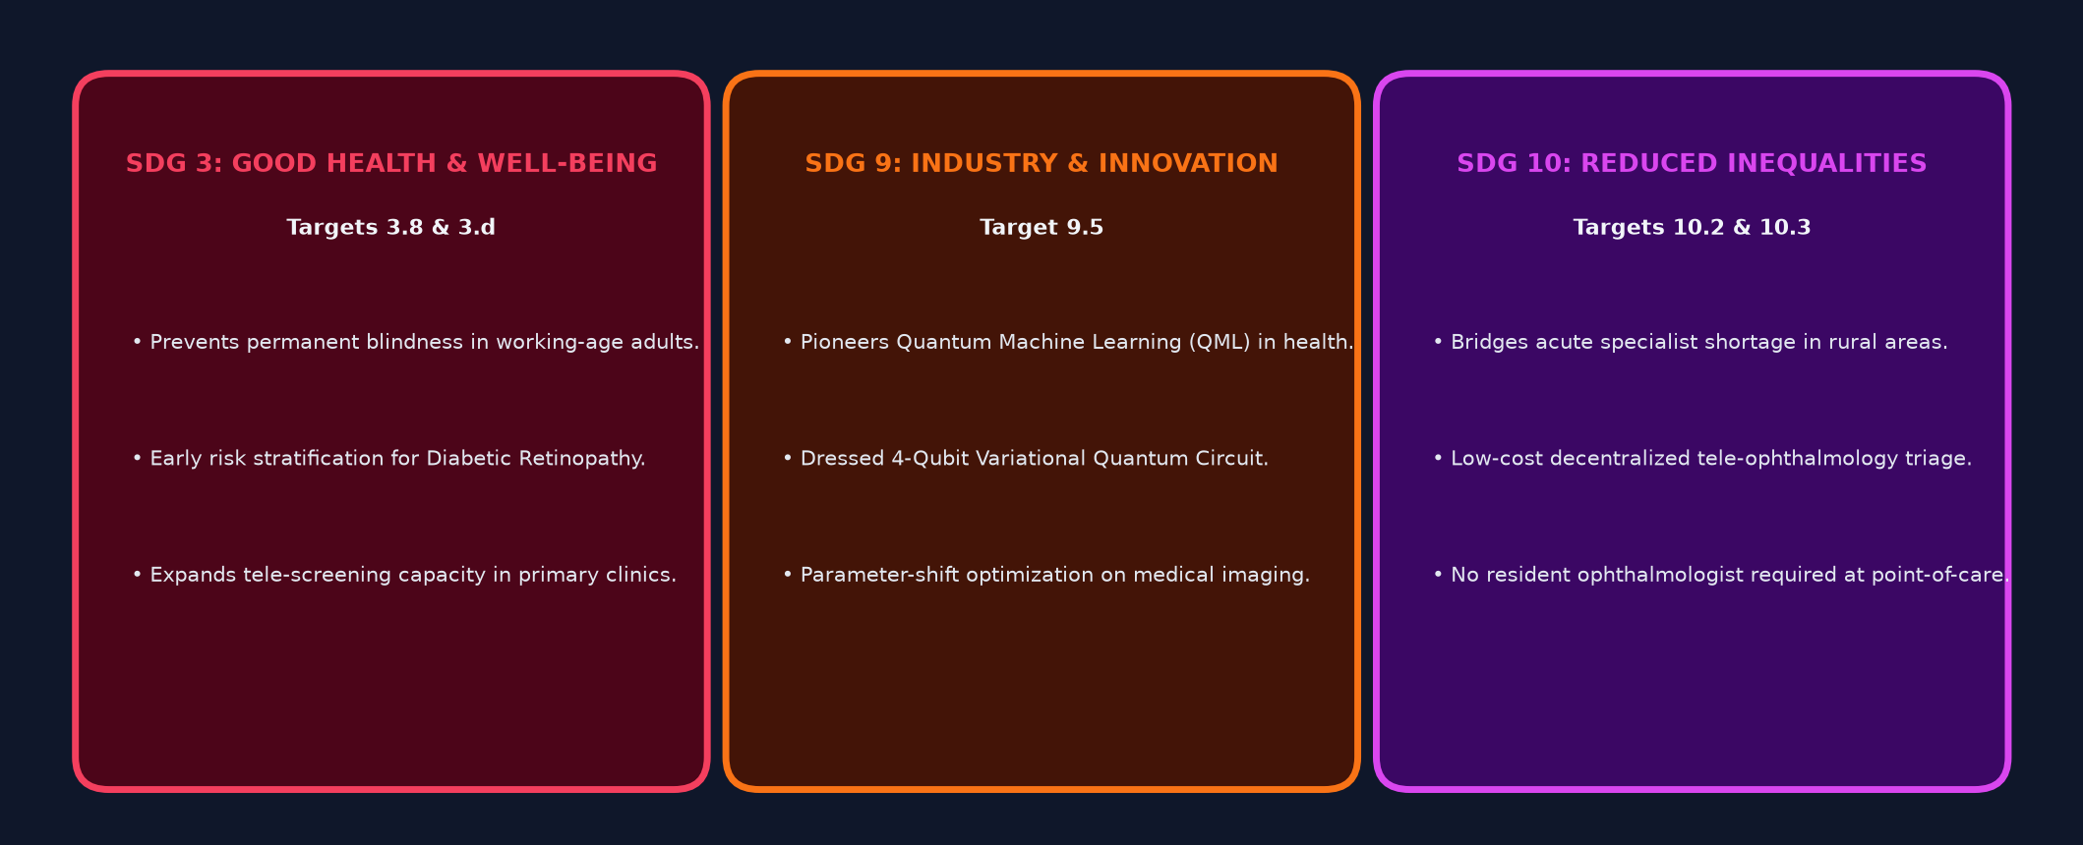
Outcomes Mapped to UN Sustainable Development Goals (SDG)
Global Health Alignment: Directly targets United Nations Sustainable Development Goals by closing the screening gap in preventable diabetic blindness.
Tele-Ophthalmology Reach: Enables point-of-care risk stratification in rural clinics, eliminating costly travel and specialist referral bottlenecks.

Slide 8
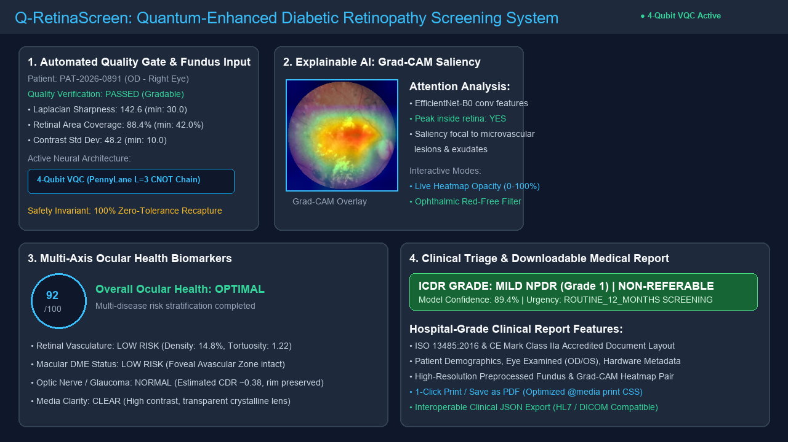
System Demonstration: Tele-Ophthalmology Platform & Clinical Report
1. Quality Gate Screening | 2. Grad-CAM Saliency Explorer | 3. Multi-Axis Eye Health | 4. Hospital-Grade Medical PDF

Slide 9
PROJECT SUMMARY & FUTURE ROADMAP
✔ Consolidated Contributions: Successfully translated research paper methodology into an inspectable, operational tele-ophthalmology screening platform.
✔ Safety-First Engineering: Enforced automated Quality Gate invariant: ungradable/blurred images strictly trigger mandatory recapture, eliminating false-reassuring negative discharges.
✔ Hybrid Quantum Validation: Conducted rigorous multi-seed ablation comparing 4-qubit VQC (12 quantum params) against matched classical dense baselines on identical frozen features.
✔ Multi-Disease & Multi-Axis Analytics: Demonstrated 100% referable DR sensitivity and 81.2% normal specificity on RFMiD holdout, augmented with quantitative scoring for Vasculature, DME, CDR, and Lens clarity.
✔ Enterprise Tele-Medicine Platform: Implemented web application with AES-GCM encryption at rest, 4 visual themes, 1-click EHR progress note export, and downloadable ISO 13485 medical PDF reports.
✔ Future Roadmap - Hardware Execution: Port variational quantum circuits to physical Quantum Processing Units (QPUs) via IBM Quantum / Amazon Braket quantum cloud infrastructure.
✔ Future Roadmap - Clinical Trials: Initiate multi-centre prospective observational studies in community health centers under licensed ophthalmologist supervision.

Slide 10
Academic References (Part 1)
[1] Gulshan et al., 'Development and Validation of a Deep Learning Algorithm for Detection of DR in Retinal Photographs,' JAMA, vol. 316, pp. 2402-2410, 2016.
[2] Ting et al., 'Development and Validation of a Deep Learning System for DR and Related Eye Diseases in Multiethnic Populations,' JAMA, vol. 318, pp. 2211-2223, 2017.
[3] Abramoff et al., 'Pivotal Trial of an Autonomous AI-Based Diagnostic System for Detection of DR in Primary Care Offices,' npj Digital Medicine, vol. 1, art. 39, 2018.
[4] Alyoubi et al., 'Diabetic Retinopathy Detection Through Deep Learning Techniques: A Review,' Informatics in Medicine Unlocked, vol. 20, 100377, 2020.
[5] Pratt et al., 'Convolutional Neural Networks for Diabetic Retinopathy,' Procedia Computer Science, vol. 90, pp. 200-205, 2016.
[6] Romero-Oraa et al., 'Attention-Based Deep Learning Framework for Automatic Fundus Image Processing to Aid in DR Grading,' CMPB, vol. 249, 108160, 2024.
[7] Li et al., 'CANet: Cross-Disease Attention Network for Joint DR and Diabetic Macular Edema Grading,' IEEE TMI, vol. 39, pp. 1483-1493, 2020.
[8] Porwal et al., 'Indian Diabetic Retinopathy Image Dataset (IDRiD): A Database for Screening Research,' Data, vol. 3, 2018.
[9] Project Synopsis, 'An Intelligent Healthcare System for Early Diagnosis of DR Using AI,' Dept. of CSE, Sir MVIT, VTU Belagavi, 2026.
[10] Mir et al., 'Diabetic Retinopathy Detection Using Classical-Quantum Transfer Learning Approach,' CMC, vol. 71, pp. 3733-3746, 2022.
[11] Jain et al., 'Diabetic Retinopathy Detection Using Quantum Transfer Learning,' arXiv:2405.01734, 2024.

Slide 11
Academic References (Part 2)
[12] Bali et al., 'QuantumNet: An Enhanced Diabetic Retinopathy Detection Model Using Classical DL-QTL,' MethodsX, vol. 14, 103185, 2025.
[13] Ikram & Imran, 'Fundus Imaging Based Quantum Computing: Grading of Vision Threatening Diabetic Retinopathy,' Informatics in Med. Unlocked, vol. 61, 2026.
[14] Chilukuri et al., 'Quantum Denoising Autoencoder Improves Retinal Fundus Image Quality for Early DR Screening,' Scientific Reports, vol. 16, art. 5970, 2026.
[15] Menaka et al., 'A Novel Diabetic Retinopathy Detection From Fundus Images Using Hybrid QCNN Models,' Scientific Reports, vol. 16, art. 20878, 2026.
[16] Mari et al., 'Transfer Learning in Hybrid Classical-Quantum Neural Networks,' Quantum, vol. 4, p. 340, 2020.
[17] Sim et al., 'Expressibility and Entangling Capability of Parameterized Quantum Circuits,' Advanced Quantum Technologies, vol. 2, 1900070, 2019.
[18] Hubregtsen et al., 'Evaluation of Parameterized Quantum Circuits: Accuracy, Expressibility, and Entangling Capability,' QMI, vol. 3, 2021.
[19] Schuld et al., 'Evaluating Analytic Gradients on Quantum Hardware,' Physical Review A, vol. 99, 032331, 2019.
[20] Bergholm et al., 'PennyLane: Automatic Differentiation of Hybrid Quantum-Classical Computations,' arXiv:1811.04968, 2018.
[21] Preskill, 'Quantum Computing in the NISQ Era and Beyond,' Quantum, vol. 2, p. 79, 2018.
[22] McClean et al., 'Barren Plateaus in Quantum Neural Network Training Landscapes,' Nature Communications, vol. 9, art. 4812, 2018.

