Slide 1

SMART INDIA HACKATHON 2026
TITLE PAGE
• Problem Statement ID – SIH26089
• Problem Statement Title – Cooperative-Owned Digital Marketplace for Labour Cooperative Federations
• Theme – Smart Automation
• PS Category – Software
• Team ID – ACET_SIH26_006
• Team Name – SAHAKARYA

Slide 2
SAHAKARYA — COOPERATIVE MARKETPLACE
SAHAKARYA
FROM PLATFORM DEPENDENCY → COOPERATIVE OWNERSHIP
CURRENT GIG ECOSYSTEM
SAHAKARYA MODEL
RETHINK THE BUSINESS MODEL
Worker / Cooperative Member
CUSTOMER
→
SAHAKARYA
MARKETPLACE
→
VERIFIED
WORKER
Private gig aggregator
→
ECONOMIC CHARTER
Platform-controlled demand
95%
5%
0%
20–30% commission*
The platform is
owned by the cooperative.
Worker take-home
Welfare Fund
Platform cut
Reduced worker take-home
Fair matching
Verified workforce
Fixed tariffs
distance + rating + skill
federation roster + NCCT
no surge pricing
Limited collective welfare
Live service
Worker welfare
Smart automation
GPS + ETA + chat
medical + tools + training
7-day demand forecast

Slide 3
TECHNICAL APPROACH — SAHAKARYA
SAHAKARYA
3 client experiences → 1 real-time backend → data + geospatial matching → ML forecast
CUSTOMER APP
PARTNER APP
FEDERATION CONTROL CENTER
Flutter 3.x • Dart
Flutter 3.x • Dart
React 18 • Vite • TypeScript
Discovery • fixed tariffs GPS tracking • chat • billing
Availability radar • dispatch payouts • welfare claims
Worker roster • live monitor policy • welfare ledger • analytics
FASTAPI ASYNC GATEWAY + PYTHON-SOCKETIO
Python 3.11 • JWT role guards • real-time events • Fair Match = distance decay + rating + skill bonus
MONGODB + GEOSPATIAL
ML — GRADIENTBOOSTINGREGRESSOR
2dsphere search • Beanie/Pydantic • location-based discovery Welfare audit ledger • scalable data layer
R² = 0.958 • MAE = 1.10 bookings/day 7-day forecast • festival + weekly seasonality factors
IMPLEMENTATION FLOW
BOOK
→
MATCH
→
TRACK
→
SETTLE
→
RATE

Slide 4
FEASIBILITY AND VIABILITY — SAHAKARYA
SAHAKARYA
TECHNICALLY READY
OPERATIONALLY FIT
ECONOMICALLY SUSTAINABLE
Flutter + React + FastAPI + MongoDB Modular real-time architecture
Federation-managed rosters Verified workers + tariff governance
95% worker payout + 5% welfare 0% extractive platform commission
CHALLENGES / RISKS → MITIGATION
RISK
WHAT CAN GO WRONG
HOW SAHAKARYA RESPONDS
Worker digital adoption
Different levels of digital literacy
Multilingual Flutter UX + federation-assisted onboarding
Demand–supply imbalance
Peak demand can create shortages
7-day ML forecasts + reserve-worker mobilization
Dispatch accuracy
Stale GPS / availability data
Live location updates + geospatial matching + time-bound offers
Trust & governance
Payment / welfare disputes
Transparent settlement + federation-controlled audit ledger
Scale across regions
More users, jobs and federations
Async backend + modular services + geospatial indexing

Slide 5
IMPACT AND BENEFITS — WHO GAINS?
SAHAKARYA
A marketplace designed to keep value, visibility and welfare closer to the people who do the work.
WORKERS
COOPERATIVES
• 95% direct take-home
• Digital storefront for existing rosters
• 5% collective welfare
• Demand forecasting & workforce planning
• Digital profile + certification
SAHAKARYA
• Tariff + policy governance
• Fair, transparent dispatch
• Auditable welfare ledger
COOPERATIVE-OWNED
DIGITAL MARKET
CUSTOMERS
SYSTEM-LEVEL VALUE
• Verified cooperative workers
• Higher value retention
• Fixed federation tariffs
• Worker welfare built into flow
• Live ETA + tracking
DIGITISE THE COOPERATIVE — NOT THE MIDDLEMAN.
• Digital inclusion of labour co-ops
• Ratings & transparent billing
• Smart automation over surge pricing

Slide 6
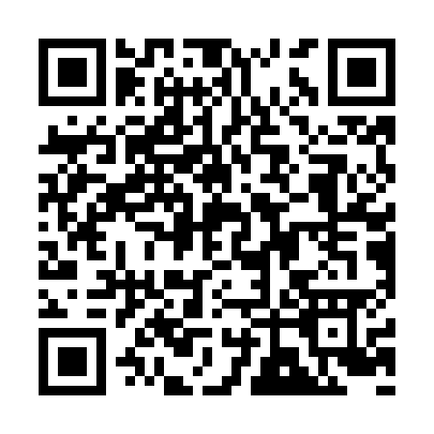
RESEARCH AND REFERENCES
SAHAKARYA
EXTERNAL RESEARCH BASIS
1
ILO — Platform Workers in India & EBMOs (2024)
PROJECT HUB
Reports 25–30% commissions among interviewed platform workers and documents worker concerns around bargaining / platform conditions.
ilo.org
2
ILO / ISSA / OECD — Social Protection in the Gig Economy (2023)
Reviews gaps and country lessons for extending adequate and sustainable social protection to platform workers.
ilo.org
3
NCDC — Compendium / Labour Cooperatives (2024)
Recognises labour cooperatives within the non-farm cooperative development landscape and income-generating activities.
ncdc.in
SOURCE CODE + PROJECT ASSETS
4
ILO — Digital Labour Platforms: Number of Platforms and Workers (2026)
Documents the continued growth of digital labour platforms and the need for better measurement and policy evidence.
github.com/Sahakaryaa
ilo.org
Backend • ML • Customer App
Worker App • Admin Dashboard
Sources: ILO / NCDC public reports • Full project repositories are available via the Project Hub QR.
Research sources are used to support the problem context; SahaKarya-specific metrics are prototype/model results.

