Slide 1

Analytics
Taxi Data Analysis
BDA
BL.EN.U4AIE20046 P.NANDIESWAR
BL.EN.U4AIE20054 RITHVIKA ALAPATI
BL.EN.U4AIE20056 SAI ASWATH S

Slide 2
01
Analysing taxi data and visualisation
Problem
Statement

Slide 3

DATASET DESCRIPTION
It contains fields capturing pick-up and drop-off dates/times, pick-up and drop-off locations, trip distances, rate types, and passenger counts.
File Format : CSV Format
File Size : 11 GB of data

Slide 4
VendorID | A code indicating the unique key
tpep_picku p_datetime | The date and time when taxi was at pickup location.
tpep_dropo ff_datetime | The date and time when taxi was at drop-off location.
Passenger_ count | The number of passengers in the vehicle.
Trip_distan ce | The elapsed trip distance in miles reported by the taximeter.
Pickup_lon gitude | Longitude coordinates at pickup location.
Pickup_latit ude | Latitude coordinates at pickup location.
RateCodeID | Taximeter rate code for which the fare is different for each rate code
Store_and_ fwd_flag | This flag indicates whether the trip record was held in vehicle memory before sending to the vendor, aka “store and forward, "because the vehicle did not have a connection to the server.
Dropoff_longi tude | Longitude coordinates at drop-off location.
Dropoff_ latitude | Longitude coordinates at drop-off location.
Payment_type | A numeric code signifying how the passenger paid for the trip.
Fare_amount | The time-and-distance fare calculated by the meter.
Extra | Extra charges
MTA_tax | $0.50 MTA tax that is automatically triggered based on the
Improvement_ surcharge | $0.30 improvement surcharge assessed trips at the flag drop
Tip_amount | Cash tips are not included.
Tolls_amount | Total amount of all tolls paid in trip.
Total_amount | The total amount charged to passengers. Does not include cash tips.

Slide 5

CLUSTERING

Slide 6

Work flow
Dataset
Training set
Data pre-processing
Feature selection
ML Algo
Testing set

Slide 7
Decision tree regression: Decision tree builds regression or classification models in the form of a tree structure. It breaks down a dataset into smaller and smaller subsets.The result is a tree with decision nodes and leaf nodes.
Data
Distance<5
Distance>5
Peak hour
Peak hour
True
False
True
False
>10
<10
>15
<15

Slide 8
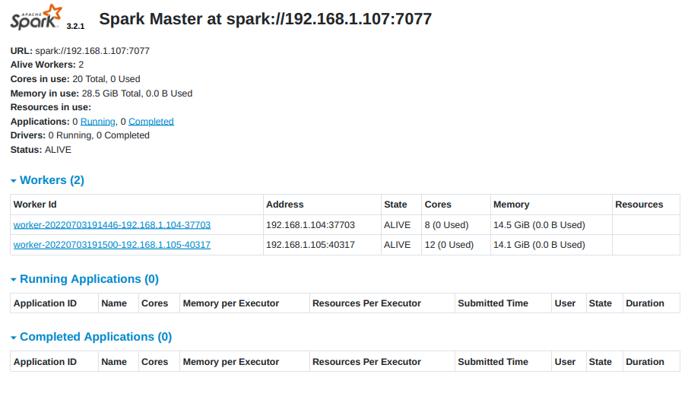
Execution
A Spark cluster is a combination of a Driver Program, Cluster Manager, and Worker Nodes that work together to complete tasks.
We used 3 systems for clustering :
Master – 192.168.1.107 ➔ 16gb (8 core)
Slave1 – 192.168.1.104 ➔ 16gb (8 core)
Slave2 – 192.168.1.105 ➔ 16gb (12 core)

Slide 9
import pyspark.sql.functions as F - List of built-in functions available for DataFrame. from pyspark.sql.types import DoubleType, IntegerType – importing required datatypes from pyspark.ml.feature import VectorAssembler – creates a single vector from multiple colums from pyspark.ml.regression import DecisionTreeRegressor – for regression in form of trees from pyspark.ml.evaluation import RegressionEvaluator – evaluator for regression import numpy as np import pandas as pd - for handling arrays and dataframes import matplotlib.pyplot as plt import seaborn as sns - for data visualisation
Libraries Imported

Slide 10
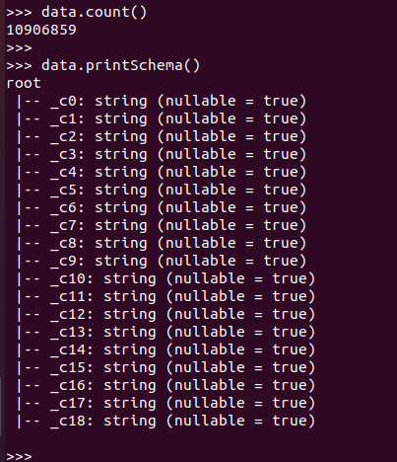
Data reading data = spark.read.csv('yellow_tripdata_2015*.csv')
data.createOrReplaceTempView('NY_taxi') data.count() data.printSchema() read all csv files and merge them into one dataframe create a temporary view sql query for the read data then verifying data by counting it and projecting schema of the data

Slide 11
Data preprocessing data = data.drop('_c4','_c7','_c8','_c11','_c12','c13','_c14','_c15','_c16','_c17') data.printSchema()
data = data.withColumn("_c18", data["_c18"].cast(DoubleType())) data.select(F.min('_c18').alias('min'), F.max('_c18').alias('max')).show() data.select('_c18').describe().toPandas()
data = data.filter(data['_c3']>0) drop the unwanted data colums from data to avoid computing unwanted data check whether the data is droped by projecting schema all data colums are in string type. Cast them to double or integer data type accordingly check min and max of taxi fare(to remove negative and outliers) checking mean and std_dev of data remove rides with passenger count with 0

Slide 12
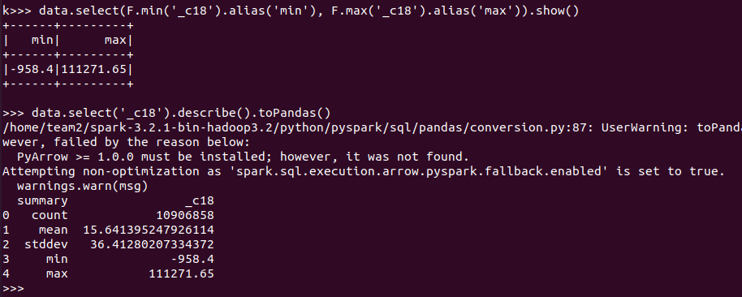
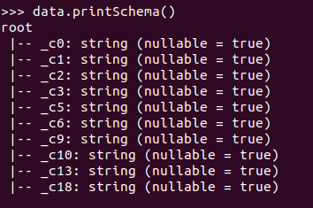
req = """select * from NY_taxi where _c18>0 and _c18<100"""
data = spark.sql(req)
data.count() removing outliers from data and checking the count of rows data.select([F.count(F.when(F.isnan(c),c)).alias(c) for c in data.columns]).show() used for removing null values from data

Slide 13
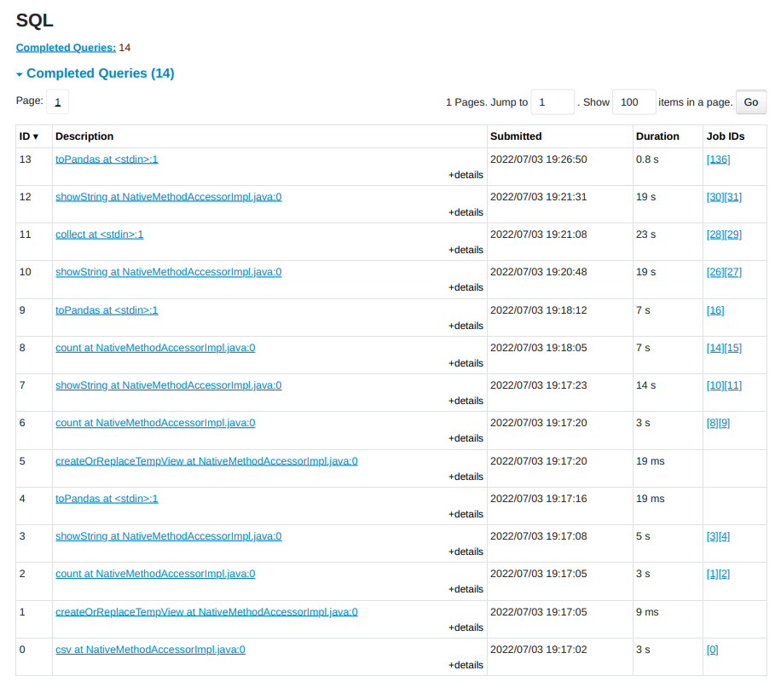

Slide 14
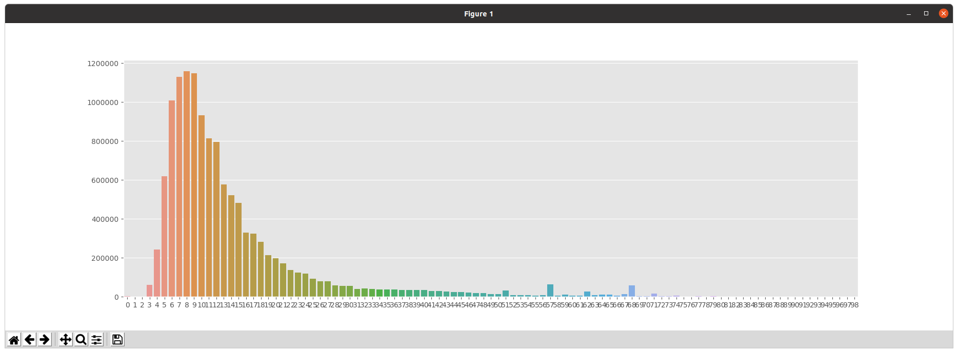
Data visualization and analysis hist = data.select('_c18').rdd.flatMap(lambda x: x).histogram(100)
plt.figure(figsize=(22,6))
sns.barplot(list(map(lambda x: int(x), hist[0][:-1])), hist[1])
plt.show()

Slide 15
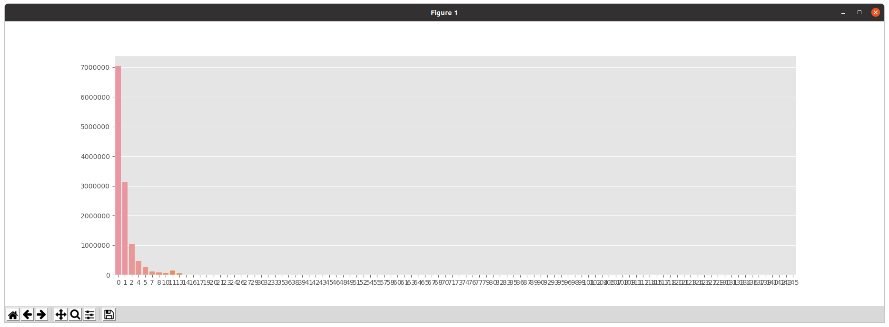
DISTANCE VS no of trips

Slide 16
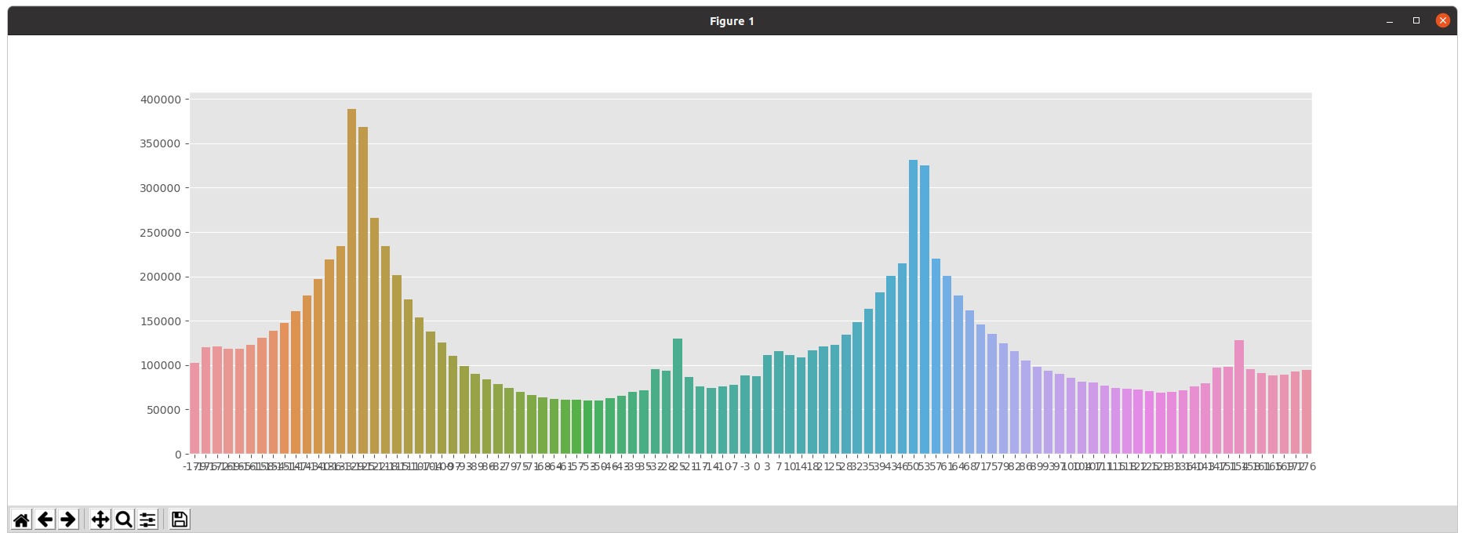
Direction vs no of trips

Slide 17
Data visualization and analysis distance analysis: p = 0.017453292519943295
data = data.withColumn('distance', 0.6213712*12742*F.asin((0.5-F.cos((data['_c10']-data['_c6'])*p)/2 + F.cos(data['_c6']*p) * F.cos(data['_c10']*p) * (1-F.cos((data['_c9']-data['_c5'])*p))/2)**0.5)) to calculate distance and direction between two points using latitude and longitude we used Haversine formula
Time and date analysis
data = data.withColumn('dayofweek', F.dayofweek(data['_c1']))
data = data.withColumn('hour', F.hour(data['_c1']))
data = data.withColumn('peak_hours', F.when((data['hour']>=16) & (data['hour']<20) & (data['dayofweek']!=7)&(data['dayofweek']!=0), 1).otherwise(0))
data = data.withColumn('night_time', F.when((data['hour']>=20) | (data['hour']<6), 1).otherwise(0)) analyzing day, hour for getting highly dependent hour and day separating nighttime for different price

Slide 18
(trainingData, testData) = data.randomSplit([0.7, 0.3], seed=66)
continuous_variables = ['dayofweek','hour','peak_hours','night_time','_c3','distance','direction']
assembler = VectorAssembler(inputCols=continuous_variables,outputCol='features') dividing data for training and tesing the model from the data we derived using given data we are creating trainingData = assembler.setHandleInvalid("skip").transform(trainingData)
testData = assembler.setHandleInvalid("skip").transform(testData) tells to skip the invalid data dt = DecisionTreeRegressor(featuresCol='features', labelCol='_c18') predictions = model.transform(testData) evaluator = RegressionEvaluator(labelCol='_c18', predictionCol="prediction", metricName="rmse")

Slide 19
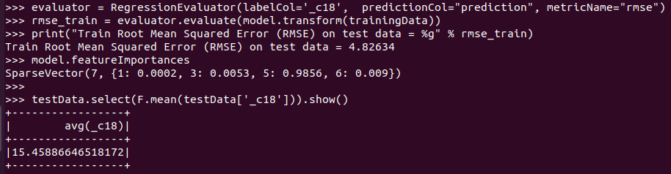

Slide 20
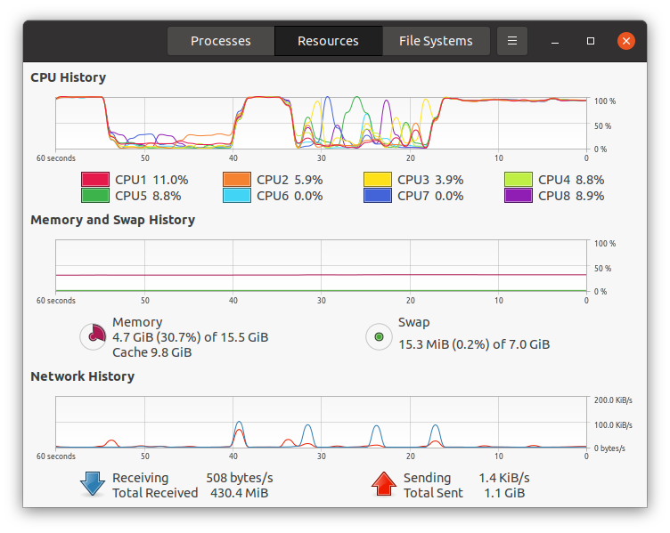
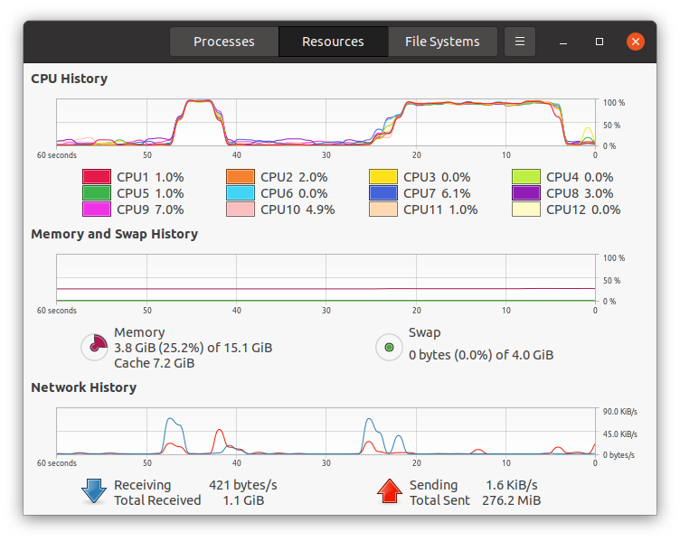
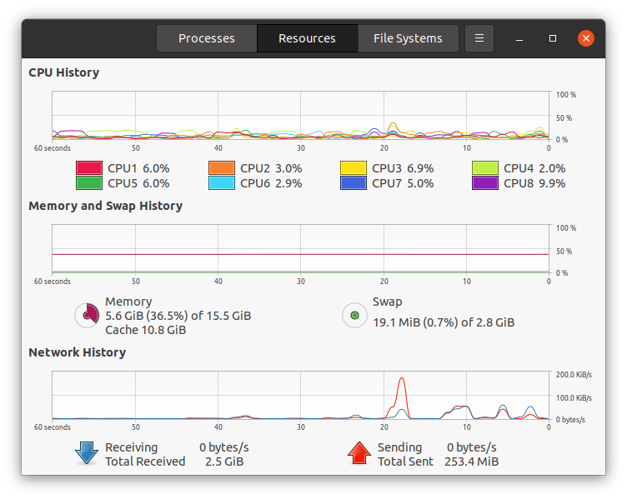
SLAVE-1
SLAVE-2

Slide 21
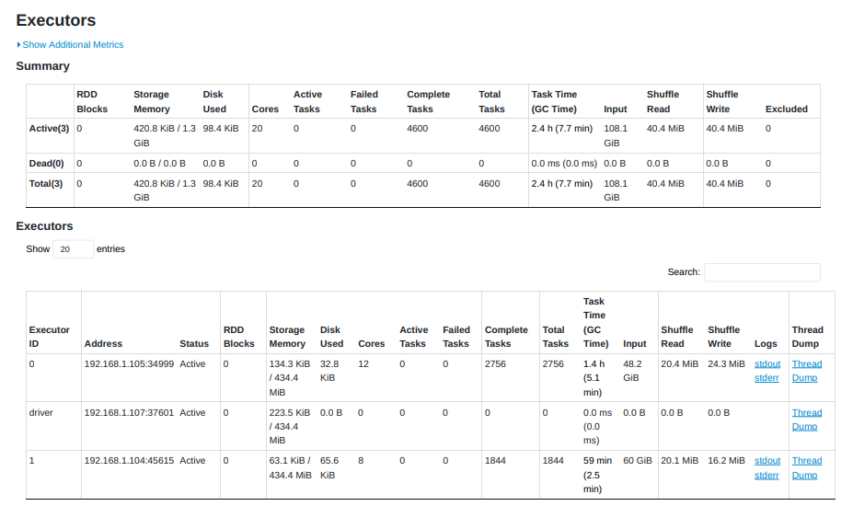

Slide 22
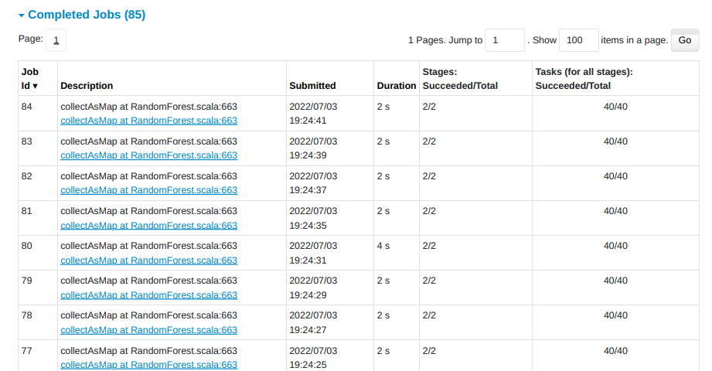
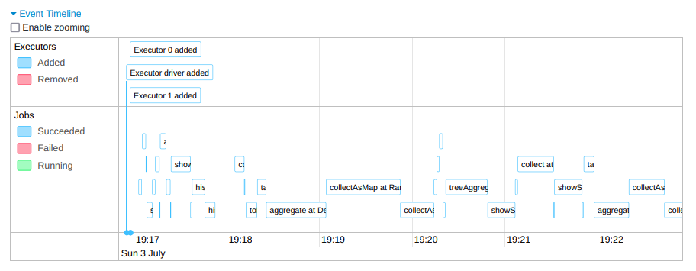

Slide 23
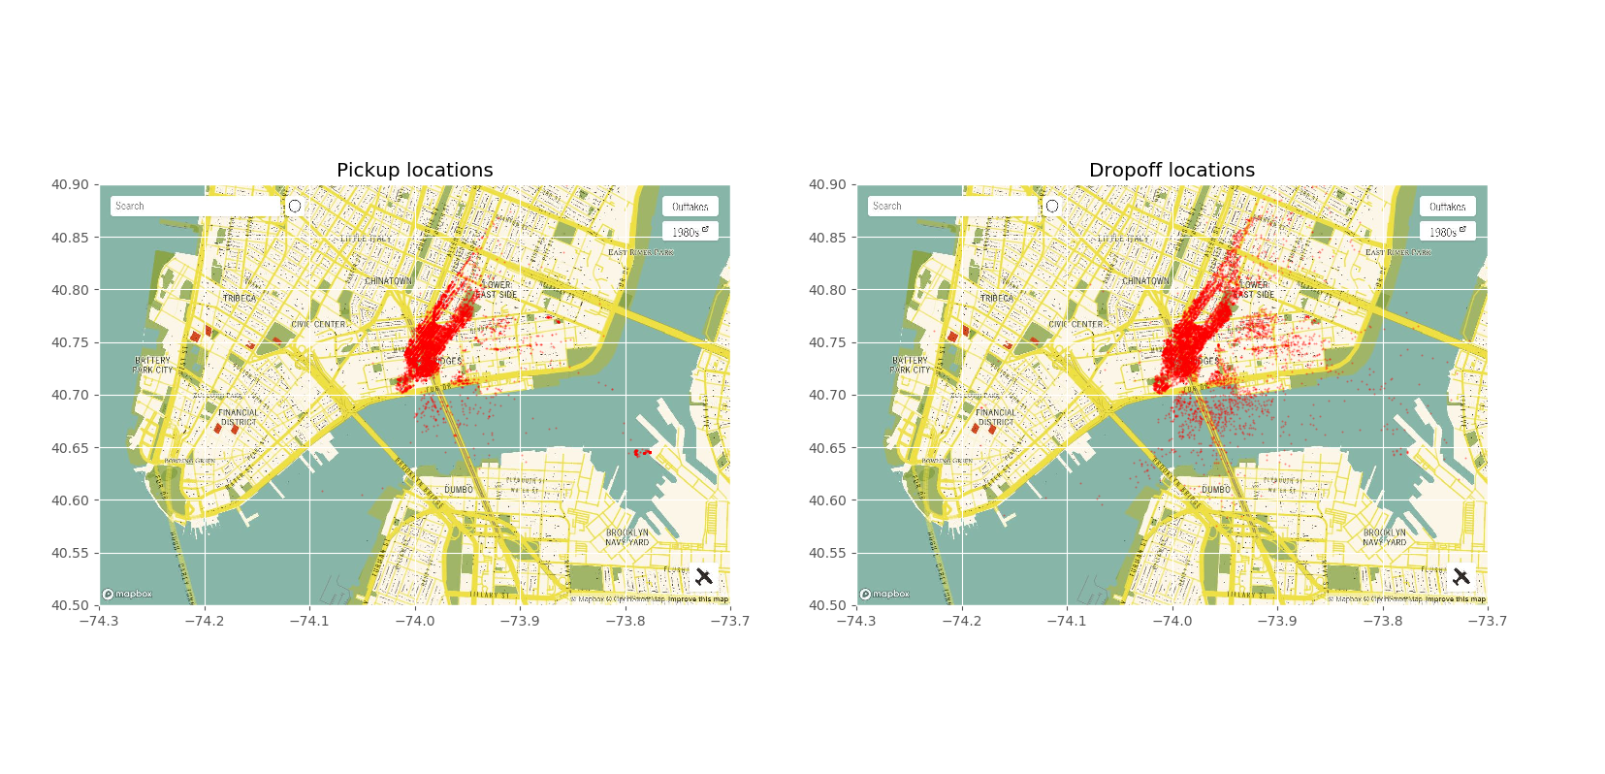

Slide 24
CONTRIBUTION
P.NANDIESWAR - Sql ,making cluster, data preprocessing
RITHVIKA ALAPATI – ppt , making clustering, data visualization
SAI ASWATH S - dataset , clustering ,machine learning

Slide 25

Thank you

