Slide 1



YOUTUBE COMMENTS SENTIMENTAL ANALYSIS
Team 20
P Nandieswar Reddy– BL.EN.U4AIE20046
Rithvika Alapati – BL.EN.U4AIE20054
Sai Aswath S – BL.EN.U4AIE20056
Dr. Beena B M

Slide 2
Introduction
Sentimental analysis is critical in understanding the user’s reaction toward the content on social media platforms.
Content creators face a huge challenge in analyzing large volumes of comments and the need for automated sentiment analysis.
Comments - product development,
advertising techniques,
customer service,
Research scholars.
Notes:
Here we are focusing on YouTube.
comments for improving product development, advertising techniques, and customer service. Research scholars can examine public sentiment on numerous subjects and may contribute to investigations in areas that consist of psychology, politics, and advertising and marketing
an examine public sentiment on numerous subjects and may contribute to investigations in areas that consist of psychology, politics, and advertising and marketing

Slide 3
Objective
To analyse sentiment in YouTube comments using a model built with LSTM and NLP techniques.
Notes:
A sentimental model using LSTM and NLP techniques is built and trained using the IMDB dataset and deployed using Amazon web services (AWS).

Slide 4
Literature Survey
Sentimental Analysis of YouTube Video Comments Using Bagging Ensemble Learning Approach. (2023).;02(04) doi: 10.55041/isjem00336
Uses emotional scores to predict video enjoyment on YouTube by analyzing emotional tones in comments. Utilizes the YouTube API to retrieve and preprocess comments, categorizing them as positive, negative, or neutral. Employs language processing tools such as TextBlob or NLTK for sentiment analysis. Provides valuable insights for content creators and marketers to understand audience sentiment.

Slide 5
Literature Survey
I, Putu, Agus, Eka, Darma, Udayana., I., G., A., Indrawan., I, Putu, Denny, Indra, Putra. Decision Support System for Sentiment Analysis of Youtube Comments on Government Policies. Journal of Computer Networks, Architecture and High Performance Computing, (2023).;5(1):27-37. doi: 10.47709/cnahpc.v5i1.1999
Focuses on sentiment analysis classifying YouTube comments as positive, negative, or neutral. Applies the Naïve Bayes algorithm and analytical metrics like accuracy, precision, and recall. Analyzes 18 YouTube video links with 50.64% positive, 7.70% negative, and 39.23% neutral sentiments.

Slide 6
Literature Survey
Dimaz, Cahya, Ardhi., Dwi, Puspita, Sari. (2022). Sentiment Analysis of YouTube Comments: Potential Indonesian Presidential Election Candidates. International Journal of Computer Applications Technology and Research, 451-456. doi: 10.7753/ijcatr1112.1010
Examines YouTube content generated by Kompas TV, analyzing public opinion on potential presidential candidates. Uses Python with Pandas, matplotlib, word cloud, and textblob for data analysis. Identifies positive sentiments towards specific candidates: Ganjar Pranowo, AnisBaswedan, and Prabowo Subianto..

Slide 7
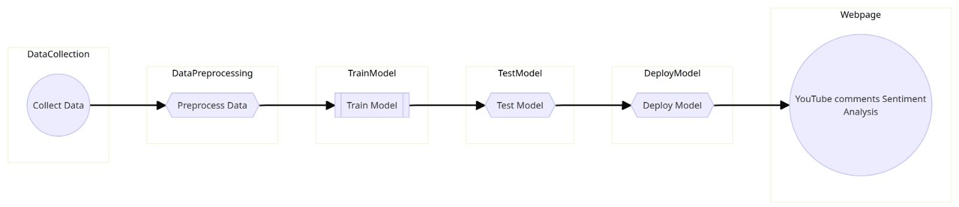
Methodology

Slide 8
Dataset
The IMDB dataset, also known as the Large Movie Review Dataset v1.0, is designed for binary sentiment classification.
It comprises 50,000 movie reviews, equally split into 25,000 positive and 25,000 negative reviews.
The reviews are stored as individual text files in English
The training - 25,000 IMDb movie reviews
The test - 25,000 movie reviews.
Notes:
with explicit positive or negative labels.
posing a challenge for sentiment prediction without explicit class labels.

Slide 9
Data processing
HTML tags are removed from the text using the BeautifulSoup library.
The text is converted to lowercase to ensure uniformity
Stopwords are eliminated.
stemming is applied using the Porter Stemmer to reduce words to their root form.
The data is converted to numerical values for easier processing.

Slide 10




AWS Services
AWS Lambda
AWS Identity and Access Management(IAM)
AWS Api Gateway
AWS Sage Maker

Slide 11




AWS Services
AWS Cost Explorer and Management Console
AWS S3 Bucket
AWS Cloudwatch
AWS EC2

Slide 12
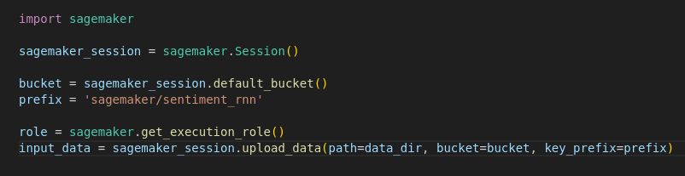
AWS S3 Bucket
Amazon S3, or Simple Storage Service, is a highly scalable and durable object storage service provided by Amazon Web Services (AWS). It is designed to store and retrieve any amount of data from anywhere on the web.

Slide 13
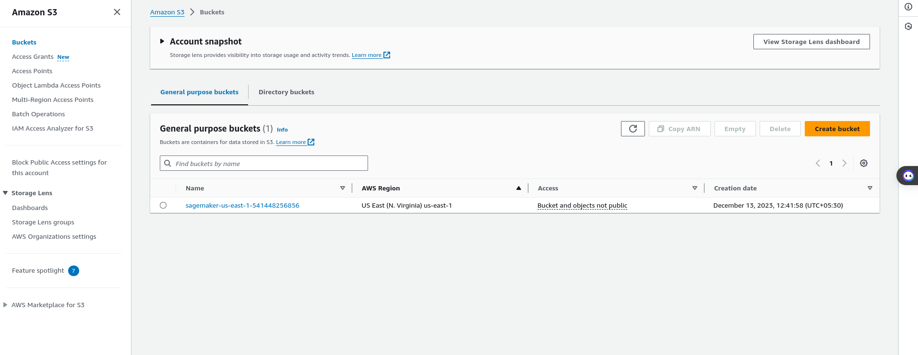
AWS S3 Bucket

Slide 14
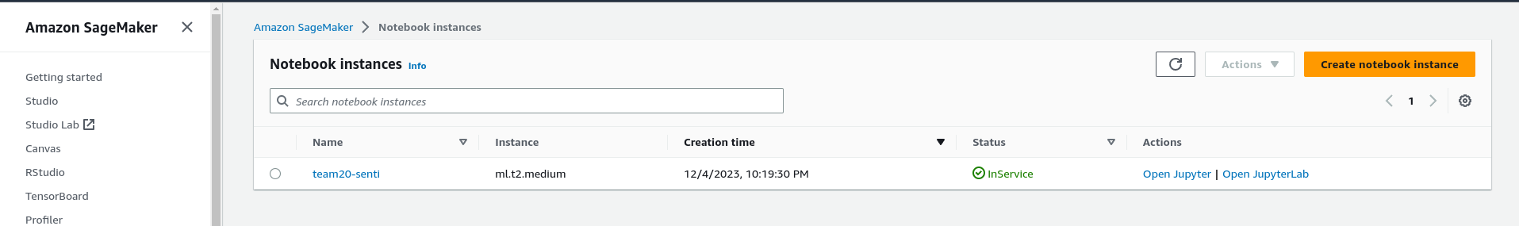
AWS SageMaker
SageMaker by Amazon is a comprehensive machine learning service on AWS that simplifies the entire lifecycle of model development, training, and deploy machine learning models. It provides an integrated solution for tasks ranging from data labeling to hosting models, supporting multiple frameworks.
Steps to create notebook instance:

Slide 15
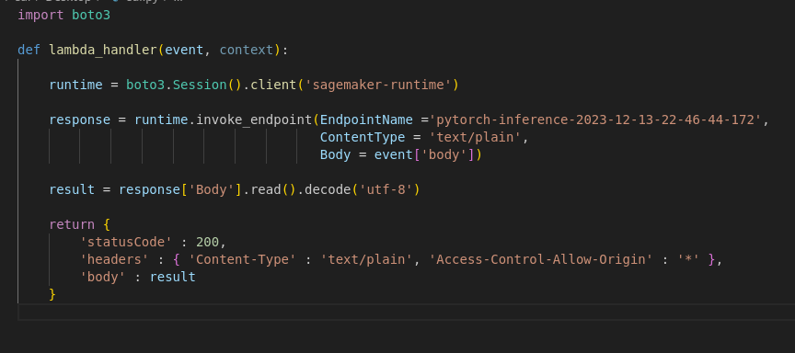
AWS Lamda
AWS Lambda is a serverless computing service that enables you to execute code without the need for server provisioning or management. It automatically handles the scaling and management of computing resources, adjusting to the demands of your code in response to different events.
Steps to create lambda function:

Slide 16
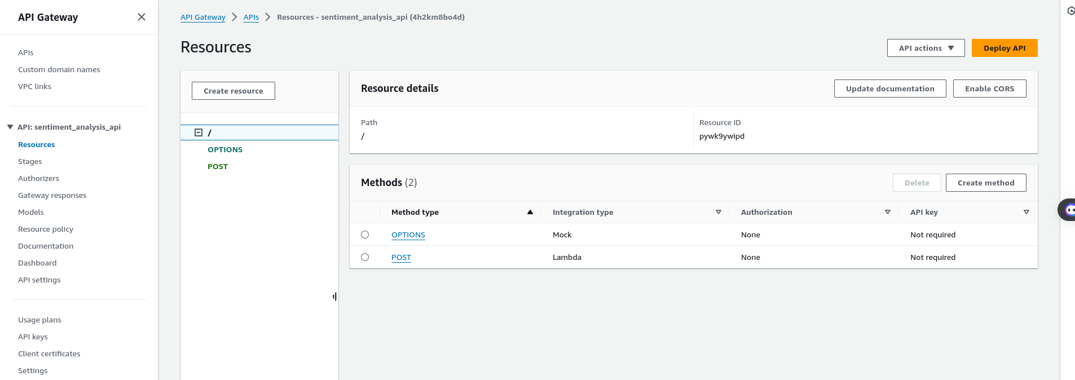
AWS Api Gateway
Amazon API Gateway is a comprehensive, fully managed service designed to simplify the process for developers in creating, publishing, maintaining, monitoring, and securing APIs at any level of scalability. Serving as a gateway, it facilitates seamless communication between different components of your application, fostering efficient connectivity.
Steps to create Api Gateway:

Slide 17
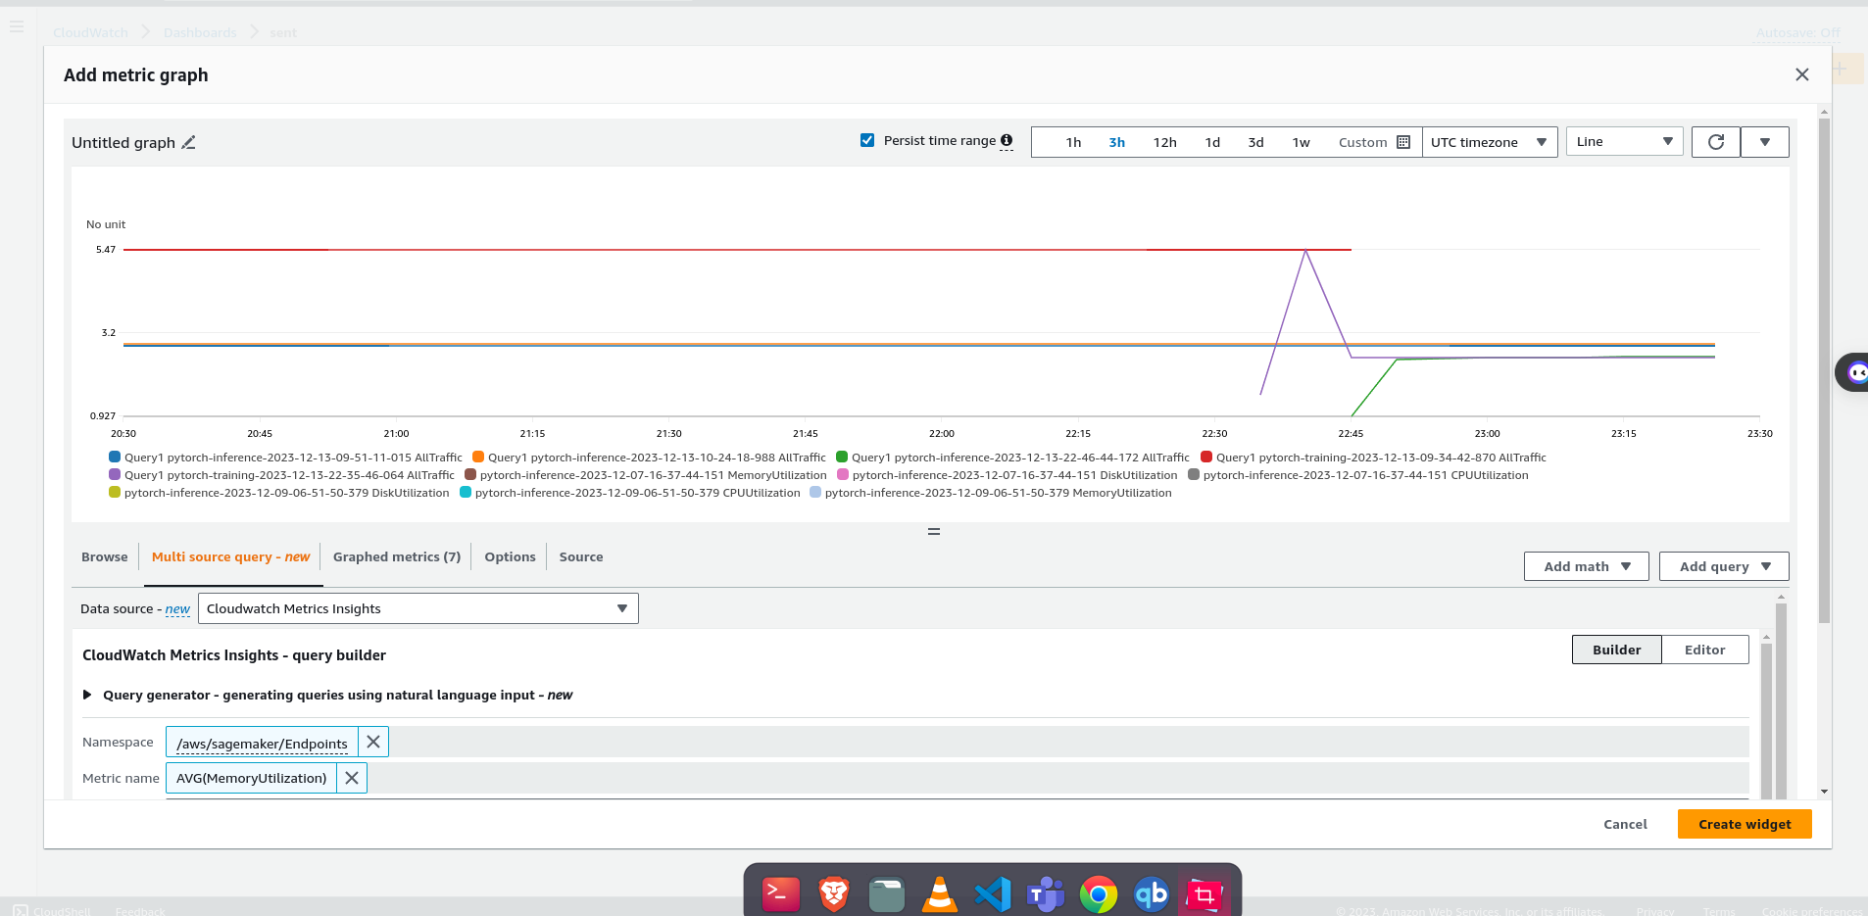
Aws Cloudwatch
Amazon CloudWatch is a monitoring and observability service provided by Amazon Web Services (AWS). It allows you to collect and track metrics, collect and monitor log files, and set alarms.

Slide 18
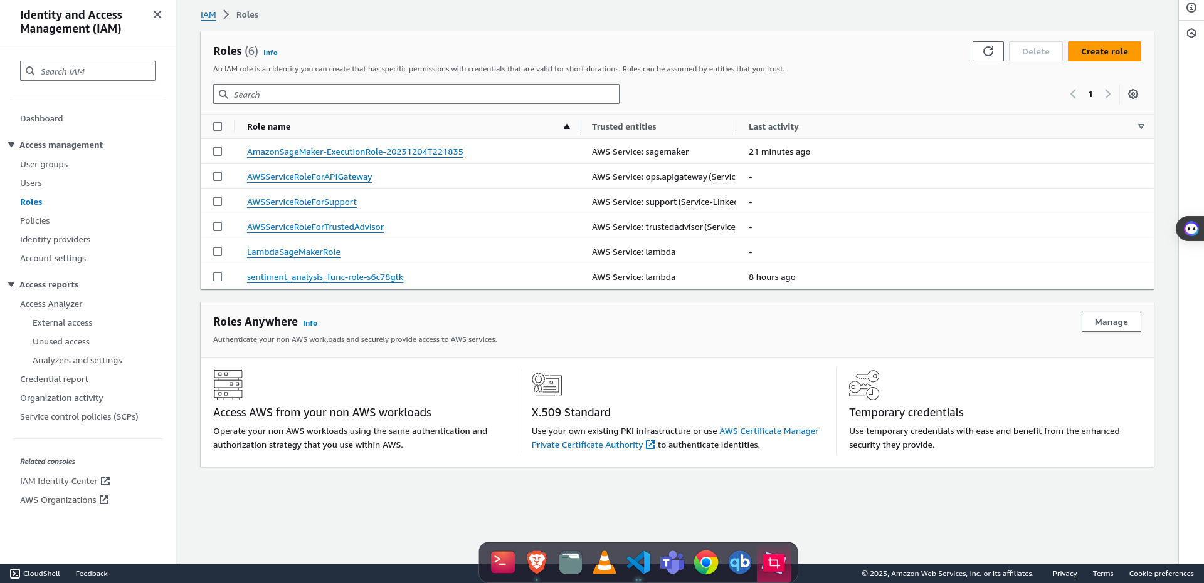
Aws IAM
AWS Identity and Access Management (IAM) is a web service provided by Amazon Web Services (AWS) that helps you securely control access to AWS resources. IAM enables you to create and manage AWS users and groups, assign policies to them, and control permissions to AWS resources.

Slide 19
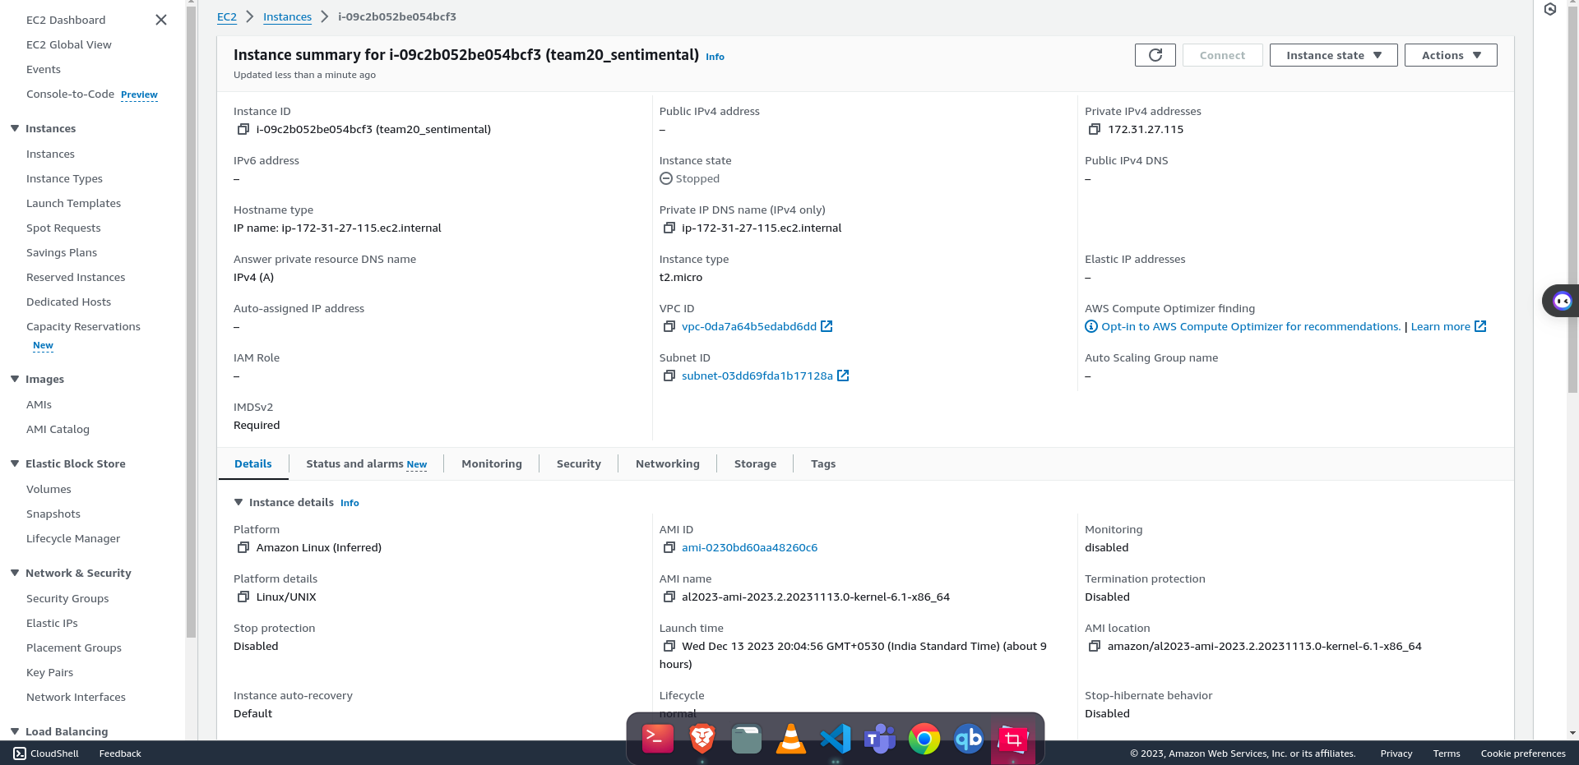
Aws EC2
Amazon Elastic Compute Cloud (Amazon EC2) is a web service provided by Amazon Web Services (AWS) that offers resizable compute capacity in the cloud. It allows users to run virtual servers, known as EC2 instances, which can be easily scaled up or down based on computing requirements.
Steps to create ec2 instance:

Slide 20
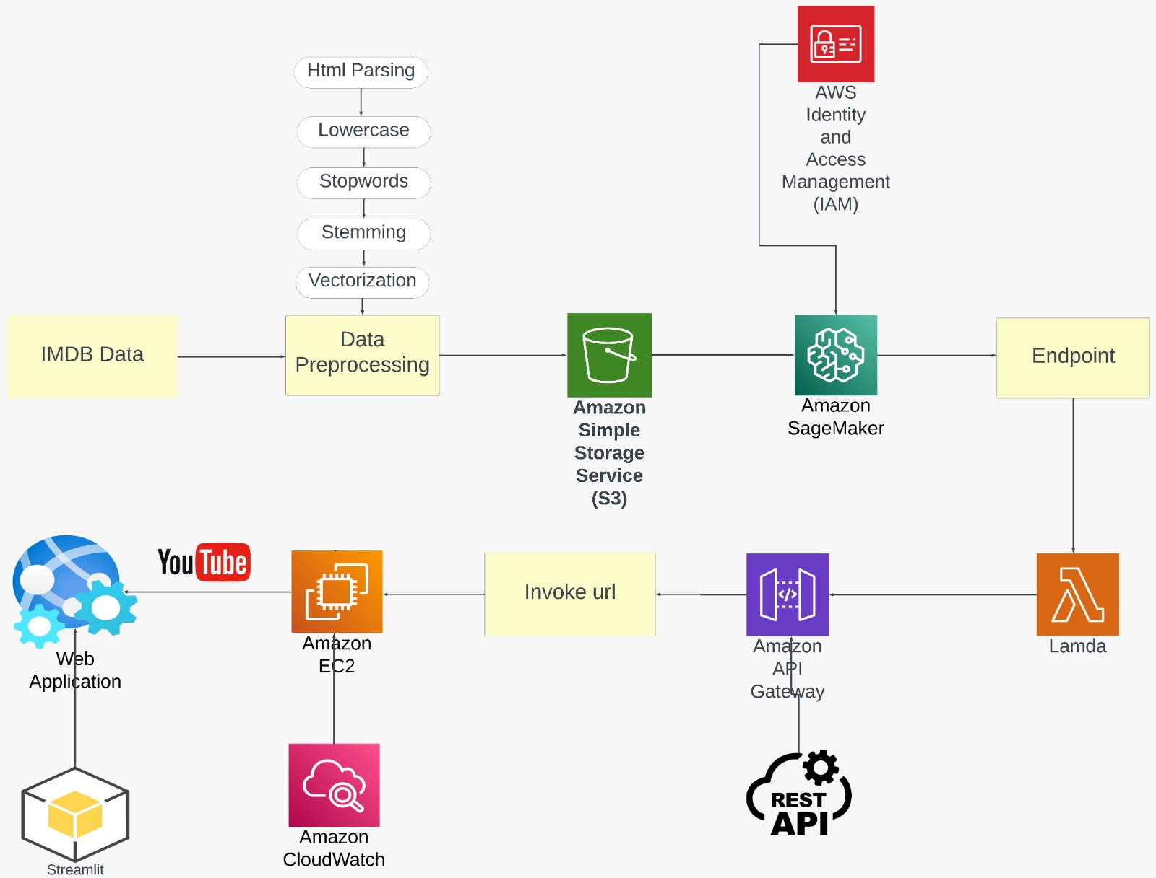
Implementation

Slide 21
Machine Learning Model
The Model is trained in AWS Sagemaker
The selected model architecture is LSTM, a recurrent neural network (RNN) known for its proficiency in capturing sequential dependencies within textual data
The aim is to balance accuracy, efficiency, and preventing overfitting.

Slide 22
Architecture and Hyperparameters
Embedding dimensions | 32
Hidden dimensions | 100
Dense layer | 1
Loss function | BCE loss
Optimizer | Adam
Learning rate | 0.001
Epochs | 20
Btach sixe | 50

Slide 23
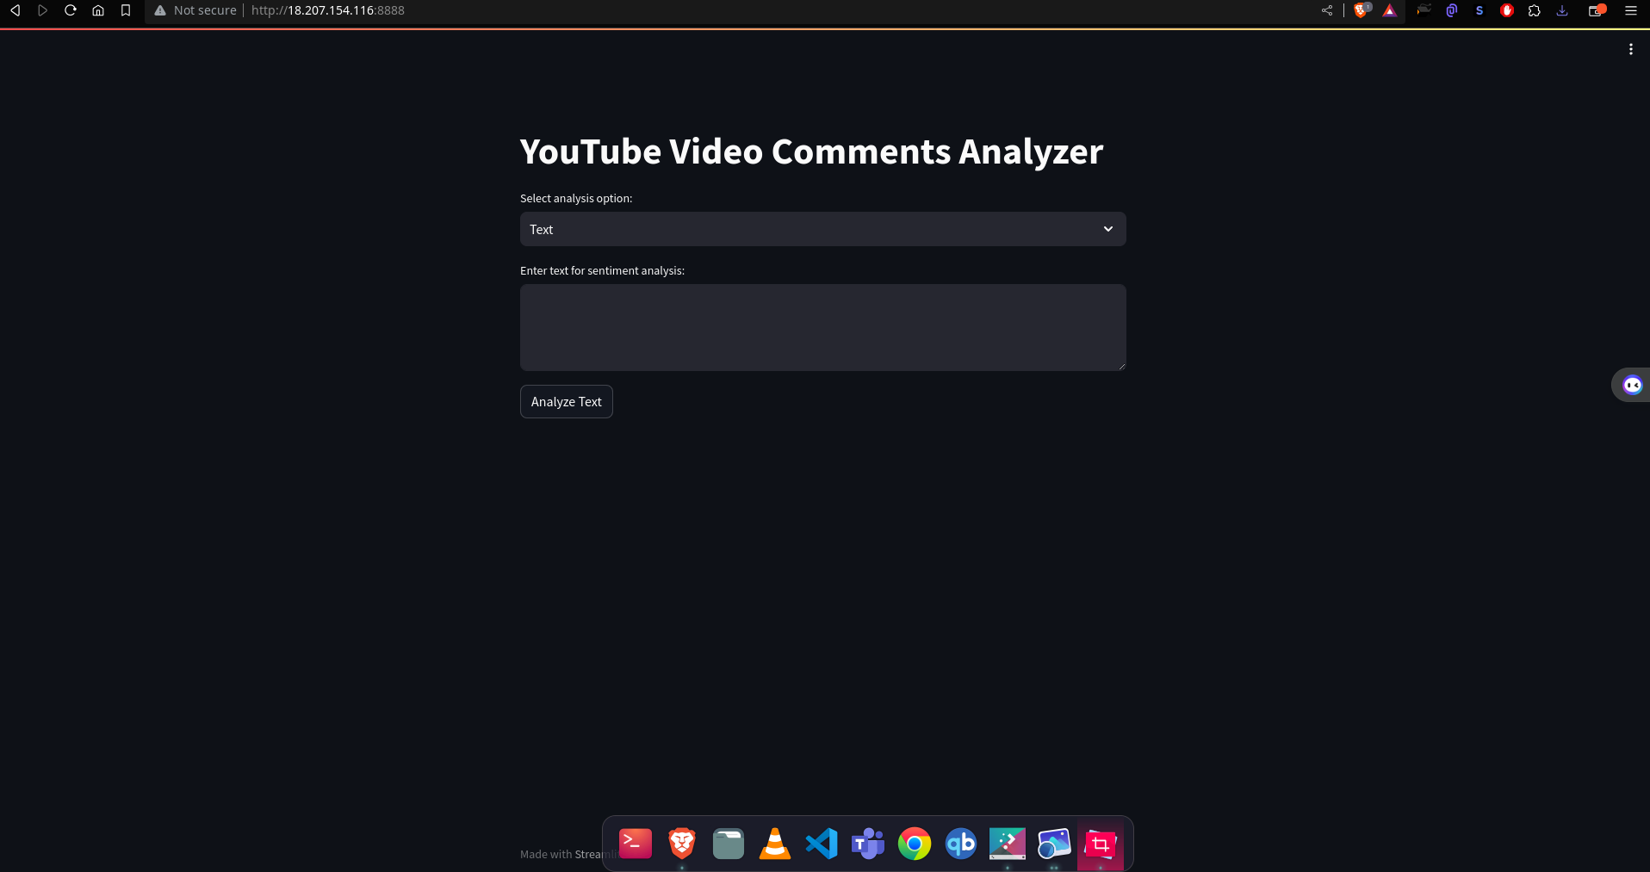
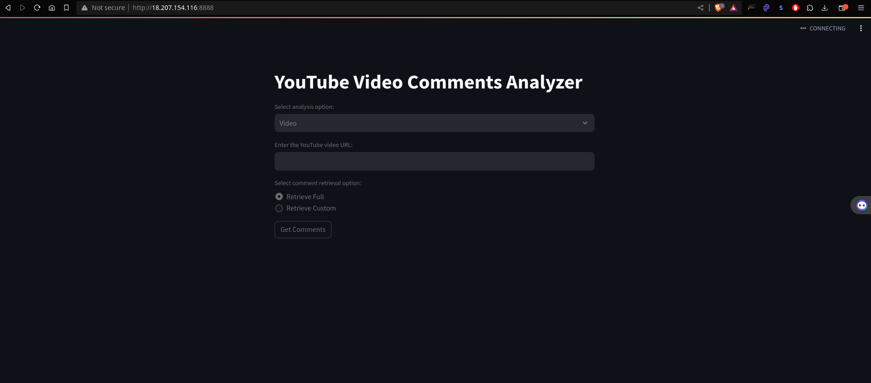
Results

Slide 24
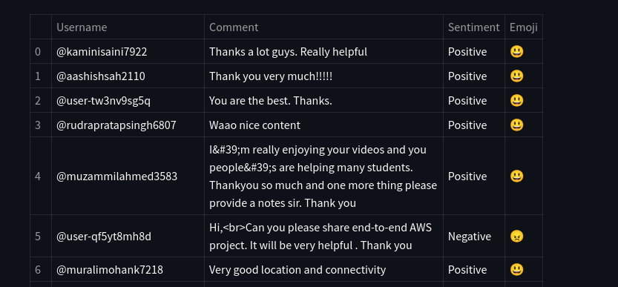
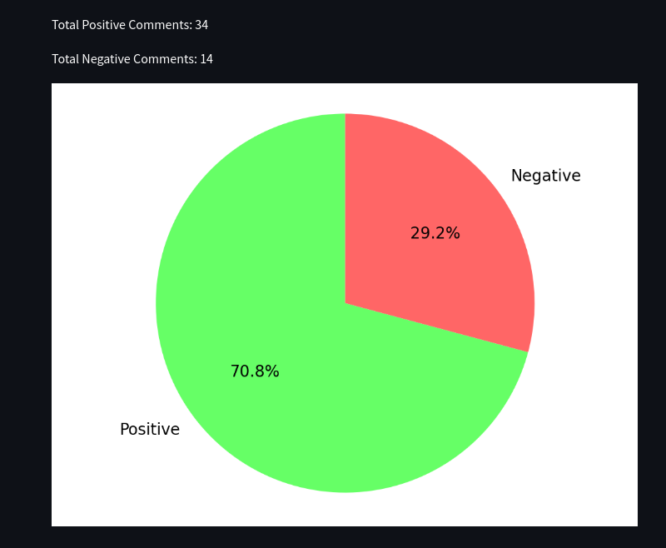
Results

Slide 25
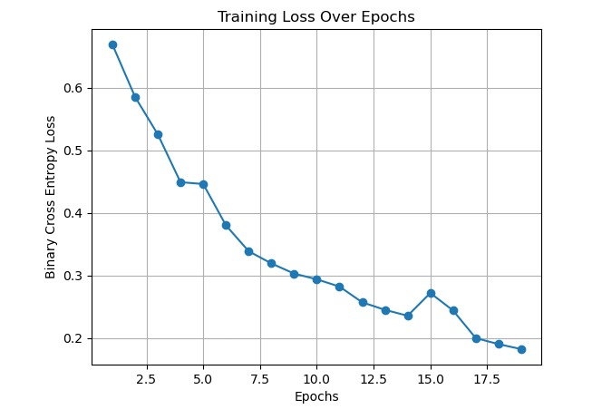
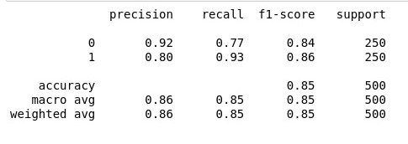
Results

Slide 26
Conclusion
We have successfully developed a sentimental model
Using LSTM and NLP techniques is built and trained using the IMDB dataset and deployed using Amazon web services (AWS).
85%accuracy persisted and detailed the model’s performance in categorizing comments as positive and negative.
Interactive dashboard is built using stream-lit.
Notes:
and detailed the model’s performance in categorizing comments as positive and negative. The interactive dashboard is built using stream-lit.

Slide 27
References
[1] Sentimental Analysis of YouTube Video Comments Using Bagging Ensemble Learning Approach. (2023).;02(04) doi: 10.55041/isjem00336
[2]I, Putu, Agus, Eka, Darma, Udayana., I., G., A., Indrawan., I, Putu, Denny, Indra, Putra. Decision Support System for Sentiment Analysis of Youtube Comments on Government Policies. Journal of Computer Networks, Architecture and High Performance Computing, (2023).;5(1):27-37. doi: 10.47709/cnahpc.v5i1.1999
[3]Dimaz, Cahya, Ardhi., Dwi, Puspita, Sari. Sentiment Analysis of YouTube Comments: Potential Indonesian Presidential Election Candidates. International Journal of Computer Applications Technology and Research, (2022).451-456. doi: 10.7753/ijcatr1112.1010
[4]Dhiaa, Musleh., Nasro, Min-Allah., Mamoun, Masoud, Abdulqader. Arabic Sentiment Analysis of YouTube Comments: NLP-Based Machine Learning Approaches for Content Evaluation. Big data and cognitive computing, (2023).;7(3):127-127. doi: 10.3390/bdcc7030127
[5]Siti, Khomsah. Sentiment Analysis On YouTube Comments Using Word2Vec and Random Forest. Telematika, (2021).;18(1):61-72. doi: 10.31315/TELEMATIKA.V18I1.4493
[6]Theodoros, G., Iliopoulos. (2023). A Cloud Based Sentiment Analysis through Logistic Regression in AWS Platform. Computer Systems: Science & Engineering, 45(1):857-868. doi: 10.32604/csse.2023.031
321
.

Slide 28


Thank You

