Slide 1
Mutual Fund Analytics Dashboard
Mutual Fund Analytics Dashboard
Using Python, SQLite, and Power BI
Bluestock Mutual Fund Capstone Project
Prepared By: Nandini | June 2026
Financial Growth Illustration
/Bluestock Logo Placeholder

Slide 2
Problem Statement & Objectives
Problem Statement
Mutual fund data is scattered across multiple sources.
Raw financial data is difficult to interpret directly.
Investors lack a unified platform for analysis.
Identifying fund performance and risk is time-consuming.
Understanding investor behavior requires advanced analytics.
There is a need for interactive dashboards for better decision-making.
Data-driven insights can support smarter investment choices.
Objectives
Collect and integrate mutual fund datasets.
Clean and transform raw financial data.
Design a SQLite database for efficient storage.
Perform exploratory data analysis (EDA).
Evaluate fund performance using risk-return metrics.
Analyze investor behavior and market trends.
Develop an interactive Power BI dashboard.
Generate insights to support investment decisions.

Slide 3
Data Sources
1. Fund Master
6. Monthly SIP Inflows
2. NAV History
7. Category-wise Inflows
3. Scheme Performance
8. Industry Folio Count
4. Investor Transactions
9. Portfolio Holdings
5. AUM by Fund House
10. Benchmark Indices
Total: 10 Datasets

Slide 4





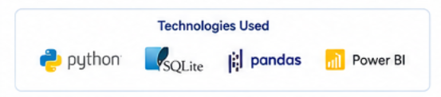
System Architecture
Raw CSV
Python ETL
SQLite
EDA
Power BI

Slide 5
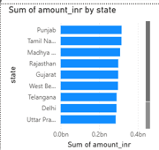
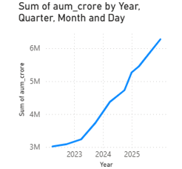
EDA Highlights Part 1
NAV Trend
AUM Growth
SIP Inflow Trend

Slide 6
EDA Highlights Part 2
Age Groups
City Tier
Folio Growth

Slide 7

Performance Metrics
CAGR
Description
Measures the annualized growth rate of an investment over a specific period.
Sharpe
Description
Evaluates risk-adjusted returns by comparing excess return to total risk.
Sortino
Description
Measures returns relative to downside risk, focusing only on negative volatility.
Alpha
Description
Indicates the excess return generated by a fund compared to its benchmark.
Beta
Description
Measures a fund's sensitivity to market movements and systematic risk.

Slide 8
Advanced Analytics
VaR & CVaR
Rolling Sharpe
Cohort
SIP Continuity
Recommender

Slide 9
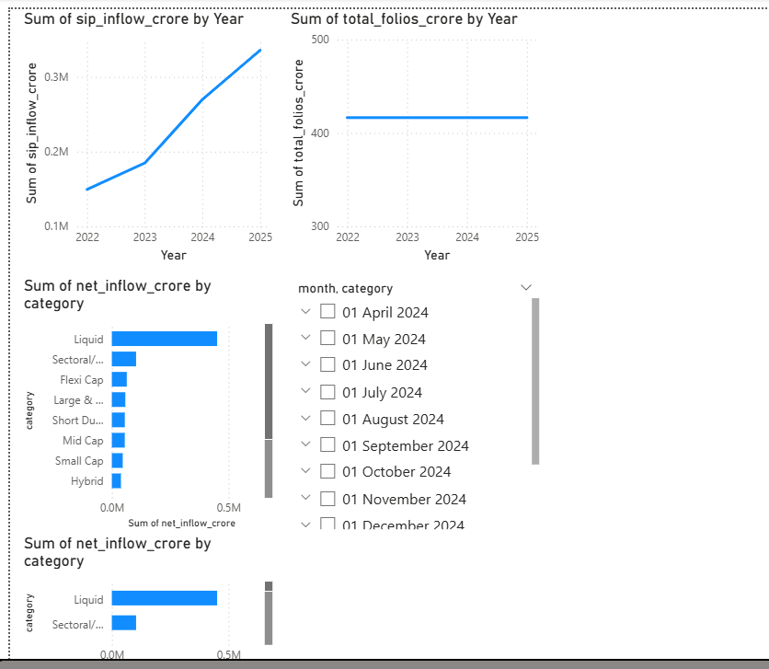
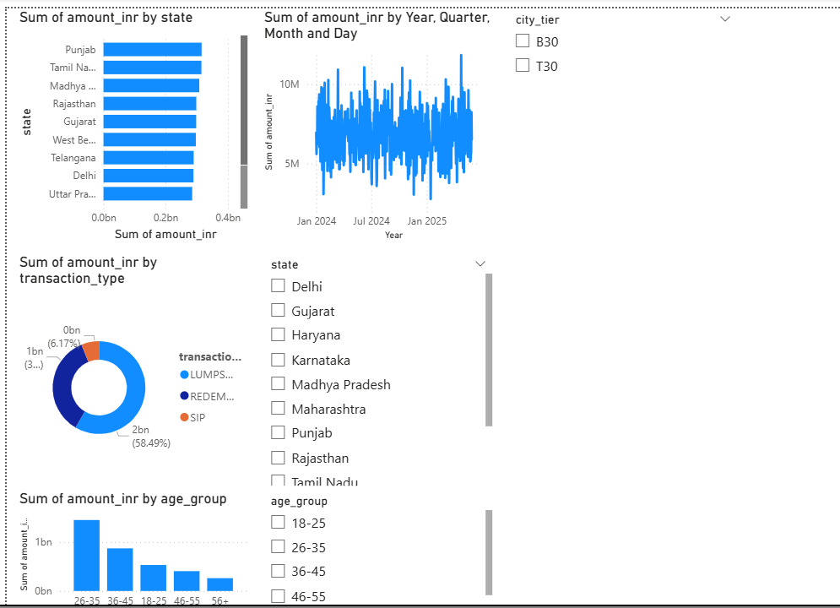
Dashboard Screenshots
Fig4: Investor Analytics
Fig 3: SIP Market Trends
Dashboard 1
Dashboard 2

Slide 10
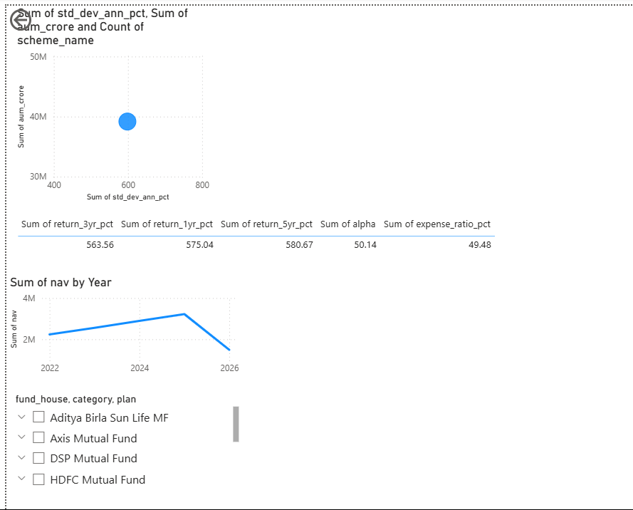
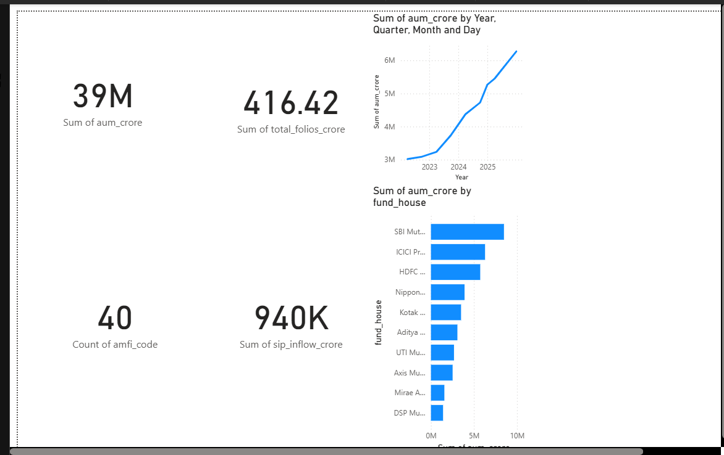
Dashboard Screenshots
Fig 2:Industry Overview
Fig 1:Fund Performance
Dashboard 2

Slide 11

Key Findings
📈 SIP inflows increased significantly from 2022–2025, indicating growing investor participation.
💰Equity-oriented mutual funds attracted the highest net inflows among all categories.
👥 Investors aged 26–35 years were the most active contributors.
🏙️ T30 cities generated a larger share of investments compared to B30 cities.
⭐ Funds with higher Sharpe Ratios delivered better risk-adjusted returns.
📊 Industry AUM and folio counts showed strong and consistent growth over the study period.
Insight Illustration

Slide 12
Thank You
Thank You!
Prepared By: Nandini
Email: nandinisingh3563@gmail.com.com

