Slide 1
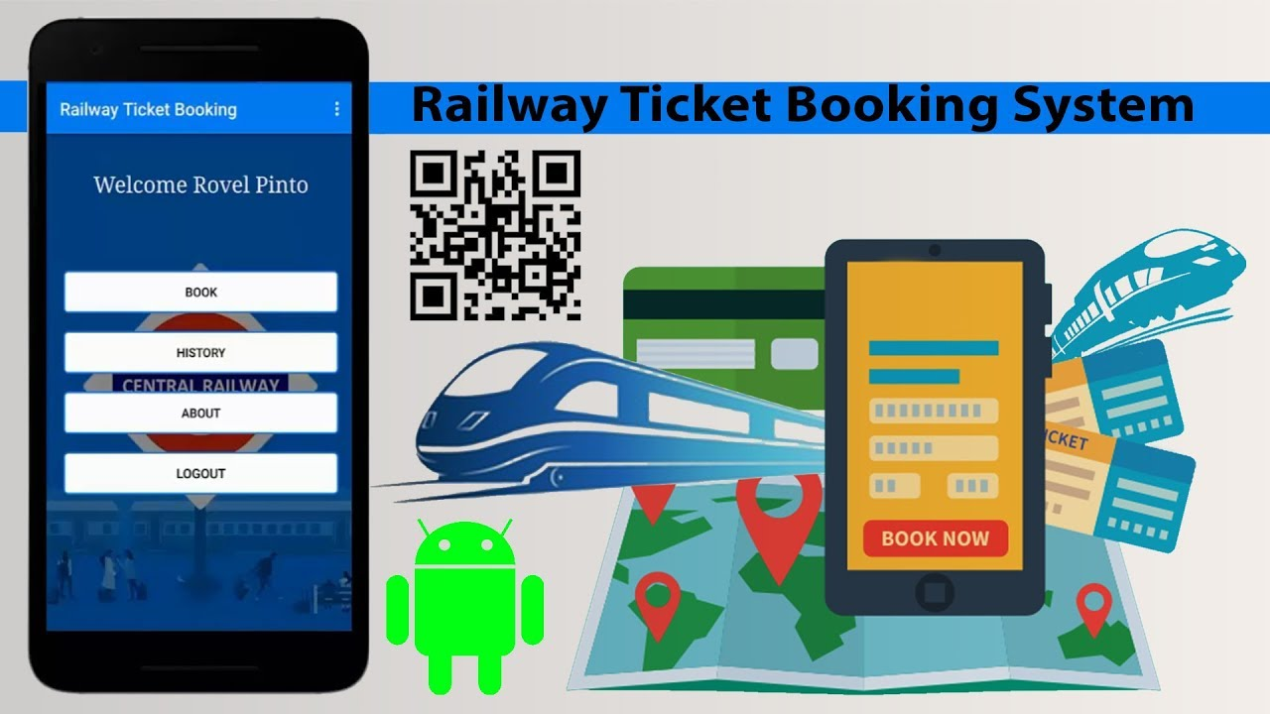
Online Reservation system Using Qrcode

Slide 2
Description:
This project deals with the development and implementation of web application . Which is more effective and simple than current ticket booking system.The “Railway Ticket Booking System Using Qrcode” can brought easily anytime anywhere the ticket will be present in the customers phone in the form of Qrcode.Based on this Qrcode admins can add details about aadhar and personal information of customer’s that will generated a details as a Qrcode format and also the customers can easily download that Qrcode in their smartphones .When Tc’s can check easily during the journey.And journey details should easily made in that Smartphone.Based on the Qrcode the TC’s can scan the tickets throught their related devices..

Slide 3
Requirements:
Tools:
VScode
Vscode Insiders
Github

Slide 4
Technologies:
Frontend:
HTML
CSS
BOOTSTRAP
Backend:
Python
Django
Frameworks

Slide 5
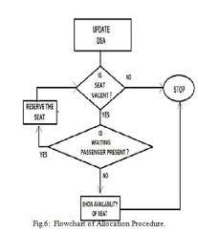
Architecture:

Slide 6
Benefits:
Revenue Of railway is increased.
Procurement of tickets by touts is eliminated
It Attempts to reserve each and every seat even vacant for one station to next station.
It maintains the transparency in berth allocation and makes the ticket checking process fast.
Great burden reduced to Tc’s.
Easy to maintain and highly securable Database.

