Slide 1

UE19CS204 – Web Technologies Mini Project
Project Title-
Cruise reservation website

Slide 2
Team Members Names SRN
Likhitha D PES2UG19CS202
Nandini N PES2UG19CS248
Naveen S PES2UG19CS249
https://github.com/Nandini-23/Cruise_reservation_website.git

Slide 3
Abstract
Introduction :
The main objective of the project is to create website of booking cruise tickets and making available online ,so customer can book cruise ticket at his or her place .
In this website , user can login or signup with their credentials to view cruises or to reserve their tickets .
Only admin users can update or add the information about the cruises , it is restricted to users .
Cruise store has been created to view different types of cruises
Category wise cruises page has been created to view cruises based on the category.

Slide 4
Modules
The project contains the following modules
1.Admin Signup
2. Admin signin
3.User signup
4.User signin
5.Adding cruises
6.Cruise info
7.Adding different types of cruises
8.Ticket booking
9.logout

Slide 5
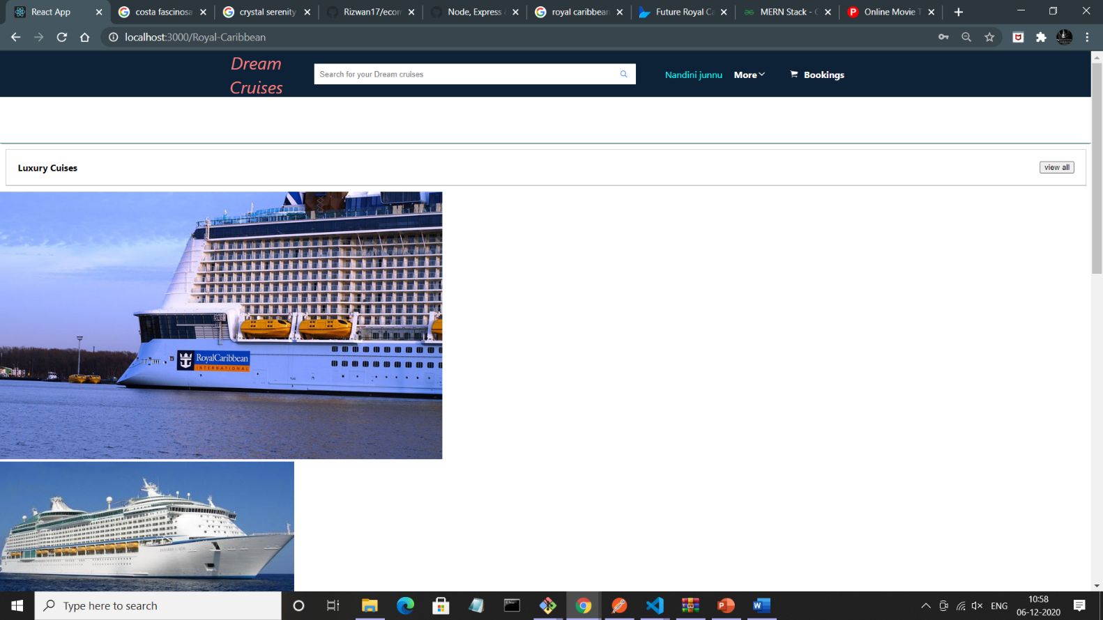
Cruises collection

Slide 6
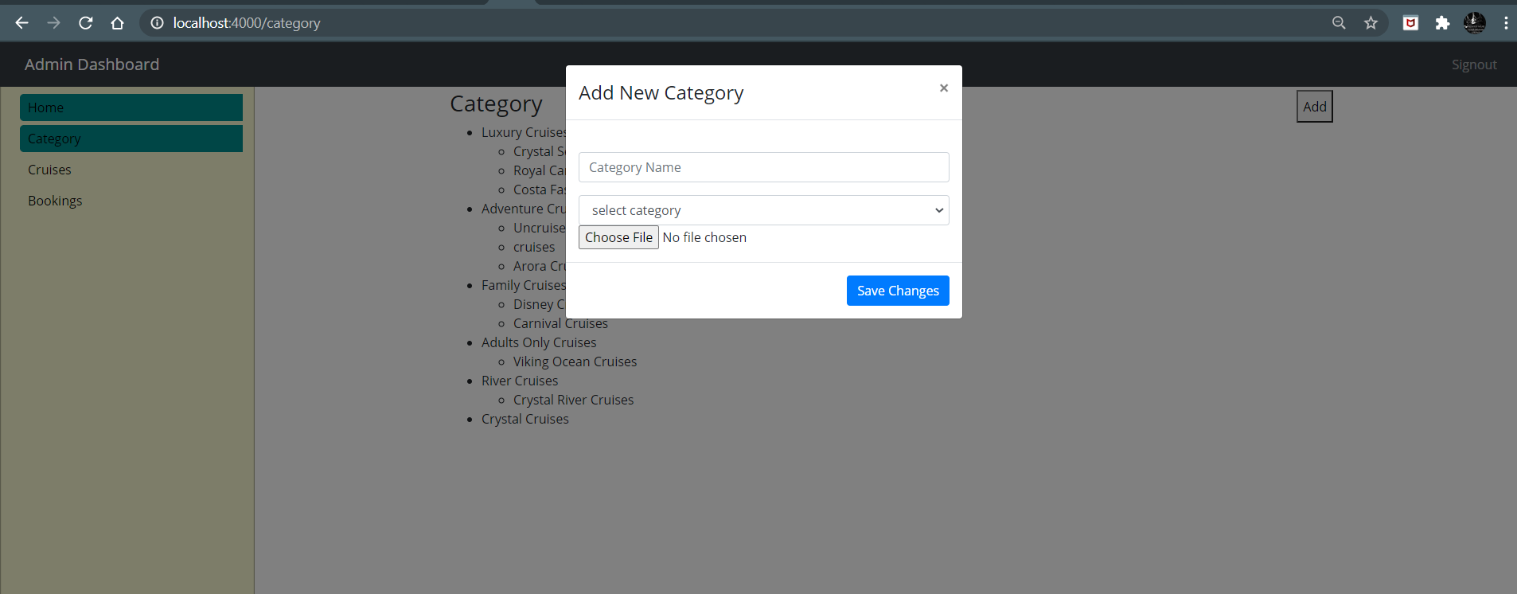
Add new category of cruses

Slide 7
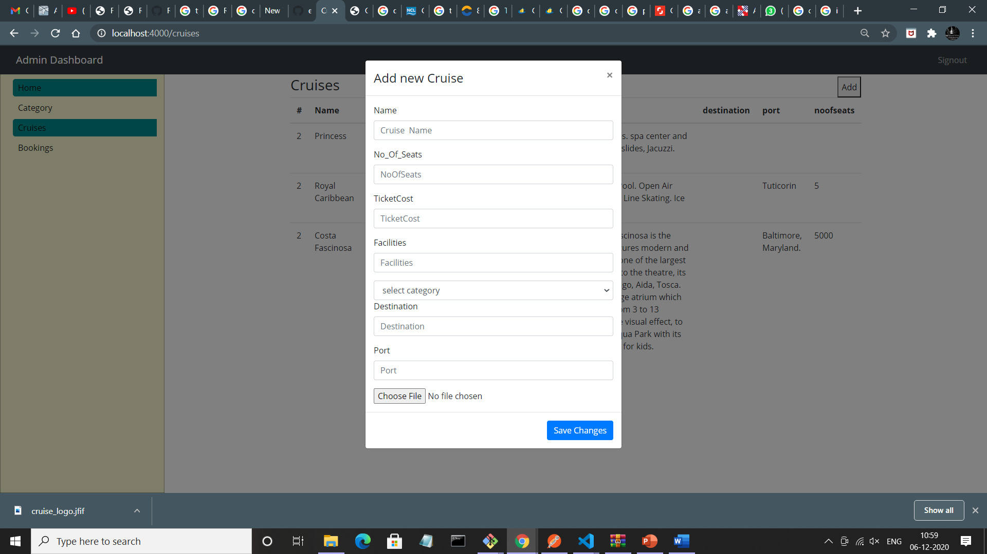
Adding new cruise

Slide 8
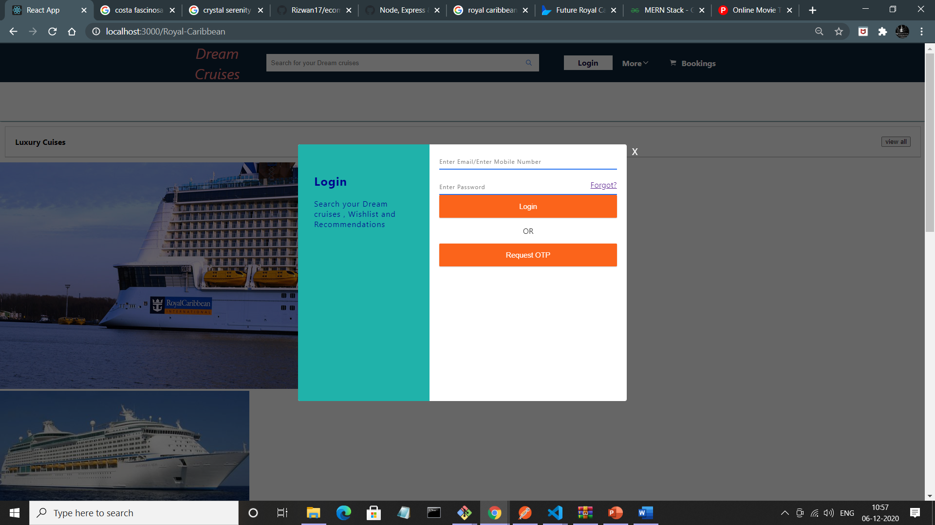

Slide 9
Member Contributions
Frontend : Cruises information , login page , category of cruises ,
booking tickets -> Nandini N
Backend : User Information , cruise information , categories
Likhitha D
Backend : Signin , signup user information , ticket booking information
Naveen S

