Slide 1

Title of the Idea: AI-Based Video Fact Checker
Name of the Students : B. Nandini
B. Harini
B. Rohini
Roll Numbers : 24RH5A0508
23RH1A0594
23RH1A0580
Branch & Year : CSE IV Year & I Semester
Batch Number : 12

Slide 2
CONTENTS
INTRODUCTION
EXISTING SYSTEM
PROPOSED SYSTEM
FEATURES ADDED
TECHNOLOGIES USED
ADVANTAGES OF PROPOSED SYSTEM
MODULES USED
SYSTEM ARCHITECTURE
IMPLEMENTATION
TESTING AND VALIDATION
OUTPUT AND CONCLUSION
REFERENCES

Slide 3
INTRODUCTION
Social media platforms contain a large amount of video-based information, but some videos may contain misleading or false information.
Manually verifying the information in a video is time-consuming and requires checking multiple reliable sources.
The proposed system automatically converts video speech into a complete transcript and extracts the important information from it.
It then searches for related news about the overall video information and provides authenticity, risk, deepfake analysis, and a PDF verification report.

Slide 4
EXISTING SYSTEM
Manual Verification
Users must watch the video, identify important information, and manually verify it using different sources.
2. Text-Based Fact Checking
Many existing systems mainly analyze text-based claims rather than directly processing complete video content.
3. Multiple Verification Sources
Users often need to search different websites and news platforms separately to determine whether the information is reliable.
4. Limited Video Analysis
Existing solutions may not combine transcription, information extraction, news verification, and deepfake detection in a single system.
5. Lack of Integrated Reports
Many systems do not provide a single structured PDF report containing the transcript, highlights, supporting articles, and analysis results.

Slide 5
PROPOSED SYSTEM
The proposed system is an AI-based Video Fact Checker that automatically analyzes uploaded videos and verifies the information presented in them. The system extracts audio from the video and uses Whisper to generate a complete transcript. NLP techniques are then used to identify the important information or highlights from the transcript. Based on the overall information in the video, the system searches for related news articles from external sources. It also provides authenticity and risk analysis, supports deepfake detection, generates a PDF verification report, and stores the analysis results in an SQLite database for future reference.

Slide 6
FEATURES ADDED
Video Upload & Preview
Complete Speech-to-Text Transcript
Important Information Highlights
Overall Video-Related News Search
Authenticity & Risk Analysis
Deepfake Detection
PDF Report Generation
SQLite Database Storage

Slide 7
TECHNOLOGIES USED
Software Requirements :
Programming Language & Libraries:
Python
Flask – Backend API
React & Vite – Frontend development
Whisper – Speech-to-text transcription
spaCy – NLP and information extraction
MoviePy – Audio extraction
OpenCV – Video and deepfake analysis
Axios – API communication
ReportLab – PDF report generation
AI Tools:
OpenAI Whisper – Automatic speech recognition
NLP Models – Information/highlight extraction
Deepfake Detection Model – Video manipulation analysis

Slide 8
TECHNOLOGIES USED
Hardware Requirements:
Processor:
Intel Core i5 or equivalent processor
2.0 GHz or higher
RAM:
Minimum 8 GB
Recommended 16 GB for AI/video processing
Storage:
Minimum 10 GB free space
SSD recommended for faster processing
Graphics:
Integrated graphics supported
Dedicated GPU recommended for faster deepfake/AI processing

Slide 9
ADVANTAGES
OF PROPOSED SYSTEM
Automated Video Verification
Accurate Transcript Generation
Important Information Extraction
Related News Search
Deepfake Detection
Risk Assessment
PDF Report Generation
Database Storage
Easy-to-Use Interface

Slide 10
MODULES USED
Video Upload Module
Audio Extraction Module
Speech-to-Text Module
Information Highlight Module
Related News Search Module
Authenticity & Risk Analysis Module
Deepfake Detection Module
PDF Report Module
Database Management Module

Slide 11
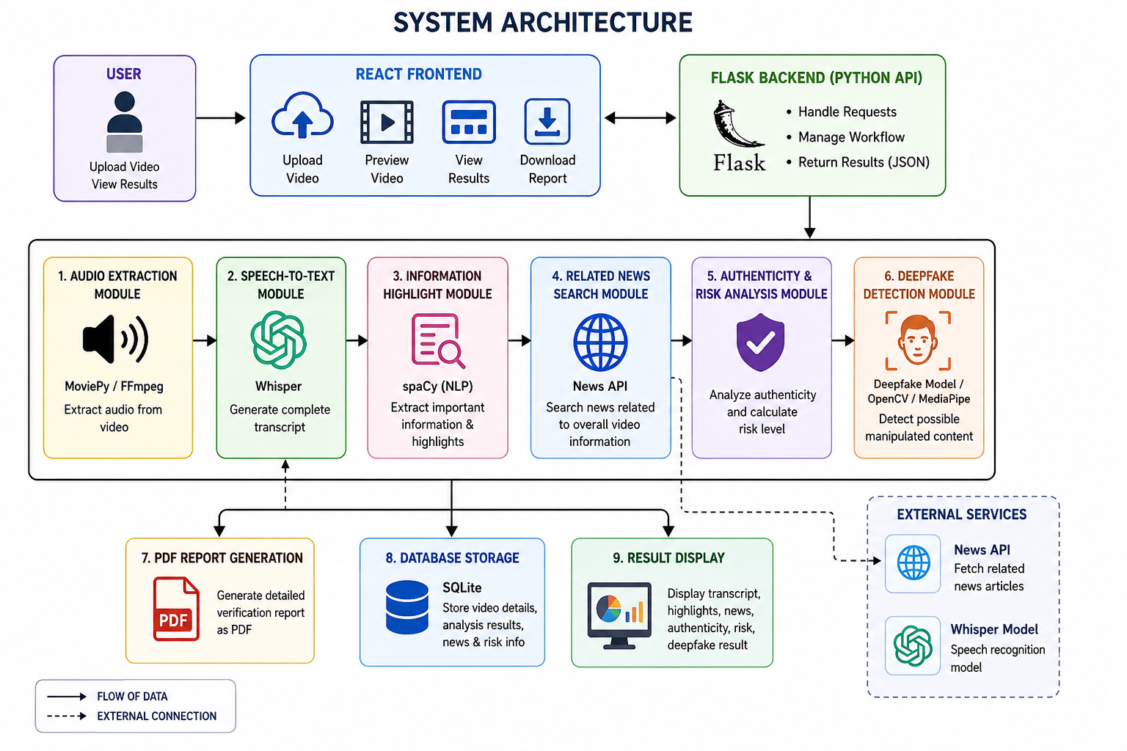
SYSTEM ARCHITECTURE

Slide 12
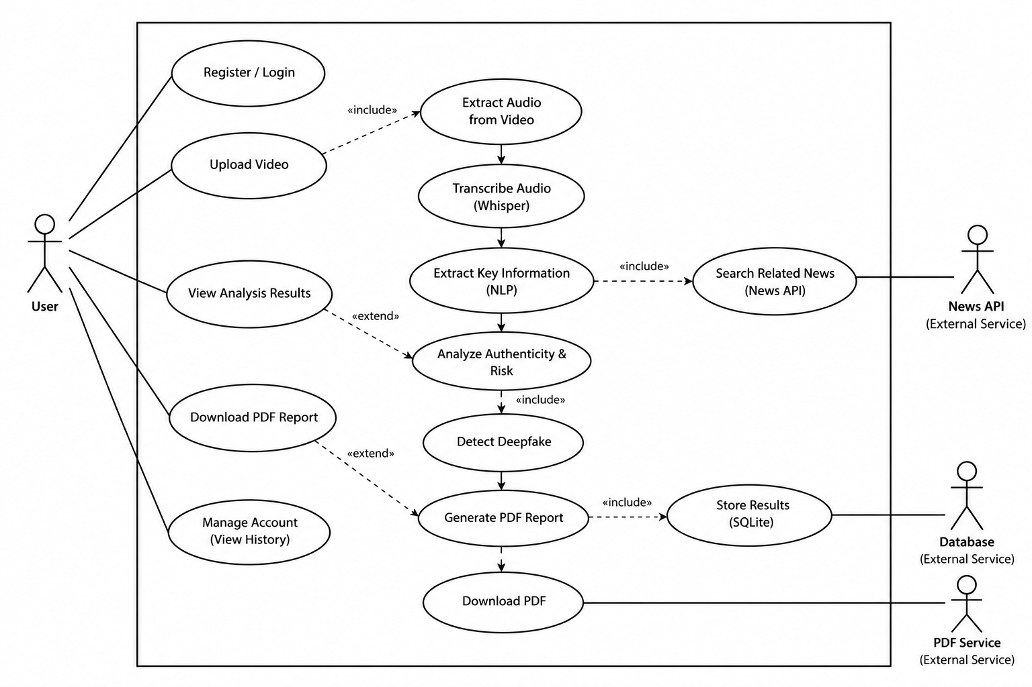
USE CASE DIAGRAM

Slide 13
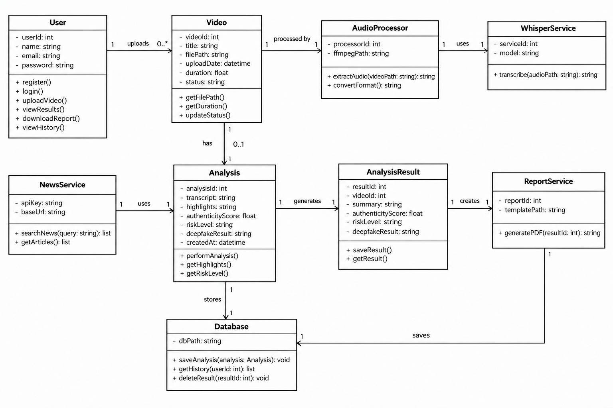
CLASS DIAGRAM

Slide 14
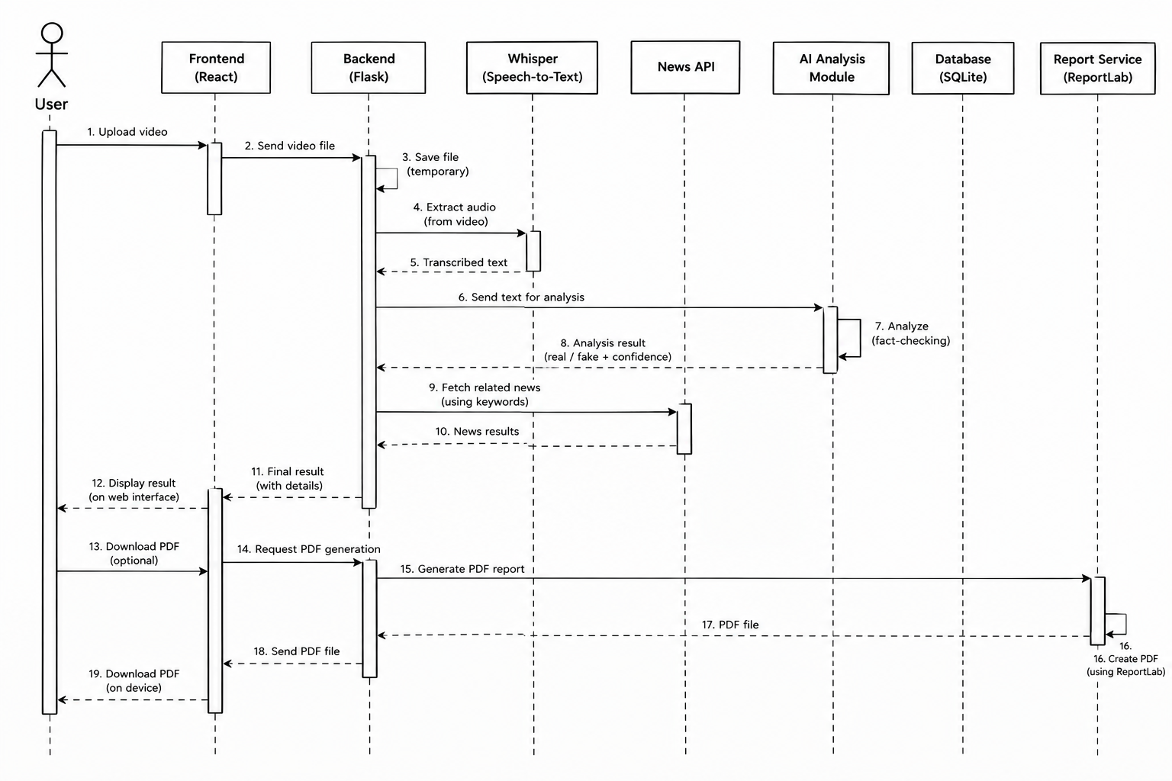
SEQUENCE DIAGRAM

Slide 15
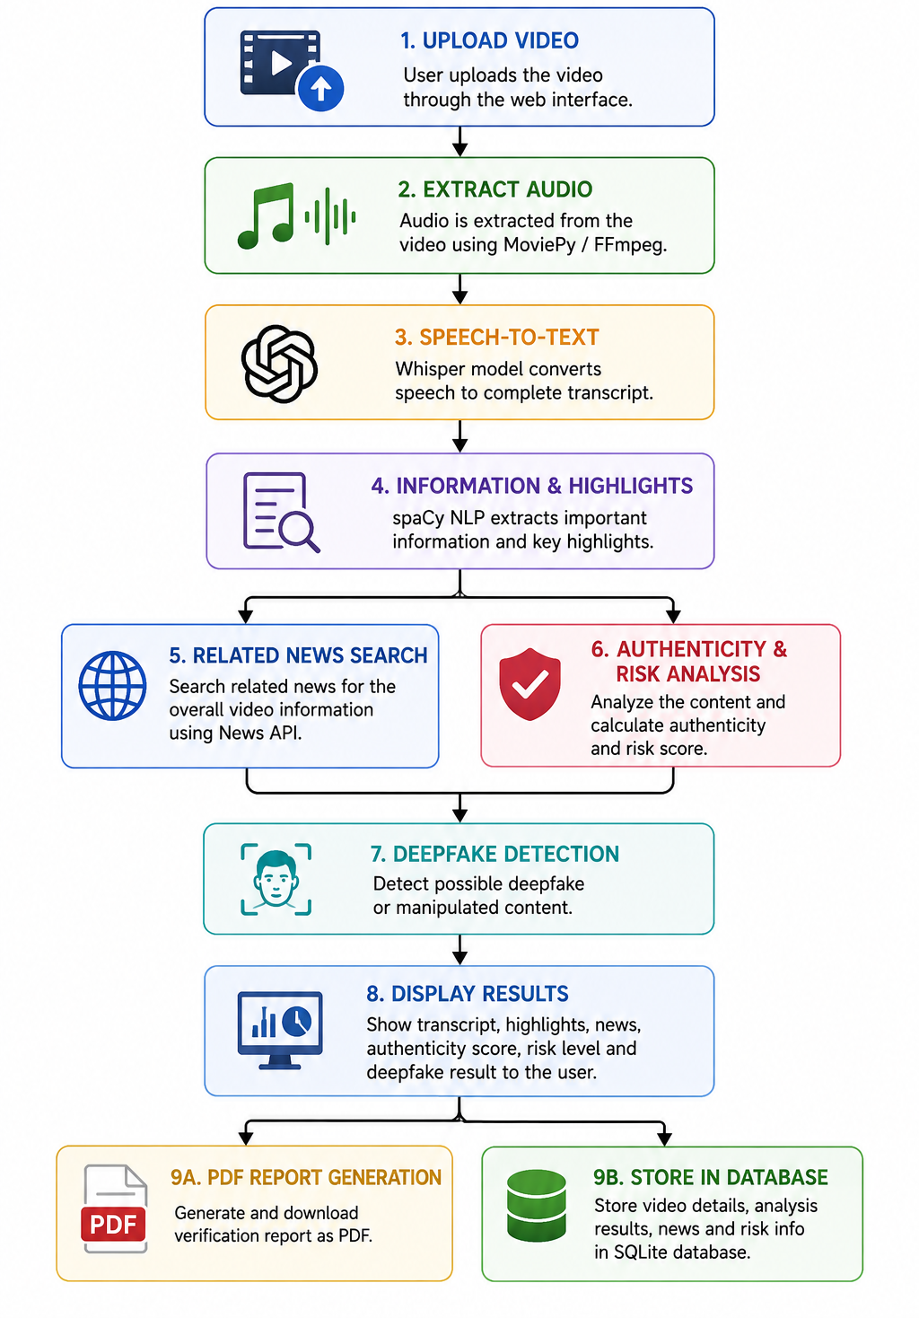
IMPLEMENTATION

Slide 16
TESTING AND VALIDATION
Video Upload: Valid and invalid video testing.
Transcription: Check audio-to-text accuracy.
Claim Extraction: Verify extracted claims.
News Verification: Cross-check claims with news sources.
Result Testing: Check Real/Fake/Unverified output.
Error Testing: Test API, network, and file errors.
Database Validation: Cross-check stored results and logs.
User Feedback: Evaluate accuracy and usability.

Slide 17
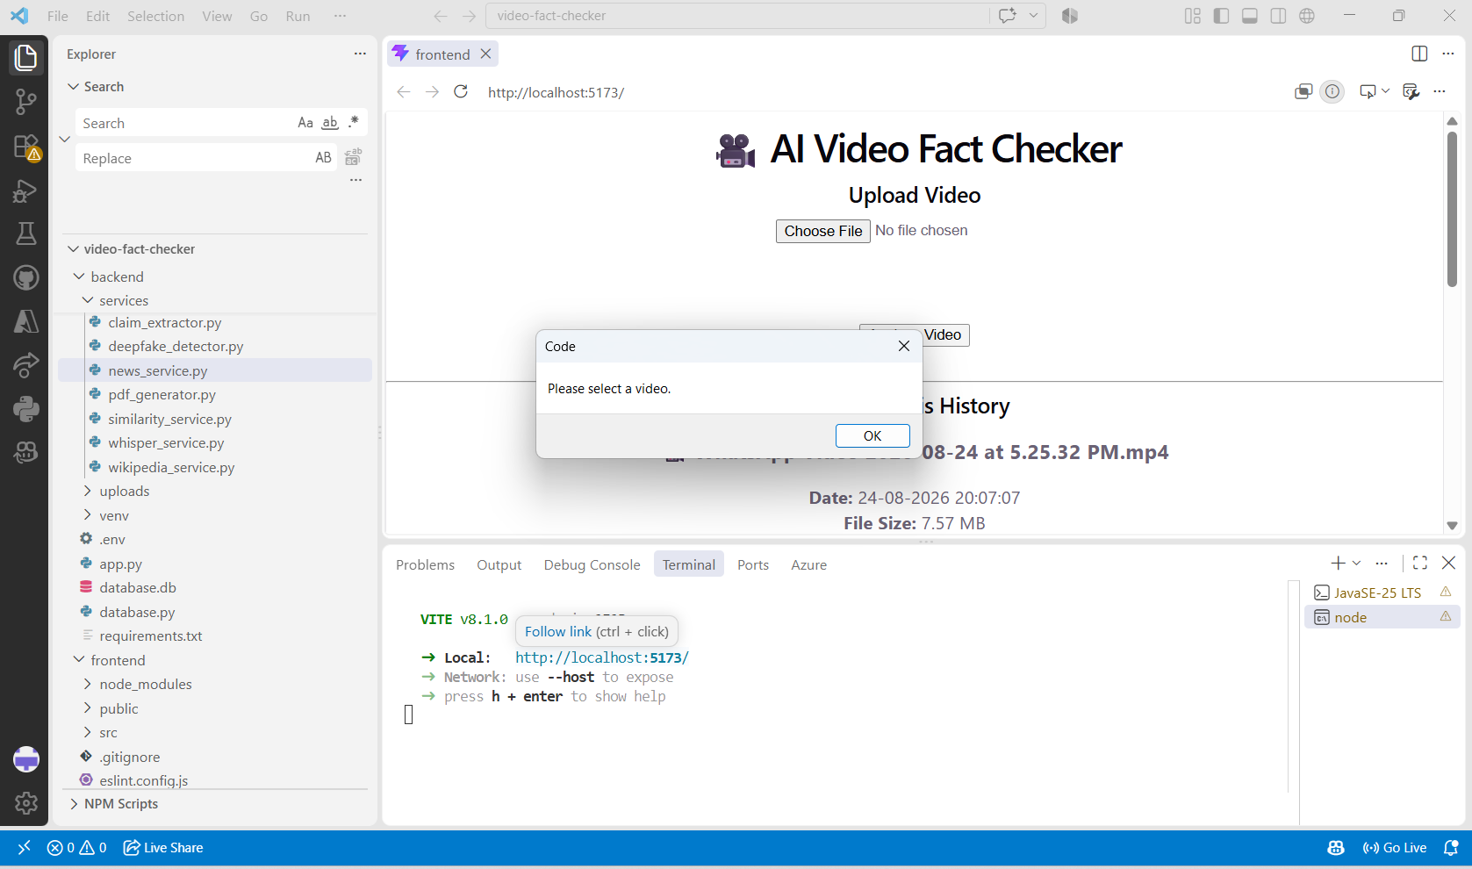
TESTING

Slide 18
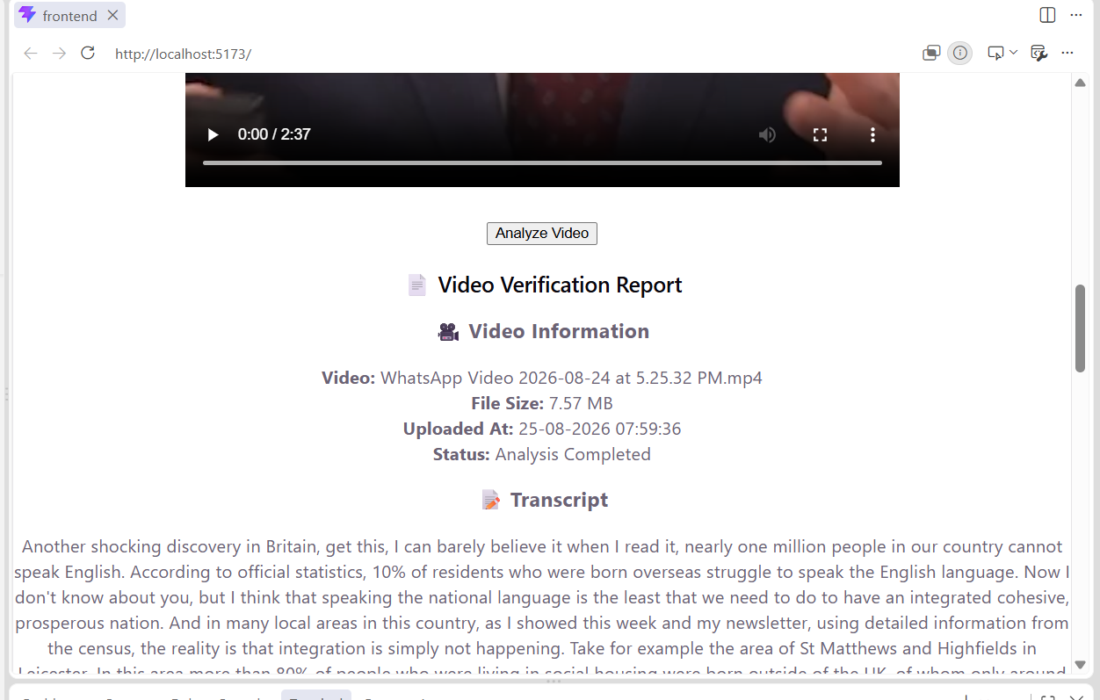
VALIDATION

Slide 19
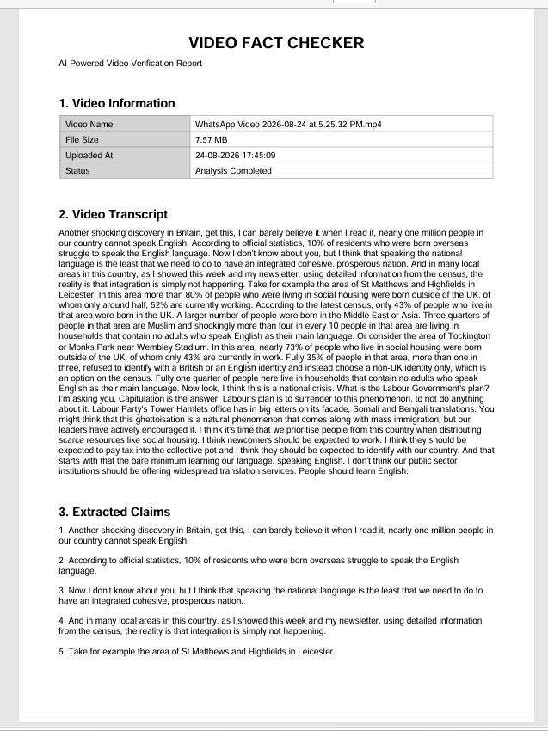
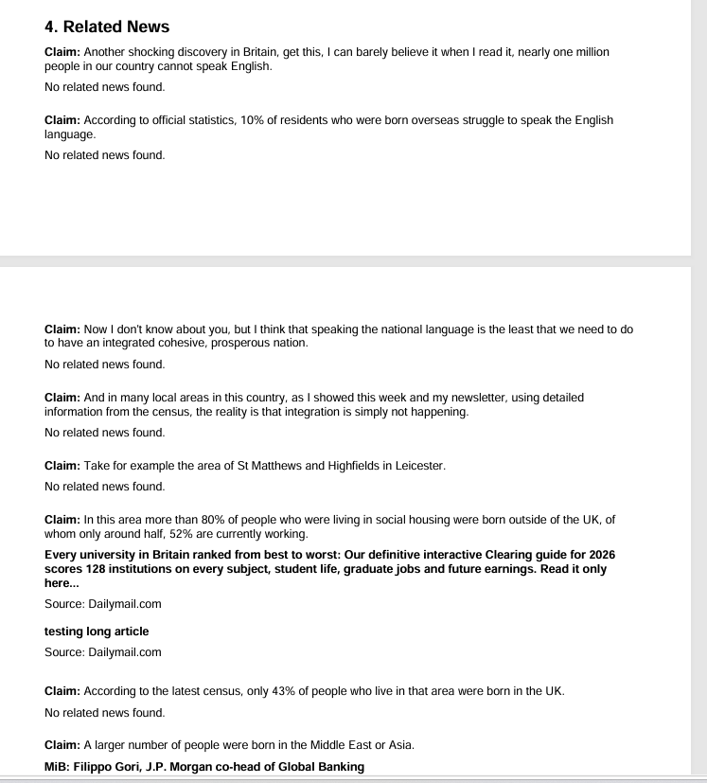
OUTPUT

Slide 20
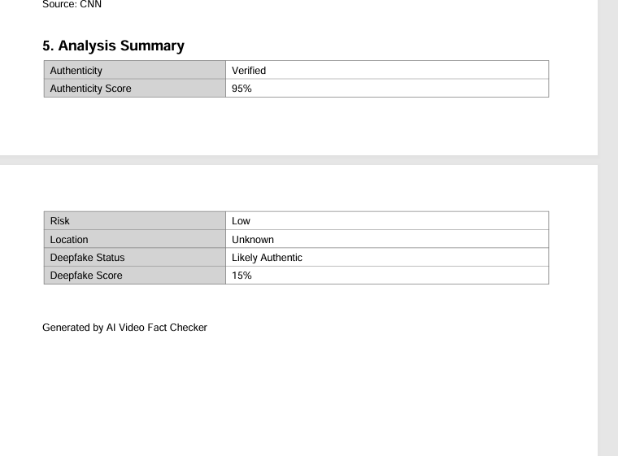
OUTPUT

Slide 21
CONCLUSION
The extension of the attendance system with email notification enhances the overall efficiency and transparency of real-time attendance monitoring. By automatically sending email alerts upon successful face recognition, the system ensures instant communication with concerned individuals or authorities. The integration of email notifications into the face recognition-based attendance system significantly improves communication and transparency. Each time attendance is recorded, an automatic email is sent to the respective individual or authority, ensuring immediate awareness and reducing the need for manual updates. This real-time notification feature enhances reliability, supports timely action, and adds an extra layer of accountability to the attendance process.

Slide 22
REFERENCES
OpenAI Whisper - Speech Recognition
OpenAI Whisper - Used for converting video audio into text.
News API Documentation
News API Documentation - Used to search and retrieve news articles for claim verification.
Google Gemini API
Gemini API Documentation - Used for AI-based text analysis and claim processing.
Whisper Research Paper
Robust Speech Recognition via Large-Scale Weak Supervision - Reference for the speech recognition technology used in the system.
News API – Everything Endpoint
News API Everything Endpoint - Used for searching relevant articles based on extracted claims.

Slide 23
THANK YOU

