Slide 1


Electric Vehicle (EV) Adoption Forecast
Presented by:Nandini.Banothu
nandunandini4034@edunet.com
nandunandini4034@gmail.com

Slide 2

Learning Objectives:
Understand data preprocessing techniques and feature engineering for time series data.
Apply machine learning models to forecast electric vehicle adoption
Develop a user-friendly web application using Streamlit
Visualize and compare forecasted trends across multiple counties.
Interpret forecast results and evaluate model performance over time.
GOAL
Source :
www.freepik.com/

Slide 3
Tools and Technology used:
Libraries:
Pandas, numpy – Data manipulation
scikit-learn, statsmodels – Machine learning and statistical modelling
matplotlib – Visualization
streamlit – Interactive web app
joblib – Model loading
Others:
Jupyter Notebook (EV_Adoption_Forecasting.ipynb) for development
forecasting_ev_model.pkl – Pretrained model
preprocessed_ev_data.csv – Final cleaned datase

Slide 4
Methodology:
Data Collection & Preprocessing:
Gather historical EV registration data by county.
Clean and transform into a time-series format.
Feature engineering using lag values, moving averages, percentage changes, and slope of growth.
Model Training & Forecasting:
Trained a regression model (likely linear or tree-based) using historical trends.
Created features to capture trend momentum and cyclical patterns.
Deployment:
Built a Streamlit dashboard (app.py) for county selection and interactive forecasting.
Visualized cumulative EV adoption trends (historical + 3-year forecast).
Evaluation:
Forecasted growth percentages calculated for insight.
Compared adoption trends across multiple counties.

Slide 5
Problem Statement:
Despite increasing electric vehicle (EV) adoption, localized forecasting data is unavailable to aid decision-making for infrastructure planning, policymaking, and industry growth.

Slide 6
Solution:
Develop an AI-powered forecasting model that predicts EV adoption trends for counties in Washington State. The interactive Streamlit dashboard provides:
County-level forecasts for 3 years.
Graphs showing cumulative EV adoption.
Comparative analysis for up to 3 counties.
GitHub:https://github.com/Nandini-Banothu1114/EV_Vehicle_Demand_prediction.git
Aicte ID: nandunandini4034@edunet.com
Student ID: nandunandini4034@gmail.com

Slide 7
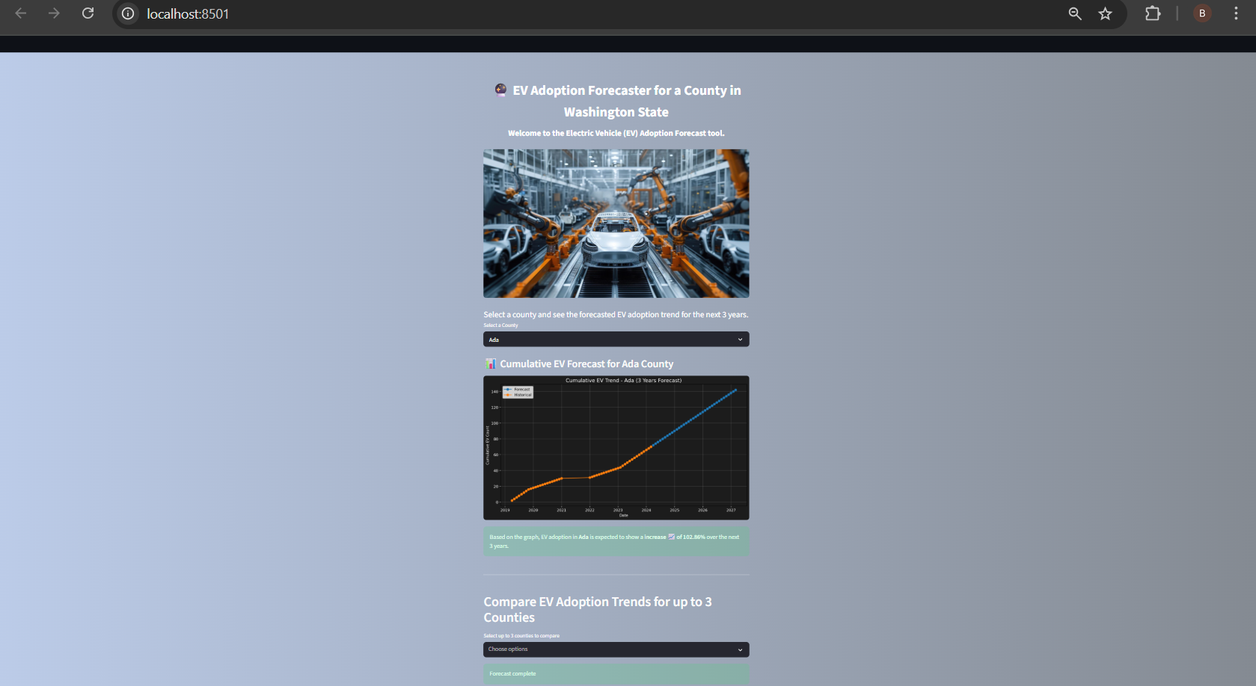
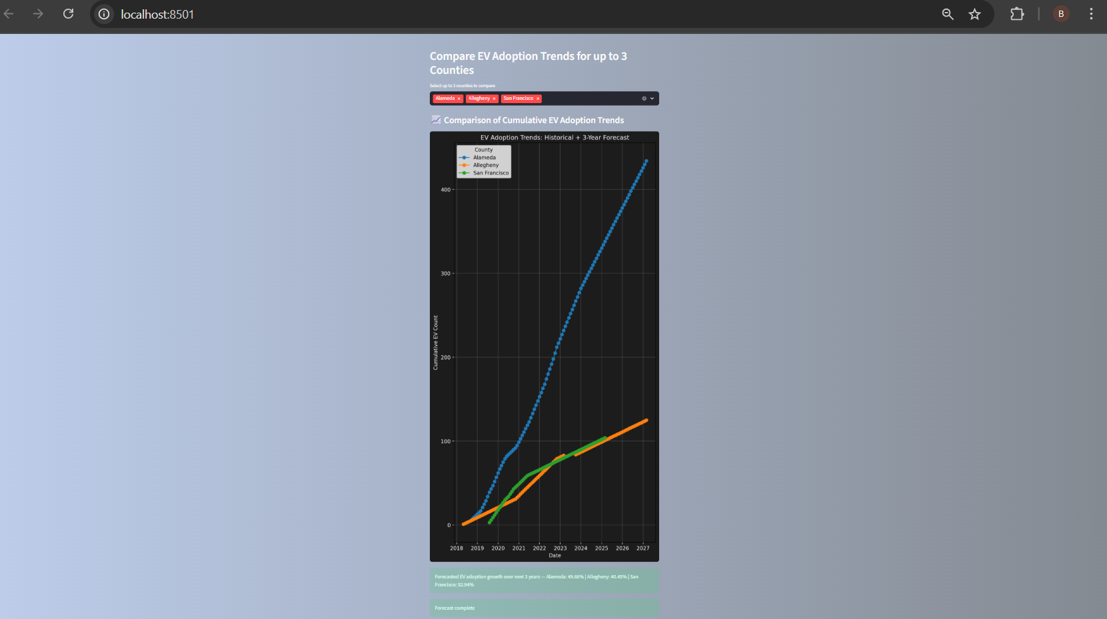
Screenshot of Output:

Slide 8
Conclusion:
The project successfully demonstrates the use of machine learning to forecast EV adoption trends at a county level. This tool can support environmental planning, energy resource allocation, and policy formulation. With further improvements, it could be scaled for national use or integrated into governmental dashboards.

