Slide 1

CASE STUDY OF AIRLINES DATA USING TIME SERIES FORECASTING

Slide 2
CONTENT
OBJECTIVE
TABLE ANALYSIS
STATIONARITY CHECK OF THE DATA
PREDICTIVE MODELLING
CONCLUSION

Slide 3
OBJECTIVE
Objective of the case study to predict sales of an Airline’s 3 years ahead and to observe how does the forecasted period looks like.
Using the past values of the sales data will predict about the future movements of the sales using Time Series Forecasting.

Slide 4
TABLE ANALYSIS
We have an airline company’s sales data from year 2003 to 2014 with 2 columns and 144 variables. This is a univariate series, we have one column of sales only. The data is present at monthly level. Each data point of sales corresponds to one month here.
The data is in dataframe format with 144 observations and 2 variables. To make ARIMA model work on it converted the data into a timeseries object which starts from January 2003 and ends in December 2014. This data got frequency of 12 as it’s a monthly data.

Slide 5
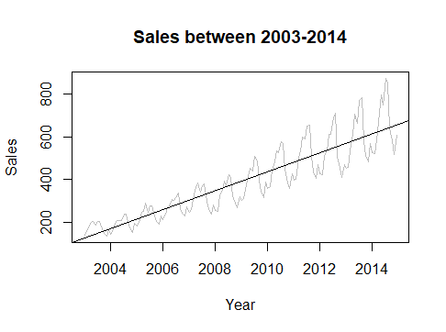
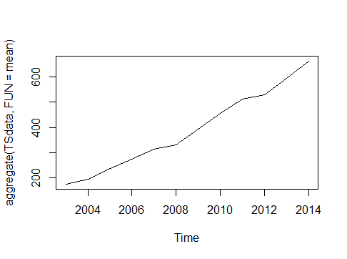
Plotting the Sales
The sales is continuously increasing year over year and this has traces of seasonality as well as a slight positive trend. We fit a regression line into the graph and it indicates that the series is non stationary because here mean and variance is changing over time as the regression line doesn’t pass from every point in the series. The plot at right side is trying to find the mean of sale from 2004 to 2014 which is increasing that also proves the data is non stationary.

Slide 6
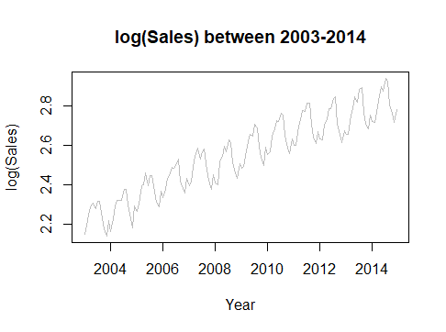
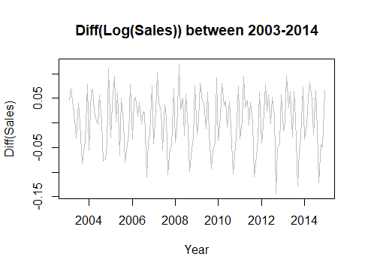
CHECKING IF THE TIME SERIES DATA IS STATIONARY OR NOT IF NOT MAKING IT STATIONARY
Plotting the log of data shows that the data is non stationary (plot left side). So we differenced the data which shows that the mean is constant but not the variance. So log transformation is not giving stationarity. Now instead of taking the difference of original data taking difference of log of time series data which shows the series is now has constant mean and a consistent variance. (plot below)

Slide 7
AUGMENTED DICKEY FULLER TEST
Checking the stationarity of transformed data using the Augmented Dickey-Fuller Test(ADF)-
Ho: The series is non stationary.
Ha: The series is stationary.
The test got low p value 0.01 and hence we can reject the Ho and can say that at 90% confidence level the data has achieved stationarity.
Till here we took order of differencing 1 , so d = 1 (the order of integration, one matrix of ARIMA).

Slide 8
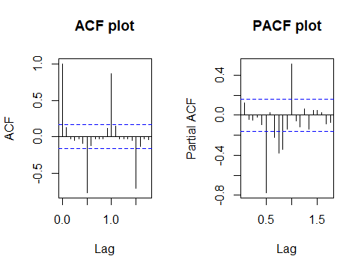
PREDICTIVE ANALYSIS
ACF & PACF PLOTS
Two important orders of ARIMA are autocorrelation function that determines order of MA(q) and partial autocorrelation function that determines order of AR(p). In the plots the blue lines are the threshold and we are considering the positive spikes which are above those threshold lines . Hence for ACF & PACF the lags we are considering are 0.0, 1.0. So we can say the potential order combination for p is 0 & 1 and for q is 0 & 1. So iterating upon the different combinations of p, q, d we get:
 | AR | I | MA
 | Order of AR | Order of Differncing | Order of MA
Model Combinations | p | d | q
Model 1 | 0 | 1 | 0
Model 2 | 0 | 1 | 1
Model 3 | 1 | 1 | 0
Model 4 | 1 | 1 | 1

Slide 9
MAPE
WE HAVE FOUR DIFFERENT COMBINATIONS OF P, D, Q AND WE RUN THE ARIMA (NON SEASONAL) TEST ON THOSE MODELS WHICH PROVIDES MAPE (MEAN ABSOLUTE PERCENTAGE ERROR) FOR EACH MODEL. THE TABLE BELOW SHOWS THE MAPE FOR EACH OF THE MODEL. THE MODEL WITH LOWEST MAPE IS CONSIDERED AS THE OPTIMUM ONE AND THAT MODEL IS MODEL 3 , WITH P=1, D=1, Q=0. STILL THIS MAPE IS QUITE HIGH.
USING R PACKAGE RUN THE AUTO ARIMA PROCESS ( SEASONAL ARIMA) WHICH CHOOSES BEST MODEL FOR ARIMA ITSELF WHICH GIVES LOWER MAPE (LAST ROW OF ABOVE MODEL) THAN THE PREVIOUS MODEL AND HENCE IT GIVES BETTER MODEL.
THE DATA TREND WE HAVE FOR OUR TIME SERIES DATA IS QUIET SEASONAL AND HENCE THE NON SEASONAL ARIMA DIDN’T WORK ON THIS DATA GOOD.
 | AR | I | MA
 | Order of AR | Order of Differencing | Order of MA
Model Combinations | p | d | q | MAPE
Model 1 | 0 | 1 | 0 | 1.845706
Model 2 | 0 | 1 | 1 | 1.820655
Model 3 | 1 | 1 | 0 | 1.810217
Model 4 | 1 | 1 | 1 | 1.826004
 |  |  |  | 0.44685

Slide 10
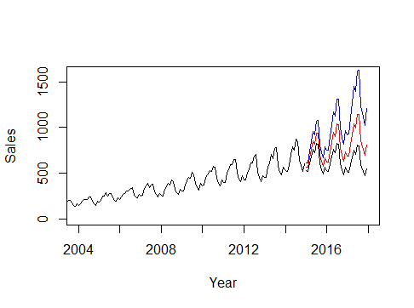
PREDICTING THE FUTURE VALUES
After predicting the log data for 36 data point ahead need to now predict on the actual data. This below graph shows the actual data in the black line and predicted data through red line which mimics the previous data. The blue and black line gives me the range of how much my fluctuation in my predicted series can be with +2, -2 standard error respectively.

Slide 11
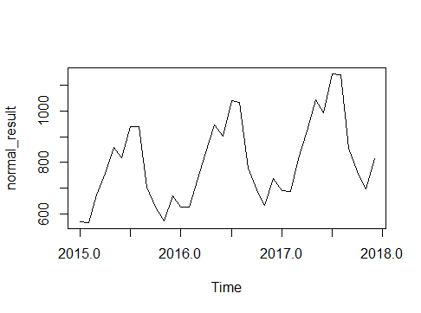
GENERATING THE FINAL OUTPUT
CONVERTED THE LOG DATA INTO THE ACTUAL DATA (ORIGINAL SERIES) WHICH IS PLOTTED WHICH SHOWS JUST THE PREDICTED DATA WHICH IS 36 POINT AHEAD THAT IS JANUARY 2015 TO DECEMBER 2017.
THEN CHANGED THE DATATYPE TO DATAFRAME AND THEN GENERATED THE DATES AND FINALLY EXPORTED THAT AS MY FINAL OUTPUT.

Slide 12
CONCLUSION
We had the airlines sales data from 2003 to 2014 which we can say is stationary or time independent with 90% of confidence.
The airlines sales has positive trend that is it increases over time.
Using that data we predicted its sales nature 3 time points ahead which also shows a positive trend in it.
So it can be concluded that the airline’s sales is increasing over time as it exhibits a positive trend.

Slide 13
THANK YOU

