Slide 1
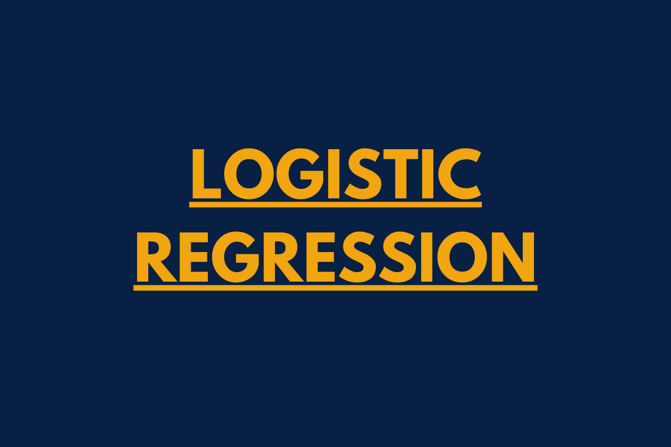
CASE STUDY ON CUSTOMER CHURN AT A TELECOM INDUSTRY

Slide 2
CONTENT
OBJECTIVE
TABLE ANALYSIS & CASE STUDY
EXPLANATORY DATA ANALYSIS
PREDICTIVE MODEL
CONCLUSSION

Slide 3
OBJECTIVE
The telecom organization wants to find out whether a customer will churn or not based on the attributes available and hence we will build the logistic model to find that which is a supervised classification technique where we want to predict whether a particular event happening or not happening. We model upon Y=1 (here its customer churn), want to infer about what are the coefficients or variables driving the probability of happening the particular dependent variable.

Slide 4
TABLE ANALYSIS
It is a Telecom organization’s data with 20 columns and 7043 rows. About the columns :
We have information about the customers in terms of gender, SeniorCitizen, Partner, Dependents, tenure, PhoneService, MultipleLines, InternetService, OnlineSecurity, OnlineBackup, DeviceProtection, TechSupport, StreamingTV, StreamingMovies, Contract, PaperlessBilling, PaymentMethod, MonthlyCharges, TotalCharges, Churn.
Here Churn is the dependent variable which is dependent in nature- where 1 means the customer has churned and 0 means has not churned.
Rest of the variables are independent.
CASE STUDY
The case study has been done in R, the target variable is a categorical variable and hence logistic regression is chosen to build predictive model on this data. Using the target variable and important predictors the prediction of customer churn will be built.

Slide 5
EXPLANATORY DATA ANALYSIS
BASIC CHECKS of the DATA:
Changed the character variables to categorical and checked their frequency distribution.
INFERENCE ABOUT THE FREQUENCY DISTRIBUTION of the DATA:
There is an equal distribution among the gender , partner of the customers but most of the customers don’t have dependent children and there are less number of senior citizen customers. In terms of tenure there is not so much skew in outliers and the average tenure is about 3 years. So the company held on to the older customers pretty well. Most of the customers opt for phone services. There is almost an equal distribution among customers in taking multiple connections. In taking internet services most of the customers opt for fiber optics and then DSL and a very less population don’t opt for no internet services. Not a large number of customers don’t opt for auxiliary services like online security, online backup, device protection, tech support, streaming tv and streaming movies. Most of the customers in month to month contract with the company followed by the 1 year and 2 years contract. Means customer don’t like long term contract with the company. Also most of the customers opt for paper less billing with the company. Payment method is fairly distributes where most customers accepting digital paying methods respectively bank transfer, credit card, electronic check and mailed checks. In terms of the monthly charges there is not so much outliers in the data. Where as there are outliers in the data for the total charges and we need to prune this particular variable, hence here replaced the null values with the mean. For the dependent variable Churn its basically towards 0 as it has a less mean and it shows that most of the people has not churned.

Slide 6
PREDICTIVE MODEL BUILDING THE LOGISTIC MODEL on Data
Dividing the data into training and testing in 70:30 ratio we have built the logistic model and we have 4930 observations in train data set and 2113 observations in test data set.
INTERPRETATION of the MODEL:
WALD TEST of P values : We analyzed the variables based on the p values. The model follows a z stat. We retained the variables which are significant at least at 90% and for that removed the insignificant variables. Here estimates are log of odd ratio and will take exponential of that. We are analyzing which variables are increasing the probability of churn. Thus we are getting the directions of the variable and magnitude of the variables will get from the exponential.
Finally after removing the variables, the variables which are positively related to the dependent variables (means customers are more likely to churn in that case) are: SeniorCitizen1 , I(MultipleLines == "Yes")TRUE, InternetServiceFiber optic, I(StreamingTV == "Yes")TRUE , I(StreamingMovies == "Yes")TRUE, PaperlessBillingYes, I(PaymentMethod == "Electronic check")TRUE for train data and I(PaymentMethod == "Electronic check")TRUE, PaperlessBillingYes, I(MultipleLines == "Yes")TRUE, InternetServiceFiber optic, I(StreamingTV == "Yes")TRUE , I(StreamingMovies == "Yes")TRUE, , I(MultipleLines == "Yes")TRUE for test data. It clearly shows that there is some problem with the digital services of the company , customers taking that are more likely to churn.
And the variables which are negetively related to the dependent variables (means customers are less likely to churn in that case) are: tenure, InternetServiceNo , ContractOne year , ContractTwo year in train data and InternetServiceNo , ContractOne year , ContractTwo year in test data.
MODEL with these variables finally will be checked on few more tests.

Slide 7
CHECKING THE OVERALL FITNESS OF THE MODEL
MULTICOLIEARITY CHECK:
Checking the GVIF with the degrees of freedom we can say there is no maximum value >1.7 in both train and test data and this model hence don’t have the problem of multicoliearity.
WALD TEST:
Here the null hypothesis is all my beta co-efficients are zero and the alternative is at least one of them is not equal to 0. In this model for both train and test data we have a very low p value and hence we reject the null hypothesis.
Lagrange Multiplier or Score Test :
This is to assess whether the current variable significantly improves the model fit or not. Null hypothesis is here my baseline model is equal to my final model. After doing the check on train and test data the P value came around 0 which means we will reject the null hypothesis and we can conclude that my baseline model (which is without any independent variable) not equal to my final model (which is with independent variable).

Slide 8
PREDICTIVE MODEL CHECKS ON RESIDUALS to CHECK ACCURACY OF MODEL
Predicting Power of the Model: We will checking R^2 values here which is overall is between 0 -0.5 and Good in between 0.2 - 0.4.
Using Pseudo R Square :
It checks the how good your model is in terms of predicting output. Hosmer and Lemeshow R^2 measure is around 0.26 for train data and 0.28 for test data ,which shows my model is good.
Using Cox and Snell R Square:
Here the R^2 value is 0.265 for train data and 0.29 for test data which means model is good.
Max rescaled R square:
Here the R^2 value is 0.387 for train data and 0.42 for test data which means my model is good.
Lackfit Deviance Test :
Ho: Observed Frequencies/probabilities =Expected Frequencies/probabilities. We got high p value around 1 for both train data and test data, hence we accept the Ho.

Slide 9
PREDICTIVE MODEL MAGNITUDE OF CO EFFICIENT CHECKS
NEED TO INTERPRET THE COEFFICIENTS BY TAKING THE EXPONENTIAL and would check by what magnitude the independent variables are affecting the probability of the customers to churn.
Interpreting the coefficients:
In both train and test data it has been observed that all the internet related measures have positive co effiecients means customer is more likely to churn if they are using these and magnitude of those variables in descending order are: InternetServiceFiber optic , I(StreamingTV == "Yes")TRUE, I(MultipleLines == "Yes")TRUE, I(StreamingMovies == "Yes")TRUE.. PaperlessBillingYes, I(PaymentMethod == "Electronic check")TRUE will make customers more likely to churn accordingly based on their magnitudes.
Again if the customers don’t take internet services then they are very less likely to churn with less magnitude. Hence some problem is there in the company’s internet services.
The variables which are affecting the customers less likely to churn are in descending order based on the magnitudes: tenure, ContractOne year, ContractTwo year.
Variable importance check:
In train data set, the important independent variables which are affecting the dependent variables occurrence most are tenure followed by InternetServiceFiber optic, ContractTwo year , ContractOne year , InternetServiceNo, PaperlessBillingYes, I(PaymentMethod == "Electronic check")TRUE, I(StreamingTV == "Yes")TRUE, I(MultipleLines == "Yes")TRUE , I(StreamingMovies == "Yes")TRUE .

Slide 10
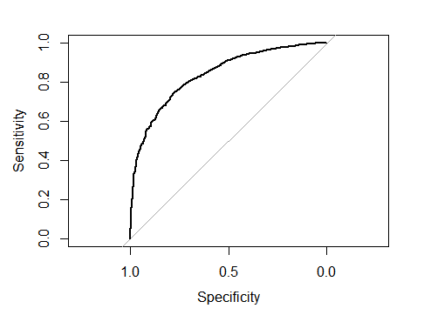
PREDICTIVE MODEL MORE CHECKS TO CHECK THE ACCURACY OF THE MODEL
Confusion Matrix:
This model got following cases in term of confusion matrix for train and test data respectively. We have high number of false negative cases. Overall accuracy of the model is around 75% for train data and 76% for test data.
Actual
Predicted 0 1
0 2698(true negative) 291(false negative)
1 924(false positive) 1017(true positive)
Actual
Predicted 0 1
0 1143 (true negative) 103(false negative)
1 409 (false positive) 458 (true positive)
ROC Curve:
In the graph the grey line is actual model and the black is
the uplift from the model, higher it is better the model.
The area under the ROC Curve is 0.84 for train data set
And 0.85 for test data set, means it is an
excellent discrimination.

Slide 11
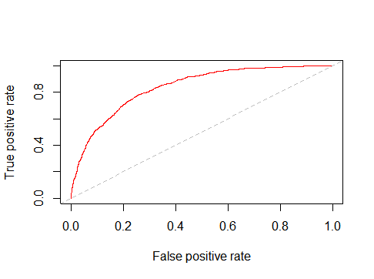
PRDICTIVE MODEL MORE CHECKS TO CHECK THE ACCURACY OF THE MODEL
Threshold: we generated the output of the logit model into probabilities that is in 0 & 1 format and to do that model threshold is used which 0.286(for train data) and 0.27(for test data), means any probability greater than these it will be converted in 1 and if less then it would be 0.
Gini :
Gini Coefficient is the area under the Lorenz Curve (which ranges from 0.5 to 0.8), this is similar ROC Curve where final model compared to baseline model. This checks again the accuracy of model which is here 0.67 for train data and 0.69 for test data. If the gini measure is around 0.8 its considered to be good and hence the model is good.
KS Statistics calculation:
If the KS Stat ranges from 0.4 to 0.7 the model is good. In the
Graph the grey line represents the actual model and the red line
Is based on performance of true positive rate and false positive rate
Higher the gap between the lines better the model is. Here the KS
Stat is 0.52 for both train and test data, which says that my
model accuracy is good.

Slide 12
CONCLUSION
So it can be concluded that the model explains more than 85% of true probability of customer churn.
The telecom organization needs to work on their internet services as customers not opting for the organization’s internet services are less likely to churn .
Customers with lesser contract to the organization are less likely to churn.
The organization should target adult but not senior citizen customers as they are less likely to churn the organization.
If the organization for electronic payment methods and paper less billing their customer will churn less.

Slide 13
THANK YOU

