Slide 1

HOSPITAL PATIENT FLOW & MEDICAL SERVICES ANALYTICS
Presented by:
Nandini Gopalakrishnan

Slide 2
Problem Statement
The objective of this project is to analyze operational efficiency and patient care metrics across hospital departments.
This includes tracking patient admissions, treatment outcomes, and doctor performance using multiple datasets.
The analysis will uncover bottlenecks, identify high-performing doctors, and help optimize
hospital resources and revenue.

Slide 3
Data Cleaning and Preparation
Doctor ID Standardization - Corrected mismatched Doctor_IDs by applying consistent prefixes to ensure accurate joins across tables (Eg: Doctor_id - D01001 to D1001)
Date Format Unification - Converted all Admission, Discharge, and Treatment dates into a uniform DATE format, enabling reliable time-based analysis.
Redundancy Removal - Dropped duplicate Department column from Doctor_Profiles to avoid data inconsistencies.
Invalid Data Handling - Removed records with invalid ages (AGE = 0) to maintain data integrity.
Feature Engineering - Created an AGE_GROUP column (0–9, 10–19, … 90–99) to support demographic and cohort-based analysis.

Slide 4
A. BASIC AGGREGATIONS

Slide 5
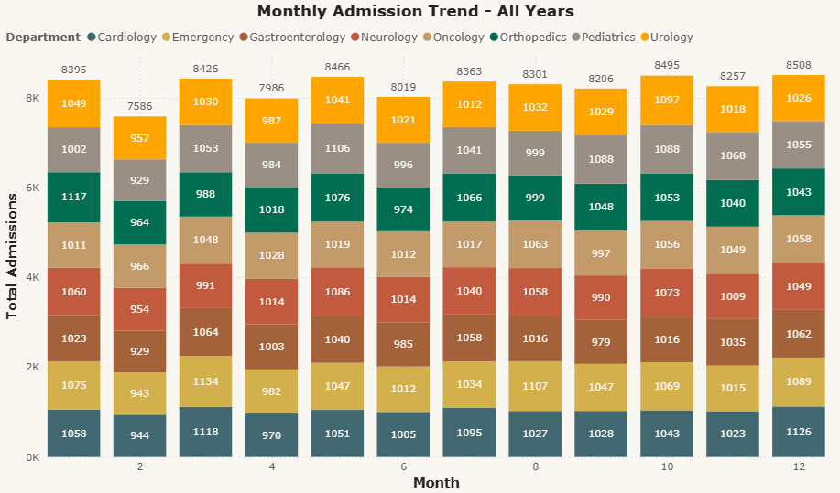
1. Calculate the number of admissions per department per month.
Key Insights:
Overall Trend – All years combined:
Emergency department has the highest admissions in March.
Gastroenterology and Pediatrics have the lowest admissions in February.
February consistently records low admissions across all departments.
Year-wise Trends:
2023: Emergency peaked in August, while Gastroenterology recorded its lowest in September.
2024: Orthopedics peaked in January, while Cardiology and Pediatrics were lowest in February.
2025: Cardiology peaked in March, while Emergency was lowest in February.

Slide 6
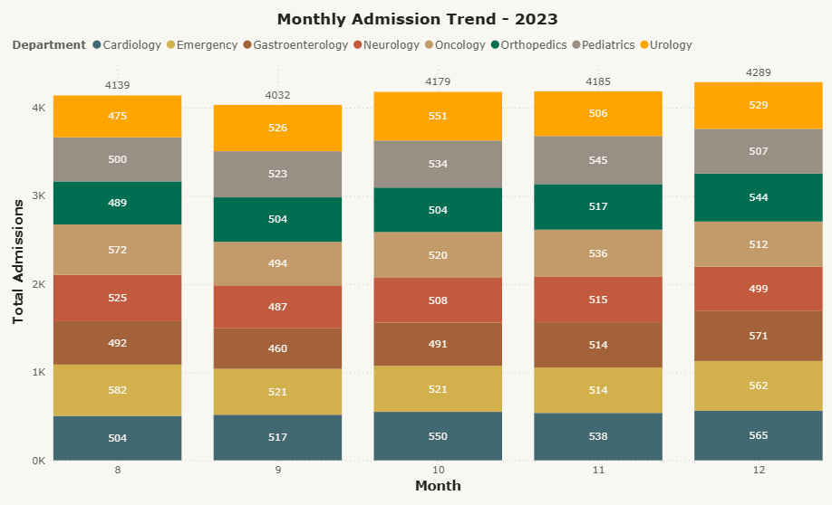
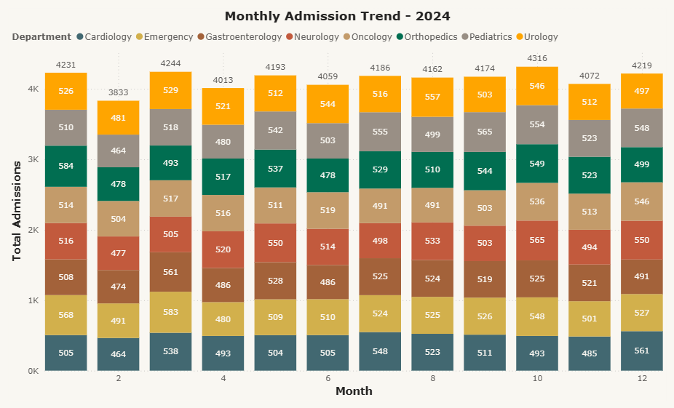
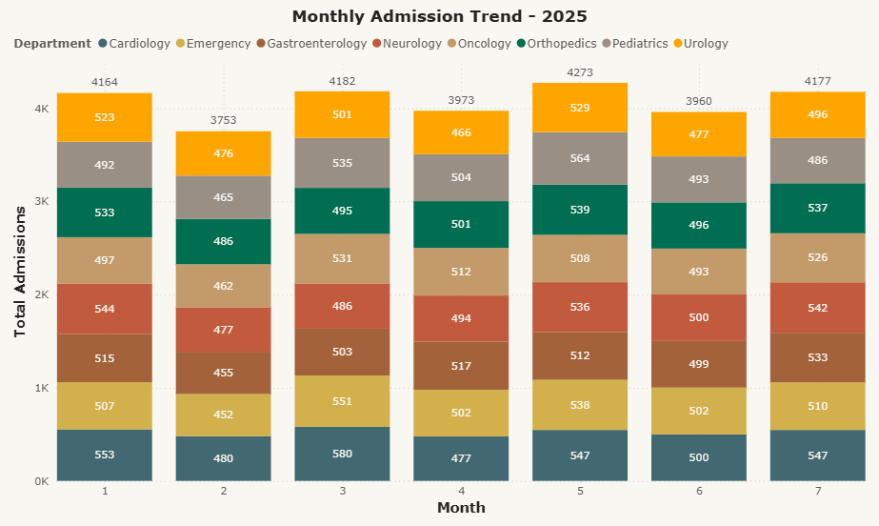

Slide 7
1. Calculate the number of admissions per department per month.
Recommendations:
Investigate seasonal or operational factors causing low admissions in February and department-specific fluctuations.
Optimize staff allocation and resource planning in months/departments with higher admission demand (e.g., Emergency in March, Orthopedics in January).
SQL:
SELECT - to fetch admissions count, department, year, and month
COUNT(*) - to calculate total admissions
YEAR() / MONTHNAME() / MONTH() - to extract year & month from admission date
GROUP BY - to group data by department and month
ORDER BY - to sort results by department, year, and month

Slide 8
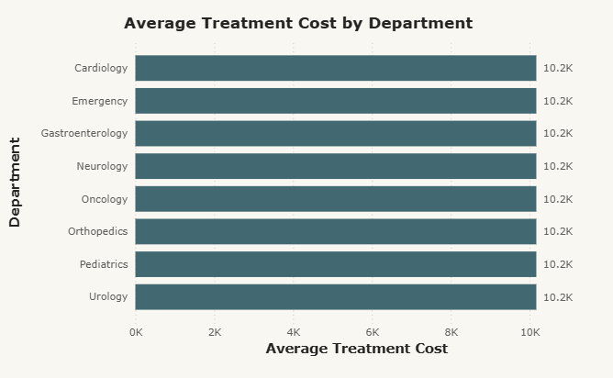
2. Find the average treatment cost per department.
Key Insight:
The average treatment cost is consistent across all departments (10.2K).
SQL :
JOIN (to combine treatment_records with patient_admissions to get department info)
GROUP BY (to calculate per department)
AVG() (to get average treatment cost)
ORDER BY (to sort by department)

Slide 9
B. JOIN OPERATIONS

Slide 10
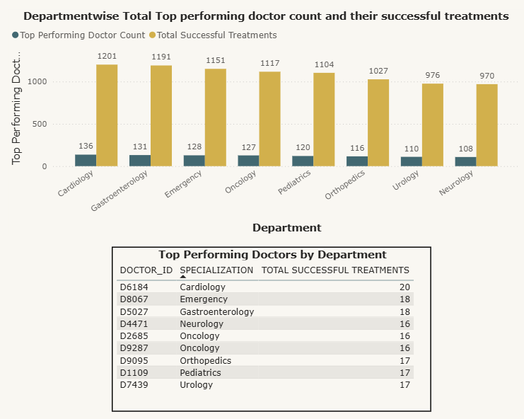
1. Join admissions with doctors to identify top performing doctors by department.
Key Insight:
Cardiology leads with the highest number of top-performing doctors (136), contributing a total of 1,201 successful treatments.
Neurology has the least top-performing doctors (108), with a total of 970 successful treatments.
Among all top performers:
Doctor D6184 (Cardiology) achieved the highest individual success count (20 treatments).
Doctor D4471 (Neurology) and Doctors D2685 & D9287 (Oncology) recorded the lowest success count (16 treatments each).
Recommendation:
Recognize and replicate best practices from high-performing departments (like Cardiology).
Provide targeted training and resources to doctors in lower-performing departments (Neurology, Oncology) to boost success rates.

Slide 11
1. Join admissions with doctors to identify top performing doctors by department.
SQL:
SELECT – to fetch doctor details, specialization, success counts, and calculated success rate
SUM() / COUNT() – to calculate total successful treatments and total patients per doctor
ROUND() – to format success rate percentage to 2 decimals
JOIN – to combine doctor profiles with treatment records
GROUP BY – to aggregate data per doctor and specialization
DENSE_RANK() OVER (PARTITION BY … ORDER BY …) – to rank doctors by success rate within each department
CTE (WITH clause) – to simplify query by breaking into steps (DOCTOR_PERFORMANCE, MAX_SUCCESSFUL_TREATMENTS_PER_DEPT)
MAX() – to identify the doctor with the highest successful treatments in each department
WHERE – to filter only top-ranked doctors
ORDER BY – to sort results by specialization

Slide 12
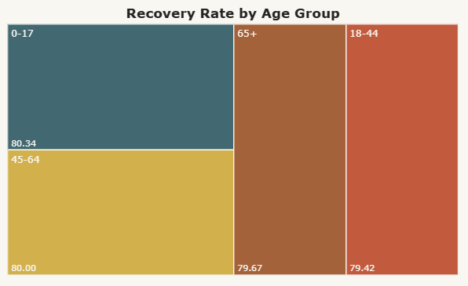
2. Join treatments with patient data to evaluate recovery rate by age group.
Key Insight:
Recovery Rate = (Successful Treatments ÷ Total Patients) × 100
0–17 yrs - Highest recovery rate (80.34%)
45–64 yrs - Strong recovery (80.00%)
65+ yrs - Slightly lower recovery (79.67%)
18–44 yrs - Lowest recovery (79.41%)
Younger and middle-aged groups (0–17 & 45–64) show better recovery rates compared to the elderly (65+).
Recommendation:
Invest in specialized care plans and rehabilitation support for the 65+ age group to improve recovery outcomes.
Introduce screening and early intervention programs for adults (18–44), where recovery rate dips slightly.

Slide 13
2. Join treatments with patient data to evaluate recovery rate by age group.
SQL:
SELECT – to fetch age group, total successful treatments, total patients, and recovery rate
CASE – to categorize patients into age groups (0–17, 18–44, 45–64, 65+)
SUM() – to calculate the total number of successful treatments per age group
COUNT() – to count the total number of patients per age group
Arithmetic Operations (/, *) – to calculate recovery rate percentage per age group
WITH (CTE) – to simplify query by creating a temporary table with age group information
JOIN – to combine patient admissions with treatment records using PATIENT_ID
GROUP BY – to aggregate data per age group
ORDER BY – to sort results by age group

Slide 14
C. WINDOW FUNCTIONS

Slide 15
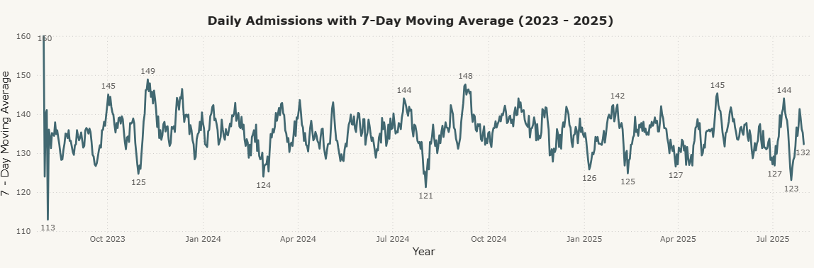
1. Calculate moving average of daily admissions (7-day MA).
Key Insight:
High variability in daily admissions - Numbers range from 60 to 166 per day, indicating strong fluctuations.
7-day moving average smooths the noise - Admissions stabilize around 130 -145, providing a clearer demand trend.
Multi-day surges exist - Spikes are not one-off; consecutive high days push the MA upwards, showing sustained demand pressure.
Risk in relying only on daily data - Sharp peaks and drops can mislead planning if not balanced with MA trends.
Recommendations:
Use 7-day MA as the primary planning metric - Guide staffing, bed allocation, and resource decisions on MA trends, not single-day counts.
Set monitoring alerts - Trigger action if daily admissions deviate by more than 20% from the MA, enabling proactive response to surges.

Slide 16
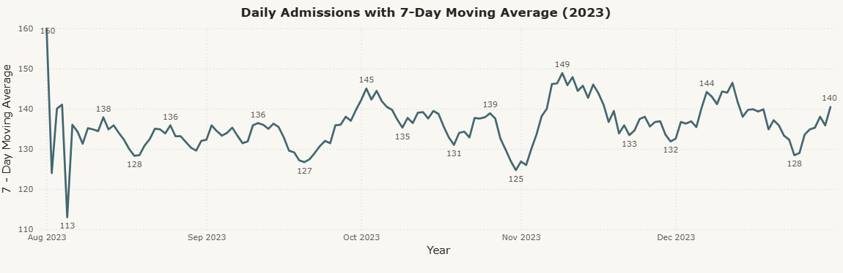
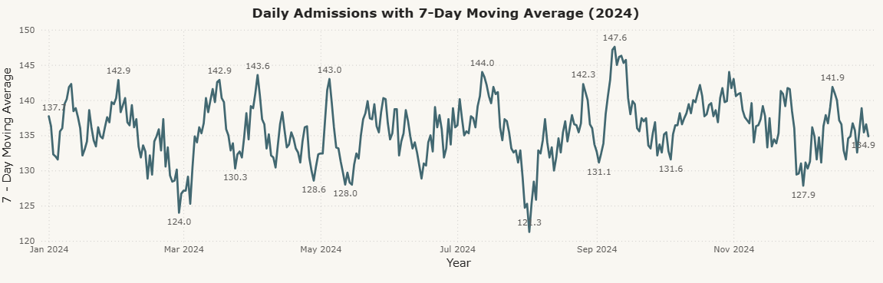
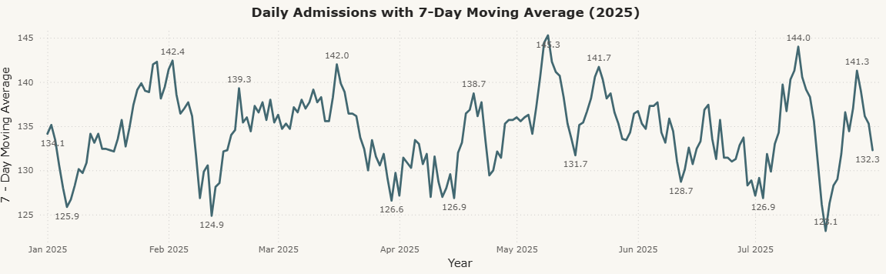
1. Calculate moving average of daily admissions (7-day MA).

Slide 17
1. Calculate moving average of daily admissions (7-day MA).
SQL:
COUNT() - To calculate the number of admissions per day.
ROW_NUMBER() - To generate sequential ordering of days.
AVG() - To compute the 7-day moving average of admissions.
ROUND() - To format the moving average values to 2 decimal places.
CASE WHEN - To apply conditional logic (show moving average only after 7 days).

Slide 18
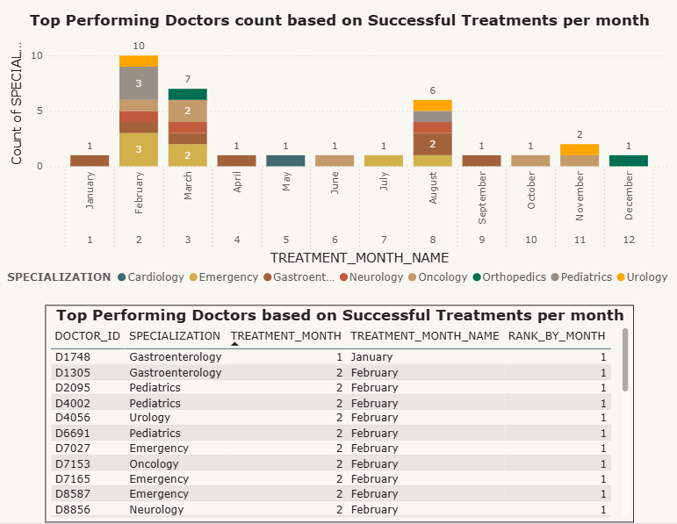
2. Rank doctors by number of successful treatments per month.
Key Insight:
Different doctors lead in different months - indicating seasonal variation in cases.
February, March, and August show the highest number of top doctors, which might be linked to higher patient inflow.
May, June, and July have fewer top doctors, suggesting lower treatment demand.
Gastroenterology, Pediatrics, Emergency, and Oncology dominate the top ranks, showing strong departmental contribution.

Slide 19
2. Rank doctors by number of successful treatments per month.
Recommendations:
Recognize and Reward Top Performers - Incentivize consistently high-performing doctors to maintain motivation and retention.
Address Seasonal Demand - Optimize staffing and resources during peak months (e.g., Pediatrics in Feb, Emergency in summer) to balance workload and ensure quality care.
SQL:
COUNT() - Counts the number of successful treatments per doctor.
MONTH() - Extracts the month number (1–12) from treatment date.
MONTHNAME() - Returns the month name (e.g., January, February).
DENSE_RANK() OVER(PARTITION BY … ORDER BY …) - Assigns ranking within each month based on number of successful treatments (no gaps in ranking).
GROUP BY - Groups records by doctor, specialization, and month for aggregation.
JOIN - Combines treatment records with doctor profiles to get specialization.
ORDER BY - Sorts results first by month, then by number of successful treatments (descending).

Slide 20
D. PERCENTILES AND MEDIAN

Slide 21
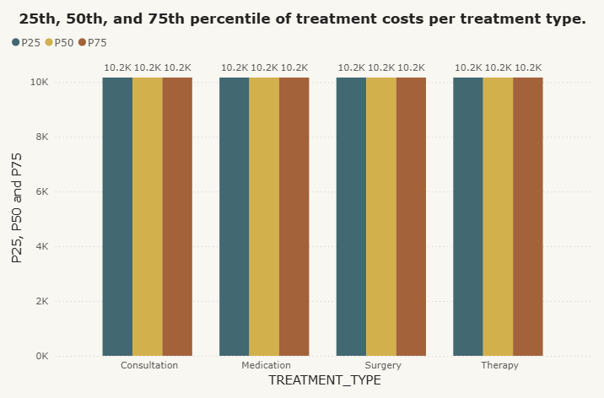
1. Calculate 25th, 50th, and 75th percentile of treatment costs per treatment type.
Key Insight:
The treatment cost is uniform across all treatment types.
Hence, the 25th, 50^{th,} and 75th percentiles for all the treatment types remain constant.
Recommendations:
Compare treatment costs with industry averages to assess competitiveness and identify optimization opportunities.
SQL:
PERCENT_RANK() - To calculate the relative position of each COST within its TREATMENT_TYPE (for quartile calculation).
CASE WHEN ... THEN ... END - To filter costs that fall within specific percentile ranges (P25, P50, P75).
MAX() - To pick the highest cost within each percentile range for each TREATMENT_TYPE.
GROUP BY - To aggregate the results by TREATMENT_TYPE after calculating quartiles.

Slide 22
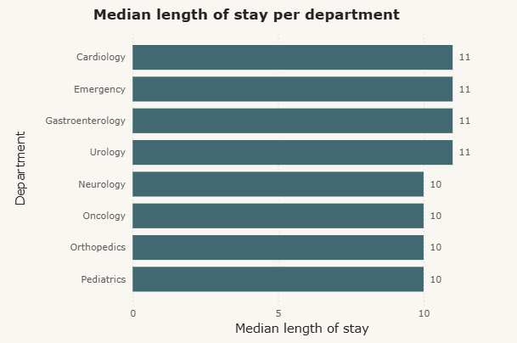
2. Find the median length of stay per department.
Key Insight:
The length of stay is fairly consistent across departments, with slight variations.
Most departments (Cardiology, Emergency, Gastroenterology, Urology) have a median stay of 11 days.
Other departments (Neurology, Oncology, Orthopedics, Pediatrics) have a median stay of 10 days.
Departments with higher median stays (11 days) may indicate more complex cases or slower patient turnover.
Recommendations:
Monitor departments with longer stays for operational bottlenecks or care efficiency improvements.
Use this data for capacity planning and staff allocation in high-stay departments.

Slide 23
2. Find the median length of stay per department.
SQL:
DATEDIFF() - Calculates the length of stay for each patient.
ROW_NUMBER() OVER(PARTITION BY DEPARTMENT ORDER BY LENGTH_OF_STAY) - Ranks patients by stay within each department.
COUNT() OVER(PARTITION BY DEPARTMENT) - Counts total patients per department to determine median position.
CASE WHEN ... THEN ... END - Differentiates calculation for odd vs. even number of patients.
MAX() & AVG() - Aggregates values to compute median.
GROUP BY - Groups results by department for final median calculation.

Slide 24
E. GROUPING AND CASE STATEMENTS

Slide 25
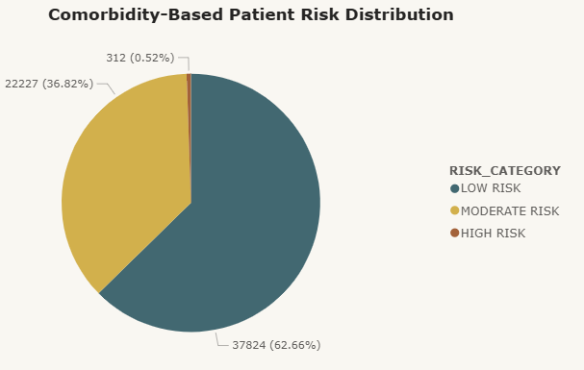
1. Group patients into 'High-Risk', 'Moderate-Risk’, and 'Low-Risk' based on comorbidity count.
Key Insight:
Low-risk patients dominate the population (62.66%, 37,824 patients).
Moderate-risk patients form a significant portion (36.82%, 2,227 patients).
High-risk patients are very few in number (0.52%, 312 patients), but need special attention due to higher comorbidity counts.
Overall, more than 1 in 3 patients fall under Moderate/High risk categories, indicating notable healthcare management needs.
Recommendations:
Targeted Care Programs: Monitor High-Risk patients closely with specialized treatment plans.
Resource Allocation: Focus resources (beds, staff, ICUs) proportionally to higher-risk categories.
Awareness & Prevention: Educate Low-Risk patients to maintain healthy lifestyles and reduce risk progression.

Slide 26
1. Group patients into 'High-Risk', 'Moderate-Risk’, and 'Low-Risk' based on comorbidity count.
SQL:
SELECT – to fetch patient IDs, comorbidity counts, and risk categories.
COUNT(DISTINCT …) – to calculate comorbidity count (unique treatment types).
CASE – to categorize patients into High/Moderate/Low risk groups.
GROUP BY – to group data at the patient level.
ORDER BY – to sort patients by descending comorbidity count

Slide 27
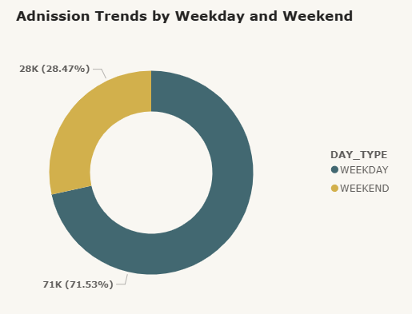
2. Find admission trends by weekday and weekend.
Key Insight:
Weekdays dominate admissions with 71k (71.53%) of total patients.
Weekends contribute significantly less, 28k (28.47%) admissions.
Indicates hospital services are primarily utilized on weekdays.
Recommendations:
Staff Allocation: Ensure more doctors, nurses, and support staff are available on weekdays to handle higher patient load.
Weekend Planning: Consider extending services/appointments on weekends to reduce weekday pressure.
Operational Strategy: Use weekend slots for non-urgent or routine checkups to balance demand.

Slide 28
2. Find admission trends by weekday and weekend.
SQL:
SELECT – fetches day type (weekday/weekend) and total admissions.
CASE – classifies admission dates into Weekday vs Weekend.
DAYNAME() – extracts the day of the week from the admission date.
COUNT() – calculates total admissions.
GROUP BY – groups admissions into Weekday vs Weekend categories.

Slide 29
F. COMPLEX JOINS AND SUBQUERIES

Slide 30
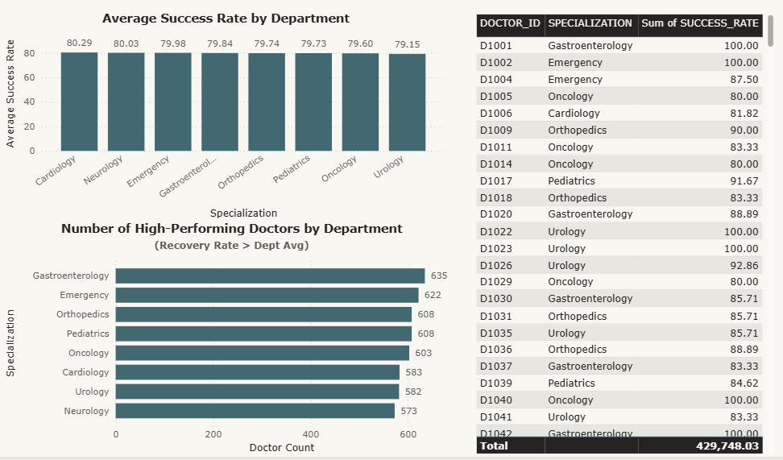
1. Find doctors whose patients had recovery rate above the departmental average.
Key Insight:
Each department has an average patient recovery rate ranging roughly from 79.1% (Urology) to 80.3% (Cardiology).
Gastroenterology has the highest number of top-performing doctors (635), while Neurology has the fewest (573).
Orthopedics and Pediatrics both have same number of high performing doctors (608)
This indicates distribution of performance varies across specializations, potentially reflecting departmental challenges or doctor expertise.
Recommendations:
Recognize and benchmark top-performing doctors for best practices.
Investigate departments with fewer top performers (Neurology, Urology) to identify training or process improvement opportunities.
Use recovery rate metrics to guide staffing, mentoring, and quality improvement initiatives.

Slide 31
1. Find doctors whose patients had recovery rate above the departmental average.
SQL:
AVG() - Calculates the departmental average patient recovery (success) rate.
COUNT() - Counts doctors exceeding the department average.
JOIN - Combines doctor_profiles with treatment_records to compute per-doctor recovery rates.
GROUP BY - Aggregates data by SPECIALIZATION or DOCTOR_ID.
CASE WHEN ... > dept_avg THEN 1 END - Filters doctors whose patients exceed the departmental average.

Slide 32
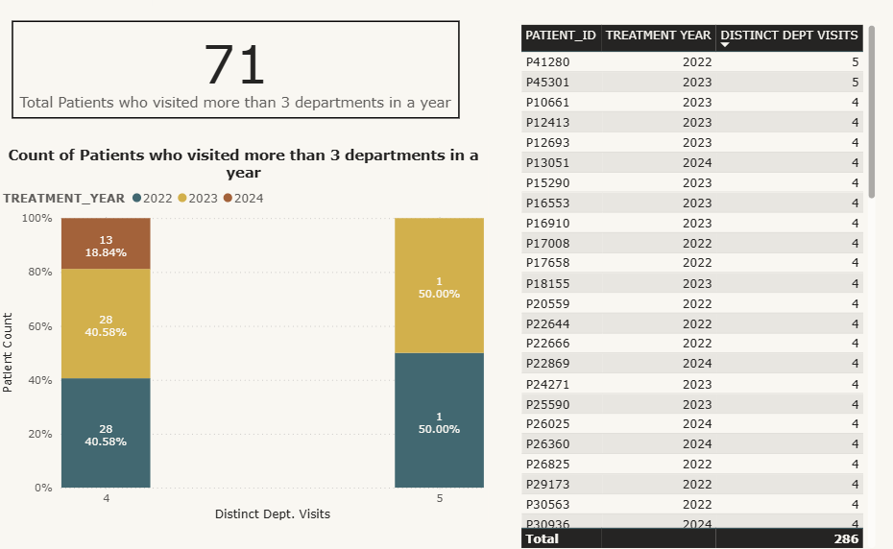
2. Identify patients who visited more than 3 departments in a year.
Key Insight:
71 patients visited more than 3 departments in a year.
Patients visiting more than 3 departments in a year are relatively few, indicating complex care needs.
Majority of these patients visited 4 departments consistently across 2022–2024.
Rare cases of 5 department visits suggest highly complex or chronic conditions.
Such patients may significantly impact hospital resource utilization and care coordination.
Recommendations:
Flag these patients for multidisciplinary care planning to improve treatment efficiency.
Investigate patterns to identify high-risk or chronic patients for proactive interventions.
Use insights for resource allocation, staffing, and operational planning in multi-department care.

Slide 33
2. Identify patients who visited more than 3 departments in a year.
SQL:
COUNT(DISTINCT D.SPECIALIZATION) - Calculates the number of unique departments visited per patient.
JOIN - Links TREATMENT_RECORDS with DOCTOR_PROFILES to get department info.
YEAR(TREATMENT_DATE) - Extracts treatment year for yearly analysis.
GROUP BY & HAVING - Aggregates per patient per year and filters patients with >3 department visits.
ORDER BY DESC - Ranks patients by number of distinct department visits.

Slide 34
G. DATE FUNCTIONS AND YOY

Slide 35
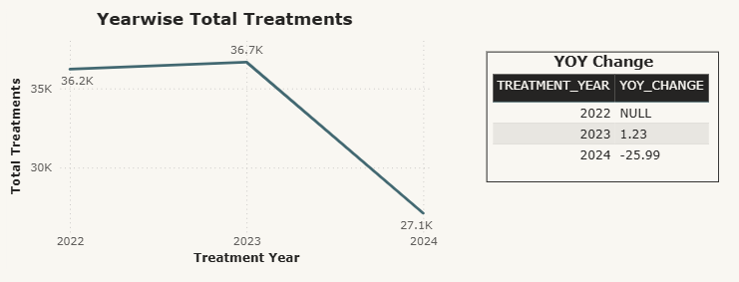
1. Calculate the year-over-year change in total treatments administered.
Key Insight:
Treatments increased slightly from 2022 to 2023 by 1.23%, indicating stable growth.
Treatments dropped sharply in 2024 by 25.99%, signaling a potential issue in service delivery, patient inflow, or data completeness.
The significant drop in 2024 warrants further investigation into seasonality, resource constraints, or external factors.
Recommendations:
Investigate causes of 2024 decline - check for missing data, operational disruptions, or changes in patient behavior.
Plan resources and staffing based on trends from 2022–2023, adjusting for potential fluctuations.
Use YoY trends to forecast future treatment demand and optimize hospital operations.

Slide 36
1. Calculate the year-over-year change in total treatments administered.
SQL:
YEAR() - Extracts the year from TREATMENT_DATE.
COUNT() - Calculates total treatments per year.
LAG() - Retrieves the previous year’s total treatments for YoY calculation.
OVER (ORDER BY TREATMENT_YEAR) - Defines the order for LAG() to compute previous year values correctly.
ROUND() - Rounds the YoY percentage change to 2 decimal places.
GROUP BY - Aggregates treatments by year.

Slide 37
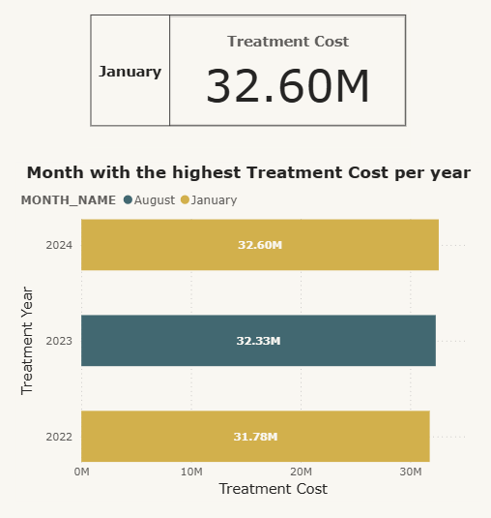
2. Find the month with the highest treatment cost.
Key Insight:
2022: January recorded the highest cost – 31.78M.
2023: August peaked with 32.33M in treatment costs.
2024: January again topped with 32.60M, showing a recurring high-cost trend at the start of the year.
Clear seasonal pattern emerging with January spikes in multiple years.
Across all years, January recorded the highest treatment cost, totaling 32.60M in 2024.
Recommendations:
Budget Planning: Allocate more financial & medical resources for January (historically high-cost month).
Predictive Strategy: Use this pattern for forecasting future treatment costs and optimizing procurement & staffing.

Slide 38
2. Find the month with the highest treatment cost.
SQL:
WITH (CTE) – creates a temporary result set (YEARWISE_MONTHLY_TOTAL_TREATMENT_COST) to simplify complex queries.
SELECT – retrieves year, month, total treatment cost, and rank.
YEAR() & MONTHNAME() – extract year and month name from treatment date.
SUM() – calculates the total treatment cost per month.
ROUND() – formats treatment cost values to 2 decimal places.
GROUP BY – aggregates costs at the year–month level.
DENSE_RANK() OVER (PARTITION BY … ORDER BY …) – assigns a rank to each month by cost within each year (highest = 1).
ORDER BY – sorts data by year and month for readability.
WHERE – filters only the highest treatment cost month (rank = 1) per year.

Slide 39
H. RETENTION AND FOLLOW-UP ANALYSIS

Slide 40
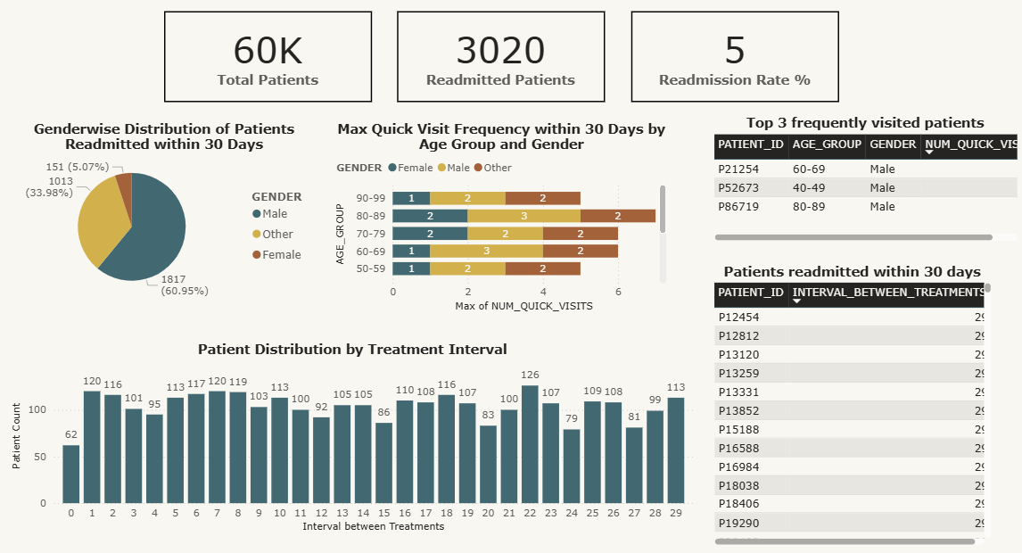
1. Find patients readmitted within 30 days of discharge.

Slide 41
1. Find patients readmitted within 30 days of discharge.
Gender-wise Distribution:
Male: 1,817 patients (60.95%) – highest readmission.
Other: 1,013 patients (33.98%).
Female: 151 patients (5.07%) – lowest readmission.
Key Insight: Readmissions are male-dominated, suggesting possible gender-linked health or lifestyle factors.
Max Visit Frequency (by Age Group & Gender):
Peak re-admissions observed in males (3 times) in ages 40–49, 60–69, 80–89.
For most other groups, 1–2 quick visits within 30 days.
Key Insight: Certain male age groups (40–49, 60–69, 80–89) are at higher risk of repeated quick readmissions.
Treatment Interval Distribution (Days Between Treatments):
Most patients return within 1–9 days.
Noticeable peaks at Day 1 (120 patients), Day 7 (120), and Day 22 (126).
Key Insight: Suggests critical monitoring periods within the first week and ~3 weeks post-discharge.
Top Frequent Readmitted Patients (within 30 days)
p21254 – Male, 60–69 - 3 visits.
p52673 – Male, 40–49 - 3 visits.
p86719 – Male, 80–89 - 3 visits.
Key Insight: All top repeat cases are male patients in different risk-prone age groups.

Slide 42
1. Find patients readmitted within 30 days of discharge.
Recommendations:
Targeted Post-Discharge Care: Focus follow-ups on males aged 40–89 with tailored care plans.
Early Intervention Programs: Closely monitor patients in the first 7 days and around Day 22 after discharge.
Patient Tracking: Maintain a high-risk patient registry to track frequent readmissions and provide additional support.
Gender-Specific Health Strategies: Explore preventive measures addressing male readmission drivers.
SQL:
LAG() - Retrieves the previous treatment date for each patient to calculate gaps between visits.
DATEDIFF() - Calculates the number of days between current and previous treatment dates.
COUNT() - Counts how many times each patient was readmitted within 30 days.
OVER (PARTITION BY ... ORDER BY ...) - Creates a window per patient, ordering by treatment date to compare consecutive visits.
JOIN - Combines treatment records with patient demographics (age group, gender).
WHERE < 30 - Filters only those visits occurring within 30 days of the previous one.
GROUP BY - Groups data by patient, age group, and gender for aggregations.
ORDER BY - Sorts patients by the number of quick readmissions.

Slide 43
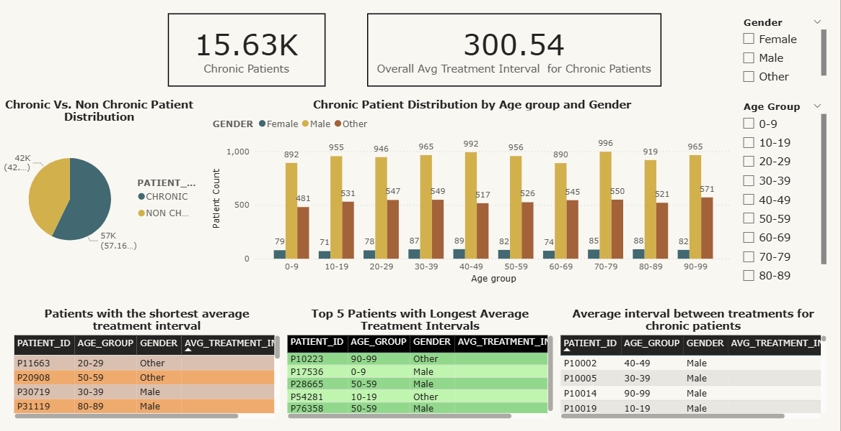
2. Calculate average interval between admissions for chronic patients.

Slide 44
2. Calculate average interval between admissions for chronic patients.
Key Insights:
Total chronic patients analyzed: 15.63K
Overall average treatment interval: 300.54 days (~10 months)
Demographics: The majority are male across all age groups.
Patients with a 0-day average interval suggest same-day repeat admissions or data recording overlaps.
Longest intervals (~975 - 988 days) found among older patients (90–99, 50–59) and a few pediatric cases (0–9).
Recommendations:
Investigate patients with 0-day intervals for potential data quality issues or emergency readmissions.
For patients with long intervals, check for treatment adherence or follow-up gaps.
Design age and gender-specific chronic care programs, focusing on male patients with shorter return gaps.
Use interval trends for predictive scheduling and chronic care planning.

Slide 45
2. Calculate average interval between admissions for chronic patients.
SQL:
CASE WHEN - Classifies patients into Chronic vs Non-Chronic based on diagnosis.
LAG() -- Fetches previous treatment date for each patient.
DATEDIFF() -- Calculates gap (days) between current and previous treatments.
AVG() -- Computes average interval per patient and overall.
ROUND() -- Rounds averages to 2 decimal places for reporting.
OVER (PARTITION BY … ORDER BY …) -- Ensures treatment intervals are calculated sequentially per patient.
GROUP BY -- Aggregates averages by patient, age group, and gender.

Slide 46
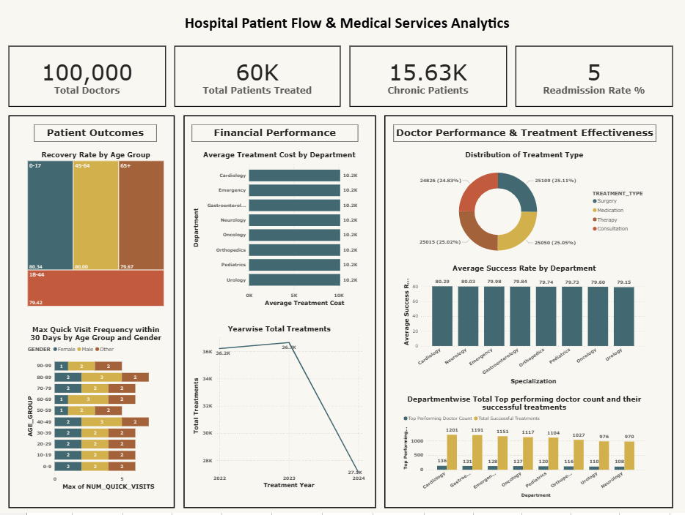

Slide 47

THANK YOU
Nandini Gopalakrishnan
nandini.gopalakrishnan98@gmail.com

