Slide 1


WitchMusic
Github Link :
https://github.com/vidhyal/WitchMusic
Contributers :
Nandini Khanwalkar
nandini2@pdx.edu
Vidhya Lakshmi Venkatarama
vidhyal@pdx.edu

Slide 2
Overview
Project Selection
What is WitchMusic ?
The dataset – Million Song Dataset.
License – The MIT License
Users

Slide 3
What’s out there ?
Musicmood
https://github.com/rasbt/musicmood
Dataset- The Million Song Dataset
Binary Classification
GenreTron
Https://Github.com/crmne/Genretron
Dataset-GTZAN Dataset
Genre Classification
GenreXpose
https://Github.com/jazdev/genreXpose
Dataset-GTZAN Dataset
Genre Classification

Slide 4
Work-Flow
Data Extraction
Preprocessing
Normalisation
Feature Selection
Models
Gaussian Naïve Bayes
Logistic Regression
Multilayer Perceptrons
Support Vector Machines
Decision Tree
Combination Model
GridSearch
Testing

Slide 5
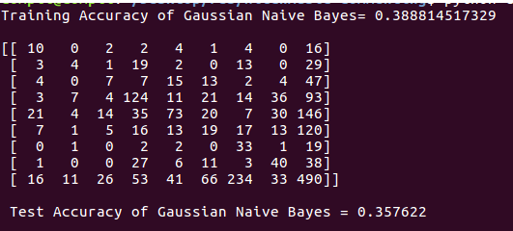
10 Genre Classification Gaussian Naïve Bayes

Slide 6
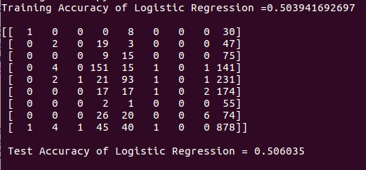
10 Genre Classification Logistic Regression

Slide 7
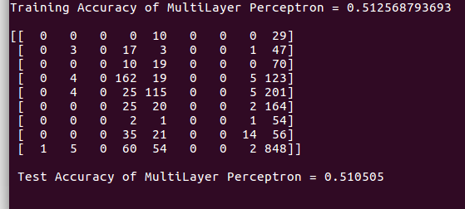
10 Genre Classification Multi Layer Perceptron

Slide 8
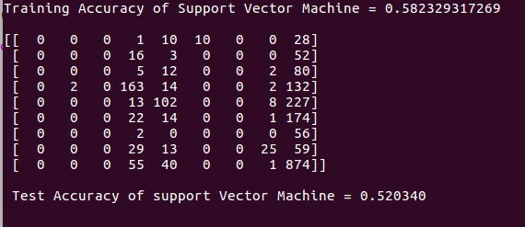
10 Genre Classification Support Vector Machine

Slide 9
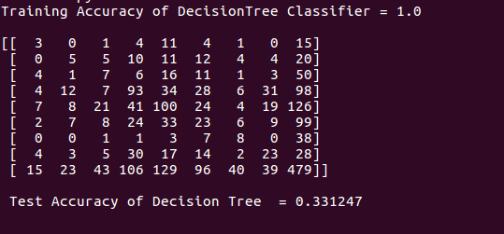
10 Genre Classification Decision Tree

Slide 10
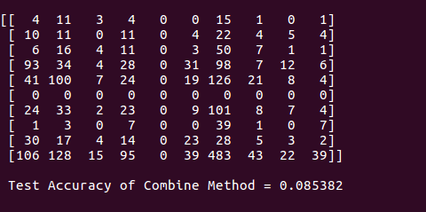
10 Genre ClassificATION Combination Method

Slide 11
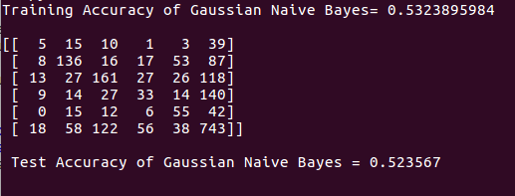
6 Genre Classification Gaussian Naïve Bayes

Slide 12
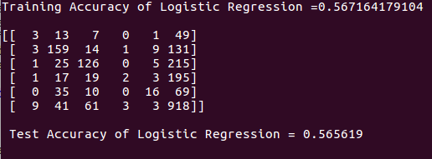
6 Genre Classification Logistic Regression

Slide 13
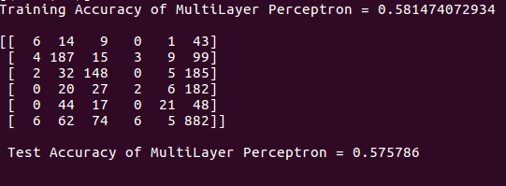
6 Genre Classification Multi Layer Perceptron

Slide 14
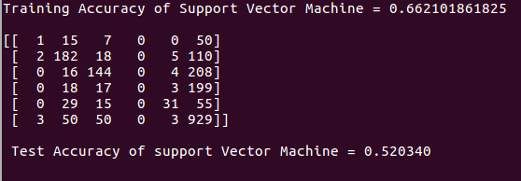
6 Genre Classification Support Vector Machine

Slide 15
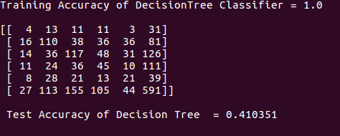
6 Genre Classification Decision Tree

Slide 16
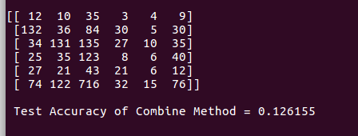
6 Genre Classification Combination Method

Slide 17
To sum it up
Issues
Data Disparity
Bug in Combine MethoD
What we learnt
Open Source
Python
SciKit Learn
Git HuB
What’s next ?
Improved feature manipulation
Weight balanced training
Feature extraction from audio tracks
Classification based on Lyrics (Also)
Develop user friendly application

Slide 18


