Slide 1
Sauce Demo Automation Testing Project
Submitted By : Nandini Kamireddy
Mail : nandinikamireddy11@gmail.com
Superset id : 5217856

Slide 2
Content :
Overview
Features
Pre – Requisites
Work flow
Modules implemented
Test Execution & reports
Future Enhancements
Jenkins, Git & Jira Implementation
Dependencies
Outcome
Test Cases Screenshots
Jenkins – Outcome
Jira - Outcomes
Conclusion
References & links

Slide 3
Overview :
This project automates the functionality of the SauceDemo.com website using Java, Selenium WebDriver, and TestNG for test execution. The automation suite includes key operations such as login, add to cart, completing checkout, sorting, logout, locked out, cart badges count. All test results are reported using Allure, generating detailed and interactive reports for test analysis also created the report on surefire-report.
The goal of this project is to ensure the smooth functionality of the website by automating critical flows and validating the website’s behavior under various scenarios based on Test Scenarios.

Slide 4
Features :
Automated Login Test :Automated login Test with valid and invalid credentials.
Add to Cart : Automated add to cart functionalities with adding/removing product in cart.
Checkout Operation : Automates the entire checkout process with followed all steps like enter first name, last name zip code
Sorting Product Validation : Sort by dropdown a to z, z to a, by name and price low to high , high to low.
Automated Logout :click on menu bar and click on logout button.
Locked Out User : login with locked person user pass and verify properly pop a error massage.
Cart Badge Count : Adding multiple product and removing verify to cart badges are counted correctly.
Report Generate with Allure : Generates rich, visually appealing HTML reports of the test executions.

Slide 5
Pre - Requisites :
Programming Language: Java
Automation Tool: Selenium WebDriver
Testing Framework: TestNG
Build Tool: Maven
Reporting: Allure Reports
Version Control: GitHub
Continuous Integration: Jenkins

Slide 6
Work flow :
USER LOGIN
ADD TO CART
CHECKOUT
ADD DETAILS
OVERVIEW
FINISH

Slide 7
Modules implemented :
Login Page Testing (valid & invalid users)
Inventory Page (product listing & selection)
Product Details Page Testing
Cart & Checkout Flow
Negative Test Cases (e.g., locked user login)

Slide 8
Test Execution & reports :
Automated test cases executed via TestNG.
Test results automatically captured by Allure Framework.
Allure generated detailed interactive reports.
Screenshots captured for all Test cases.

Slide 9
Future Enhancements :
Integrate with Jenkins for CI/CD pipeline.
Perform cross-browser testing on cloud platforms.
Expand coverage with more complex scenarios.

Slide 10
Jenkins, Git & Jira Implementation :
GitHub repository for project version control
Jenkins integrated with Git for CI/CD
Automated build trigger on commit
Test execution (Selenium + TestNG + Allure)
Report generation after each build
Jira integration for project management & bug tracking
Automatic update of test results in Jira

Slide 11
Dependencies :
Selenium dependencies
<dependency>
<groupId>org.seleniumhq.selenium</groupId>
<artifactId>selenium-java</artifactId>
<version>4.25.0</version>
</dependency>
TestNG dependencies
<dependency>
<groupId>org.testng</groupId>
<artifactId>testng</artifactId>
<version>7.10.2</version>
<scope>test</scope>
</dependency>

Slide 12
Allure dependencies
<dependency>
<groupId>io.qameta.allure</groupId>
<artifactId>allure-testng</artifactId>
<version>2.29.0</version>
</dependency>

Slide 13
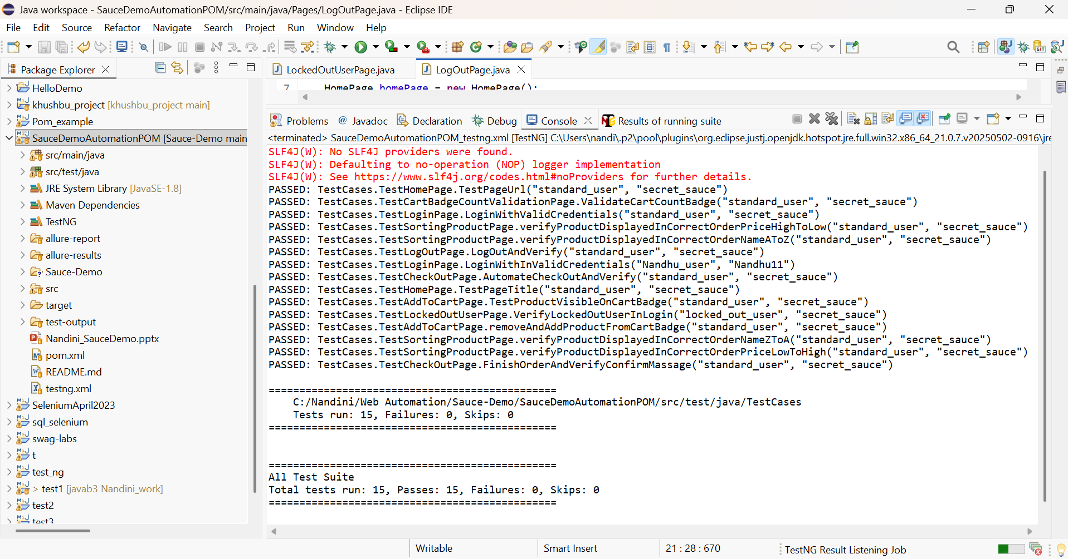
Outcome :

Slide 14
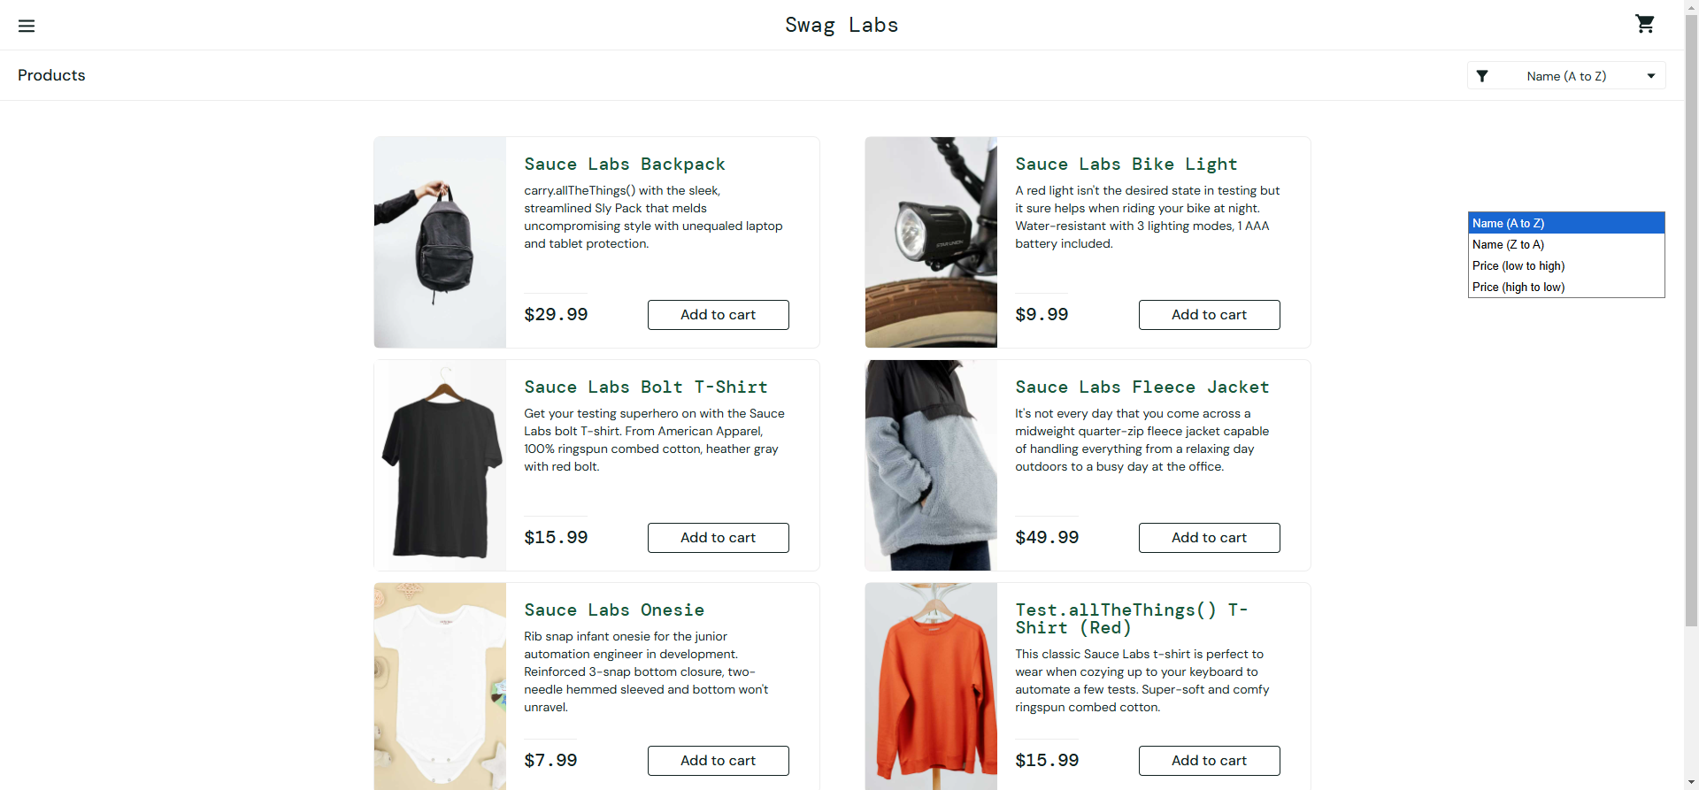
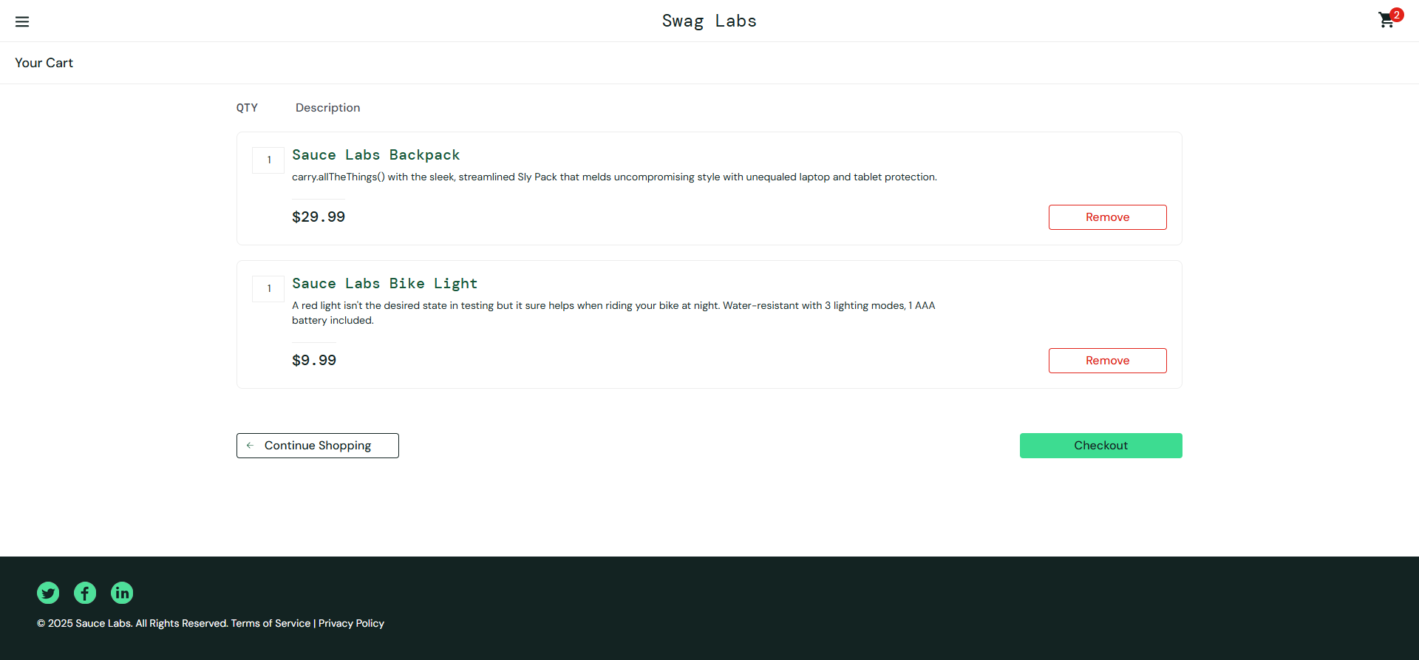
Test cases Screenshots :

Slide 15
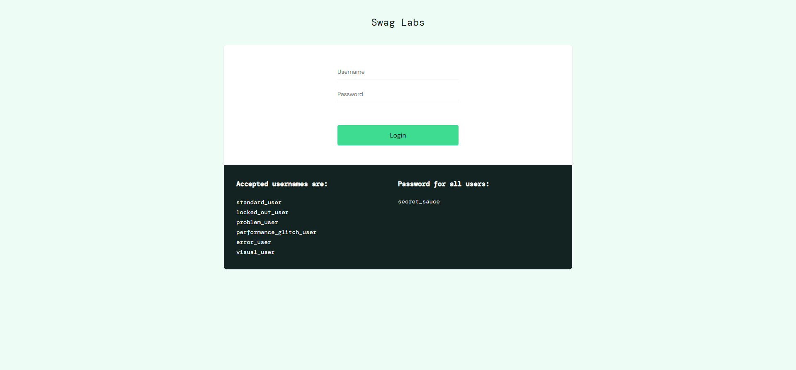
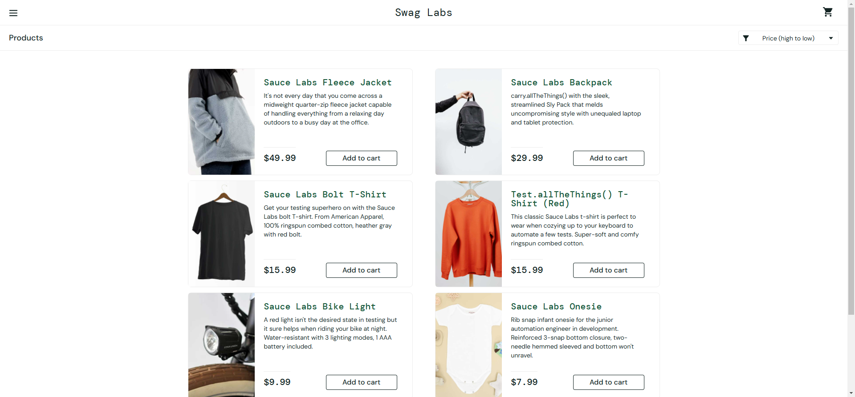
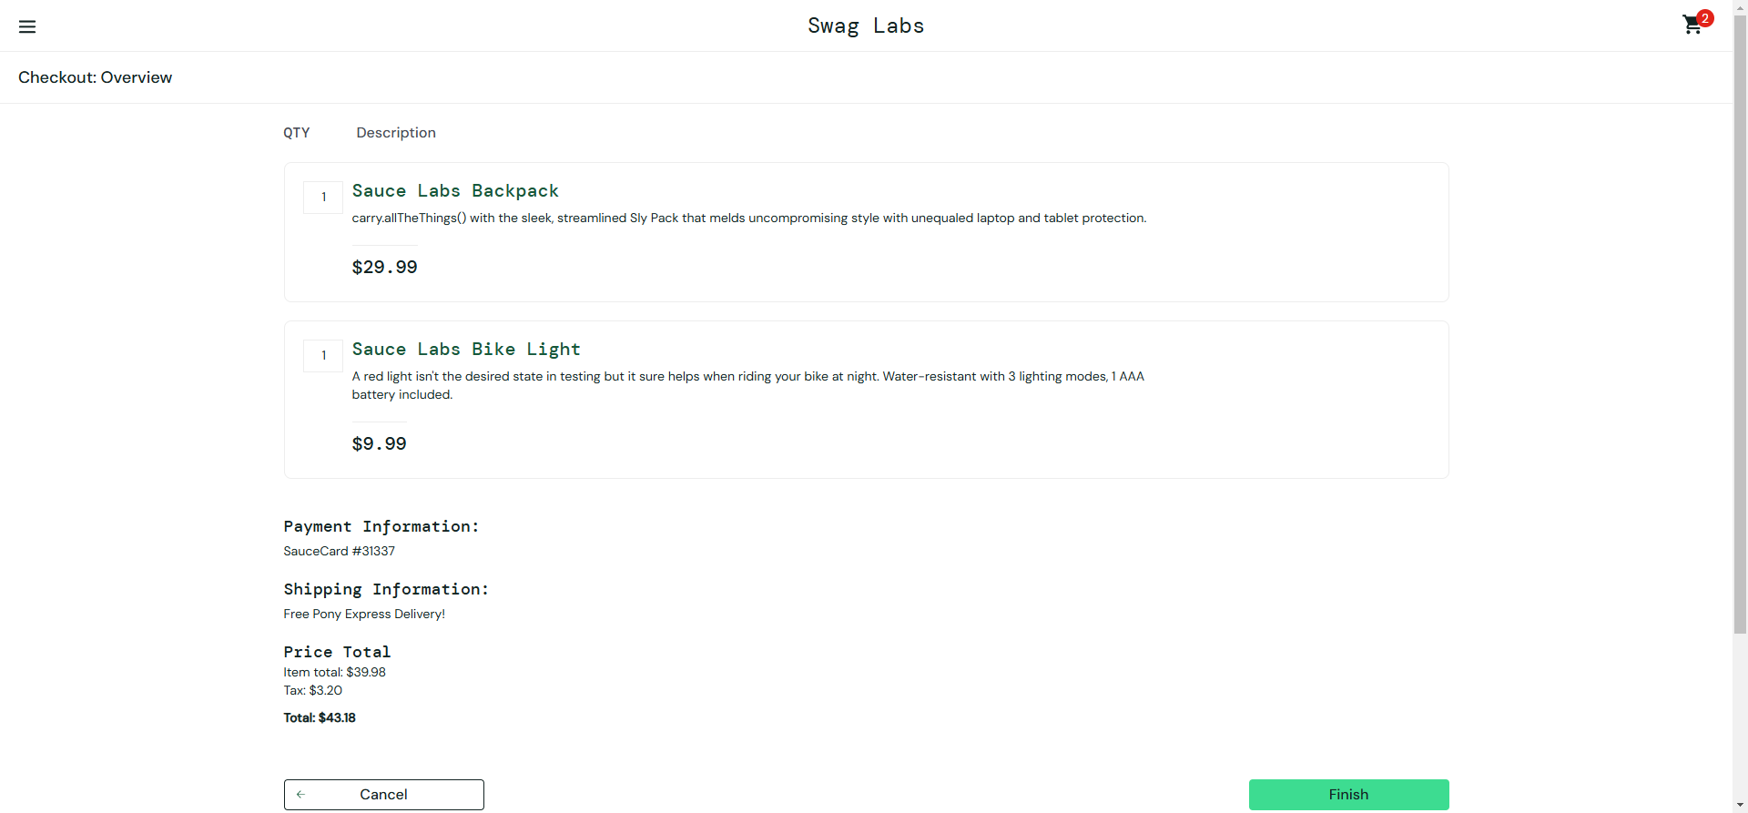
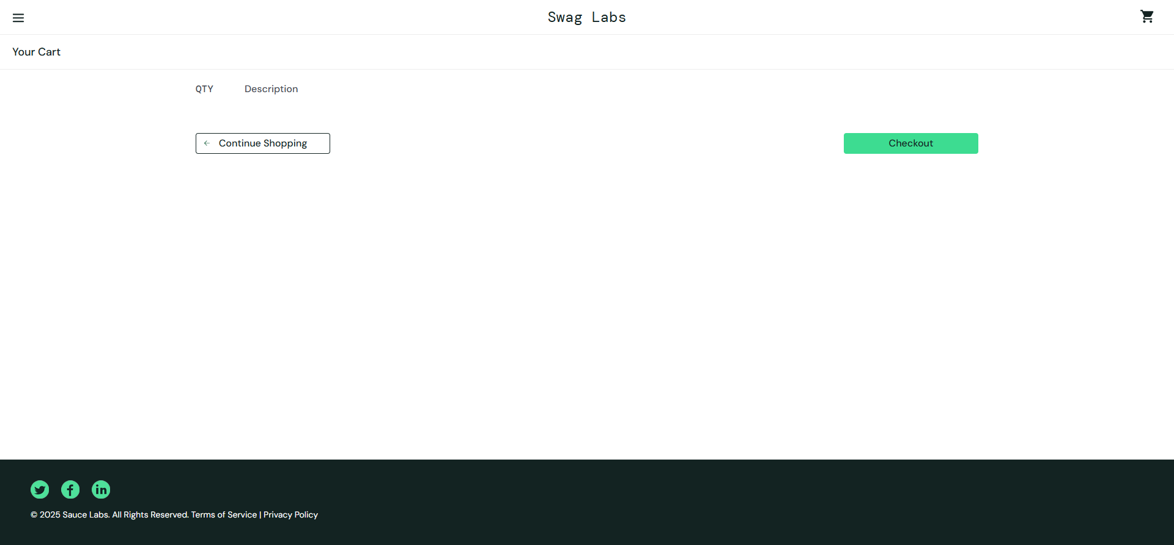

Slide 16
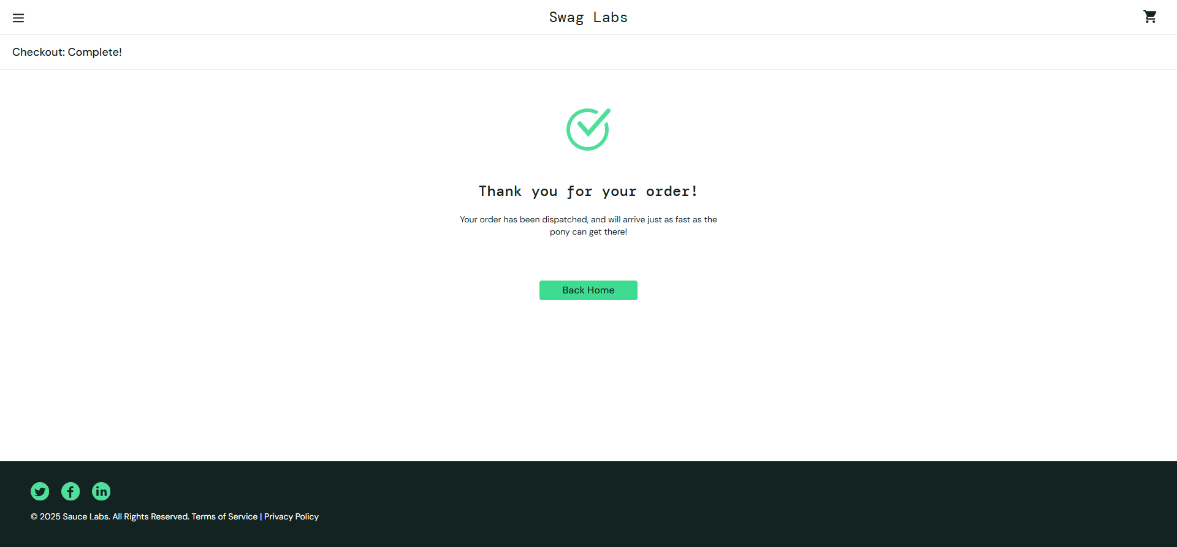

Slide 17
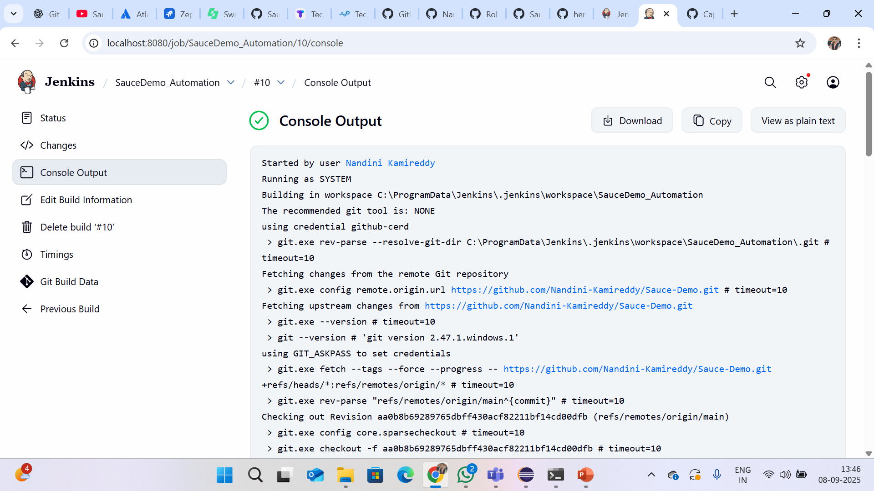
Jenkins :

Slide 18
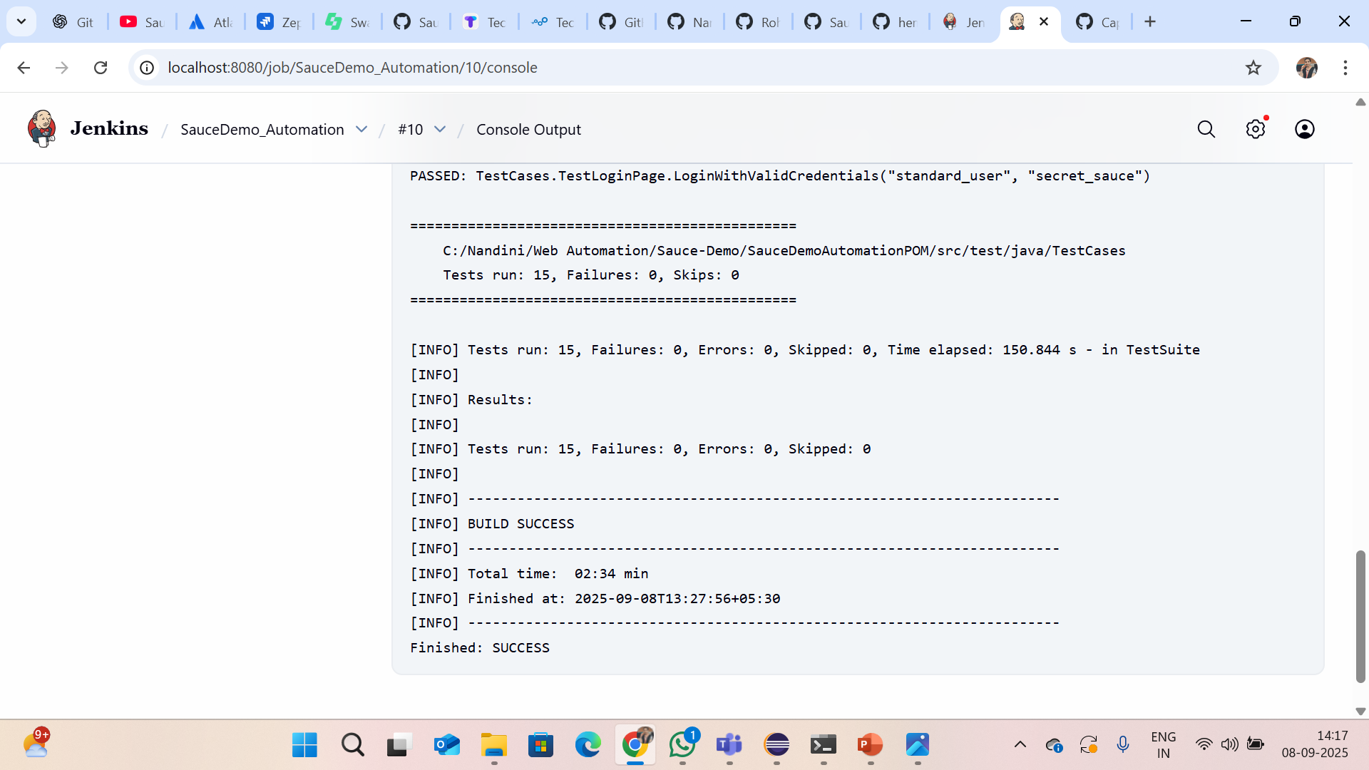

Slide 19
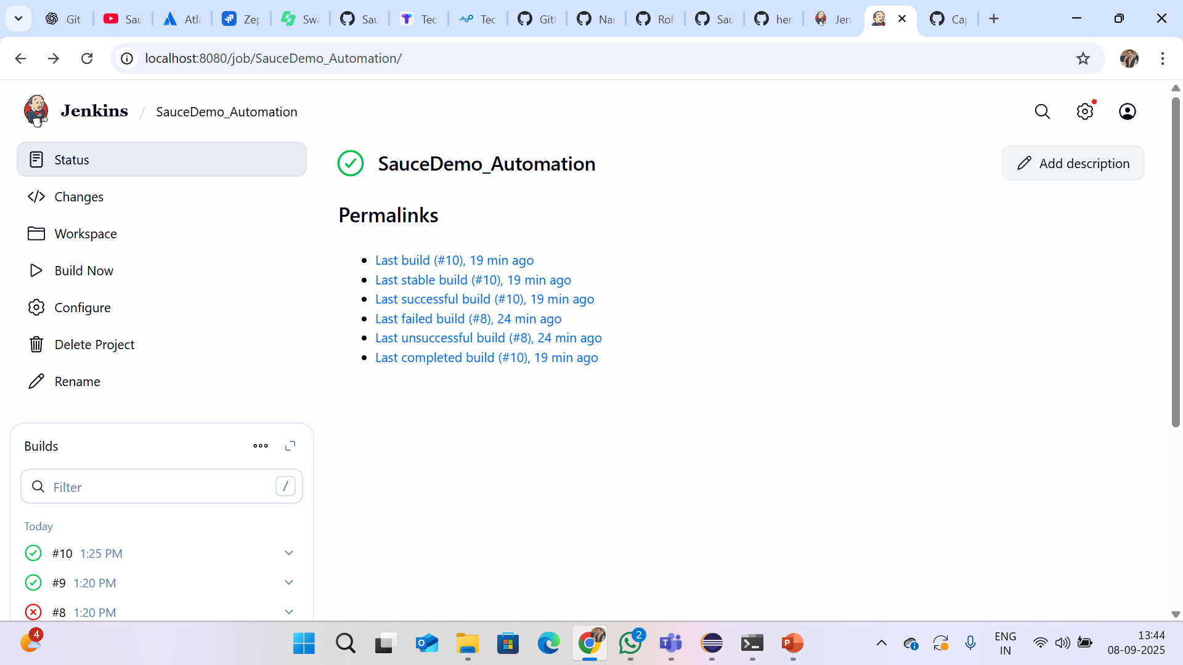

Slide 20
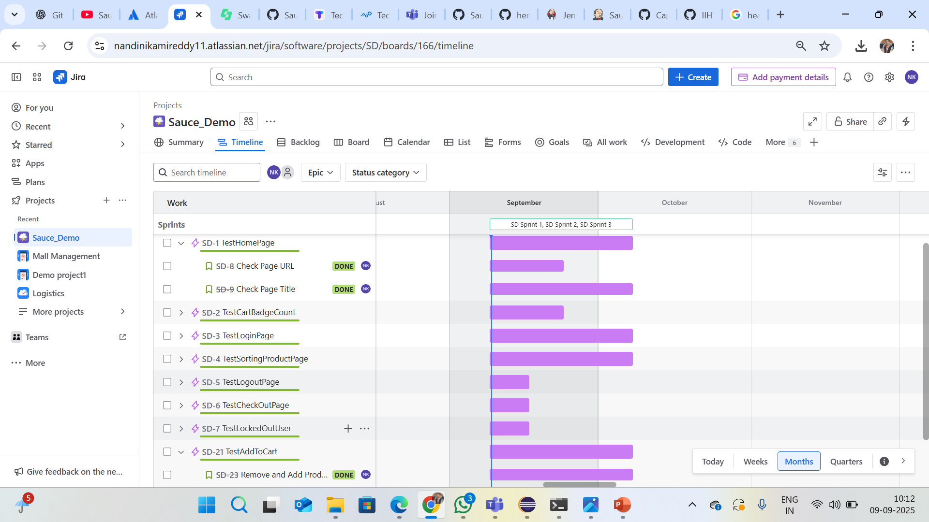
Jira – agile board :

Slide 21
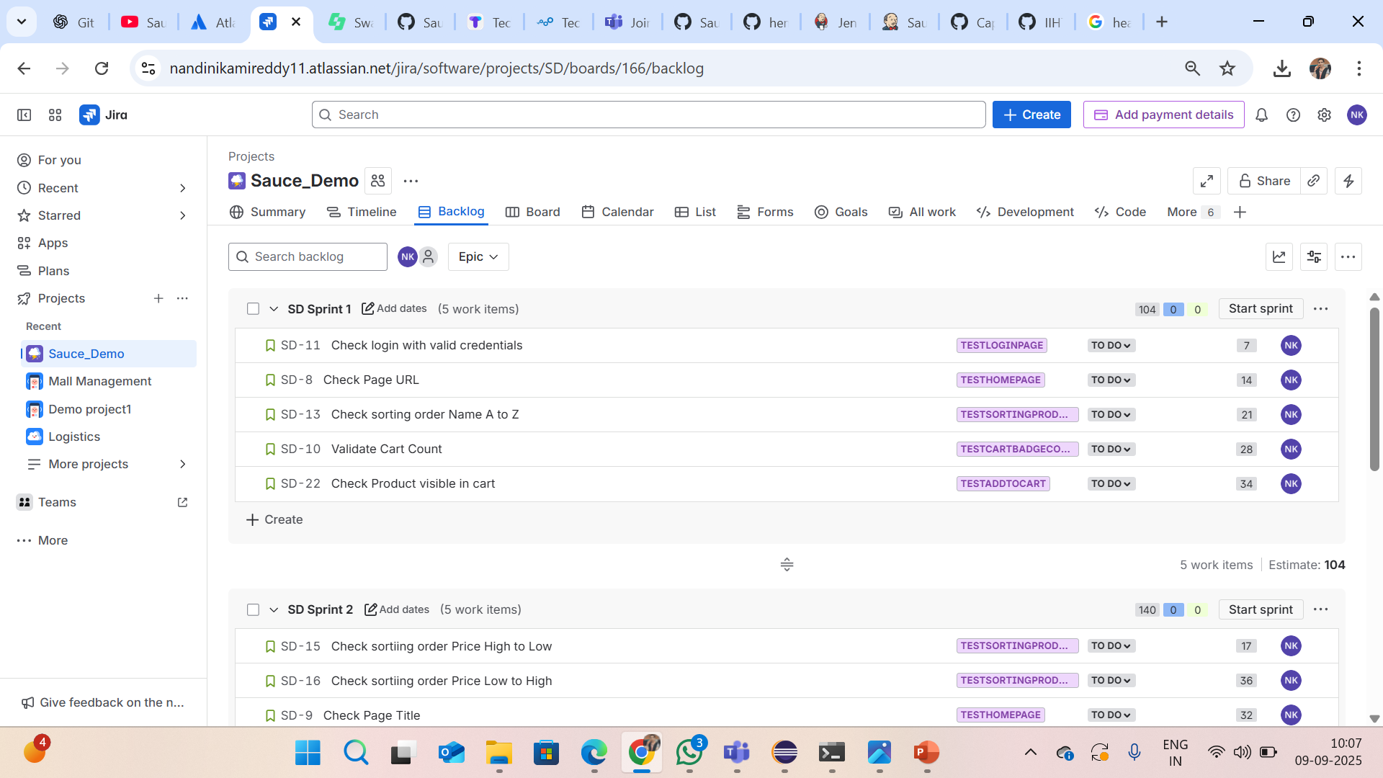
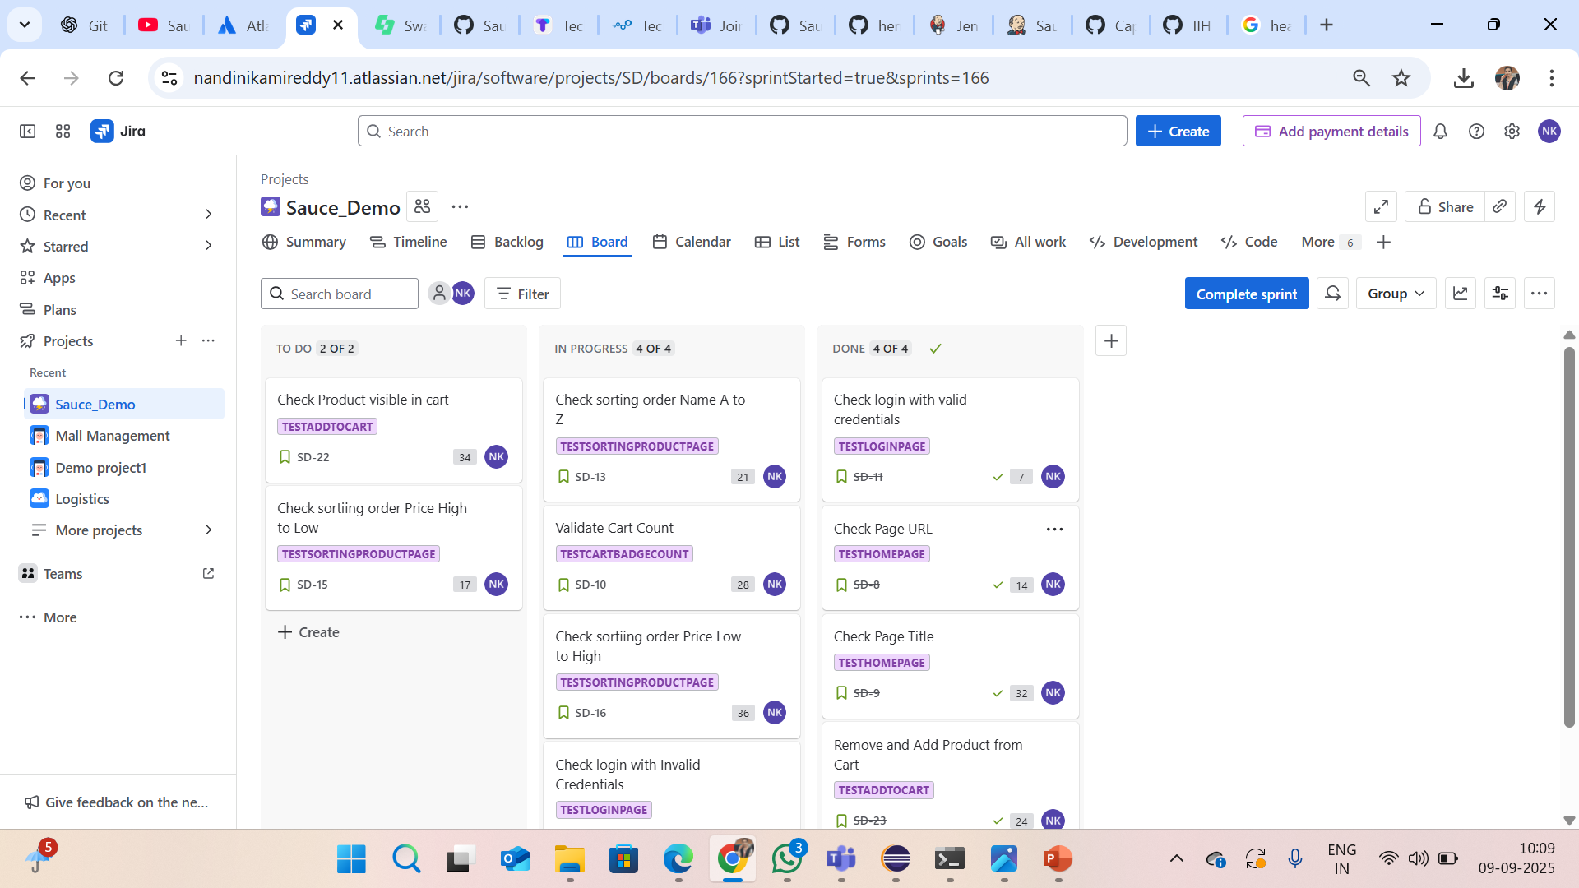
Sprint creation :

Slide 22
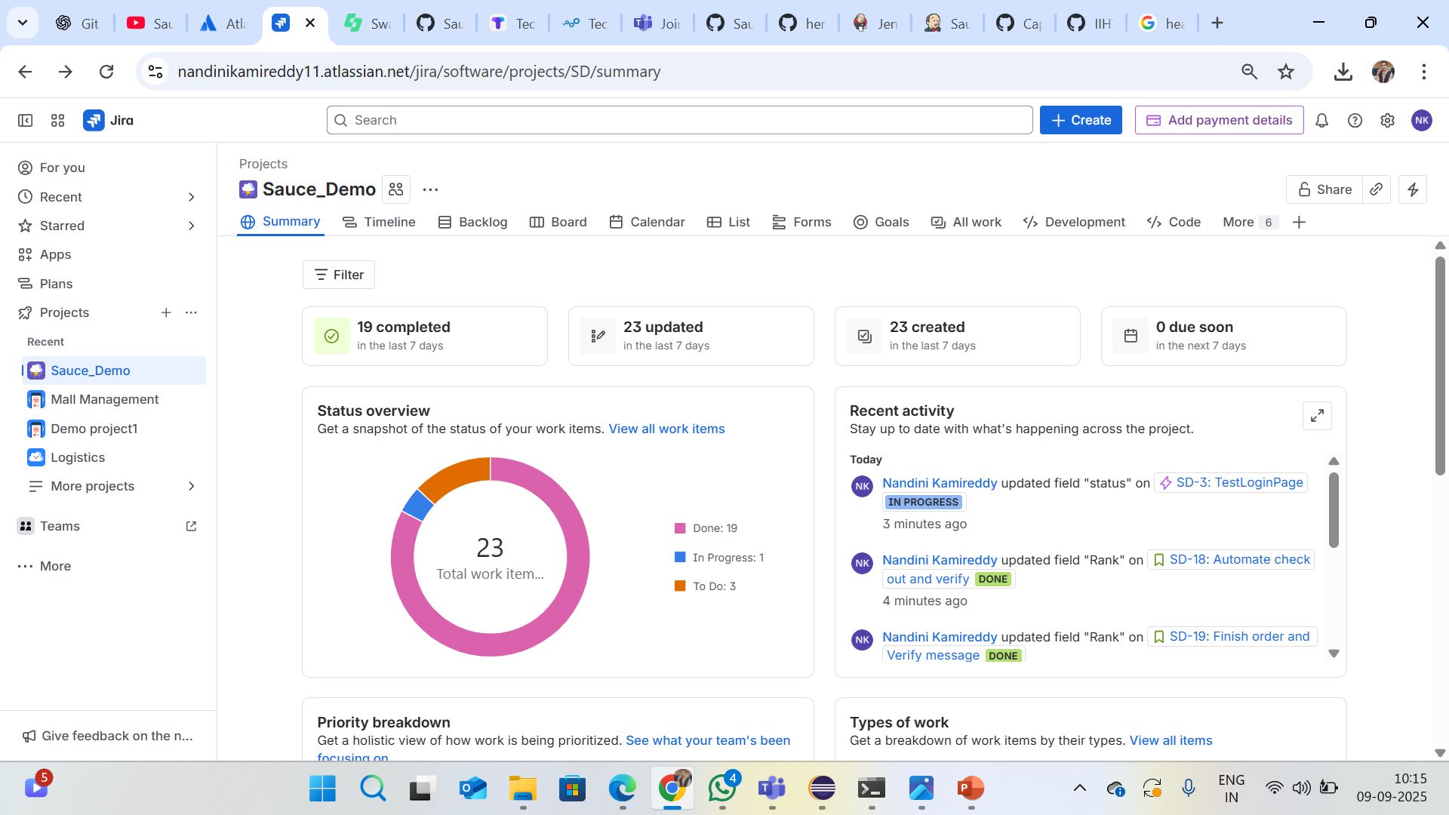
Summary :

Slide 23
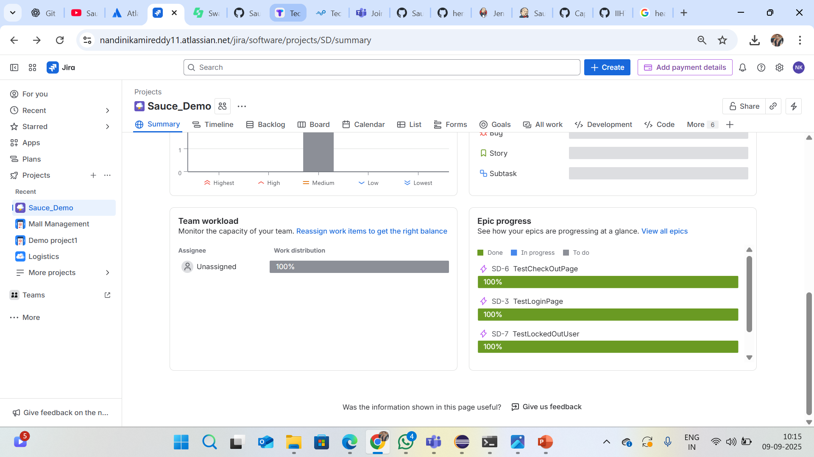

Slide 24
conclusion :
Project successfully automated Sauce Demo website.
Improved efficiency, reliability, and reusability.
Ready for integration into real-time pipelines.
References & links :
GitHub : https://github.com/Nandini-Kamireddy/Sauce-Demo.git
Website : https://www.saucedemo.com/

Slide 25
Thank you…

