Slide 1
E-Commerce Sales Analysis
Data-Driven Insights for Sustainable Growth
March – June 2022
PRESENTED BY:
NANDINI SHIVAPPA

Slide 2
Problem Statement & Company Background
Company:
Leading apparel e-commerce retailer (amazon.In channel)
Problem statement:
- Understand sales performance across product categories, cities, sizes, and timeframes.
- Identify low-performing areas and high-performing segments.
- Drive informed decisions in marketing, inventory, and operations.

Slide 3
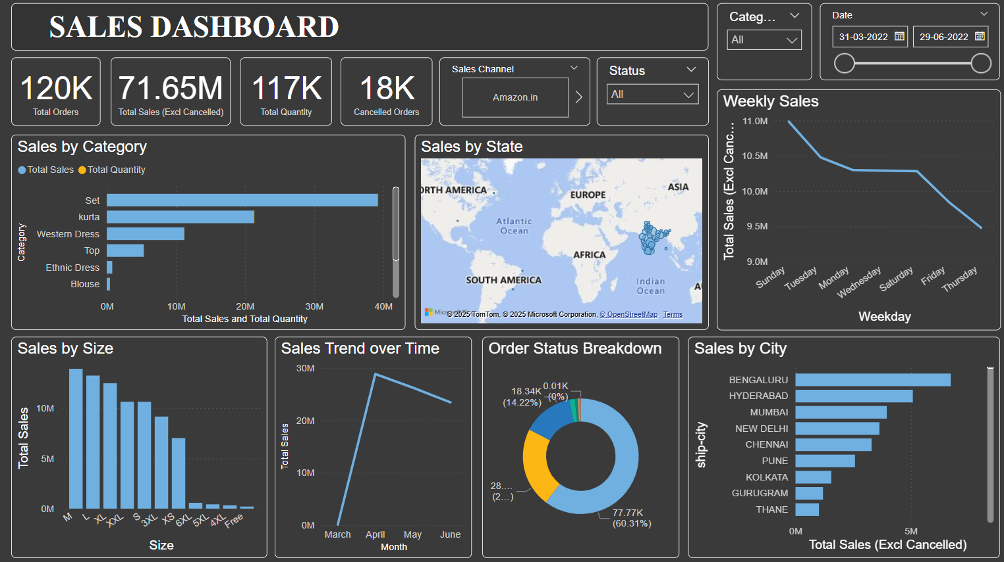
Dashboard Overview
Snapshot of overall sales KPIs, category performance, city-wise distribution, trends, and more.

Slide 4
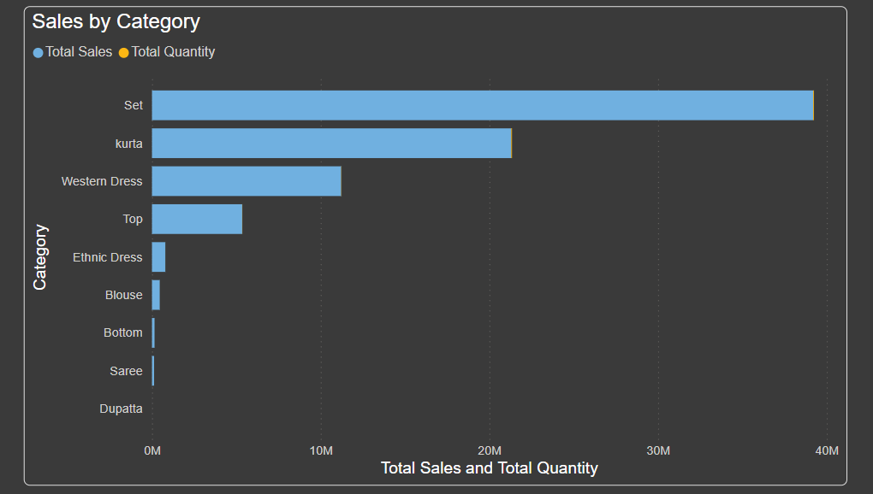
Sales by Category
‘Set’ and ‘Kurta’ dominate sales. 'Blouse' and 'Ethnic Dress' are underperforming, requiring deeper analysis.

Slide 5
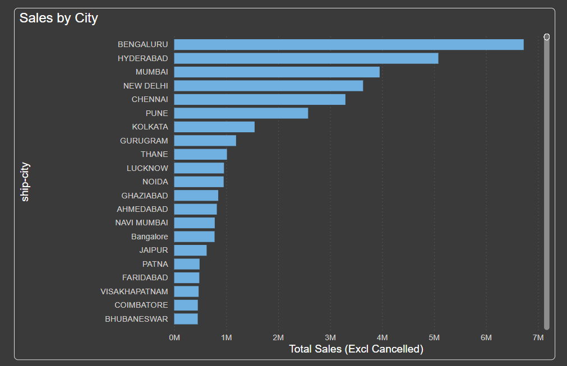
Sales by City
Bengaluru, Hyderabad, and Mumbai are top contributors. Focus marketing efforts on emerging cities.

Slide 6
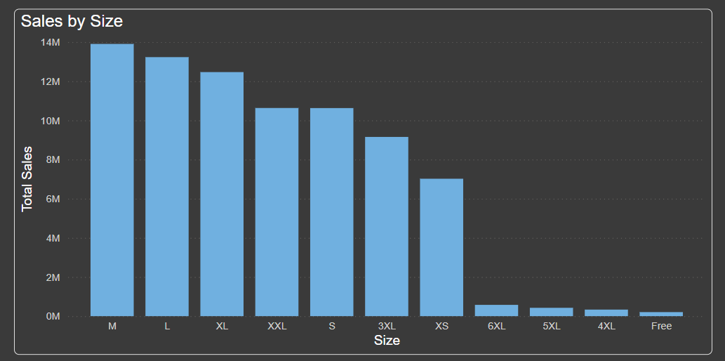
Sales by Size
Sizes M, L, and XL have highest demand. Limited sales for 5XL, 6XL indicate niche or redundant inventory.

Slide 7
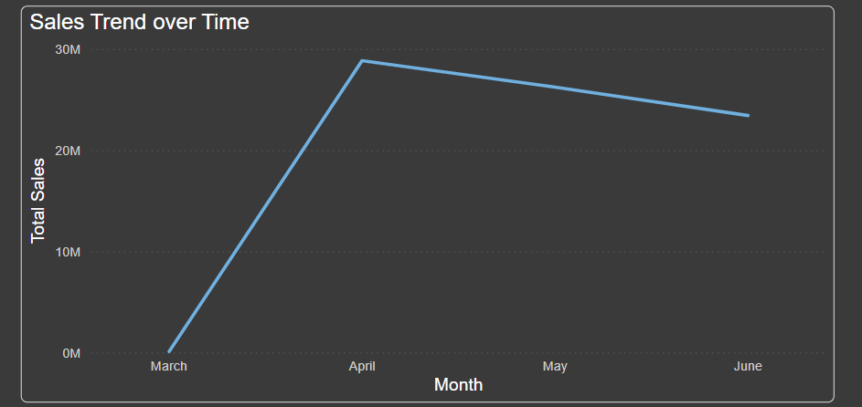
Sales Trend Over Time
Sales peaked in April, with a gradual decline. Seasonal effects or promotions may be influencing trends.

Slide 8
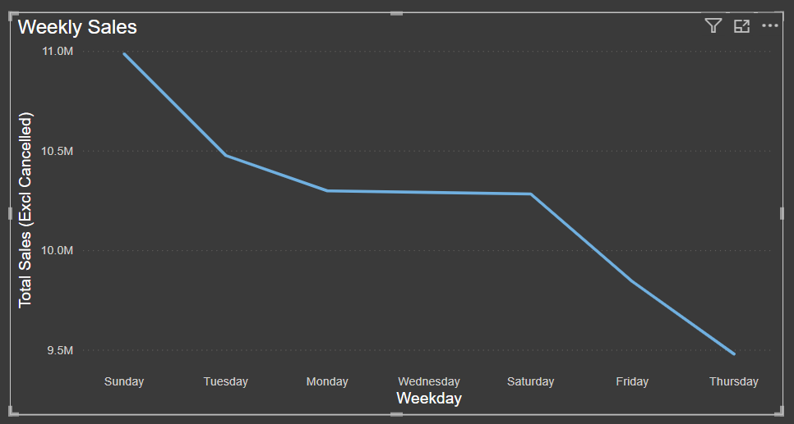
Weekly Sales Pattern
Sales are highest on Sundays and decline toward Thursday. Target mid-week with discounts or campaigns.

Slide 9
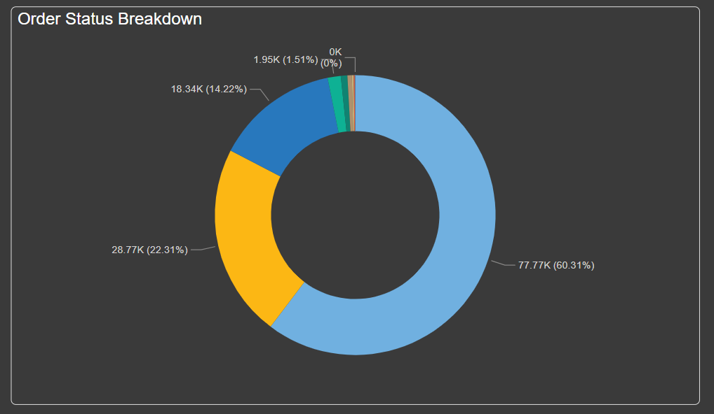
Order Status Breakdown
Most orders are completed. However, cancellations and returns highlight the need for process improvement.

Slide 10
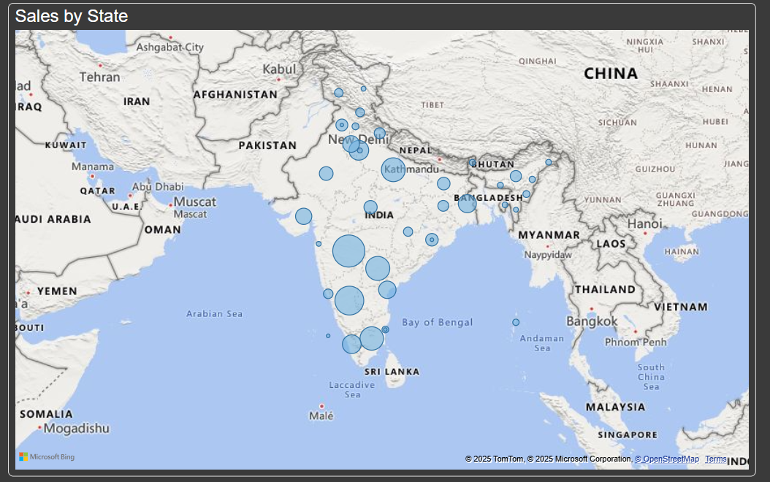
Sales by State (Geographic View)
Concentration of sales in specific regions of India. Regional strategies can be developed.

Slide 11
Sales Data Extraction & Conclusion
Dataset Extraction:
Extracted from an e-commerce sales system.
Fields included order ID, category, SKU, size, fulfillment type, shipping details, and financials.
Cleaned by removing cancellations and replacing missing values
Conclusion:
‘Set’ and ‘Kurta’ dominate revenue.
Sizes M and L are preferred.
April is the top sales month; Sundays are the best sales days.
Bengaluru and Hyderabad are top revenue cities.
Reduce 14% cancellation rate through better fulfillment and customer engagement.

Slide 12
Key Insights & Recommendations
- Focus on popular categories like 'Set' and 'Kurta'.
- Optimize stock for top-performing sizes.
- Address causes of cancellations and returns.
- Utilize city and weekday trends for strategic planning.

