Slide 1

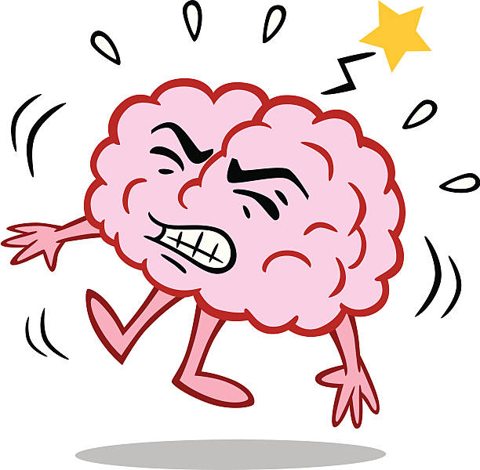
BRAIN STROKE PREDICTION
PRESENTED BY
TEAM NO:265
Ms. TATI KRUPA NANDINI
Ms. TADIBOINA SAITEJA
UNDER THE GUIDANCE OF
Mr. SAI SATISH(CEO of INDIAN SERVERS)

Slide 2
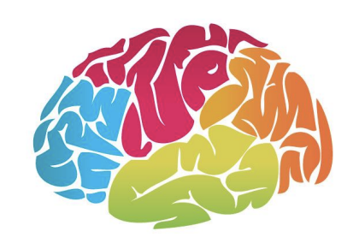
CONTENT
1. OVERVIEW
2. DATASET
3. METHODOLOGY
4. STROKE MONITORING SYSTEM
5. ARCHITECTURE
6. OUTPUT & ACCURACY

Slide 3
OVERVIEW
Brain prediction is expected to be great asset to the conventional method.
This research of the stroke predictor model using machine learning techniques.
Machine learning algorithms such as Multi-Layer Perceptron(MLP),Convolution
Neural Network(CNN).
Brain stroke prediction is based on observation of patient’s data.

Slide 4

DATASET
The dataset is collected from “Kaggle”.
This dataset is used to predict whether a patient is likely to get stroke based on input parameters like gender, age, various diseases, and smoking status.
Each row in the data provides relevant information about the patient.

Slide 5
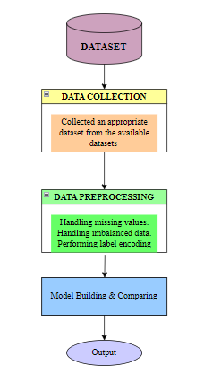
METHODOLOGY
Fig: The flowchart of the proposed system methodology

Slide 6
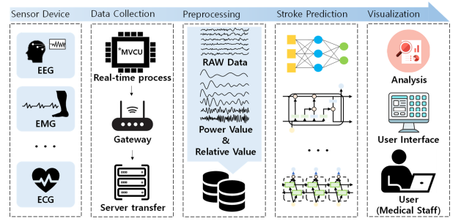
Elderly stroke monitoring system using bio signals

Slide 7
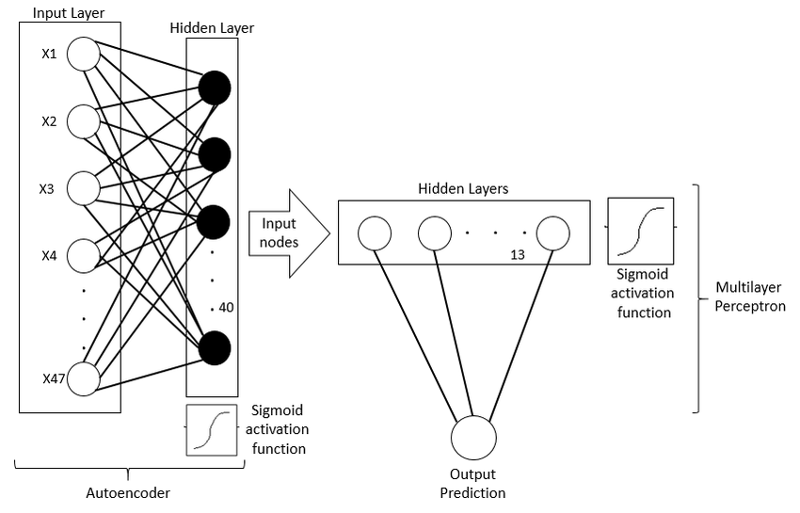
ARCHITECTURE

Slide 8
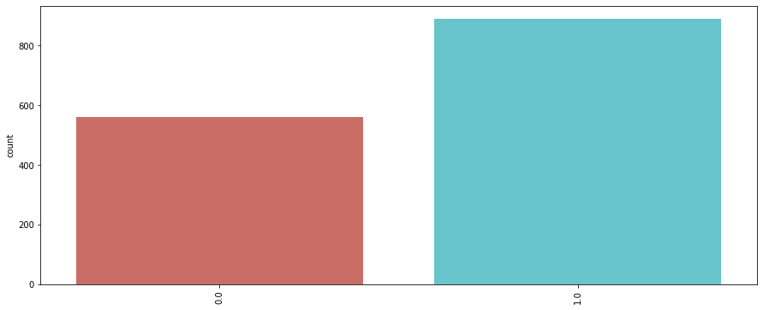
OUTPUT & ACCURACY
Accuracy is the fraction of predictions our model got right.
The accuracy of the model is 89%.

Slide 9
THANK YOU

