Slide 1

High-Frequency Trading Price Lookup By
Nandini Solanki Aaryan Kuchekar Sahil Ghone Raad Dalwai

Slide 2

Problem Statement
In high-frequency trading (HFT), decisions must be made in microseconds
Traders need to quickly find the closest stock price ≤ target price
Data is large and continuously updating
Linear search is too slow (O(n))
Key Challenge:
How to search huge datasets instantly and efficiently

Slide 3
Solution
Approach:
Use Binary Search (Lower Bound concept)
Works on sorted price data
What the system does:
Takes a target price as input
Searches for the nearest price ≤ target
Returns:
Closest price
Timestamp
Why this works:
Binary search reduces time complexity to O(log n)
Suitable for real-time systems like trading engines

Slide 4
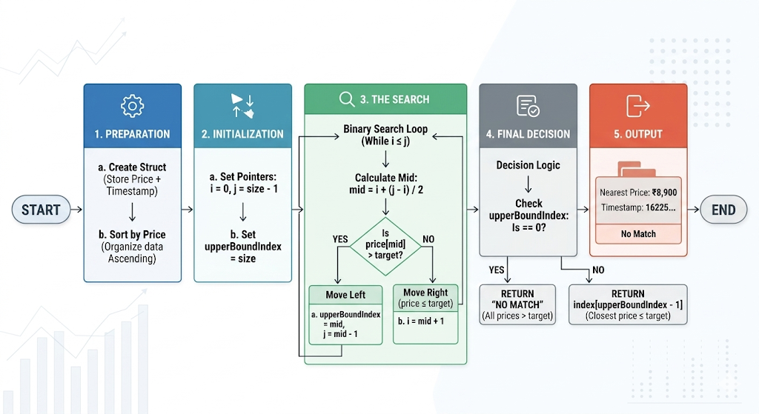
Working(Method/Mind Map)

Slide 5
Conclusion
Binary Search makes price lookup extremely fast
Ensures real-time decision making in trading
Scalable for large datasets
Can be extended with:
Live data streaming
Multi-stock support
AI-based predictions

Slide 6
Thank You

