Slide 1
PROJECT TITLE:MOBILE APP TO TRACK, MONITOR, RECORD AND ANALYSE MALNOURISHMENT IN CHILDREN
CSE7101- Capstone Project
Review-1
Batch Number : PSCS_673
Under the Supervision of,
Dr./Mr./Ms./Prof.
Professor / Associate Professor / Assistant Professor
School of Computer Science and Engineering
Presidency University
Roll Number | Student Name
20221CSE0701 20221CSE0700 20221CSE0784 | POOJA MA NANDINI R P DIKSHITH
Name of the Program: CSE-Computer Science and Engineering
Name of the HoD: Dr. Asif Mohammed
Name of the Program Project Coordinator: Dr. Jayavadivel Ravi
Name of the School Project Coordinators: Dr. Sampath A K , Dr. Geetha A

Slide 2
Problem Statement Number:
Organization:
Category (Hardware / Software / Both) : Software
Problem Description:
Child malnutrition remains a serious global concern, particularly in underprivileged regions, due to inadequate monitoring, inaccurate record-keeping, and limited analysis of growth indicators. Current paper-based or manual methods are slow, prone to errors, and often inaccessible to healthcare authorities, resulting in delayed detection and intervention. Such delays can lead to severe health complications or even death. There is an urgent need for a reliable, easy-to-use mobile solution that enables real-time tracking, recording, and analysis of children’s nutritional status, ensuring early detection and timely action to reduce malnutrition.

Slide 3
Content
Problem Statement
Objectives
Background and Related work for title Selection
Analysis of Problem Statement
Innovation or Novel Contributions
Git-hub Link
Timeline of the Project
References

Slide 4
Content (continution)..
Problem Statement
Objectives
Background and Related work for title Selection
Analysis of Problem Statement
Innovation or Novel Contributions
Git-hub Link
Timeline of the Project
References

Slide 5
Objective
Digitize Nutritional Records – Provide a centralized platform to store and access children’s growth and nutrition data securely.
Real-time Monitoring – Enable continuous tracking of weight, height, BMI, and growth indicators.
Early Risk Detection – Use analytical tools to flag potential malnutrition cases for timely intervention.
Data Visualization – Offer graphical insights and growth trend charts for easier understanding by healthcare workers and parents.
Offline Functionality – Allow data entry and storage without internet connectivity, syncing automatically when online.
Custom Alerts & Reminders – Notify health workers or parents about upcoming check-ups or abnormal readings.

Slide 6
Background and Related work
Child malnutrition is a critical public health issue causing stunting, wasting, and developmental delays, especially in low-resource regions. Traditional monitoring relies on manual records and periodic surveys, which are slow, error-prone, and lack real-time analysis. Mobile technology enables on-site data capture, automated growth analysis, and instant alerts, improving early detection and intervention.
Existing solutions like WHO Anthro, CommCare, and ICDS-CAS collect nutrition data but often lack integrated predictive analytics, offline functionality, geospatial mapping, and user-friendly interfaces for low-literacy users. UNICEF’s RapidPro provides SMS reporting but lacks visual insights and trend analysis.
This gap highlights the need for an integrated, offline-first mobile application that can track, monitor, record, and analyze child nutrition data, offering predictive alerts, geotagging, and accessible visualizations for both healthcare workers and caregivers.

Slide 7
Analysis of Problem Statement
Technology Stack Components:
Frontend: Flutter (Dart) / React Native – Cross-platform mobile development.
Backend: Node.js (Express) / Django – API and business logi
Analytics: Python (Pandas, NumPy) – Growth status classification.
Cloud: AWS / Firebase – Hosting and storage.
Notifications: Firebase Cloud Messaging – Alerts & reminders.
Offline Storage: SQLite – Local data storage.

Slide 8
Github Link
The Github link provided should have public access permission.
Github Link

Slide 9
Analysis of Problem Statement (contd...)
Hardware Requirements:
Development:
Laptop with Intel i5/Ryzen 5 (min), 8 GB RAM, 256 GB SSD.
Testing Devices:
Android 9.0+ smartphone (3 GB RAM, 32 GB storage).
iOS 13+ device.
Server:
Quad-core CPU, 8 GB RAM, 500 GB SSD, high-speed internet.

Slide 10
Analysis of Problem Statement (contd...)
Software Requirements:
Frontend: Flutter / React Native, VS Code, Android Studio, Xcode (iOS).
Backend: Node.js / Django, MySQL/PostgreSQL.
Analytics: Python, Pandas, NumPy.
Design Tools: Figma / Adobe XD.
Version Control: GitHub.
Hosting: AWS / Firebase.

Slide 11
Innovation and Novel Contributions
Geo-Intelligent Hotspot Mapping : Generates real-time malnutrition heatmaps using geotagged data for targeted interventions.
Growth Trend & Velocity Analysis : Tracks changes over time to improve early warning accuracy compared to static measurement methods.
Offline On-Device ML : Deploys a lightweight TensorFlow Lite model on mobile devices for instant, offline risk assessment in rural areas.
Role-Specific Dashboards : Delivers tailored interfaces for health workers, administrators, and parents to ensure relevant insights for each user group.

Slide 12
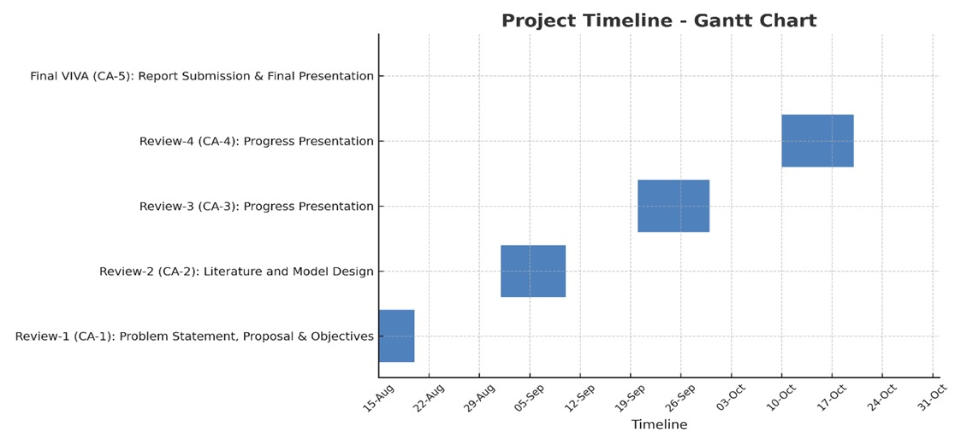
Timeline of the Project (Gantt Chart)

Slide 13
References (IEEE Paper format)
[1] T. C. Kustiawan, S. R. Nadhiroh, R. Ramli, and C. Butryee, “Use of mobile app to monitoring growth outcome of children: A systematic literature review,” Digital Health, vol. 8, Nov. 2022, Art. no. 20552076221138641.
[2] A. Dewi, M. C. Anwar, and T. Susilowati, “Monitoring the growth and development of toddlers aged 1–24 months using the Android-based BigMom application,” Int. J. Allied Med. Sci. Clin. Res., vol. 11, no. 1, pp. 27–33, Feb. 2023.
[3] “Android-Based Smart Nutrition Application for Children Nutritional Awareness,” IEEE Conf. Publication, 2025.

Slide 14


