Slide 1

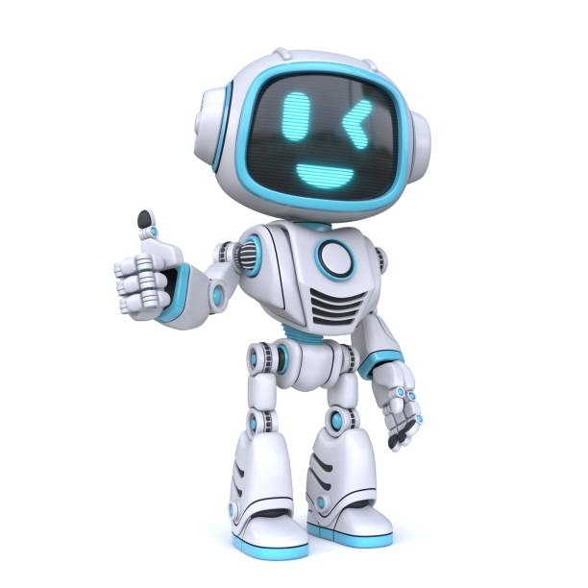
Choo-Choo Clean: The Future of Train Hygiene on the Fast Track!
Welcome to the Future!
In a world where germs are everywhere, the Automated Sanitization Revolution is here to save the day!
Problem Statement:
Due to travelling of heavy passengers in trains there is a possibility of getting infected with the people suffering from various diseases.
To address the issue, a system is to be developed for proper sanitization without manual involvement

Slide 2






All Aboard the Hygiene Express!
Train integrated air dispenser !
UV-C Light Disinfection: Activated when compartments are empty to kill bacteria and viruses
Disinfectant Sprayers: Automatically sprays non-toxic disinfectant on surfaces.
HEPA Air Filtration: Continuously cleans the air of harmful particles during travel.
Electrostatic Surface Sanitization: Coats surfaces with disinfectant to cover high-touch areas.

Slide 3
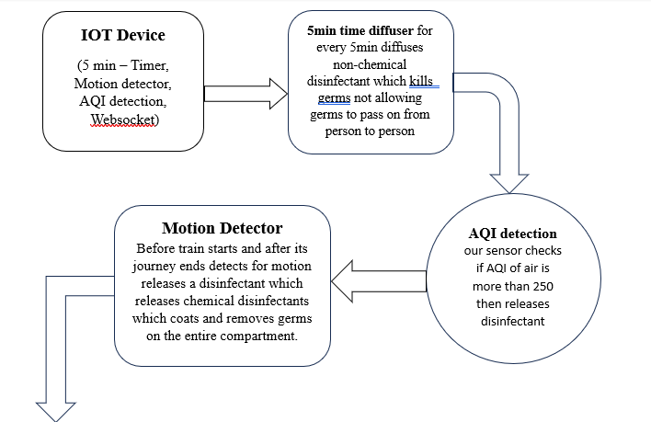
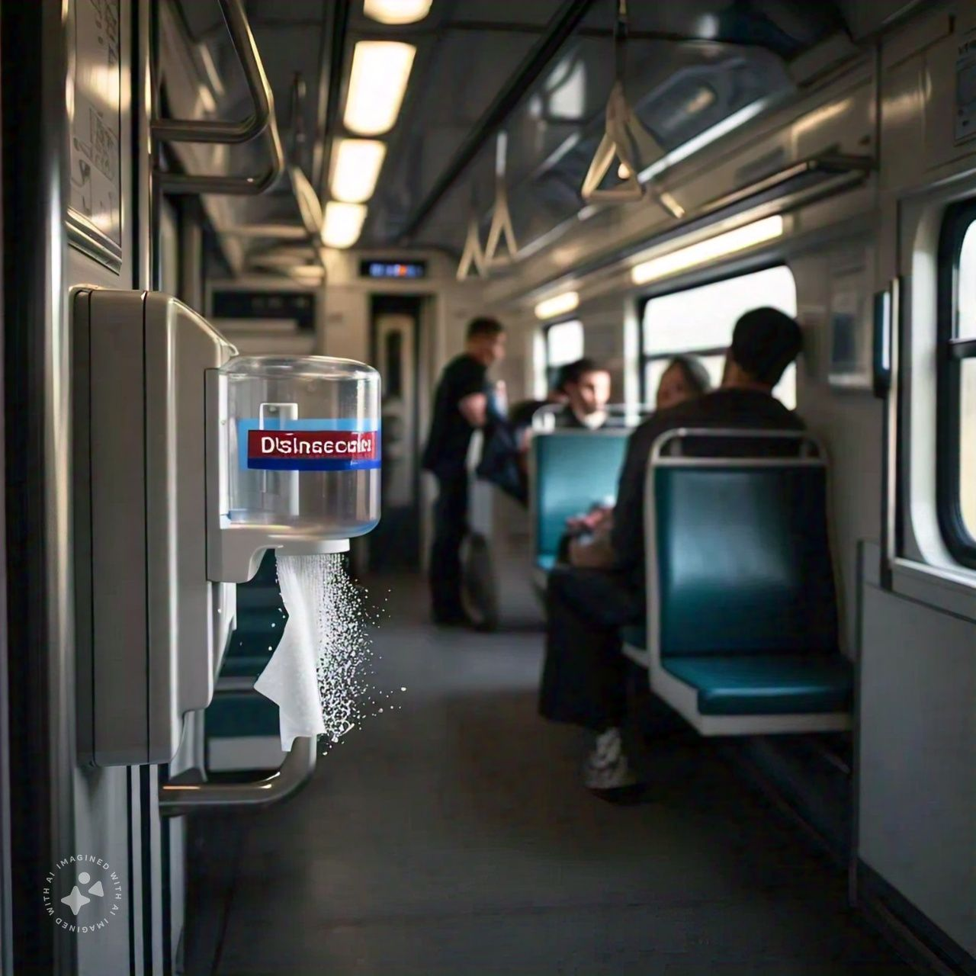
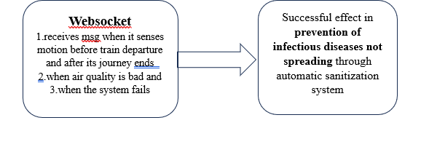

Slide 4
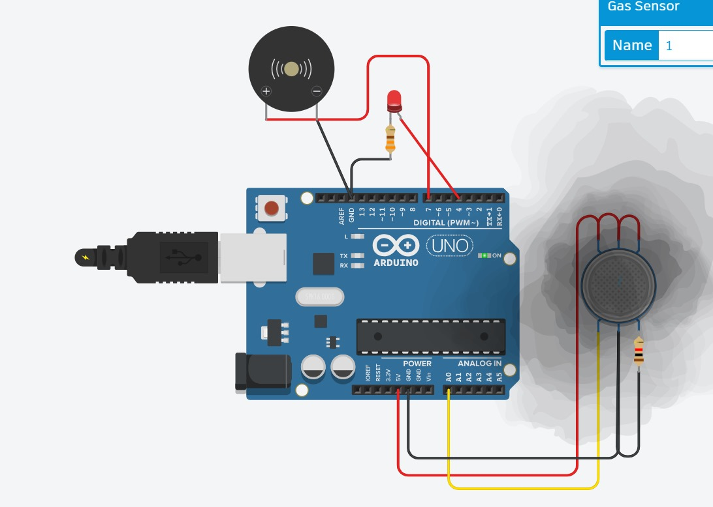
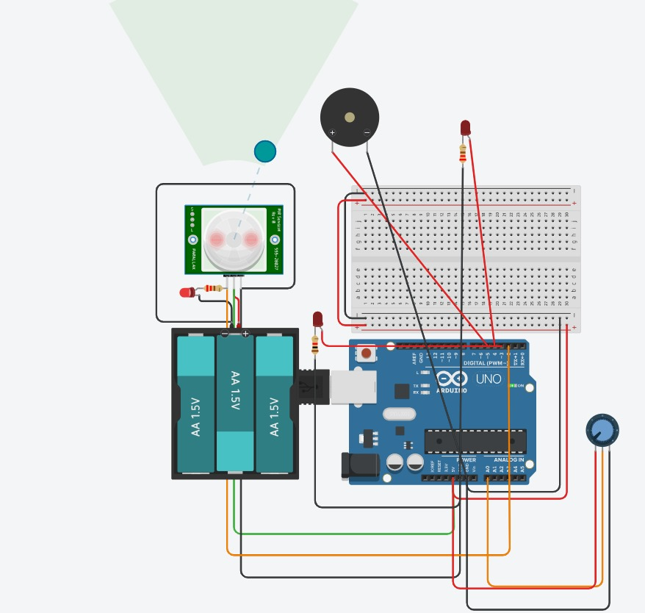
Prototype :r

Slide 5


Thank You !

