Slide 1
Expense Tracker ML
Automated expense categorization + budget alerts
Team: <your names>
Date: <today>

Slide 2
Problem & Goal
Manual expense categorization is slow and inconsistent.
Goal: fast, accurate category prediction + clear spending insights.
Data: spending_patterns_detailed.csv (10k rows, 9 columns).

Slide 3
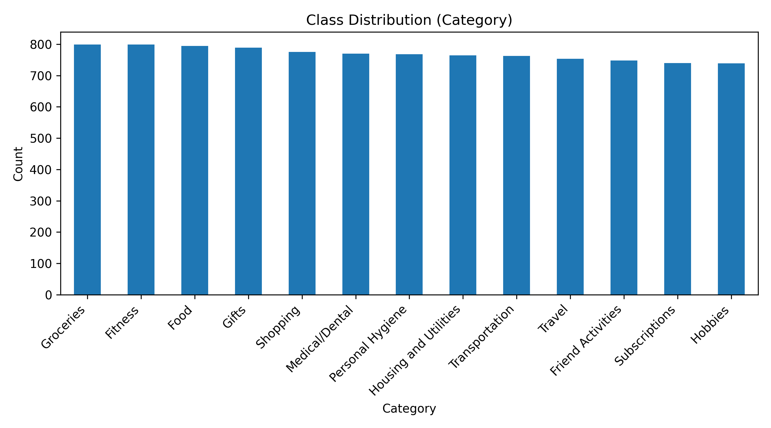
Class Distribution

Slide 4
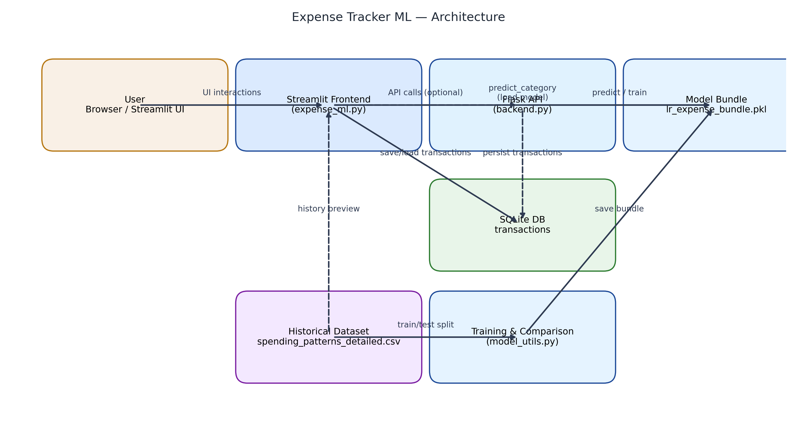
Architecture

Slide 5
Feature Pipeline
TF-IDF on Item text (max_features=3000).
StandardScaler on Total Spent.
One-Hot on Payment Method & Location.
Rare categories (<3) folded into 'Other'; stratified 80/20 split.

Slide 6
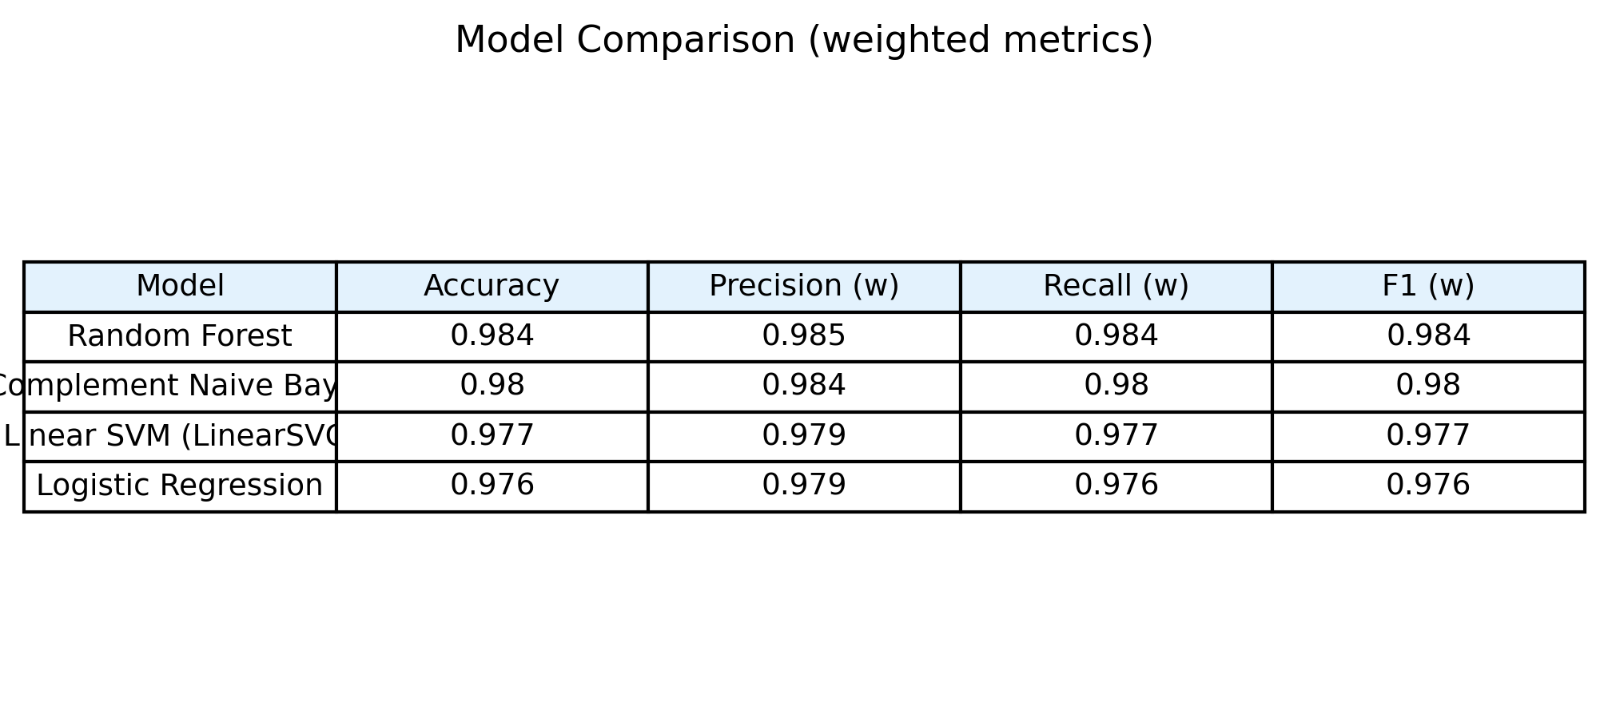
Model Comparison (Metrics Table)

Slide 7
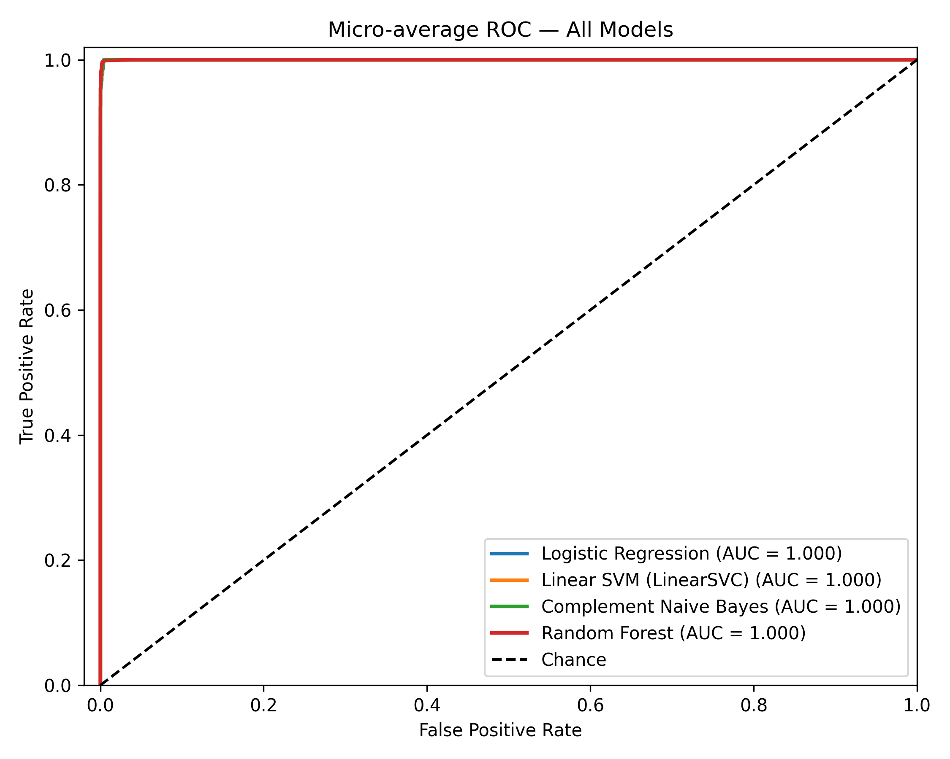
ROC Comparison — All Models

Slide 8
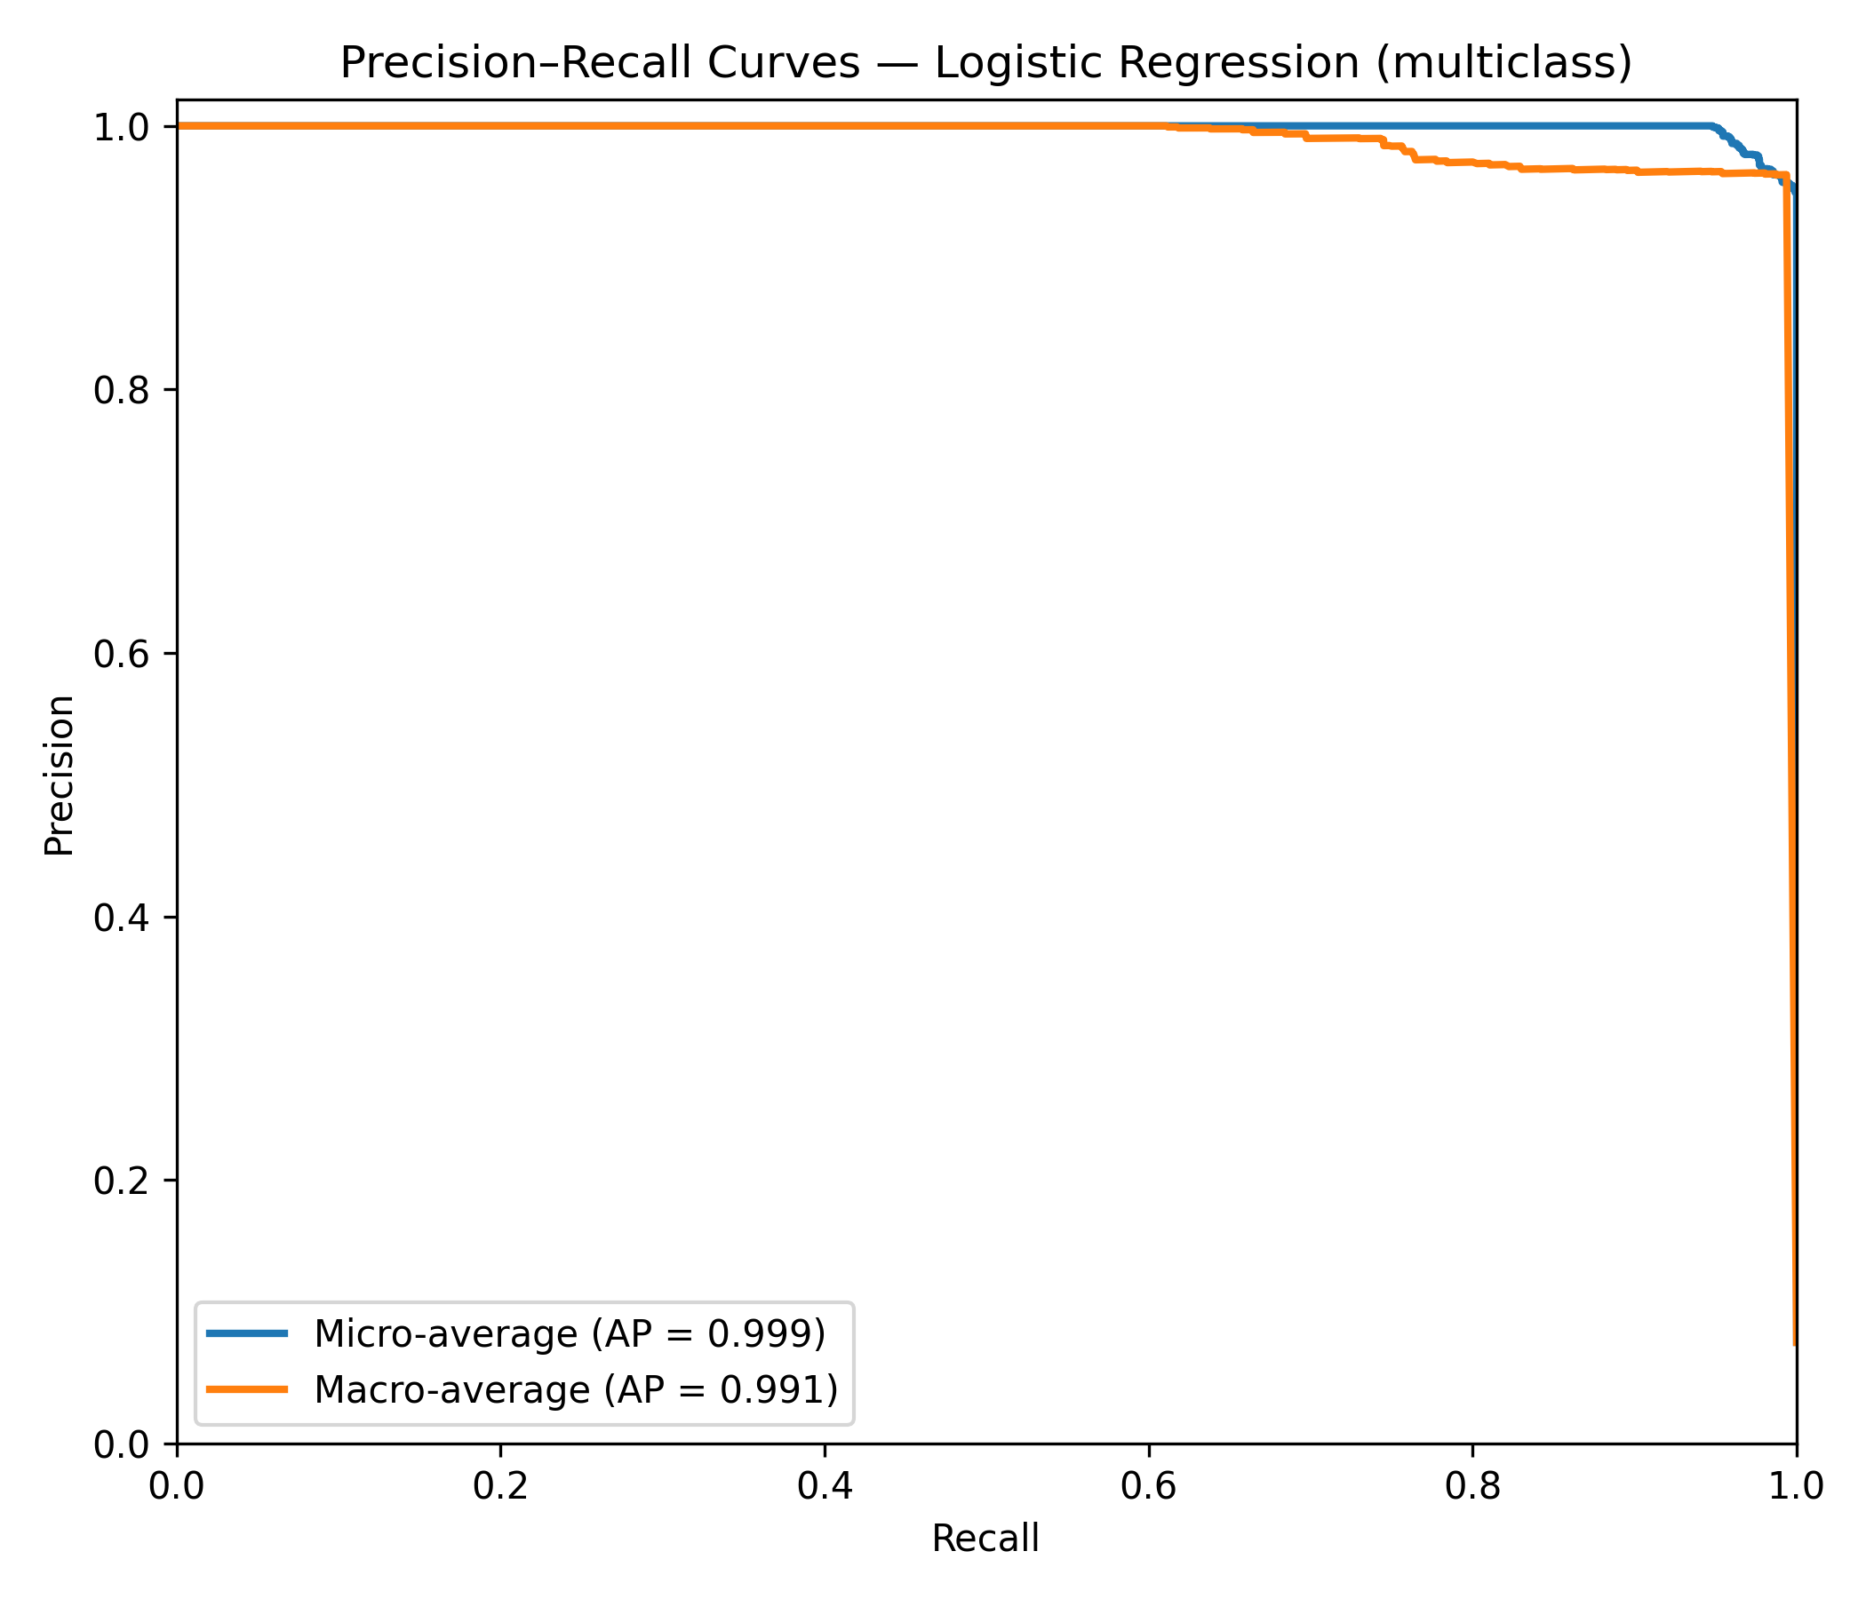
Precision–Recall (LogReg)

Slide 9
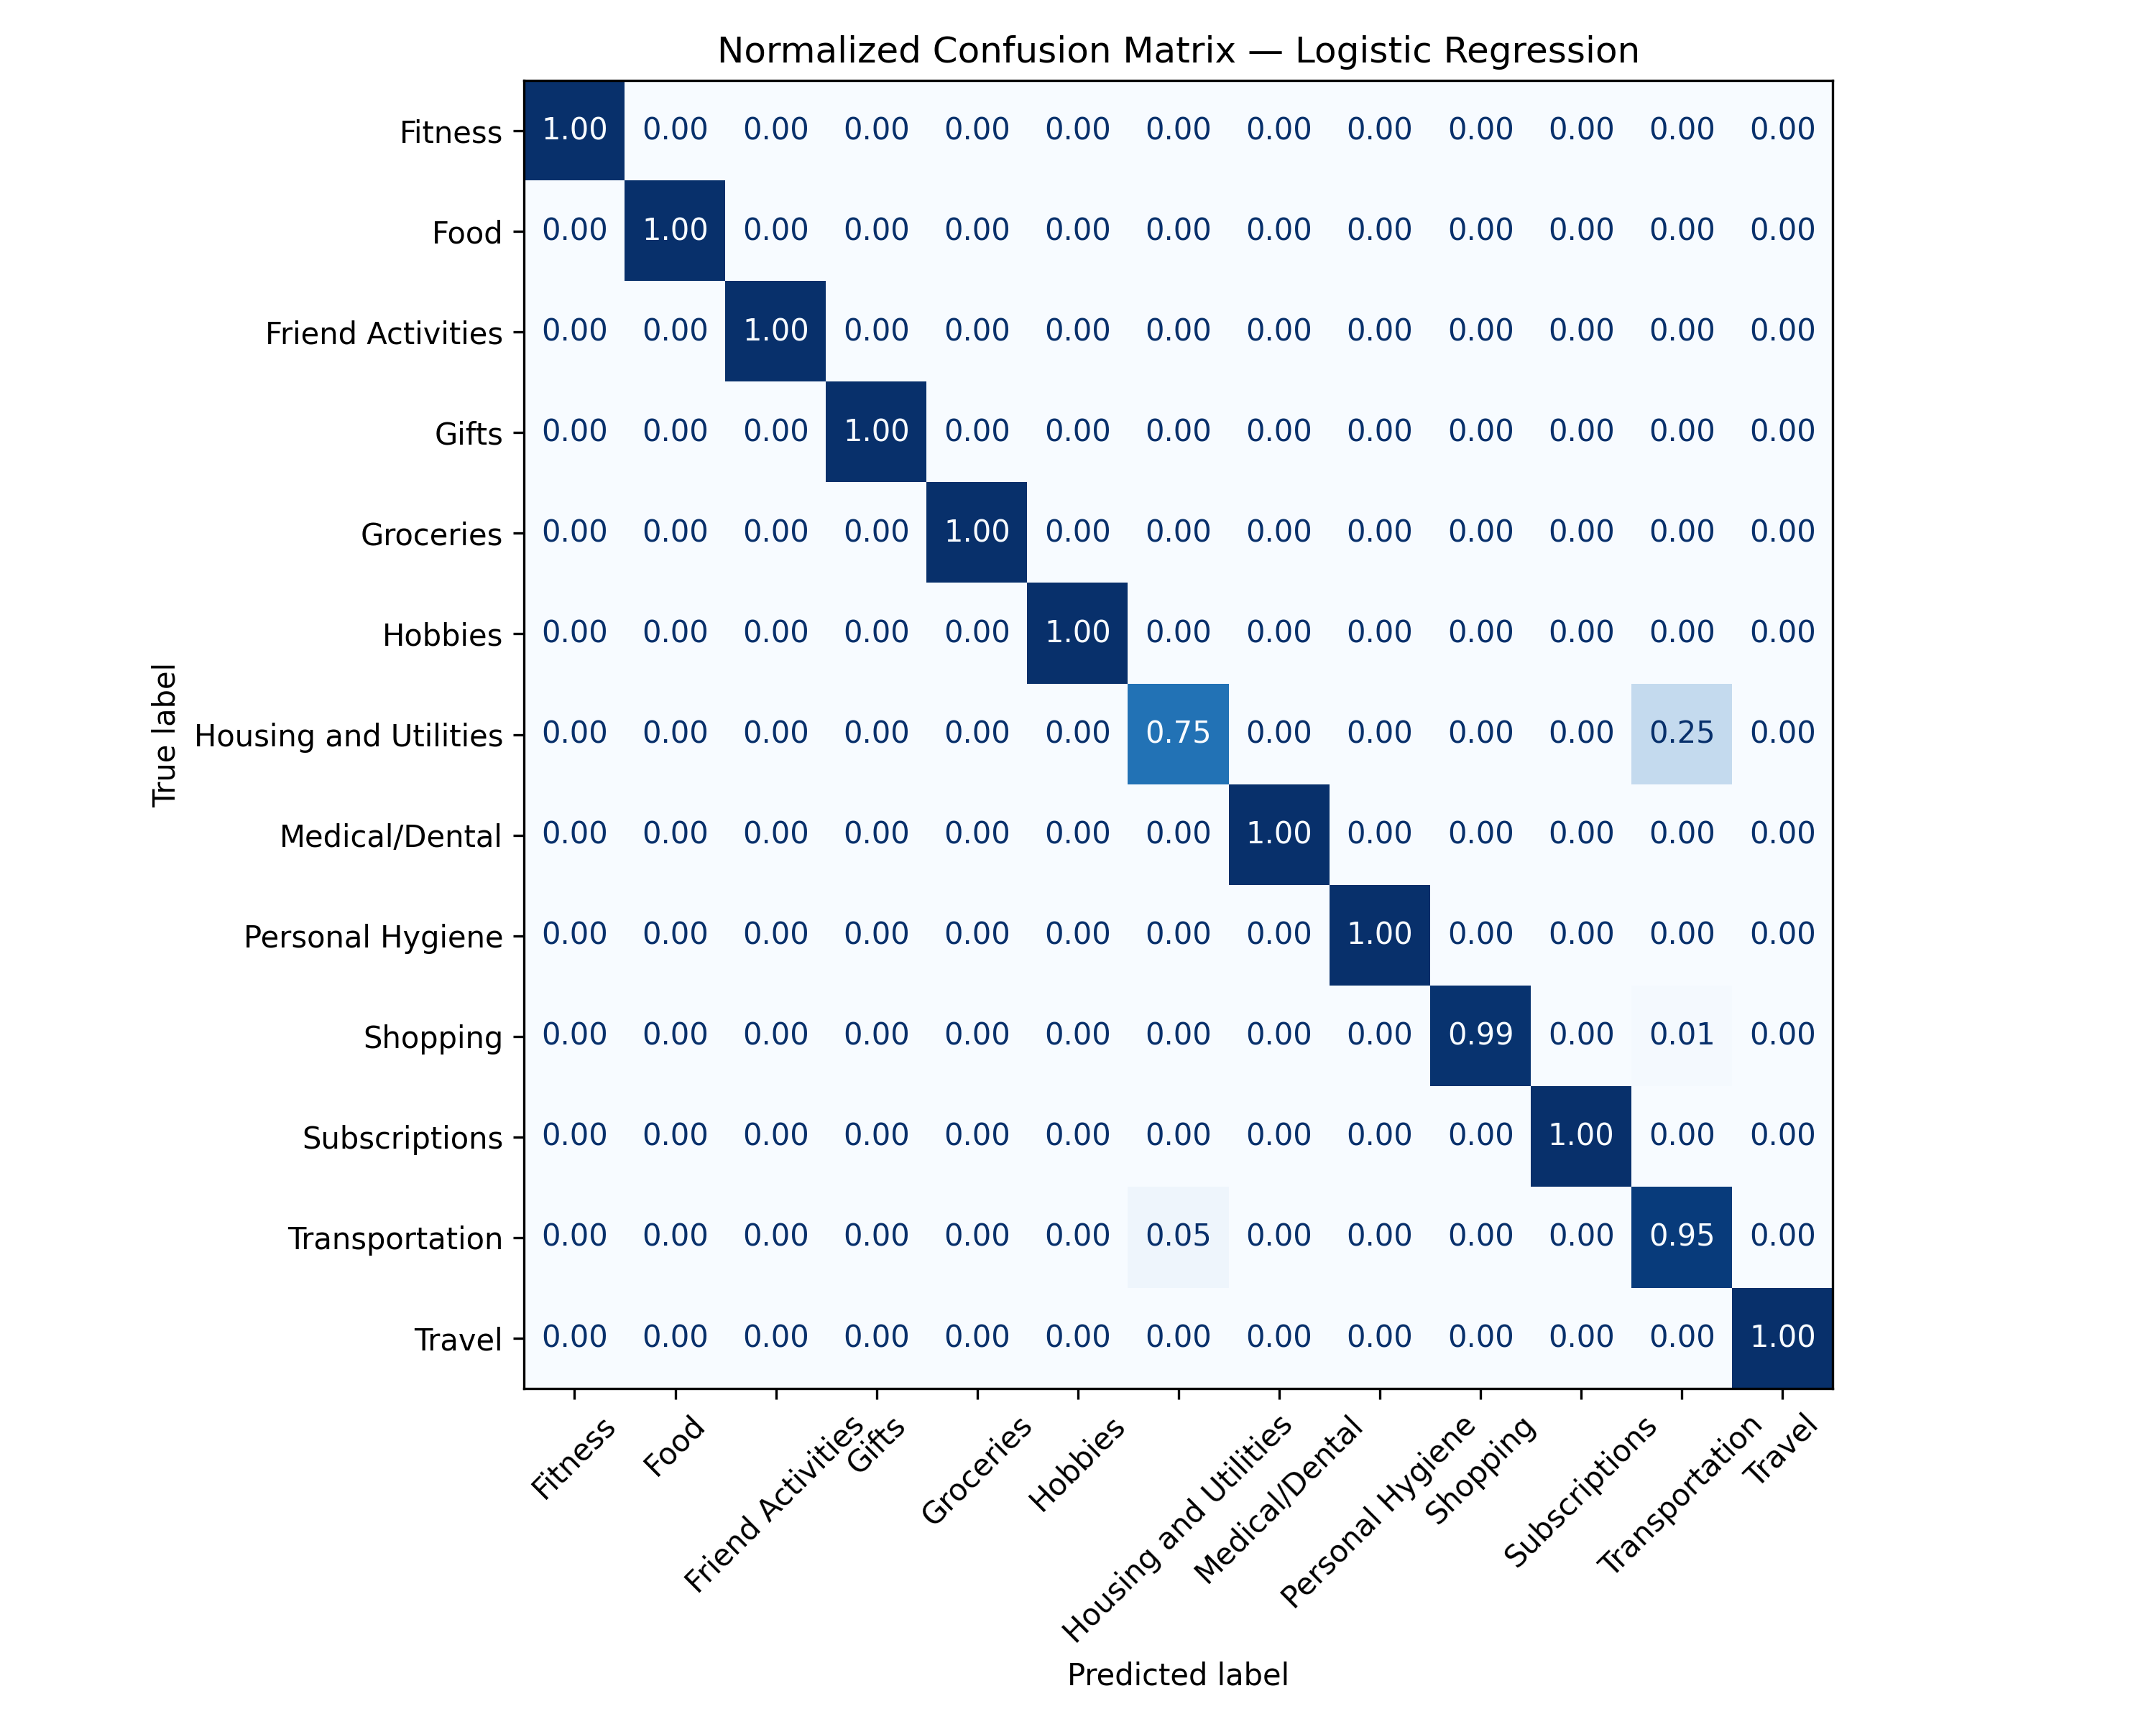
Confusion Matrix (LogReg)

Slide 10
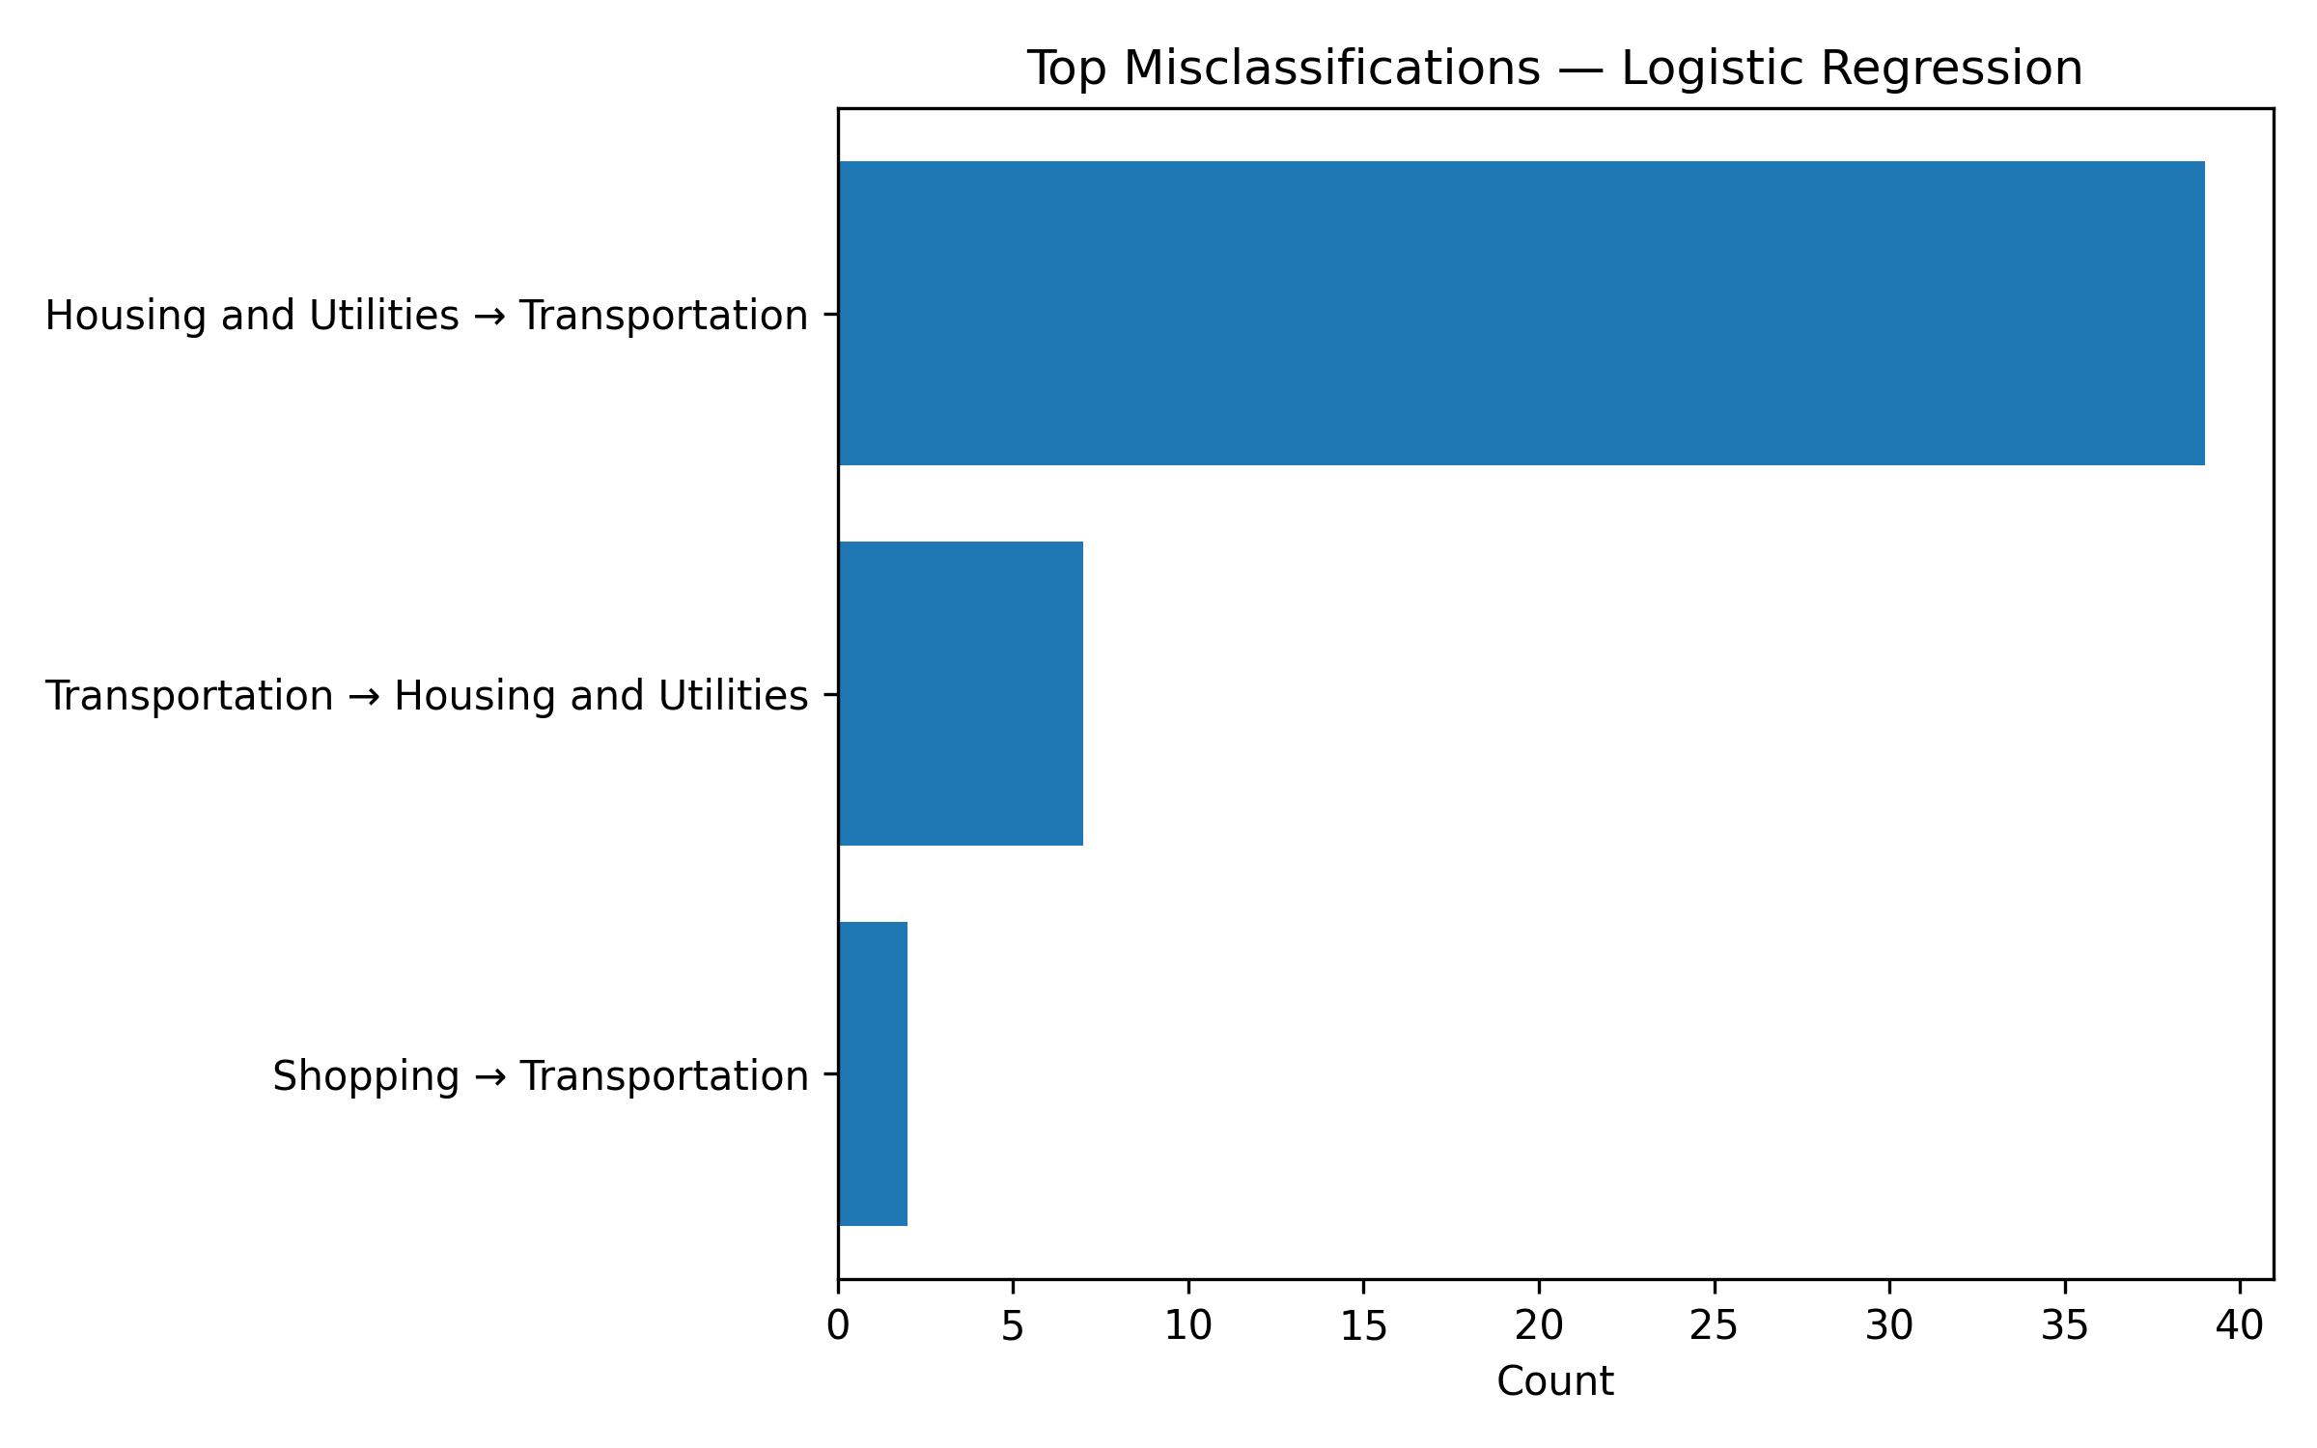
Top Misclassifications

Slide 11
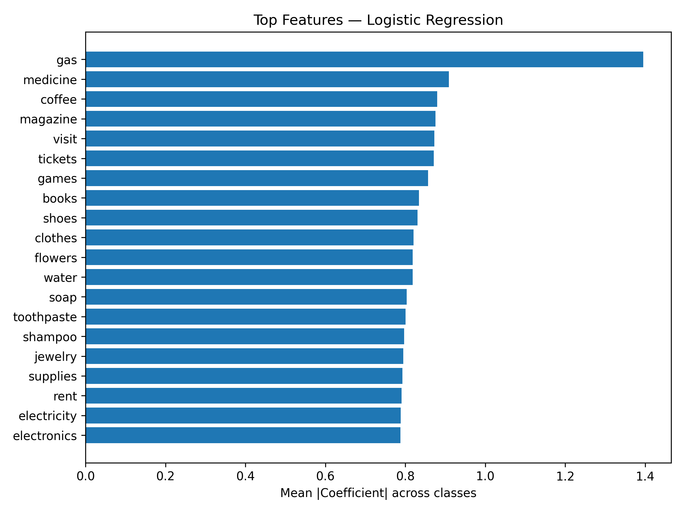
Feature Importance (LogReg)

Slide 12
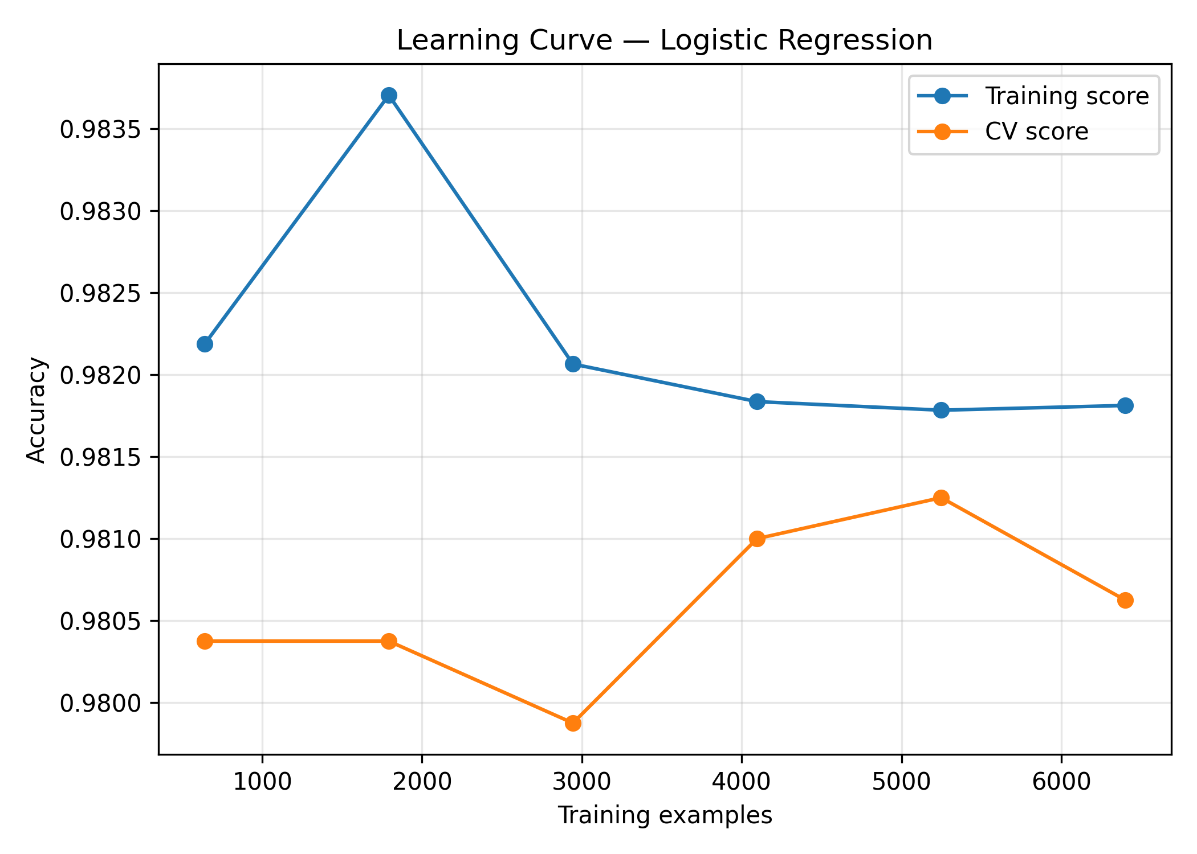
Learning Curve (LogReg)

Slide 13
Results & Next Steps
Best overall: Logistic Regression (balanced class weights).
Confidence available via predict_proba for UI display.
Next: hyperparameter sweep, incremental retraining, mobile UI.

