Slide 1

Customer Shopping Behavior Analysis
This project analyzes customer shopping behavior using transactional data from 3,900 purchases. Our goal is to uncover insights into spending patterns, customer segments, product preferences, and subscription behavior to guide strategic business decisions.

Slide 2

Dataset Summary
Rows: 3,900
Columns: 18
Missing Data
Comprehensive transactional data.
Rich details from demographics to purchase specifics.
37 values in Review Rating column.
Key features include customer demographics, purchase details (item, category, amount, season, size, color), and shopping behavior (discounts, promo codes, previous purchases, frequency, review rating, shipping type).

Slide 3

Exploratory Data Analysis (Python)
Data Preparation
Feature Engineering
Data Loading: Imported dataset using pandas.
Column Standardization: Renamed columns to snake_case.
Initial Exploration: Used df.info() and .describe() for structure and summary.
Age Group: Created age_group by binning customer ages.
Purchase Frequency: Derived purchase_frequency_days.
Missing Data Handling: Imputed missing 'Review Rating' values using median per product category.
Data Consistency: Dropped redundant promo_code_used.
Database Integration: Loaded cleaned data into PostgreSQL for SQL analysis.

Slide 4
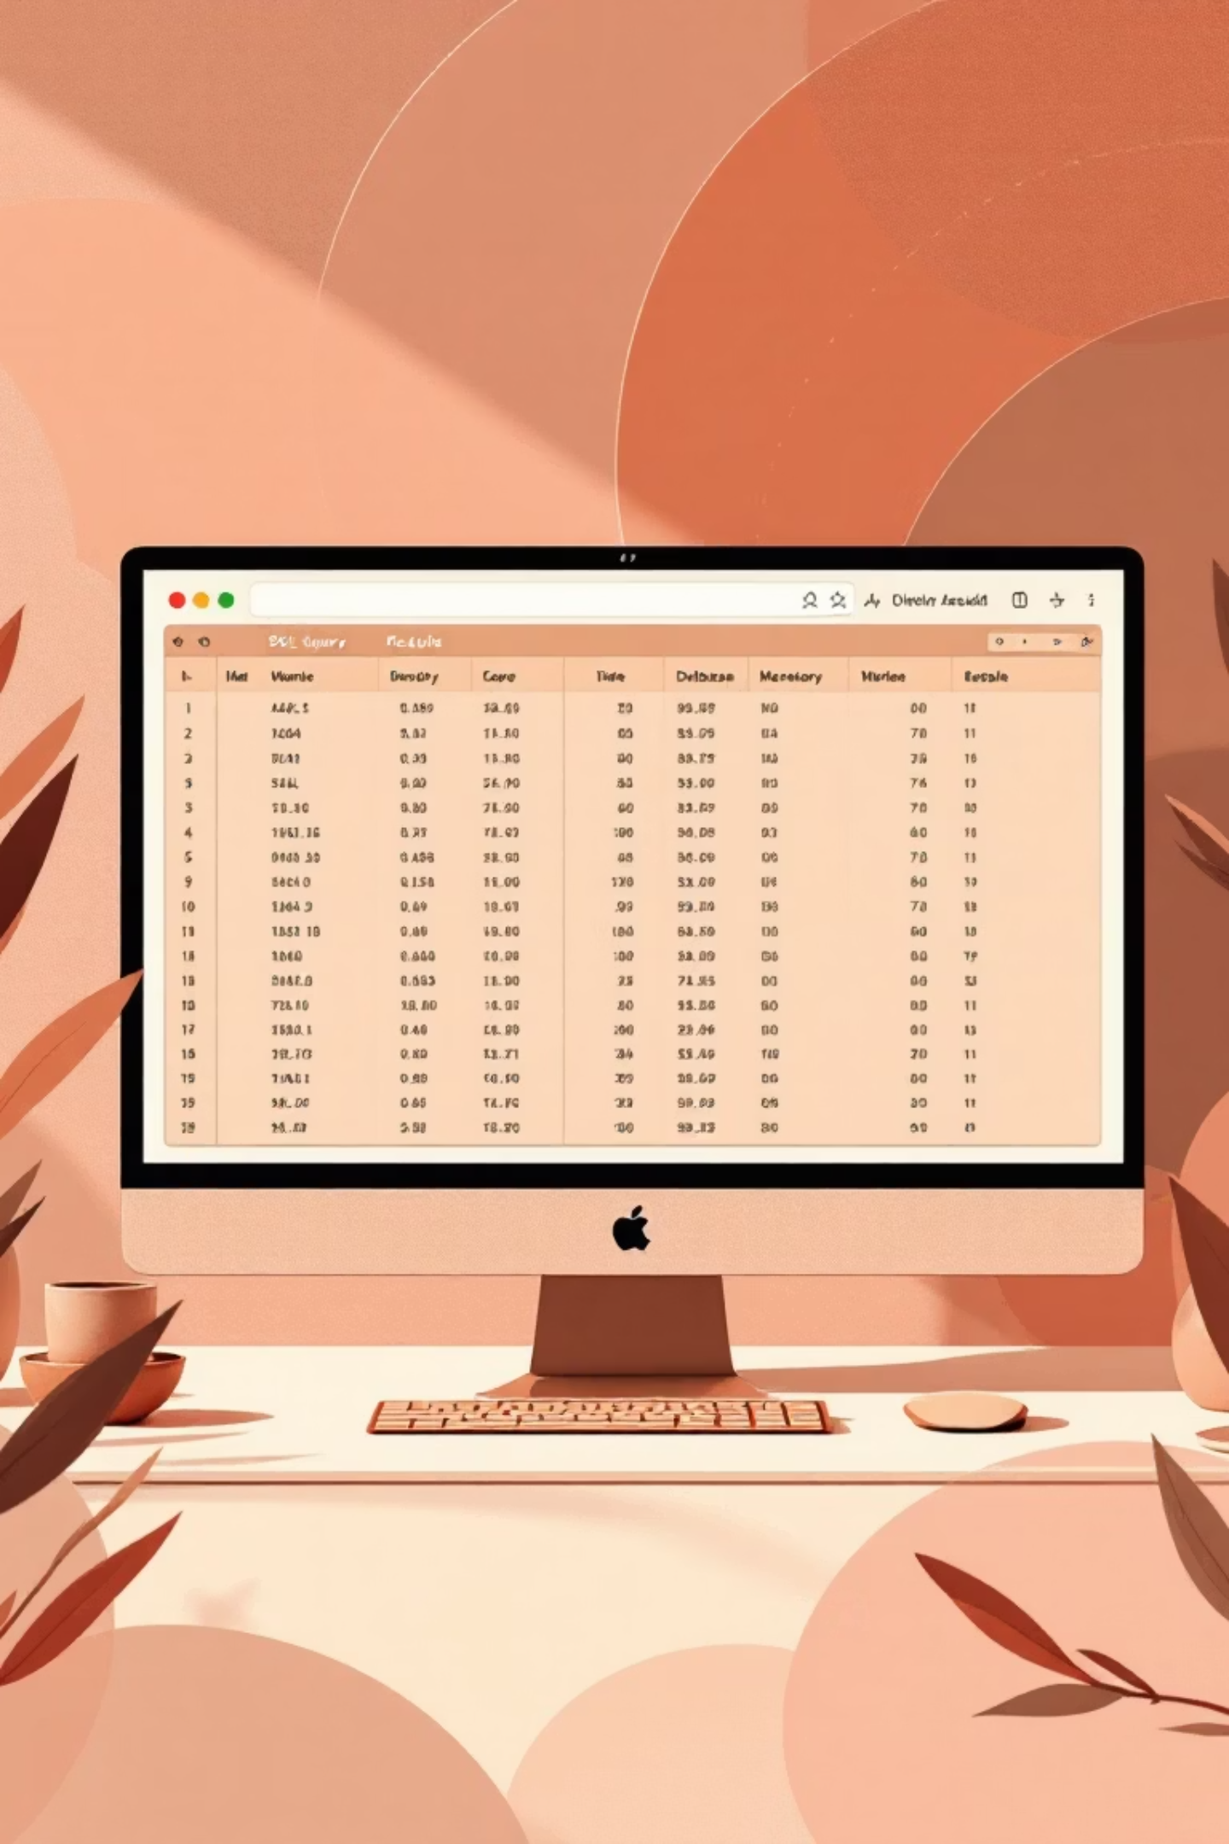



Data Analysis using SQL: Key Insights
Revenue by Gender
Male customers generated significantly more revenue ($157,890) than female customers ($75,191).
High-Spending Discount Users
Identified 839 customers who used discounts but still spent above the average purchase amount.
Top 5 Products by Rating
Gloves, Sandals, and Boots lead with the highest average review ratings.

Slide 5


Shipping & Subscription Impact
Shipping Type Comparison
Subscribers vs. Non-Subscribers
Express shipping shows a slightly higher average purchase amount ($60.48) compared to Standard shipping ($58.46).
Non-subscribers contribute more to total revenue ($170,436) than subscribers ($62,645), despite similar average spend.

Slide 6
Discount-Dependent Products
Certain products show a higher reliance on discounts to drive purchases.
50%
49.66%
49.07%
Hat
Sneakers
Coat
48.17%
47.37%
Sweater
Pants
These products consistently have a high percentage of discounted purchases, indicating potential price sensitivity or promotional effectiveness.

Slide 7



Customer Segmentation
Customers are segmented into three groups based on their purchase history.
Returning
701 Customers
Loyal
3116 Customers
New
83 Customers
This segmentation helps in tailoring marketing strategies for each group.

Slide 8
Top Products per Category
1
Accessories
Jewelry
171
1
Clothing
Blouse
171
1
Footwear
Sandals
160
1
Outerwear
Jacket
163
Understanding top products within each category can inform inventory and marketing decisions.

Slide 9
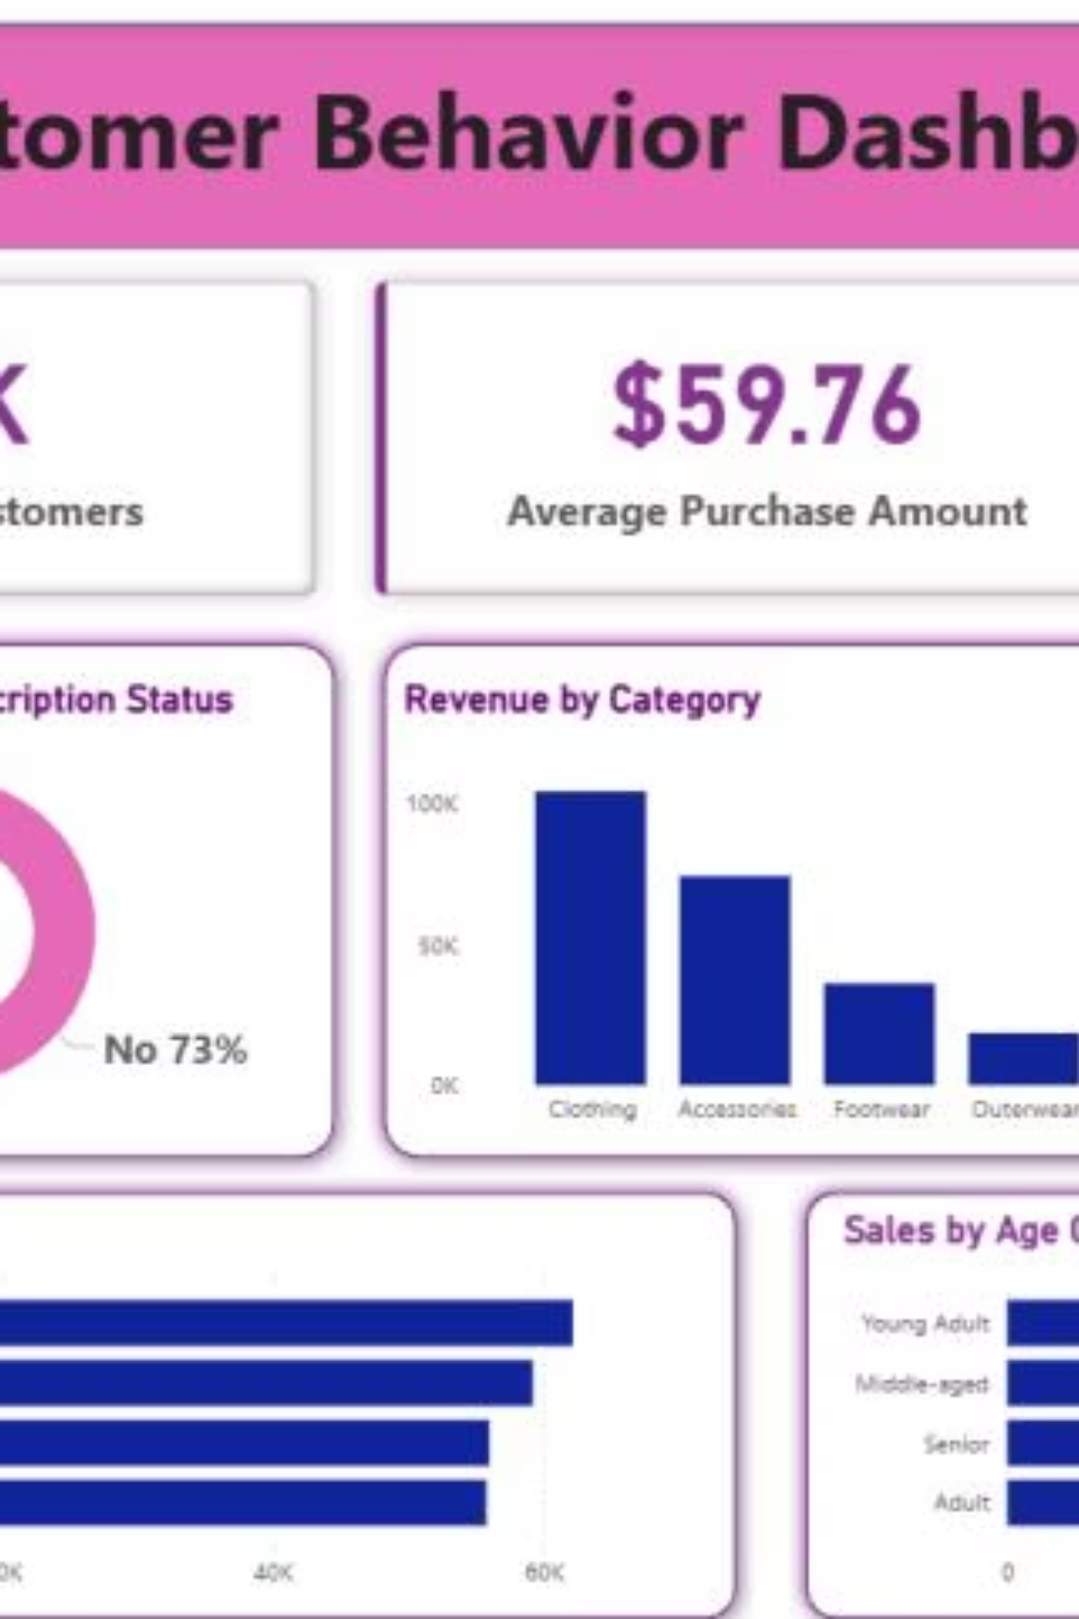
Dashboard in Power BI
An interactive Power BI dashboard was created to visualize key insights.
The dashboard presents customer behavior metrics, subscription status, revenue by category and age group, and average purchase amounts, offering a comprehensive overview for strategic decision-making.

Slide 10

Business Recommendations
Boost Subscriptions
Promote exclusive benefits to increase subscriber base.
Customer Loyalty
Reward repeat buyers to foster loyalty and move them to the "Loyal" segment.
Review Discount Policy
Balance sales boosts with margin control for discount-dependent products.
Targeted Marketing
Focus efforts on high-revenue age groups and express-shipping users.

