Slide 1

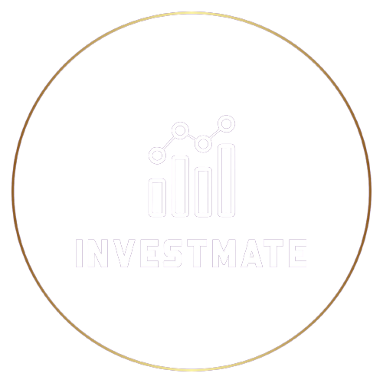
Investment Tracker App
Presented By:
Dhananjay, Nandini, Tej Sahan, Swastika

Slide 2
Content
PROBLEM STATEMENT
OBJECTIVE
PROJECT ARCHITECTURE
PROJECT FLOW
TECHNOLOGY AND TOOLS USED
CONCLUSION

Slide 3
Problem Statement
Design an investment tracking app that offers comprehensive wealth management and stock investment services. The app will provide users with real-time stock data, enabling them to build diverse portfolios that align with their financial goals and values, including ESG (Environmental, Social, and Governance) criteria. Additionally, the app will facilitate personal wealth management and allow users to monitor stock prices and review transaction history.
In addition to these features, the app will integrate an interactive chatbot dedicated to ESG education, ensuring users are well-informed about the environmental and social impact of their investments. This innovative platform aims to be a one-stop solution, offering an inclusive and accessible approach to investment tracking, portfolio management, and financial education.

Slide 4
Objectives
Secure and personalized user registration and authentication system
Intuitive dashboard for a comprehensive overview of investments, wealth, and transaction history
Extensive stock database with real-time updates
Easy stock exploration and selection
Search functionality for streamlined stock selection
Education on ESG (Environmental, Social, and Governance) investing with a glossary for beginners
Watchlist creation and management based on ESG ratings
Multiple portfolio creation for different investment objectives (ethical, green, impact investing)
Portfolio analysis tools with graphs for informed decision-making
Detailed transaction history with filtering and sorting options
Export functionality for transaction data for tax and reporting purposes
Real-time stock data access
Overall wealth tracking across various assets
User-friendly customer support form for inquiries and grievances.

Slide 5
Project Architecture

Slide 6

*Investment Tracking App
WAR
Front End
(ReactJs &
Chakra)
User Service
Price Service
POST/GET/
PUT/DELETE
Request
Response
BankDetails Service
Apache
Portfolio Service
MySQL
POST/GET/
PUT/DELETE
Transaction Service
Stock Service
Watchlist service
Tomcat
‹#›

Slide 7
Project Flow

Slide 8
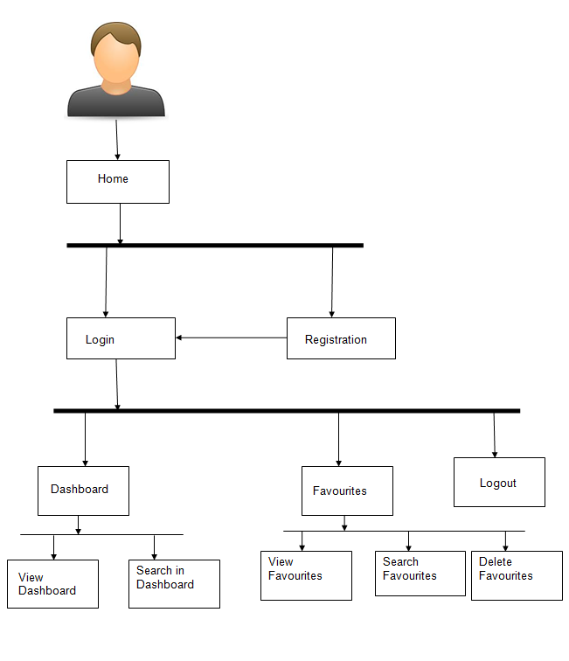
*Investment Tracking App
Internet Browser
Home
About
Contact
Team
Getting Started
Login
Register/
Signup
Dashboard
ESG Articles
Portfolios
Watchlists
Past Transactions
Stocks
Indexes
Top Stocks
About
Books
Analytics
Search Stocks
Transaction History
Live Stocks Data
Logout
Tutorial
Category- equity and MF

Slide 9


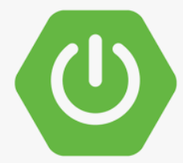
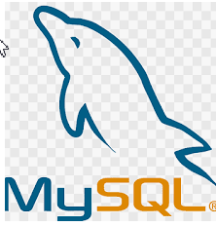
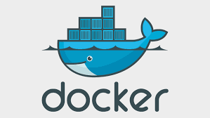
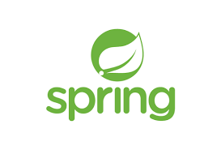
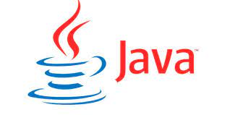


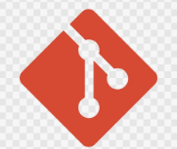





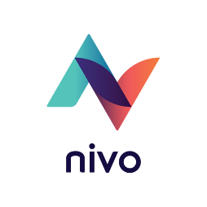

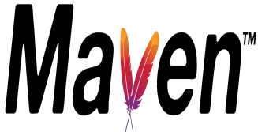


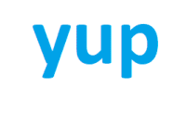

*Investment Tracking App
Tools and Technologies used:

Slide 10
Conclusion
By providing real-time stock data, ESG education, and portfolio analysis tools, the app equips users with the knowledge and tools they need to make informed investment decisions, regardless of their financial expertise.
With a user-friendly interface and a focus on education, this app breaks down the barriers to entry that often make the world of investments seem daunting. It ensures that both novices and experienced investors can benefit from its features.
The app's commitment to data security ensures that users can trust it with their financial information. This trust is fundamental in the world of investments, where safeguarding personal data is most important.
By bridging the gap between individuals and the complexities of investments, this app plays a crucial role in democratizing financial decision-making. It makes financial empowerment accessible to a wider audience.

Slide 11
Thank you!

