Slide 1

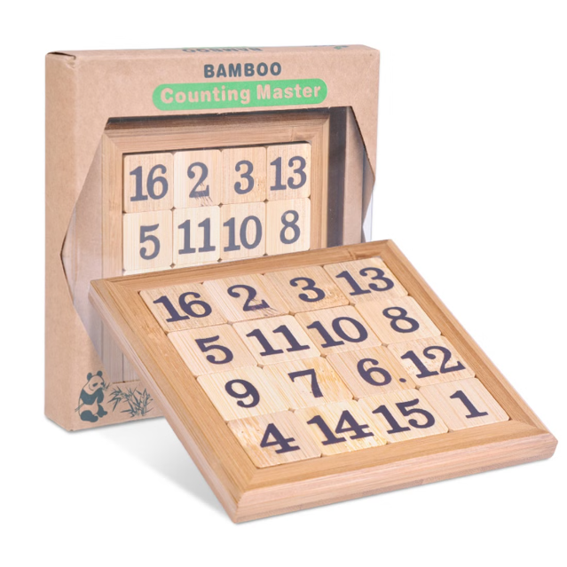

Introduction to Sudoku Solver Visualizer
Discover the power of a Sudoku solver visualizer - a tool that takes the guesswork out of solving even the most complex Sudoku puzzles. Explore the inner workings of this innovative technology and unlock the secrets to mastering the classic logic-based game.
by Nandini Raj

Slide 2

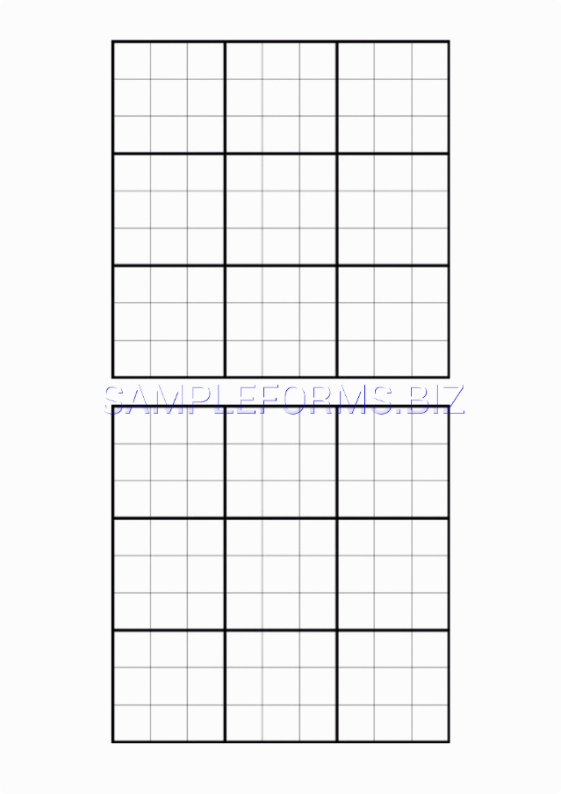
How Sudoku Works
1
Grid Structure
Sudoku puzzles are built on a 9x9 grid, divided into 9 smaller 3x3 boxes.
2
Logical Deduction
The objective is to fill the grid with digits 1-9, ensuring each row, column, and 3x3 box contains all the digits without repetition.
3
Difficulty Levels
Sudoku puzzles can range from easy to extremely challenging, testing players' problem-solving skills and logical reasoning abilities.

Slide 3


Solving Sudoku Puzzles
1
Analyze
Carefully examine the given clues and identify the empty cells that need to be filled.
2
Eliminate
Use logic to rule out the impossible numbers and focus on the viable options.
3
Place
Strategically place the numbers in the empty cells, ensuring they don't conflict with the existing clues.

Slide 4
Backtracking Algorithm Explained
The Concept
Step-by-Step
Efficiency
The backtracking algorithm is a recursive problem-solving technique used to solve Sudoku puzzles.
It systematically tries different possibilities, backtracking when a solution is found to be invalid.
This approach ensures that the solver finds the optimal solution, even for the most challenging puzzles.

Slide 5

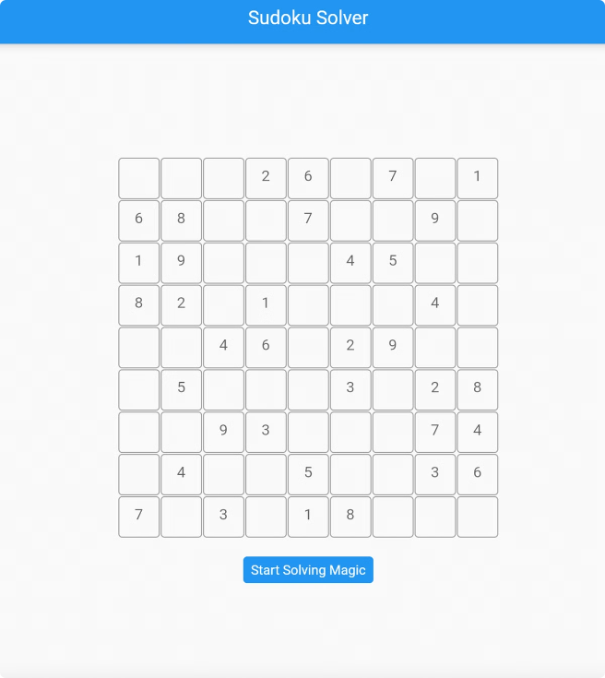

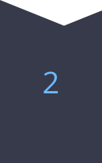


Step-by-Step Visualization
Identify Empty Cell
The algorithm starts by finding the next empty cell in the grid.
Try Possible Values
It then systematically tries filling the cell with numbers 1-9.
Check Validity
The solution is checked against the rules to ensure it's valid.
Backtrack if Needed
If a solution is invalid, the algorithm backtracks and tries a new value.

Slide 6

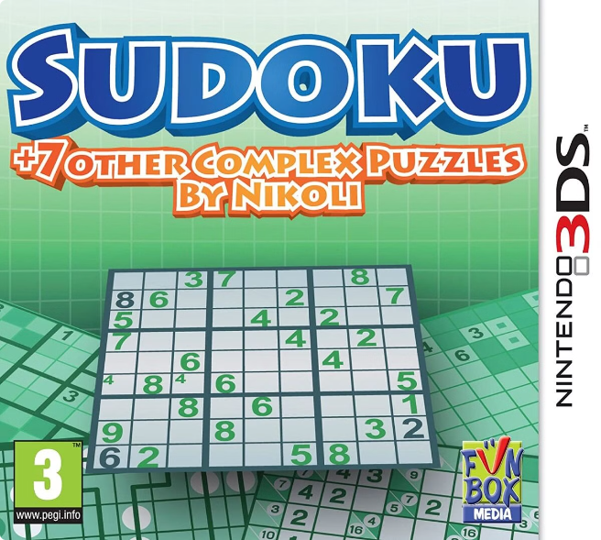
Handling Difficult Puzzles
Advanced Techniques
For challenging puzzles, the solver may employ more sophisticated strategies, such as hidden singles and naked pairs.
Brute Force Approach
If logic-based methods fail, the solver can resort to a brute-force approach, systematically trying all possible combinations.
Optimized Performance
The visualizer ensures the solver remains efficient, even when tackling the most intricate Sudoku puzzles.
Elegant Solutions
The visualizer presents the solving process in a clear and intuitive manner, highlighting the solver's logic and decision-making.

Slide 7


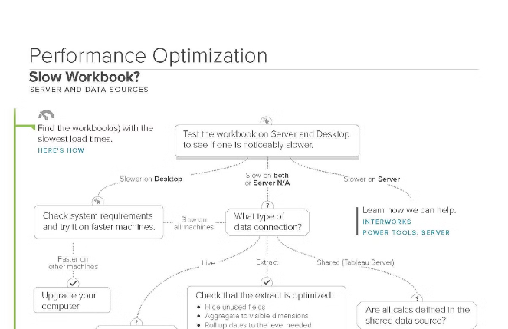



Optimizing the Solver
Computational Efficiency
The solver is designed to minimize computational overhead, ensuring fast and accurate solutions.
Memory Management
Careful memory allocation and data structures optimize the solver's memory usage, even for large puzzles.
Algorithmic Improvements
Continuous research and development refine the backtracking algorithm, making it more robust and versatile.
Code Optimization
The visualizer's codebase is meticulously optimized to deliver smooth and responsive user experiences.

Slide 8

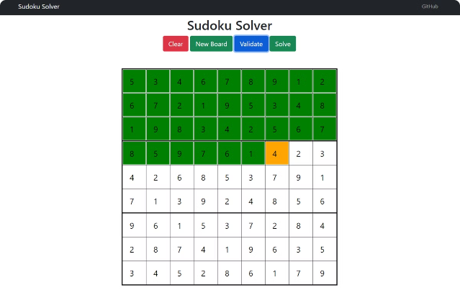
Conclusion and Demo
Experience the power of the Sudoku solver visualizer for yourself. Witness the elegant step-by-step solving process, from identifying empty cells to backtracking through complex puzzles. Prepare to be amazed as this cutting-edge tool unlocks the secrets of Sudoku mastery.
Try the Sudoku Solver Visualizer

