Slide 1



Tw Cen MT
BDM
Capstone
Project
Optimizing the Business Model of a Retail Steel Furniture Business
Presenting By
Nandini Kushwah
22f1001148
22f1001148@ds.study.iitm.ac.in
nandinikushwah1407@gmail.com

Slide 2






About Project
An independent project work in order to find a real-world and data-driven business problem. Following its analysis, solutions and results.
Reach a Business
Find Problems
Collect Data
Analysis
Suggestions
Any real business organized or unorganized like manufacturing, vendors etc.
Find out the problems that the business is facing. And set the objectives.
Collect data related to the objectives and problem. Data should be primary.
Detailed examination of the data for finding useful insights from it, related to the objectives.
Suggest constrictive solutions for the problem.

Slide 3



About Project
An independent project work in order to find a real-world and data-driven business problem. Following its analysis, solutions and results.
Reach a Business
Find Problems
Collect Data
Analysis
Suggestions
Any real business organized or unorganized like manufacturing, vendors etc.
Find out the problems that the business is facing. And set the objectives.
Collect data related to the objectives and problem. Data should be primary.
Detailed examination of the data for finding useful insights from it, related to the objectives.
Suggest constrictive solutions for the problem.

Slide 4



About Project
An independent project work in order to find a real-world and data-driven business problem. Following its analysis, solutions and results.
Reach a Business
Find Problems
Collect Data
Analysis
Suggestions
Any real business organized or unorganized like manufacturing, vendors etc.
Find out the problems that the business is facing. And set the objectives.
Collect data related to the objectives and problem. Data should be primary.
Detailed examination of the data for finding useful insights from it, related to the objectives.
Suggest constrictive solutions for the problem.

Slide 5

About Project
An independent project work in order to find a real-world and data-driven business problem. Following its analysis, solutions and results.
Reach a Business
Find Problems
Collect Data
Analysis
Suggestions
Any real business organized or unorganized like manufacturing, vendors etc.
Find out the problems that the business is facing. And set the objectives.
Collect data related to the objectives and problem. Data should be primary.
Detailed examination of the data for finding useful insights from it, related to the objectives.
Suggest constrictive solutions for the problem.

Slide 6

About Project
An independent project work in order to find a real-world and data-driven business problem. Following its analysis, solutions and results.
Reach a Business
Find Problems
Collect Data
Analysis
Suggestions
Any real business organized or unorganized like manufacturing, vendors etc.
Find out the problems that the business is facing. And set the objectives.
Collect data related to the objectives and problem. Data should be primary.
Detailed examination of the data for finding useful insights from it, related to the objectives.
Suggest constrictive solutions for the problem.

Slide 7
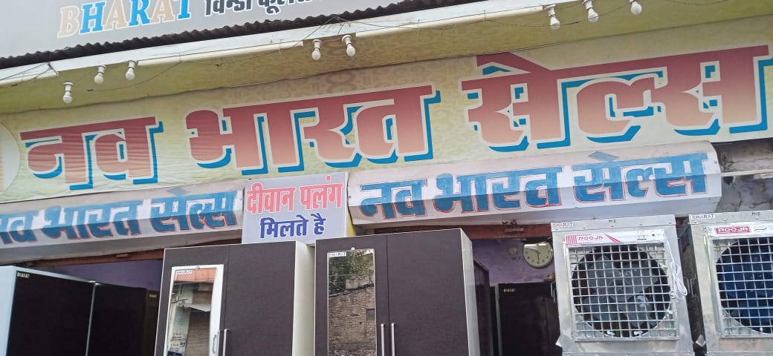

Nav Bharat Sales
Nav Bharat Sales is a retail steel furniture business, since 1983, running by a family. They sell steel products like Almirahs, Coolers, Dewans etc.
Location
1
Oonth pul Lashkar
Products
2
Cooler, Almirah ,Dewan
Employees
1 Salesman 2 worker
3
Future vision of expanding the business.

Slide 8




Process Used
Four stage of analytics is used for finding the root cause, for giving the solution and predicting the goodness of the solution.
“What happened in past?”
“Why did this happened?”
“What should we do next?”
“What might happen in future?”
Descriptive Analysis
Diagnostic Analysis
Prescriptive Analysis
Predictive Analysis

Slide 9








Descriptive Analysis
“What happened in past?”
Why Net Profit is low?
How is the business going these days?
Sales are increasing every year but the growth is not visible in the business !!!
Profit & Loss Statement

Slide 10







Diagnostic Analysis
“Why did this happened?”
Why Net Profit is low?
Why these almirahs are not giving good profit margin?
Indori almirahs not giving good profit margin.
Importing them from other city.
01. Powder Coated almirahs (Indori Almirahs) have a share of 45% in the revenue.
Indorie Almirahs
45%
Indore/ Delhi
Cost Price
Cooler
45%
33.16%
02. Profit margin is around 15.41%
(lower than other products).
15.41%
Gwalior
Indorie Almirahs
Other Products

Slide 11




Prescriptive Analysis
“What should we do next?”
Net profit is low because of low profit margin of the star product.
Start manufacturing Powder Coated Almirahs by Own
Increase the Net Profit
of the Business
Increase the Gross Profit of the Business
Increase profit margin of Powder Coated Almirahs
Q1. Will this manufacturing unit increase the profit margin?
Q2. What will be the cost of finished product?
Q3. What will be the breakeven point?

Slide 12

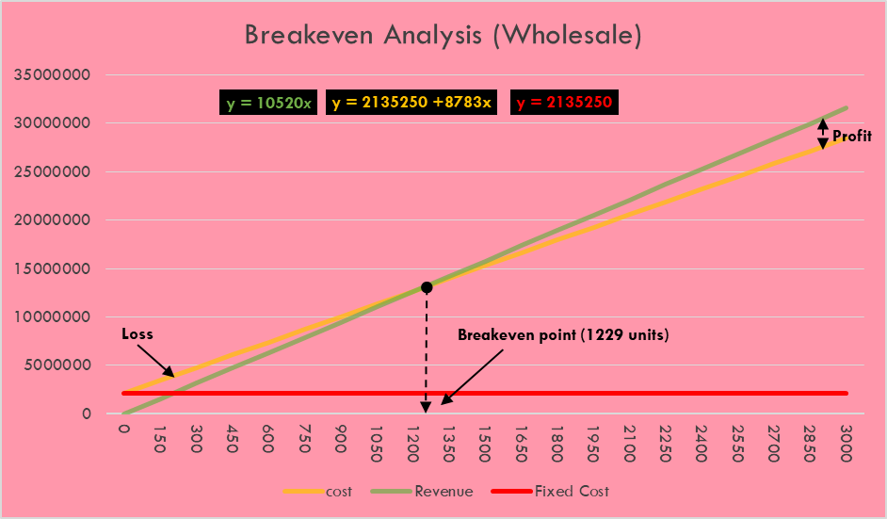
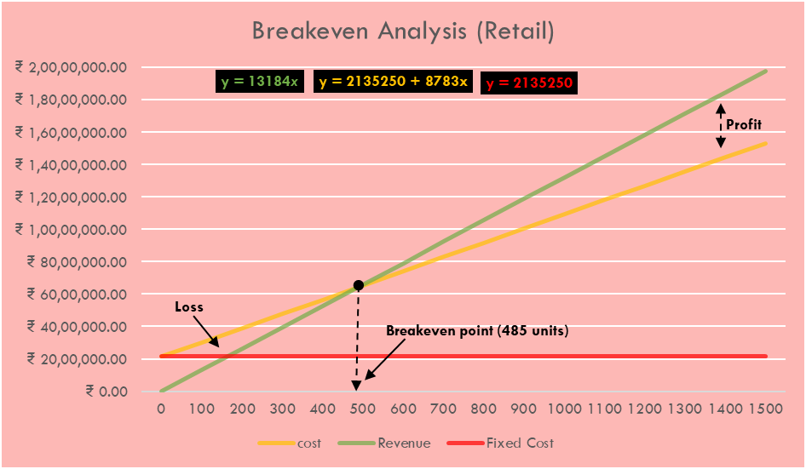
Predictive Analysis
5
“What might happen in future?”
4
RESULTS & INSIGHTS
3
2
Fixed Cost or
Investment
Demand at Nav Bharat Sales
1
Rs. 21,35,250
127 units
01
03
02
04
Average increase of gross profit percentage for these two years could have been approximately 17.8% if they had produced these almirahs.
Average net profit percentage of these two year goes from 12.9% to 27.4% which is reasonably good.
Cost Price of finished product
Demand in Market
Average Selling Price of powder coated almirah → Rs 10,520
Breakeven Point (For retail Business) → 1229 units
Recovery of the investment in 1 year 11 months
With average profit % of 19.72%
Average Selling Price of powder coated almirah → Rs 13,184
Breakeven Point (For retail Business) → 485 units
Recovery of the investment in 3 years 9 months
With average profit % of 54%
650 units
Rs. 8783
An increase of 38.35% can be seen in the average profit percentage.
Before the average profit margin was 15.41% and after it will be 53.76%.

Slide 13


Recommendations
They should build the manufacturing unit as it is solving the problem of the business. And also creating new opportunities.
01. In that manufacturing unit they should focus on producing 4 products the most that are Regular Shoe Daraj, Royal, Side dressing and Regular.
02. Last three month (October, November, December) have a high demand so they should produce the almirahs accordingly.
Growth
New Opportunities
03. They should sperate the business from their home. Also, they should digitize it for customer satisfaction and retention.
04. Stop buying Indori Almirahs from other cities.

Slide 14
THANK YOU

