Slide 1






NGOCONNECT
A Web-Based Platform Connecting Verified NGOs, Donors and Volunteers
Sardar Vallabhbhai Global University
Faculty of Computer Applications
Semester III | Academic Year 2026–27
Submitted By: [Student Name] – [Enrolment Number], [Student Name] – [Enrolment Number]
Faculty Guide: Dr./Prof. [Faculty Guide Name]

Slide 2

INTRODUCTION
What is NGOConnect?
A single platform where government-registered NGOs are verified before becoming publicly visible, donors can give with confidence, and volunteers can discover ways to contribute their time.
Verified NGOs
Donors
Volunteers
Trust, Convenience & Transparency
Organisations are checked and approved before donors ever see them.
Give confidently via gateway or in-platform wallet, with automatic 80G receipts.
Discover events and enrol to contribute time alongside money.
Verification, traceable ledgers and simplified giving in one system.
NGOConnect | Sardar Vallabhbhai Global University
2

Slide 3






PROBLEM
Drawbacks of the Existing System
No verification of legitimacy
No unified NGO discovery
No audit trail
A donor cannot confirm an NGO holds valid registration, PAN or Darpan identity.
No single searchable catalogue of verified organisations by city or cause.
Once funds leave a donor’s account, nothing records the payment against a purpose.
Manual / absent tax receipts
Payment friction on every donation
Volunteering disconnected from giving
Receipts must be requested by hand; many donors never receive one.
Card / UPI details re-entered each time, suppressing repeat giving.
No structured channel for NGOs to publish goods or volunteer needs.
NGOConnect | Sardar Vallabhbhai Global University
3

Slide 4








PROPOSED SYSTEM
How NGOConnect Solves It
Every organisation is verified and approved before it becomes visible; every donation is traceable and receipted automatically.
NGO Registration
Document Verification
Admin Approval
Public NGO Listing
Donation / Volunteer
Engagement
The trust decision is made once by an administrator with the documents in front of them — not repeatedly by every individual donor.
Gateway or Wallet donations
Append-only financial ledger
Automatic 80G tax receipt
NGOConnect | Sardar Vallabhbhai Global University
4

Slide 5




OBJECTIVES
Objectives & Key Features
Verified NGO onboarding
Document verification
Secure donation processing
Digital wallet
Automatic 80G receipt
NGO finance & ledger
Volunteer events
Direct donor–NGO communication
Admin management
NGOConnect | Sardar Vallabhbhai Global University
5

Slide 6


SYSTEM USERS
User Roles & Functional Modules
Donor
Volunteer
NGO
Admin
Browse verified NGOs
Donate via gateway or wallet
Download 80G receipts
Chat with NGOs
View events & needs
Enrol in events
Track enrolments
Receive absence alerts
Register with documents
Manage profile & content
View balance & ledger
Request withdrawals
Approve/reject NGOs
Manage user accounts
Oversee donations & events
Approve withdrawals
NGOConnect | Sardar Vallabhbhai Global University
6

Slide 7


PROCESS
System Workflow
NGO Onboarding & Verification
Registration
Upload Docs
OCR / Text
Extraction
Verification
Admin Approval
NGO Visible
Donation Journey
Select Verified
NGO
Donate
Payment
Verification
Ledger Entry
80G Receipt
A gateway-funded donation is credited only after its HMAC-SHA256 signature is verified and the donation record is atomically claimed.
NGOConnect | Sardar Vallabhbhai Global University
7

Slide 8





TECHNOLOGY
Technology Stack
Frontend
Backend
Database
Payment
React 19, Vite 8, React Router 7, Axios, CSS3
Java 17, Spring Boot 4.1.1, Spring Security, Spring Data MongoDB, Spring Mail
MongoDB Atlas
Razorpay Java SDK
Media Storage
Documents / Receipts
OCR
Build & Design Tools
Cloudinary
Apache PDFBox
Tess4J + Tesseract OCR
Apache Maven, PlantUML, Git & GitHub
NGOConnect | Sardar Vallabhbhai Global University
8

Slide 9
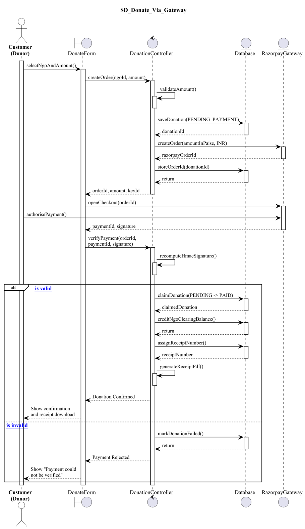
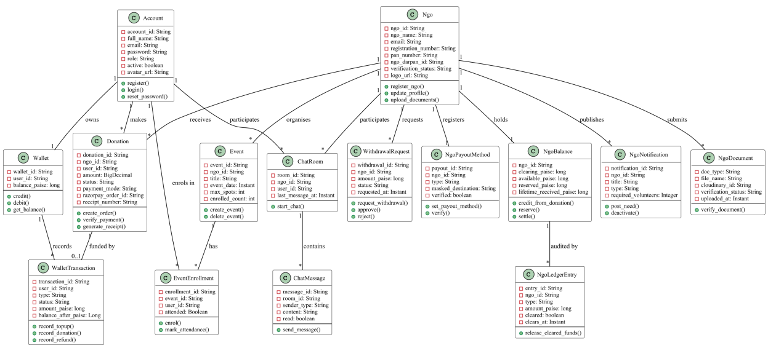


SYSTEM DESIGN
UML Design Artifacts
Class Diagram — Entities & Associations
Use Case Diagram
Activity Diagram
Donor/Volunteer and NGO/Admin capabilities — report p.19–22
Donation & NGO registration workflows — report p.24–28
Sequence Diagram — Donate via Gateway
NGOConnect | Sardar Vallabhbhai Global University
9

Slide 10






SECURITY
Security & Financial Correctness
BCrypt password hashing
Role-based authorization
HMAC-SHA256 payment verification
Atomic wallet / balance operations
Immutable, append-only ledger
Duplicate-payment protection
Server-to-server payment recovery
Settlement / clearing period
Masked payout information
NGOConnect | Sardar Vallabhbhai Global University
10

Slide 11


ROADMAP
Limitations & Future Enhancements
Limitations
Future Enhancements
Manual payout execution
Advisory document verification
HTTP Basic authentication
Single currency (INR)
No recurring donations
No native mobile app
Chat uses polling
Token-based authentication
Automated payouts
Campaign-level fundraising
Recurring donations
Government registry verification
Real-time chat
Native mobile application
Analytics / transparency reporting
Volunteer certificates & hours tracking
Event attendance verification by NGO
Email alerts on login & key actions
NGO subscription plans (platform revenue)
NGOConnect | Sardar Vallabhbhai Global University
11

Slide 12

CONCLUSION
Connects verified NGOs, donors and volunteers on one trustworthy platform
Improves trust and traceability through document verification and an append-only ledger
Automates 80G donation receipts and financial record-keeping
Provides a solid foundation for campaigns, recurring giving and mobile expansion
THANK YOU

