Slide 1
Comparative study of ML Algorithms for Classification of Cancer Types using Gene Expressions Dataset
Aditi N Sirigeri 01JST16IS002
Nandini V 01JST16IS055
Neha S 01JST16IS057
Siddharth Gokarn 01JST16IS064

Slide 2
Table of Contents
1 Introduction
1.1 Problem Statement
1.2 General Introduction
1.3 Applications
1.4 Challenges
1.5 Motivation
1.6 Objectives

Slide 3
2 System Requirements
2.1 Requirement Analysis and System Specification
2.2 Feasibility Study
2.2.1 Technical Feasibility
2.2.2 Operational Feasibility
2.3 Software Requirements Specification
3 Proposed Method
4 Implementation and Experimental Analysis
5 Conclusion and Scope

Slide 4
1.Introduction
1.1 Problem Statement
A comparative study of various algorithms for classification of different cancer types using different Gene Expression datasets.
1.2 General Introduction
Cancer research is one of the major research areas in the medical field.
Previously, cancer classification has always been morphological, and clinical based.
In order to gain a better insight into the problem of cancer classification, systematic approaches based on global gene expression analysis have been proposed.

Slide 5
Gene Expression and DNA Microarray Technology
For a classification of cancer by using gene expression data, first we have to know some fundamental knowledge in molecular biology like DNA, RNA etc.
A DNA molecule is a double-stranded polymer composed of four basic molecular units called nucleotides.(A,G,C,T).
DNA sequence is a particular arrangement of the base pairs in the DNA strand. The entire DNA sequence that codes for a living thing is called its genome.
A gene is a small, defined section of the entire genomic sequence.
The genome provides a template for the synthesis of a variety of RNA molecules.
The process of transcribing a gene’s DNA sequence into RNA is called gene expression.

Slide 6
Gene expression level represents the amount of RNA produced in a cell under different biological states.It is known that certain diseases, such as cancer, are reflected in the change of the expression values of certain genes.
Microarrays and serial analysis of gene expressions are two recent technologies for measuring the thousands of genome-wide expression values in parallel.
1.3 Application
Cancer is one of the deadliest diseases for humans. According to the WHO (2015), cancer is the causes of the death number two in the world by 13 % after cardiovascular disease. Therefore, early detection of cancer is necessary to avoid the spread of cancer.

Slide 7
As a result, machine learning has been applied to cancer prognosis and prediction.
Recent advances in biotechnologies allow us to generate various types of molecular data for the same sample, e.g. copy number aberrations as measured by array CGH, mRNA expression, SNPs, methylation, etc. Each of these distinct data types provides one view of the molecular machinery of the cancer cell.

Slide 8
Molecular data allows for adding information to the analysis of biological phenotypes. Studying the characteristics of thousands of genes simultaneously offered a deep insight into cancer classification problem.
It introduced an abundant amount of data ready to be explored. it helps in understanding the function of genes and the interaction between genes in normal and abnormal conditions.

Slide 9
1.4 Challenges
Though the successful application of cDNA microarrays and the high-density oligonucleotides have made fast simultaneous monitoring of thousands of gene expressions possible and inexpensive, the publicly available gene expression data set size remains small.
Dealing with a huge number of irrelevant attributes (genes)

Slide 10
Accuracy is important in cancer classification, but it is not the only goal we want to achieve. Biological relevancy is another important criterion. Since there are large number of attributes, finding relation between all of them is challenging

Slide 11
1.6 Motivation
The World Cancer Report described cancer as a global problem because it affects the whole greater population. The classification of different types of tumor is of great importance in cancer diagnosis and drug discovery.
Earlier studies on cancer classification have limited diagnostic ability and cancer prediction has always been clinical based and morphological.

Slide 12
Cancer classification using gene expression data stands out from the other previous classification data due to its unique nature and application domain. The recent development of microarray technology has motivated the simultaneous monitoring of genes and cancer classification using gene expression data.

Slide 13
1.7 Objectives
To Perform pre-processing in order to get cleaned data.
Gene selection is performed by using many feature selection techniques.
To classify the cancer dataset by using different algorithms and make comparative study on those algorithms.
To evaluate model by using confusion matrix, precision, recall and F1 score.

Slide 14
3.SYSTEM REQUIREMENTS
Requirement specification encompasses the needs of this project. It aims at providing a full description of the requirements based on the concepts defined in the Problem Domain.
The system requirement specification is produced at the culmination of the analysis task. The function and performance allocated to software as part of system engineering are refined by establishing a complete information description, a detailed functional description, representation of system behavior, an indication of performance requirements and design constraints, appropriate validation criteria and other information pertinent to requirements.

Slide 15
3.1 Requirement Analysis and System Specification
Intel Processor
RAM 2 GB or above.
Jupiter Notebook or Python IDLE.

Slide 16
3.2 Feasibility Study
3.2.1 Technical Feasibility
The development of this project requires time for comparison and classification of different algorithms being tested against the gene expression dataset.
With a simple python environment and operating system, this project can be implemented.
The main challenge is to study gene expression dataset and select important features among the vast features present in the dataset.

Slide 17
3.2.2 Operational Feasibility
In the proposed system we worked on three big datasets: PANCAN dataset that consists of RNA-Seq gene expressions of patients having different types of tumor: BRCA, KIRC, COAD, LUAD and PRAD have been collected from UCI Repository. The tumors are considered as class labels .
The second data set is the Colon cancer data (http://microarray.princeton.edu/oncology). This data consists of 62 samples of colon epithelial cells from colon-cancer patients. The samples consists of tumors biopsies collected from tumors, and normal biopsies collected from healthy part of the colons of the same patient. The number of genes in the data set is more than 2000.

Slide 18
The third data set is the Leukemia data (http://www.genome.wi.mit.edu/MPR). This data consists of 72 samples. The samples consist of two types of leukemia, 25 of AML and 47 of ALL. The samples are taken from 63 bone marrow samples and 9 peripheral blood samples. There are 7192 genes in the data set

Slide 19
3.3 Software Requirement Specifications
Python 3
Python is an interpreted, high-level, general-purpose programming language. Its language constructs and object-oriented approach aim to help programmers write clear, logical code for small and large-scale projects. Hence, this is the language we use to code because it is one of the best for working in ML because it has various libraries to work on ML.
Libraries used
Scikit learn
Pandas
NumPy

Slide 20
5. PROPOSED METHOD
A total of 5 classification algorithms have been used in this comparative study. The steps followed are,
5.1 Data Pre-Processing
Data pre-processing is an integral step in Machine Learning as the quality of data and the useful information that can be derived from raw data (real world data) is always incomplete and that data cannot be sent through a model.

Slide 21
Some of data pre-processing steps are importing the libraries and dataset, checking out the missing and categorical values and splitting the dataset into training and test set.
The concept of missing values is important to understand in order to successfully manage data. There are two basic ways to handle missing values:
Dropping a row if it has a null value for a feature
Replacing missing values with mean, median and mode.

Slide 22
In the second way we can calculate the mean, median or mode of the feature and replace it with the missing values.
This is an approximation which can add variance to the data set. But the loss of the data can be negated by this method which yields better results compared to removal of rows and columns.

Slide 23
Therefore we are using second way to replace the missing values.
First, we find out the all special characters->replace them with null or null values in the dataset and replace it by the mean values.
This works by calculating the mean of the non-missing values in a column and then replacing the missing values within each column separately and independently from the others.

Slide 24
Uses of replacing data with mean are,
It is simple and fast.
Works well with small numerical datasets.

Slide 25
5.2 Feature Selection
Feature selection methods are intended to reduce the number of input variables to those that are believed to be most useful to a model in order to predict the target variable.

Slide 26
5.2.1 Chi-Square as a Feature selection
The Chi Square statistic is commonly used for testing relationships between categorical variables. The null hypothesis of the Chi-Square test is that no relationship exists on the categorical variables in the population; they are independent.
Steps to perform the Chi-Square Test:
Step 1: Define Hypothesis.
Step 2: Build a Contingency table.
Step3: Find the expected values.
Step 4: Calculate the Chi-Square statistic.
Step 5: Accept or Reject the Null Hypothesis.

Slide 27
1. Define Hypothesis
Null Hypothesis (H0): Two variables are independent.
Alternate Hypothesis (H1): Two variables are not independent.
2. Contingency table
Contingency table can be built by considering one variable in rows and another in columns.
It is used to study the relation between two variables. For example considering cancer type as rows and gene type as a columns.
From this table we have figured out all observed values and

Slide 28
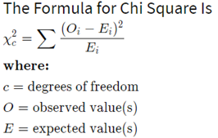
3. Find the Expected Value
Let’s E1 be the expected value for the first cell in table, it can be find by using below equation.
E1 = n * p
Where n is the probability of column variable. p is the probability of row variable. In similar, we calculate remaining Expected values.
4. Calculate Chi-Square value

Slide 29
In feature selection, we aim to select the features which are highly dependent on the response.
When two features are independent, the observed count is close to the expected count, thus we will have smaller Chi-Square value.
So high Chi-Square value indicates that the hypothesis of independence is incorrect.
In simple words, higher the Chi-Square value the feature is more dependent on the response and it can be selected for model training.
5. Accept or Reject the Null Hypothesis
With 95% confidence that is alpha = 0.05, we will check the calculated Chi-Square value falls in the acceptance or rejection region.

Slide 30
5.2.2 Random forest as a feature selection Feature selection using Random forest comes under the category of Embedded methods. Embedded methods combine the qualities of filter and wrapper methods.
Number of decision trees are built over a random extraction of the observations from the dataset and a random extraction of the features.
Nodes with the greatest decrease in impurity happen at the start of the trees, while notes with the least decrease in impurity occur at the end of trees. Thus, by pruning trees below a particular node, we can create a subset of the most important features.

Slide 31
5.3 Algorithms Used
5.3.1 Random Forest Algorithm
First, start with the selection of random samples from a given dataset.
Next, this algorithm will construct a decision tree for every sample. Then it will get the prediction result from every decision tree. The decision tree is a decision support tool. Decision contains set of rules. These rules are constructed by using information gain and Gini index calculations.
In this step, voting will be performed for every predicted result.
At last, select the most voted prediction result as the final prediction result.

Slide 32
5.3.2 Classification Algorithms- Naïve Bayes
Naive Bayes is a statistical classification technique based on Bayes Theorem. It is one of the simplest supervised learning algorithms. Naive Bayes classifier is the fast, accurate and reliable algorithm. Naive Bayes classifiers have high accuracy and speed on large datasets.
Naive Bayes classifier assumes that the effect of a particular feature in a class is independent of other features. This assumption simplifies computation, and that's why it is considered as naive. This assumption is called class conditional independence. The below Bayes’ equation helps to find conditional probability.

Slide 33

The below Baye’s equation helps to find conditional probability.
P(y/x) is posterior probability.
P(x/y) is likelihood probability.
P(y) is class prior probability.
P(x) is predicator prior probability.

Slide 34
Algorithm
Calculate the prior probability for given class labels
Find Likelihood probability with each attribute for each class
Put these value in Bayes Formula and calculate posterior probability.
See which class has a higher probability, given the input belongs to the higher probability class.

Slide 35
5.3.3 Decision Tree
The decision tree classifier creates the classification model by building a decision tree. Decision Tree algorithms are referred to as CART (Classification and Regression Trees). Decision tree is constructed from given attributes on the basis of Gini index impurity. Decision tree can contract for both continuous and categorical target variables.

Slide 36
Decision Tree Algorithm
Place the best attribute of the dataset at the root of the tree.
Split the training set into subsets. Subsets should be made in such a way that
Each subset contains data with the same value for an attribute.
Repeat step 1 and step 2 on each subset until it finds leaf nodes in all the branches of the tree.

Slide 37
Assumptions while creating Decision Tree
At the beginning, the whole training set is considered as the root.
Feature values are preferred to be categorical. If the values are continuous then they are discretized prior to building the model.
Records are distributed recursively on the basis of attribute values.
Order to placing attributes as root or internal node of the tree is done by using some statistical approach.

Slide 38
5.3.4 Gradient Boosting classifier
Gradient boosting classifier is a machine learning algorithms that combine many weak learning models together to create a strong predictive model. Decision trees are usually used when doing gradient boosting. Gradient boosting models are becoming popular because of their effectiveness at classifying complex datasets.

Slide 39
Steps to perform Gradient Boosting
In order to implement a gradient boosting classifier, we'll need to carry out a number of Different steps. We'll need to:
Fit the model
Tune the model's parameters and hyper parameters (learning rate)
Make predictions
Interpret the results

Slide 40
5.3.5 Neural Networks-Radial Basis Function
RBF network is an artificial neural network with an input layer, a hidden layer, and an output layer. The Hidden layer of RBF consists of RBF neurons, and activation function of these neurons is a Gaussian function.

Slide 41
An RBFN performs classification by measuring the input’s similarity to examples from the training set. Each RBFN neuron stores a “prototype”, which is just one of the examples from the training set. When we want to classify a new input, each neuron computes the Euclidean distance between the input and its prototype.

Slide 42
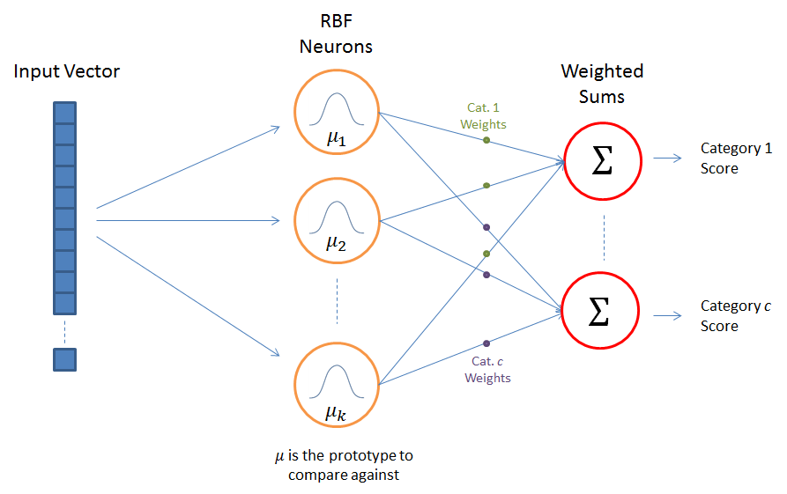
RBF Network Architecture

Slide 43
RBF Algorithm
Define the number of hidden neurons “K”.
Set the positions of RBF centres using K-means clustering algorithm.
Calculate σ (Standard deviation) using equation.
Calculate actions of RBF node using equation.
Train the output using equation.

Slide 44
Model Evaluation
Validation is done by using confusion matrix, Accuracy, precision, recall and F1 score.
Confusion Matrix
A confusion matrix is a table that is often used to describe the performance of a classification model (or "classifier") on a set of test data for which the true values are known.

Slide 45
 | Predicted No | Predicted Yes
Actual No | TN | FP
Actual Yes | FN | TP
● True positives (TP): Classifier predicted yes, and it’s correct prediction.
● True negatives (TN): Classifier predicted no, and it’s correct prediction.
● False positives (FP): Classifier predicted yes, but actually it’s not correct prediction.
● False negatives (FN): Classifier predicted no, but actually it’s not correct prediction.

Slide 46
Accuracy
Accuracy is one metric for evaluating classification models. Informally, accuracy is the fraction of predictions our model got right.
Accuracy = (TP+TN) / (TN+FP+FN+TP)

Slide 47
Precision
Precision quantifies the number of positive class predictions that actually belong to the positive class.
Precision = TP / (TP+FP)
Recall
Recall quantifies the number of positive class predictions made out of all positive examples in the dataset.
Recall = TP / (FP + FN)

Slide 48
F1-Measure
F-Measure provides a single score that balances both the concerns of precision and recall in one number. Basically, it is weighted harmonic mean of precision and recall.
F1- Measure = (2 * precision * recall) / (precision + recall)

Slide 49
6. IMPLEMENTATION AND EXPERIMENTAL ANALYSIS
6.1 Information on Dataset
First dataset is The PANCAN dataset that consists of RNA-Seq gene expressions of patients having different types of tumors: BRCA, KIRC, COAD, LUAD and PRAD have been collected from UCI Repository.
The tumors are considered as class labels.
Number of instances: 801
Number of attributes: 16384
The class labels BRCA, KIRC, COAD, LUAD, PRAD are 5 different cancer/tumour types.

Slide 50
Type Name Organ
BRCA Breast Invasive Carcinoma Breast
KIRC Kidney renal clear cell carcinoma Kidney
COAD Colon adenocarcinoma Large intestine
LUAD Lung adenocarcinoma Lungs
PRAD Prostate adenocarcinoma Prostate gland

Slide 51
The second data set is the Colon cancer data (http://microarray.princeton.edu/oncology).
The data consists of 62 samples of colon epithelial cells from colon-cancer patients. The samples consist of tumors biopsies collected from tumors, and normal biopsies collected from healthy part of the colons of the same patient. The number of genes in the data set is more than 2000.

Slide 52
The third data set is the Leukemia data (http://www.genome.wi.mit.edu/MPR).
This data consists of 72 samples. The samples consist of two types of leukemia, 25 of AML and 47 of ALL. The samples are taken from 63 bone marrow samples and 9 peripheral blood samples. There are 7192 genes in the data set.

Slide 53
6.2 Results and Discussions
Gene Expression Cancer PANCAN Data Set
Confusion Matrix
Algorithm | Without feature Selection | With Random Forest | With Chi-Square
Naive bayes | [[82 0 19 0 0] [ 0 10 3 1 0] [ 3 0 35 0 0] [15 0 5 28 0] [ 1 0 13 0 25]] | [[98 0 0 1 2] [ 0 13 0 0 1] [ 0 0 38 0 0] [ 1 0 0 46 1] [ 0 0 0 0 39]] | [[99 0 0 0 2] [ 0 13 1 0 0] [ 0 0 38 0 0] [ 1 0 0 46 1] [ 0 0 0 0 39]]
Random Forest | [[101 0 0 0 0] [ 0 14 0 0 0] [ 1 1 36 0 0] [ 7 0 0 41 0] [ 0 0 0 0 39]] | [[101 0 0 0 0] [ 0 14 0 0 0] [ 2 0 36 0 0] [ 4 0 0 44 0] [ 0 0 0 0 39]] | [[100 0 0 1 0] [ 0 12 0 0 2] [ 2 0 36 0 0] [ 2 0 0 46 0] [ 0 0 0 1 38]]
KNN | [[81 0 0 0 0] [ 0 18 0 0 0] [ 0 0 29 0 0] [ 0 0 0 40 0] [ 0 0 0 0 32]] | [[81 0 0 0 0] [ 0 18 0 0 0] [ 0 0 29 0 0] [ 0 0 0 40 0] [ 0 0 0 0 32]] | [[62 0 0 0 0] [ 0 14 0 0 0] [ 0 0 23 0 0] [ 0 0 0 32 0] [ 0 0 0 0 29]]
Decision Tree | [[99 1 0 1 0] [ 0 14 0 0 0] [ 0 0 36 0 2] [ 2 2 0 44 0] [ 0 0 0 1 38]] | [[100 0 0 0 1] [ 0 14 0 0 0] [ 0 0 38 0 0] [ 1 0 0 46 1] [ 0 0 0 1 38]] | [[100 0 0 1 0] [ 0 12 0 0 2] [ 2 0 36 0 0] [ 2 0 0 46 0] [ 0 0 0 1 38]]
GBT | [[101 0 0 0 0] [ 1 13 0 0 0] [ 1 0 37 0 0] [ 1 0 1 46 0] [ 3 0 0 0 36]] | [[81 0 0 0 0] [ 0 18 0 0 0] [ 0 0 28 1 0] [ 1 0 0 39 0] [ 1 0 0 0 31]] | [[101 0 0 0 0] [ 0 14 0 0 0] [ 2 0 36 0 0] [ 1 0 0 47 0] [ 0 0 0 0 39]]
RBF | [[73 28 0 0 0] [ 3 11 0 0 0] [ 1 37 0 0 0] [ 5 43 0 0 0] [ 0 39 0 0 0]] | [[51 30 0 0 0] [ 4 14 0 0 0] [ 3 26 0 0 0] [ 4 36 0 0 0] [ 1 31 0 0 0]] | [[89 12 0 0 0] [ 0 14 0 0 0] [ 0 38 0 0 0] [ 0 48 0 0 0] [ 0 39 0 0 0]]

Slide 54
Accuracy
Algorithm | Without feature Selection | With Random Forest | With Chi-Square
Naive bayes | 75 | 97.5 | 97.91
Random Forest | 96.25 | 98.3 | 98.75
Decision Tree | 96.25 | 96.66 | 96.66
GBT | 97.08 | 98.5 | 98.75
RBF | 35 | 32.5 | 42.91

Slide 55
Cross Validation Score
Algorithm | Mean Score and range (Without feature Selection) | Mean Score and range( With Random Forest) | Mean Score and range (With Chi-Square)
Naive bayes | 80.10 (75-82) | 98.87 (96-100) | 98 (95-100)
Random Forest | 97 (96-98) | 99.12 (96-100) | 99.62 (98.75-100)
Decision Tree | 97 (95-100) | 98.24 (93-100) | 97 (93-100)
GBT | 95 (88-97) | 99 (96-100) | 99 (98-100)

Slide 56
Gene Expression Leukaemia Data Set
Confusion Matrix
Algorithm | Without feature Selection | With Random Forest | With Chi-Square
Naive bayes | [[14 0] [ 2 6]] | [[14 0] [ 1 7]] | [[14 0] [ 1 7]]
Random Forest | [[14 0] [ 4 4]] | [[14 0] [ 1 7]] | [[14 0] [ 1 7]]
Decision Tree | [[11 3] [ 1 7]] | [[11 3] [ 1 7]] | [[11 3] [ 1 7]]
GBT | [[12 2] [ 8 0]] | [[14 0] [ 0 8]] | [[14 0] [ 2 6]]
RBF | [[13 1] [ 6 2]] | [[14 0] [ 4 4]] | [[14 0] [ 5 3]]

Slide 57
Accuracy
Algorithm | Without feature Selection | With Random Forest | With Chi-Square
Naive bayes | 90.90 | 95.45 | 95.45
Random Forest | 81.81 | 95.45 | 95.45
Decision Tree | 81.81 | 81.81 | 81.81
GBT | 54.54 | 100 | 90.9
RBF | 68.18 | 81.81 | 77.27

Slide 58
Cross Validation Score
Algorithm | Mean Score and range (Without feature Selection) | Mean Score and range( With Random Forest) | Mean Score and range (With Chi-Square)
Naive Bayes | 90.35 (71.42-100) | 90 (71.42-100) | 90.35 (71.42-100)
Random Forest | 88.92 (71.42-100) | 85 (71.42-100) | 86.25 (71.42-100)
Decision Tree | 81.78 (57.14-100) | 76.60 (42.8-100) | 66.96 (50-85.71)
GBT | 70 (50-100) | 66.96 (42-85) | 66.96 (42.7-85.71)

Slide 59
Colon Cancer Gene Expression dataset
Confusion Matrix
Algorithm | Without feature Selection | With Random Forest | With Chi-Square
Naive bayes | [[5 4] [2 5]] | [[6 3] [0 7]] | [[2 8] [1 5]]
Random Forest | [[9 0] [3 4]] | [[9 0] [7 0]] | [[8 2] [2 4]]
Decision Tree | [[8 1] [5 2]] | [[8 1] [4 3]] | [[4 6] [2 4]]
GBT | [[8 1] [5 2]] | [[8 1] [2 5]] | [[7 3] [4 2]]
RBF | [[9 1] [4 2]] | [[15 0] [ 4 0]] | [[8 1] [5 2]]

Slide 60
Accuracy
Algorithm | Without feature Selection | With Random Forest | With Chi-Square
Naive bayes | 54.26 | 81.25 | 43.75
Random Forest | 81.4 | 87.25 | 75
Decision Tree | 62.5 | 68.75 | 50.0
GBT | 62.5 | 81.25 | 56.25
RBF | 56.25 | 56.25 | 68.75

Slide 61
Cross Validation Score
Algorithm | Mean Score and range (Without feature Selection) | Mean Score and range( With Random Forest) | Mean Score and range (With Chi-Square)
Naive bayes | 54.76 (33.33-66.66) | 54.76 (33.33-66.66) | 54.76 (33.33-66.66)
Random Forest | 82.14 (50-100) | 83.3 (50-100) | 83.57 (50-100)
Decision Tree | 75 (50-100) | 77.61 (50-100) | 74.04 (50-100)
GBT | 70 (33.33-100) | 70 (33.33-100) | 70 (33-100)

Slide 62
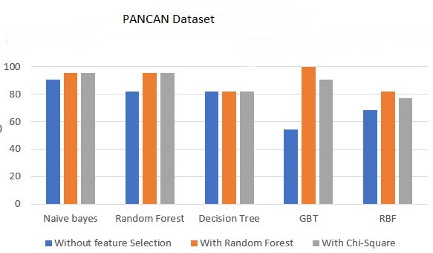

Slide 63
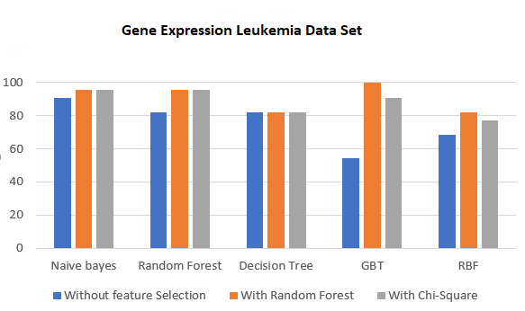

Slide 64
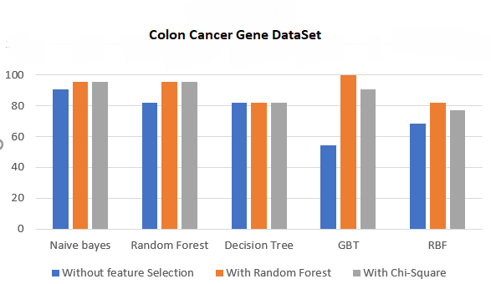

Slide 65
We observed that when we have very little data in such a case, on re-running the classifier on different training and validation sets will yield classifications that differ a lot. That is because, classification variance will be large when we have small dataset and splitting the dataset randomly.
In order to properly come to conclusion about the better algorithm, we applied K-fold cross validation.
Cross-validation is a statistical method used to estimate the skill of machine learning models.
It is commonly used in applied machine learning to compare and select a model for a given predictive modelling problem because it is easy to understand, easy to implement
Here, we are splitting the training data set into number of splits(train and test) and validating the accuracy. Therefore we get the range of accuracy in which we might get the accuracy of the test data.

Slide 66
Pros and Cons of Random Forest
Pros
Random forests work well for a large range of data items than a single decision tree does.
Random forests are very flexible and possess very high accuracy.
Random Forest algorithms maintains good accuracy even a large proportion of the data is missing.
It overcomes the problem of overfitting by combining the results of various decision trees

Slide 67
Cons
More computational resources are required to implement Random Forest algorithm.
It is less intuitive in case when we have a large collection of decision trees.
The prediction process using random forests is very time-consuming in comparison with other algorithms.
Complexity is the disadvantage

Slide 68
Pros and Cons of Naïve Bayes algorithm
Pros
Can solve problems involving both categorical and continuous valued attributes
For very high-dimensional data, when model complexity is less important.
For very well-separated categories, when model complexity is less important
Naïve Bayes classifiers are linear classifier hence it’s simple to implement

Slide 69
Cons
The assumption that all features are independent is not usually the case in real life so it makes Naive Bayes algorithm less accurate than complicated algorithms.

Slide 70
Pros and Cons of Decision Tree
Pros
Compared to other algorithms,it requires less effort for data preparation during pre-processing.
A decision tree does not require scaling of data as well.
Decision tree can use for both continuous and categorical target variables.

Slide 71
Cons
A small change in the data can cause a large change in the structure of the decision tree causing instability.
For a Decision tree sometimes calculation can go far more complex compared to other algorithms.
Decision tree often involves higher time to train the model.
Decision tree training is relatively expensive as complexity and time taken is more.

Slide 72
Pros and Cons of Gradient Boosting
Pros
Lots of flexibility-Can optimize on different loss functions and provides several hyper parameter tuning options that make the function fit very flexible.
No data pre-processing required, often works great with categorical and numerical values as is.
Cons
Computationally expensive-GDMs often require many trees(>1000) which can be time and memory exhaustive.

Slide 73
Pros and Cons of RBF
Pros
Training in RBN is faster in MLPinteractions in MLP.
We can easily interpret what is the meaning of the each node in hidden layer of the RBFN. This is difficult in MLP.
Cons
Classification will take more time in RBF than MLP.

Slide 74
7. CONCLUSION AND FUTURE SCOPE
For dataset1,(PANCAN) dataset, considering the accuracy and K-fold validation scores, we conclude that random forest perform better followed by decision tree and Naive Bayes.
For dataset2,(leukaemia gene expression dataset and colon cancer gene expression dataset) we observed random forest followed by naive Bayes has performed better.
We observed that, algorithms perform better when the number of instances in the dataset is more. Based on the results obtained, when compared with all the dataset, we observed Random Forest has performed well.
When Chi-Square feature selection is applied, we observed considerable increase in accuracy compared to random forest. But in chi square, we had to set the number of features to be selected. So random forest as a feature selector is better as we can proceed through the algorithm without manual intervention.

Slide 75
In the current implementation we were not able to achieve great results using Neural Network(RBF). So, as a part of future work, we would like to explore more neural network algorithms on a bigger gene dataset.

