Slide 1

SECURE DATA SHARING WITH EFFICIENT KEY UPDATE FOR INDUSTRIAL CLOUD-BASED MULTI ATTRIBUTE ACCESS CONTROL
Team Details
Gaddam Poojasri(20EG105313)
Vunnam Nandini Krishna(20EG105326)
Achugatla Sindhura(20EG105732)
Project Supervisor
Mrs. Asma Tahseen
Assistant Professor

Slide 2
Introduction
The Industry 4.0 revolution relies heavily on data to generate value, innovation, new services, and optimize current processes . The data origins may vary from sensor data to financial statements and even strictly confidential user or business data. Industries and businesses often join forces with other organizations to create better products, comply with regulations, or fulfill the needs of customers. Such relationships and collaborations create ecosystems in which data are often the strategic resource. Hence, data need to be shared among organizations in a data-driven ecosystem for it to be used as a strategic resource for creating desired values, innovations, or process improvement using cloud storage and services.

Slide 3
Problem Statement
The attribute revocation is a major drawback of CP-ABE since it introduces subsequent costs such as ciphertext re-encryption, user key re-generation, and key re-distribution. Existing revocable CP-ABE based access control models have focused on minimizing the cost of communication and computation cost for ciphertext re-encryption. Unfortunately, the key update issue is subject to re-key generation as traditional CP-ABE does. In essence, key update becomes crucial when there are a high number of users accessing shared data in the cloud

Slide 4
Existing method :
The existing method proposed a privacy-aware relationship semantics-based XACML access control model designed to protect electronic health records (EHRs) in a hybrid cloud called PRSX-AC. This model extends the standard XACML-ABAC with a semantic relationship-based access control (rel-BAC) hybrid approach. In rel-BAC, access rights are represented as relations between users and objects. With Joshi’s scheme, the request, decision evaluation, document retrieval, encryption, and decryption processes occur inside the organization’s trusted domain. This approach exploits the flexibility of its complex ontology schema to express and enforce complex policies using contextual and environmental attributes
Disadvantages: This application was developed in a caring environment where data access is limited to a few users. When coming to multiple-user access control policy in the industrial environment this method can't give access permission to all users effectively.

Slide 5
Problem Illustration
Existing revocable CP-ABE-based access control models have focused on minimizing the cost of communication and computation cost for ciphertext re-encryption. Unfortunately, the key update issue is subject to re-key generation as traditional CP-ABE does. In essence, key updates become crucial when there is a high number of users accessing shared data in the cloud. In this paper, we propose a lightweight and scalable access control model featuring an efficient key update scheme. A key piece of this work is that we utilize an attribute certificate (AC) to support the authorization within the CP-ABE scheme.

Slide 6
Proposed Method
we propose a lightweight and scalable access control model featured with the efficient key update scheme.
In proposed system we provide solution for improving data access and improve security with encryption, key distribution and access control for industrial data. Industrial data is taken as input and secure data with AES encryption and add Multi attribute as extension to improve access control policy where when two access policy set by owner is satisfied then only user can download data. After file is downloaded central authority will update key to stop user to share same with others users once file is downloaded.

Slide 7
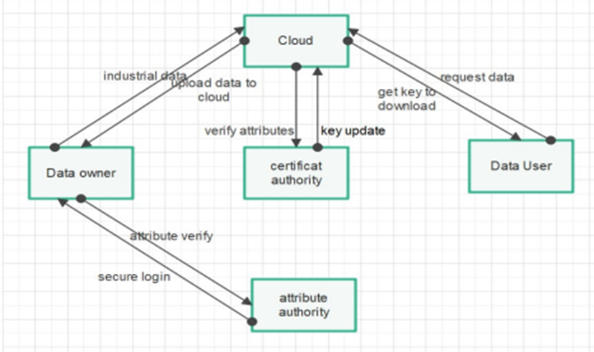
Proposed Method

Slide 8
Experiment Environment

Slide 9
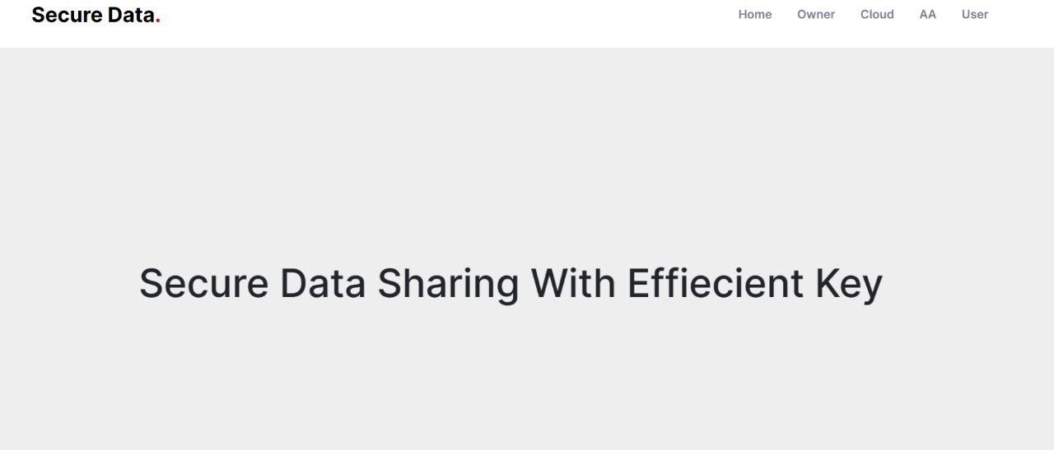
Experiment Screen shorts

Slide 10
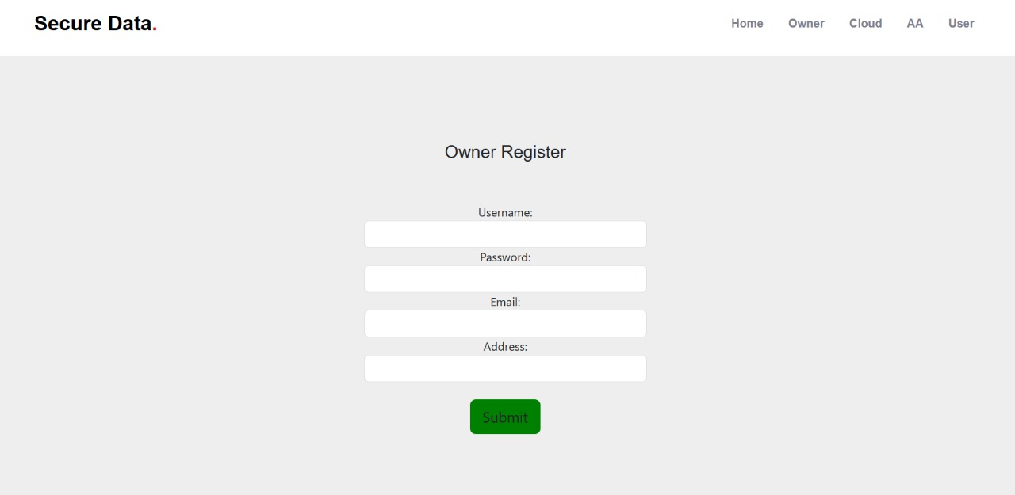
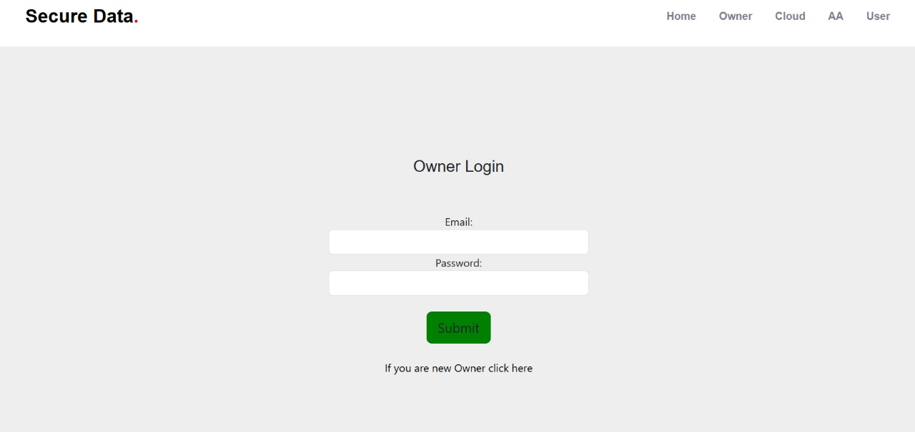
Experiment Screen shorts

Slide 11
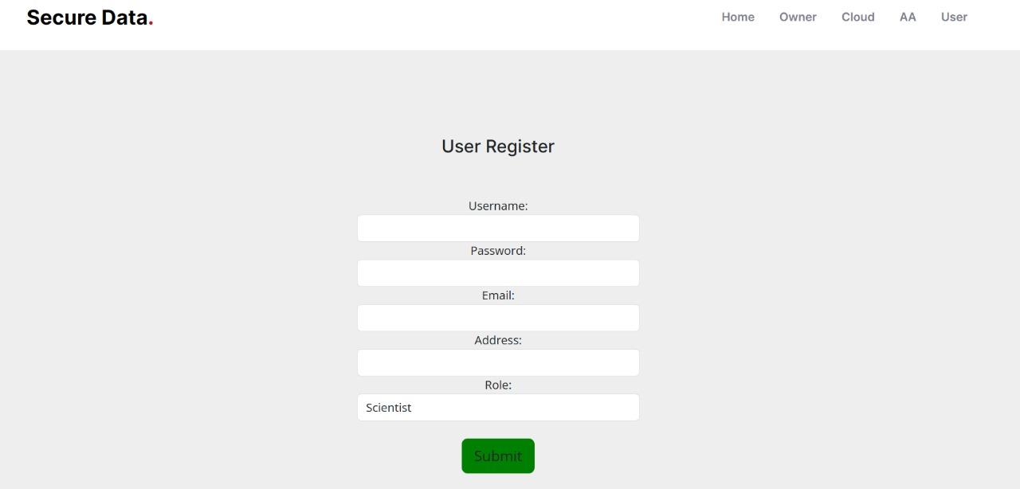
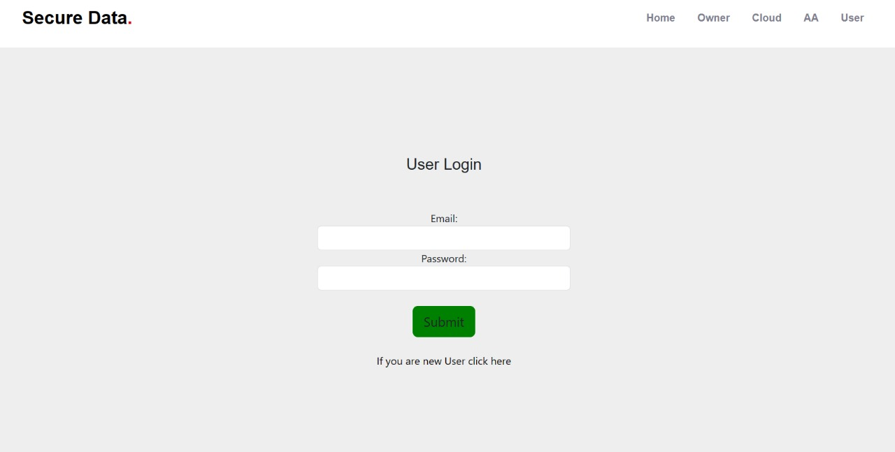
Experiment Screen shorts

Slide 12
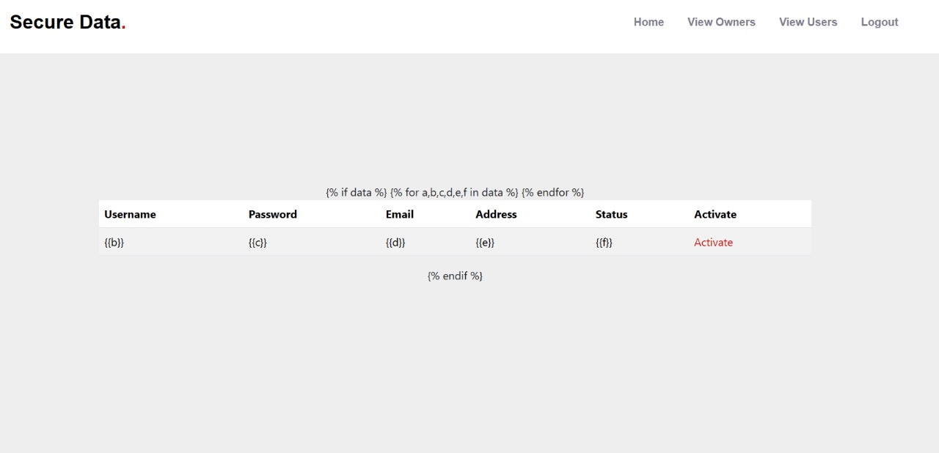

Experiment Screen shorts

Slide 13
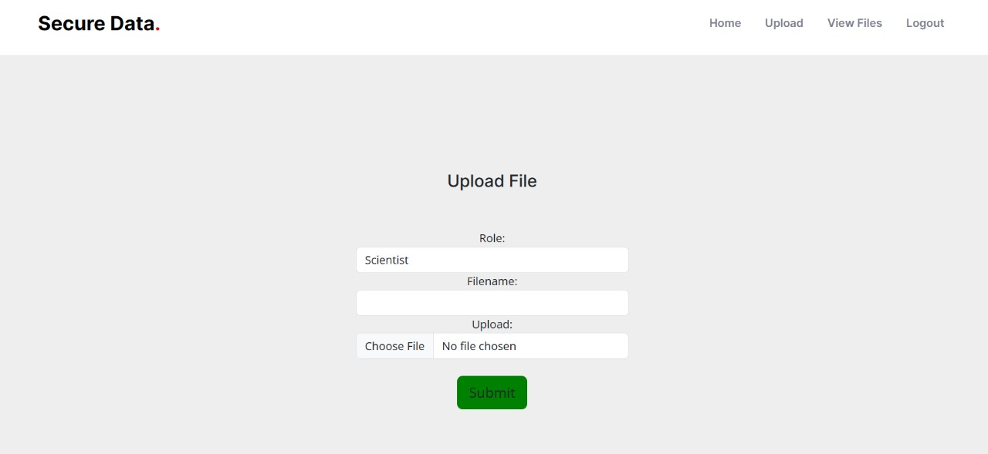
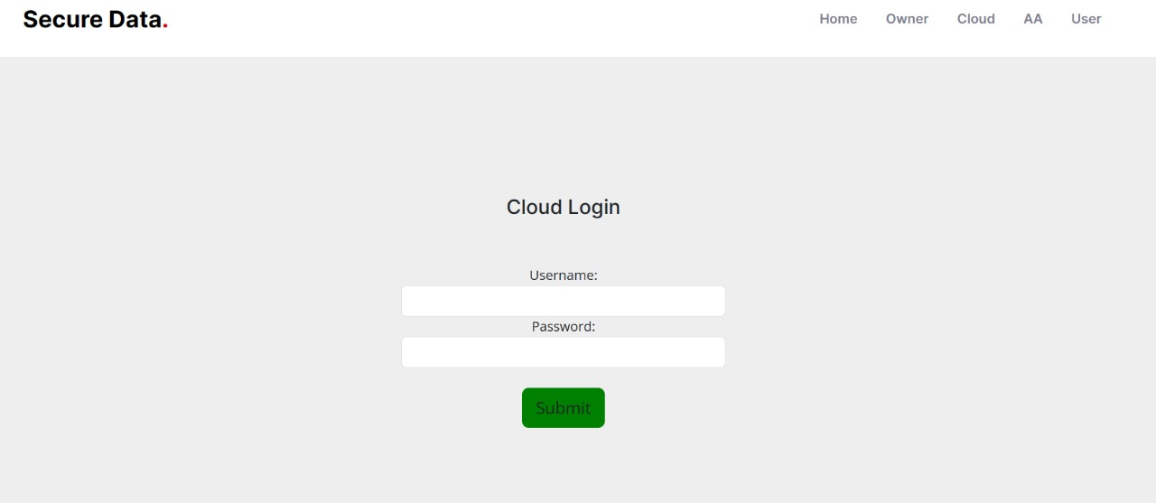
Experiment Screen shorts

Slide 14
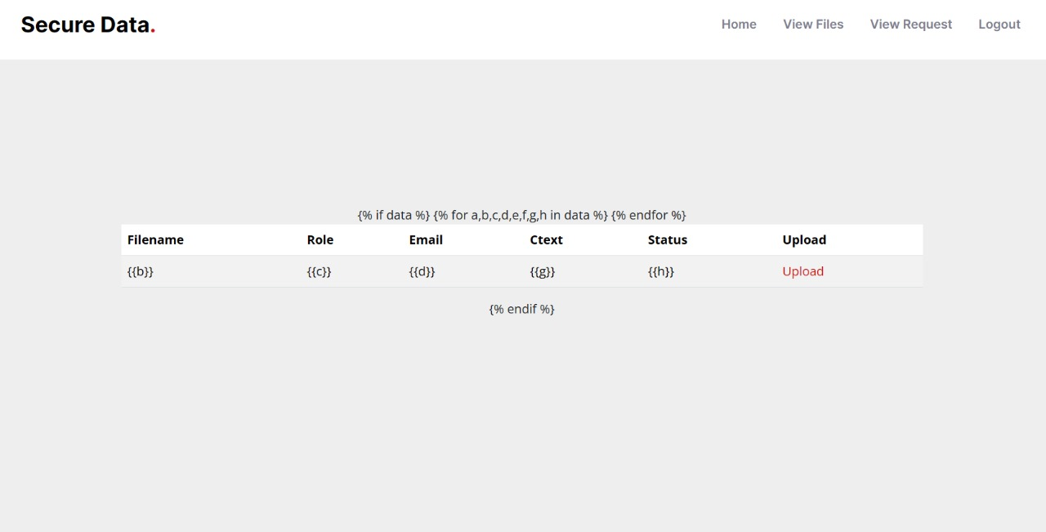
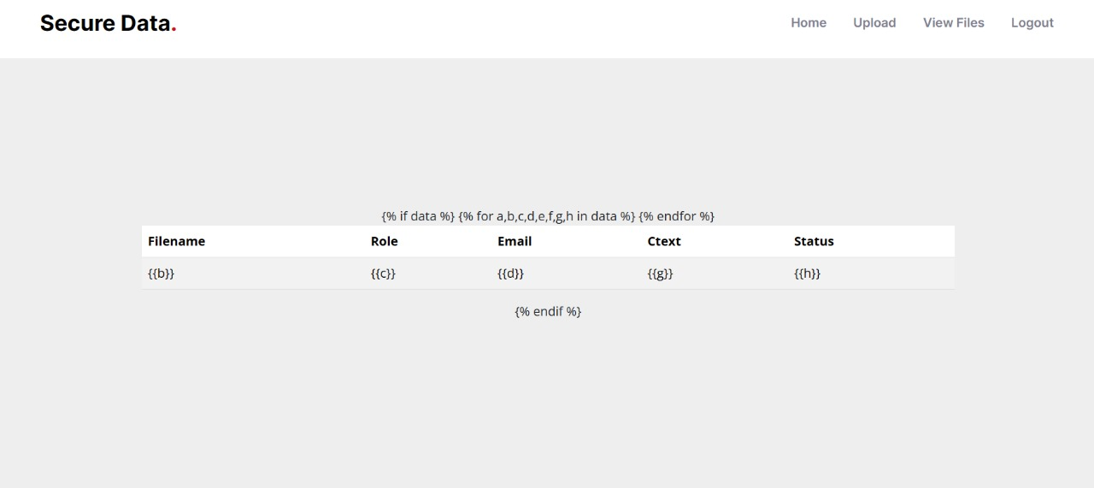
Experiment Screen shorts

Slide 15
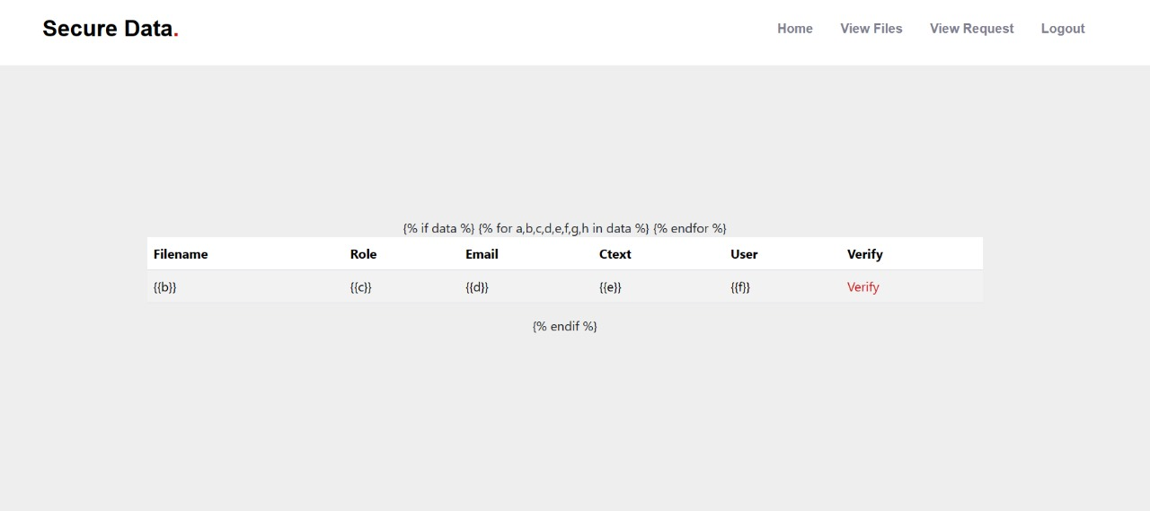
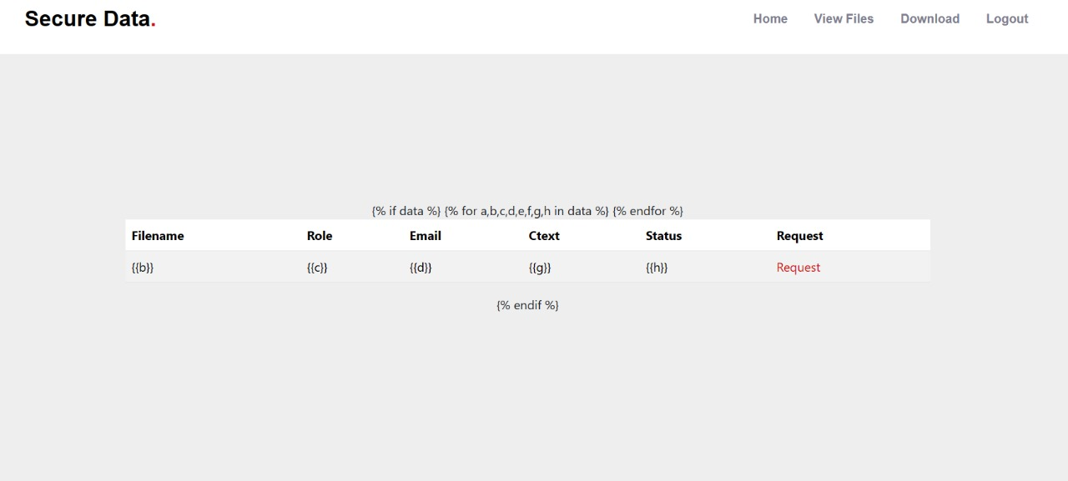
Experiment Screen shorts

Slide 16
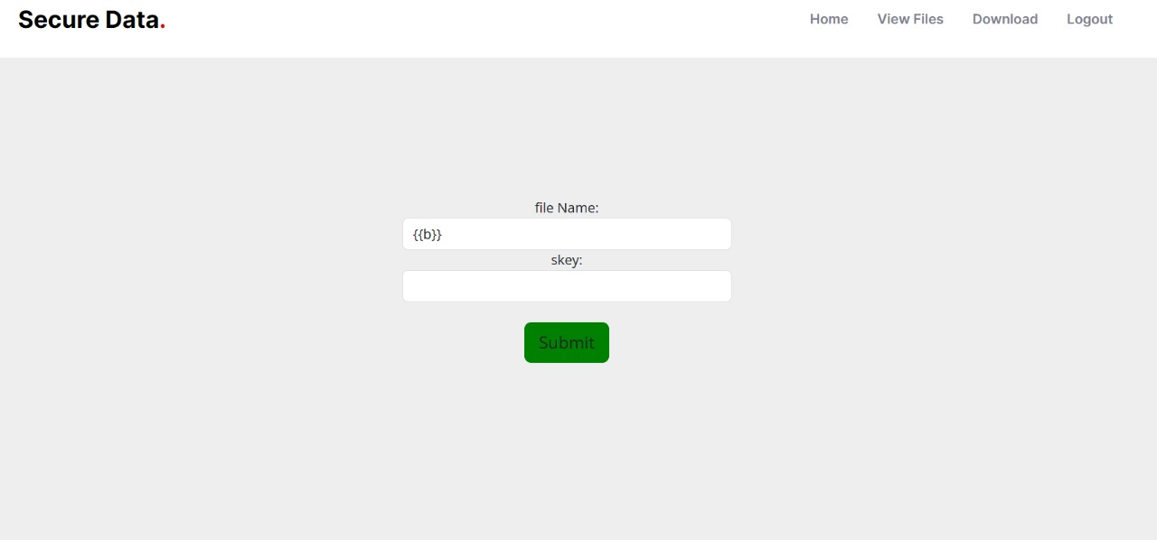
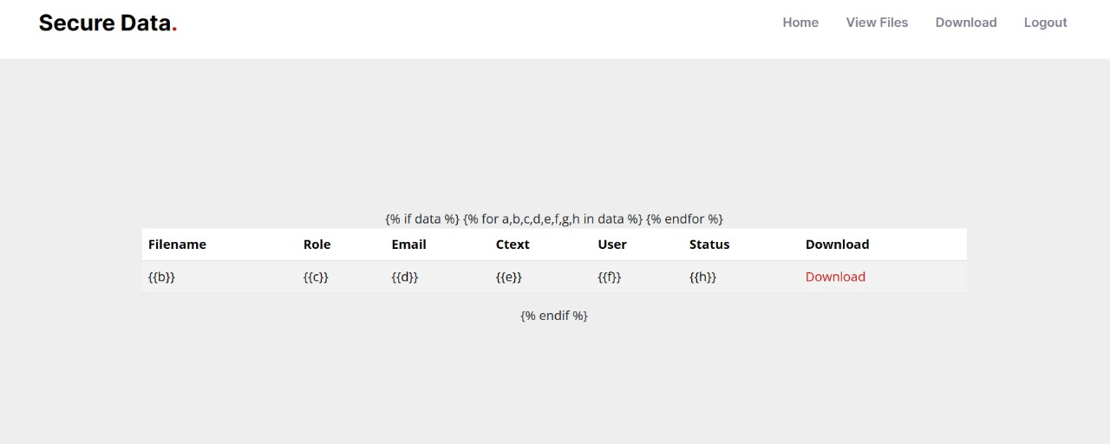
Experiment Screen shorts

Slide 17
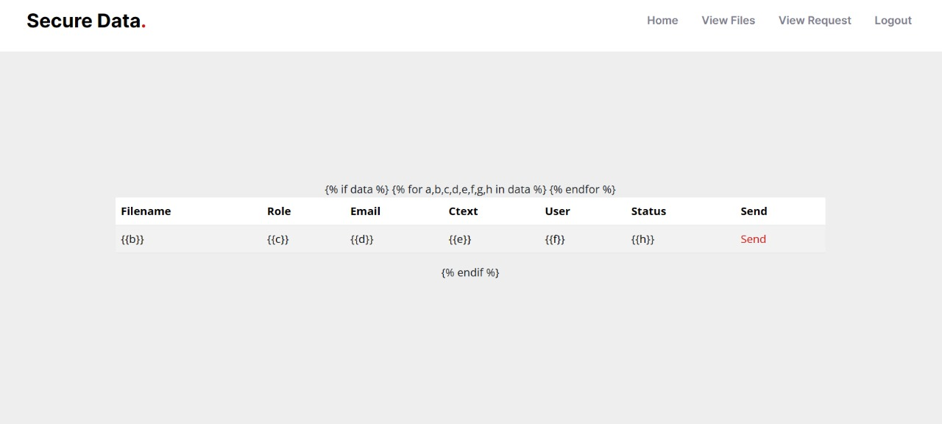
Experiment Screen shorts

Slide 18
Experiment Results

Slide 19
Finding

Slide 20
Justification
The challenge of attribute revocation in CP-ABE entails significant costs such as ciphertext re-encryption, user key regeneration, and key redistribution. Despite efforts to minimize these expenses, especially in reducing communication and computation overhead for ciphertext re-encryption, the issue of key update remains largely unattended. Unlike ciphertext re-encryption, which aims to update stored data security, key update is vital for maintaining access control when revoking or updating user privileges. In cloud environments with numerous users accessing shared data, the importance of efficient key update mechanisms is evident. Neglecting this aspect not only leads to inefficiencies in access control but also compromises the security and scalability of CP-ABE systems in the cloud. Therefore, addressing the key update problem is crucial for ensuring the effectiveness and resilience of access control mechanisms in CP-ABE systems.

