Slide 1

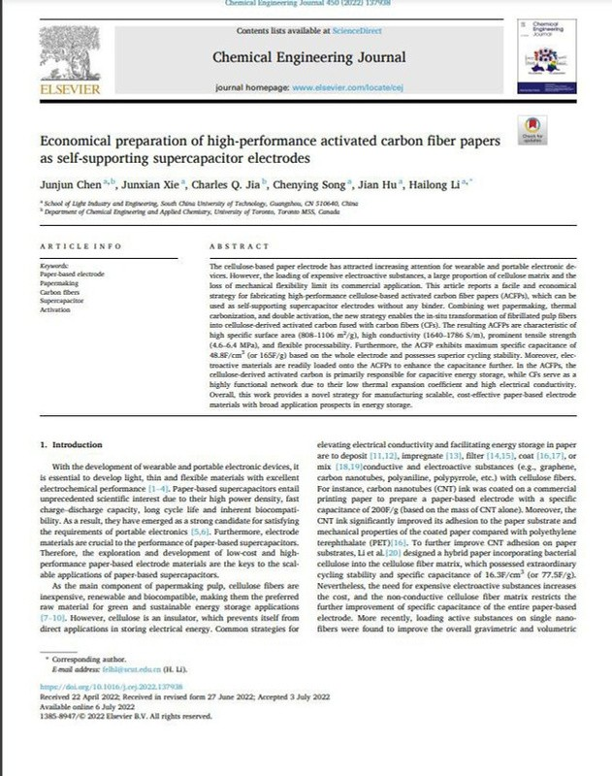
TECHNICAL WRITING AND PRESENTATION
Economical preparation of high-performance activated carbon fiber papers as self- supporting supercapacitor electrodes
Presented by-Nandini Priya 210107055
GROUP 1
13TH SEPTEMBER 2023

Slide 2
Introduction
CONTENT
Materials and Methodology
Results and Discussion
Summary and Conclusion
References

Slide 3

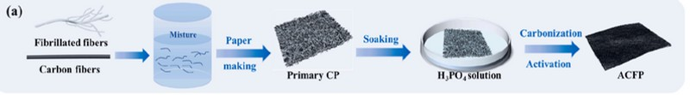
INTRODUCTION
Introducing a novel approach for developing cellulose-based supercapacitor electrodes with exceptional electrochemical performance and mechanical flexibility.
Addressing the need for cost-effective and sustainable electrode materials by utilizing cellulose fibers, a renewable and abundant resource, to create high-performance activated carbon fiber papers (ACFPs).
Combining wet papermaking, thermal carbonization, and double activation, the new strategy enables the in- situ transformation of fibrillated pulp fibers into cellulose-derived activated carbon fused with carbon fibers (CFs).
Demonstrating a scalable and economical manufacturing strategy for paper-based flexible electrode materials with broad applications in wearable and portable electronic devices, offering a sustainable alternative to traditional petroleum-based resources.
03

Slide 4
LITERATURE GAPS
Cost-Effective Cellulose-Based Electrodes: While prior work has concentrated on enhancing electrode performance, there exists a need for economically viable cellulose-based electrode materials that can rival conventional petroleum-derived alternatives.
Mechanical Flexibility and Processability Challenges: Numerous cellulose-derived carbon materials face limitations concerning their mechanical flexibility and ease of processing.
Scalability and Mass Production: Developing scalable manufacturing processes for these novel electrode materials is essential for their widespread adoption in energy storage applications.
Integration of Cellulose and Carbon Fibers: The integration of fibrillated pulp fibers and carbon fibers into a cohesive structure with enhanced properties represents a promising avenue for achieving high-performance and flexible paper electrodes.
04

Slide 5
LITERATURE COMPARISON
Graphene/Carbon Nanotube-Based Papers
Integration of graphene or carbon nanotubes into cellulose- based papers to enhance conductivity and electrochemical performance.
Carbon Fiber- Based Electrodes
Some research has utilized carbon fibers as electrode materials due to their strength and electrical conductivity but they have limited specific surface areas.
Carbonization of Cellulose
Another avenue of research involves the carbonization of cellulose to create carbon materials with improved electrochemical properties. However, these studies often resulted in materials with reduced mechanical flexibility and limited processability.
05

Slide 6
LITERATURE COMPARISON OF CARBON BASED MATERIALS
CAPACITANCE
(F/cm3)
CAPACITANCE
(F/g)
CYCLE STABILITY
CONDUCTIVITY
(S/m)
MATERIALS
REFERENCE
Bacterial Cellulose
--
74
99.5%
--
S. Li, D. Huang, B. Zhang, X. Xu, M. Wang, G. Yang, Y. Shen et. al. (2014)
Cellulose Fiber |  | 16.3 |  | 77.5 |  | 98.4% |  | 590 |  | X. Wu, M. Zhang, T. Song, H. Mou, Z. Xiang, H. Qi, et. al (2020)
Cellulose(RGO) |  | 2.4 |  | 212 |  | 94% |  | 17.2 |  | J. Bi, H. Wu, L. Wang, X. Pang, Y. Li, Q. Meng, L. Wang, et. al.(2021)
Graphene Cellulose |  | -- |  | 120 |  | 99.1% |  | 16.6 |  | Z. Weng, Y. Su, D.-W. Wang, F. Li, J. Du, H.-M. Cheng, et. al. (2011)
PANI Nanoribbon |  | 40.5 |  | -- |  | 79% |  | -- |  | D. Ge, L. Yang, L. Fan, C. Zhang, X. Xiao, Y. Gogotsi, S. Yang et. al. (2015)
--
110
80%
--
O. Okhay, A. Tkach, M.J.H. Gallo, G. Otero-Irurueta, S. Mikhalev, P. Staiti, F. Lufranoet. al. (2020)
RGO/CNT Aerogel
37.8-41.8
134.1
--
1786
ACFP-10
THIS WORK
22.0-24.1
80.0
100%
1640
ACFP-15
THIS WORK
06

Slide 7
GOALS and OBJECTIVES
Develop High-Performance Cellulose- Based Supercapacitor Electrodes
Fabricate cellulose-based activated carbon fiber papers (ACFPs) with superior electrochemical performance, including high specific surface area and conductivity
Enhance the mechanical flexibility and processability of ACFPs, making them suitable for flexible and wearable electronic devices.
Exploit the Synergy between Cellulose and Carbon Fibers
Investigate how cellulose-derived activated carbon fibers (ACFs) and carbon fibers (CFs) work in synergy to improve the capacitive energy storage capabilities of the ACFPs.
Establish Scalable and Economical Manufacturing Processes
Develop a manufacturing strategy that is scalable for mass production, ensuring the potential for widespread adoption in energy storage applications.
07

Slide 8
Materials and Methodology
Materials Required
Field Emission Scanning Electron Microscope (FE-SEM)
Cotton pulp board
Specific Surface Area Analyzer (ASAP 2460, Micromeritics)
Carbon fibers
(3 mm CFs)
Fourier Transform Infrared Spectroscopy (FTIR)
Instruments Used
Material Testing Machine (INSTRON 3300, USA)
Phosphoric acid (H3PO4)
X-ray Diffractometer (XRD) and Raman Microscope (Raman)
High-purity nitrogen (N2)
Three-Electrode Test System
Food-grade carbon dioxide gas (CO2)
All-Solid-State Symmetric Supercapacitor Setup
08

Slide 9
METHODOLOGY
Preparation of Primary Composite Papers (CPs): Fibrillated cotton pulp is prepared by beating it in a Walli Beater. Fibrillated pulp fibers and CFs are mixed with water to form primary composite papers (CPs).
Preparation of Cellulose-Based ACFPs: Primary CPs are pre-impregnated with H3PO4 solution which are then carbonized and activated at 450°C in N2 atmosphere and then under C02 atmosphere at 850°C.
Fabrication of Supercapacitors: All-solid-state symmetric supercapacitors (SSCs) are fabricated using two pieces of ACFP-15 as electrodes, cellulose paper as a separator, and PVA-KOH gel as a solid electrolyte.
Preparation of MnO2-ACFP: MnO2 electrodeposition is performed on ACFP (1x1 cm2) in a manganese sulfate solution at room temperature using reference and counter electrodes.
Materials Characterizations and . Electrochemical Performance Characterization
09

Slide 10
Results and Discussion
ACFPs exhibited a three-dimensional structure with a fibrous network, providing excellent electrical conductivity.
Unique ACFP Structure
CFs served as a conductive framework, while ACFs matrix contributed to ion storage.
ACFPs showed flexible mechanical properties, High tensile strength (up to 6.4 MPa) and Young's modulus (up to 1185 MPa)
Mechanical Properties
RESULTS
Fabrication of Cellulose-based ACFPs
Pseudocapacitive Loading
ACFPs had a large specific surface area (808-1106 m²/g) and high electrical conductivity (1640-1786 S/m).
Wettability and Durability
Electrochemical Performance
ACFPs exhibited excellent electrochemical performance in a three- electrode system with a high specific capacitance.
Good cycle stability (98.58% coulombic efficiency after 10,000 cycles) and energy density (6.01 Wh/kg) were achieved.
10

Slide 11
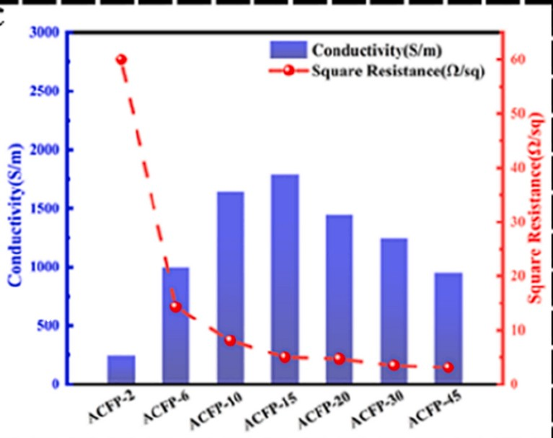
RESULTS
Square resistance and electrical conductivity of cellulose-based
ACFPs with different CFs content.
11

Slide 12
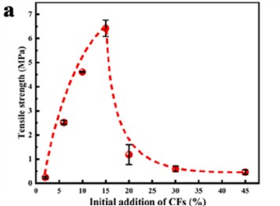
RESULTS
Tensile strength of cellulose-based ACFPs with different CFs content
12

Slide 13
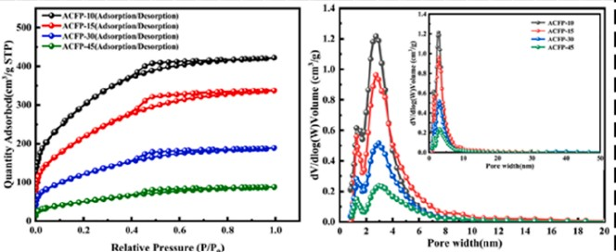
RESULTS
N2 adsorption isotherms and pore size distributions of ACFPs with different CFs content.
13

Slide 14
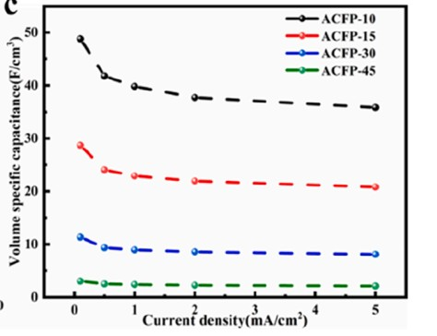
RESULTS
Volume specific capacitance of ACFPs at different current densities
14

Slide 15
SUMMARY
Back to Agenda Page
Successful fabrication of cellulose-based Activated Carbon Fiber Papers (ACFPs) using a cost-effective process.
ACFPs have a unique three-dimensional structure with a fibrous network, providing excellent electrical conductivity.
Impressive mechanical properties, including high tensile strength and Young's modulus, make ACFPs flexible and self-supporting.
They demonstrate excellent electrochemical performance, with a high specific capacitance and good cycle stability.
In summary, cellulose-based ACFPs represent a promising material for energy storage applications due to their unique structure, mechanical strength, and electrochemical performance.
15

Slide 16
CONCLUSION
FUTURE WORK
Explore the scalability and commercial viability of producing ACFPs on a larger scale for practical applications.
Subjective Conclusion
The research findings demonstrate that cellulose-based Activated Carbon Fiber Papers (ACFPs) hold immense promise as versatile materials for energy storage applications.
These ACFPs offer an impressive combination of structural integrity, electrical conductivity, and electrochemical performance, making them a compelling choice for supercapacitors and other energy storage devices.
Investigate the use of different pseudocapacitive materials to optimize energy storage performance.
Objective Conclusion
The ACFPs exhibit exceptional mechanical properties, including high tensile strength and Young's modulus, confirming their structural integrity.ACFPs display a large specific surface area, high electrical conductivity, and excellent electrochemical performance, with a specific capacitance well-suited for supercapacitor applications The ACFPs maintain good structural stability and cycle stability over extended use, highlighting their potential for long-term energy storage applications.
Examine the potential for ACFPs in applications beyond supercapacitors, such as in flexible electronics or energy storage for renewable energy systems.
Conduct in-depth environmental and economic assessments to assess the sustainability and cost- effectiveness of ACFP production.
16

Slide 17
REFERENCES
X. Zhao, Z. Xiong, Z. Qiao, X. Bo, D. Pang, J. Sun, J. Bian, Robust and flexible wearable generator driven by water evaporation for sustainable and portable selfpower supply, Chem. Eng. J. 434 (2022), https://doi.org/10.1016/j. cej.2022.134671.
J. Liang, C. Jiang, W. Wu, Toward fiber-, paper-, and foam-based flexible solid-state supercapacitors: electrode materials and device designs, Nanoscale 11 (15) (2019) 7041–7061, https://doi.org/10.1039/c8nr10301a.
J. Liang, B. Tian, S. Li, C. Jiang, W. Wu, All-printed MnHCF-MnOx-based highperformance flexible supercapacitors, Adv. Energy Mater. 10 (12) (2020), https:// doi.org/10.1002/aenm.202000022.
] J. Du, L. Liu, Z. Hu, Y. Yu, Y. Zhang, S. Hou, A. Chen, Raw-cotton-derived n-doped carbon fiber aerogel as an efficient electrode for electrochemical capacitors, ACS Sustain. Chem. Eng. 6 (3)
M. Wagih, A. Komolafe, N. Hillier, Screen-printable flexible textile-based ultrabroadband millimeter-wave DC-blocking transmission lines based on microstripembedded printed capacitors, IEEE J. Microwaves 2 (1) (2022) 162–173, https://
doi.org/10.1109/jmw.2021.3126927.
H. Wu, J. Bi, Y. Li, L. Wang, X. Pang, C. Xiong, Z. Li, Low-cost and low-density carbonized facial tissue supported uniform NiCo2S4 nanotubes for high capacity flexible solid-state supercapacitors, J. Materiomics 7 (1) (2021) 166–176, https://
doi.org/10.1016/j.jmat.2020.06.011.
17

Slide 18
THANKYOU!
+91 7294153392
p.nandini@iitg.ac.in
Department of Chemical Engineering Indian Institute of Technology, Guwahati
18

