Slide 1
TRAFFIC PREDICTION FOR INTELLIGENT TRANSPORTATION SYSTEM USING DEEP LEARNING

Slide 2
INDEX
Abstract
Objective of project
Problem Statement
Scope & Motivation
Introduction
Literature survey
Existing Method
Disadvantages
Proposed method
Advantages
Project Flow
Hardware and Software Requirements
Architecture
Modules
algorithm
UMLS
Conclusion
Future Enhancement
References

Slide 3
ABSTRACT
The most important challenge to sustainable mobility is persistent congestions of differing strength and duration in the dense transport networks. The standard Adaptive Traffic Signal Control cannot properly address this kind of congestion. Deep learning-based mechanisms have proved their significance to anticipate in adjective outcomes to improve the decision making on the predictions of traffic length. The deep learning models have long been used in many application domains which needed the identification and prioritization of adverse factors for a simplifying human life. Several methods are being popularly used to handle real time problems occurring from traffic congestion. This study demonstrates the capability of DL models to overcome the traffic congestion by simply allowing the vehicles through a signal depending on the length of vehicles. Our proposed method integrates a numeral of approach, intended to advance the cooperativeness of the explore operation. In this work, we implement the application to detect the number of vehicles in the images from the user and gives vehicles counts. To detect the vehicles count here we are using the YOLO pretrained weights.

Slide 4
OBJECTIVE
To detect the vehicles in the uploaded image and counts the number of vehicles, by using YOLO model.

Slide 5
PROBLEM STATEMENT
The problem statement revolves around traffic prediction for Intelligent Transportation Systems (ITS) using deep learning. This involves the development of advanced neural network models capable of analyzing vast amounts of traffic data to forecast congestion, traffic flow, and travel times accurately. The aim is to enhance traffic management, reduce congestion, improve transportation efficiency, and promote the overall effectiveness of intelligent transportation systems in modern urban environments through data-driven deep learning approaches.

Slide 6
SCOPE AND MOTIVATION
SCOPE
The scope of this project encompasses the development and implementation of deep learning models and algorithms for traffic prediction within Intelligent Transportation Systems (ITS). This includes data collection, preprocessing, feature engineering, model architecture design, training, and validation. The project aims to forecast various traffic parameters, such as congestion, travel times, and traffic flow, using diverse data sources like sensors, GPS, and traffic cameras. Ethical considerations related to data privacy and responsible use of deep learning in traffic management will also be explored. The ultimate goal is to provide urban planners, transportation authorities, and commuters with reliable traffic predictions for enhanced mobility and efficiency.

Slide 7
MOTIVATION
The motivation behind employing deep learning for traffic prediction in intelligent transportation systems lies in the urgent need to combat persistent congestion in dense transport networks. Traditional methods like Adaptive Traffic Signal Control fall short in addressing varied congestion levels effectively. Deep learning models offer promise in accurately anticipating traffic outcomes, aiding decision-making for congestion predictions. By leveraging these models, this study aims to revolutionize traffic management, prioritizing efficient vehicle flow based on traffic length, enhancing cooperation among systems, and optimizing signal timing for smoother traffic regulation in real-time scenarios.

Slide 8
INTRODUCTION
Over the last decade by solving many very complex and sophisticated real-world problems. The application areas included almost all the real-world domains such as healthcare, autonomous vehicle (AV), business applications, and image processing.
DL algorithms’ learning is typically based on trial-and-error method quite opposite of conventional algorithms, which follows the programming instructions based on decision statements like if-else.
One of the most significant areas of DL is simplifying human problems, in many application areas including medical domain, governments every sector is showing their interest to introduce AI to their systems
Various models have wide applicability in working with the conditions of real time. There are lots of studies performed for regulating traffic using deep learning techniques such as image segmentation, object detection etc.

Slide 9
In particular, the study is focused on live traffic regulating near a traffic signal and study is also focused on the decreasing the waiting time depending on vehicle counts and early response.
These systems can be very helpful in decision making to handle the present scenario to guide early interventions to manage these traffic regulations very effectively. This study aims to provide an better system which can be able to release the traffic depending on the count of vehicles

Slide 10

LITERATURE REVIEW
S. No | Journal Type with year | Authors | Title | Outcomes
1 | 2011. | Rutger Claes, Tom Holvoet, and Danny Weyns | A decentralized approach for anticipatory vehicle routing using delegate multiagent systems. | Advanced vehicle guidance systems use real-time traffic information to route traffic and to avoid congestion. Unfortunately, these systems can only react upon the presence of traffic jams and not to prevent the creation of unnecessary congestion.
2 | 2020. | Mehul Mahrishi and Sudha Morwal | Index point detection and semantic indexing of videos - a comparative review | Mobile Ad Hoc Network (MANET) has the ability to self-configure and establish a mobile wireless mesh that can be used in extreme conditions, such as in areas affected by disasters. One of the routings in MANET is AODV routing.

Slide 11
LITERATURE REVIEW
S. No | Journal Type with year | Authors | Title | Outcomes
3 | 2019 | C. Zhang, P. Patras, and H. Haddadi | Deep learning in mobile and wireless networking: A survey | The rapid uptake of mobile devices and the rising popularity of mobile applications and services pose unprecedented demands on mobile and wireless networking infrastructure
4. | 2004. | Chun-Hsin Wu, Jan-Ming Ho, and D. T. Lee | Travel-time prediction with support vector regression | Travel time is a fundamental measure in transportation. Accurate travel-time prediction also is crucial to the development of intelligent transportation systems and advanced traveler information systems.

Slide 12
EXISTING SYSTEM:
To fully understand just how powerful this traffic congestion problem is, we need to look at it from the very beginning which is traditional way of controlling traffic. Traditional way basically uses, a person should make traffic observations to estimate or provide the clearance to the lane which consists of high count of vehicles. Traditional method later updated by using remotes-controlled system to give the right signal to the lanes. And these practices fail because the persons may not be available at every time at the traffic center.

Slide 13
DISADVANTAGES:
1. Low Efficiency: The system operates with suboptimal resource utilization, often resulting in sluggish performance and inefficiencies in delivering desired outcomes.
2. Time Consuming: Requires a substantial amount of time to complete tasks or processes, which may lead to delays or inefficiencies.
3. High Complexities: Involves intricate and interconnected elements, demanding specialized knowledge or skills to manage or understand effectively.
4. Resources Consuming: Utilizes significant resources, such as computational power, manpower, or financial investment, potentially straining available assets.

Slide 14
PROPOSED SYSTEM:
In the proposed system we are using the Yolo pretrained weights to detect the vehicles in the junctions, X and Y junction analysis we have done in this application. Basically in x junction the vehicles can move in free left and in this we have taken two scenarios like if 1st lane has high vehicle count those vehicles can move in free left and straight with 3rd lane and also 3rd lane can also do the same thing. For 2nd and 4th lane also follow the same rule. For Y junction it follows on the three conditions, all three lanes follows individual rules like if 1st lane has high images it can move free left and right the same thing happen for remaining lanes also.

Slide 15
ADVANTAGES
1. High Efficiency: The system operates with optimal resource utilization, achieving desired outcomes promptly and effectively while minimizing waste, enhancing productivity.
2. Time Saving: Tasks are completed quickly, reducing time requirements and streamlining processes for improved efficiency.
3. Low Complexities: Involves straightforward and manageable elements, making tasks easy to understand and execute with minimal intricacies or complications.

Slide 16
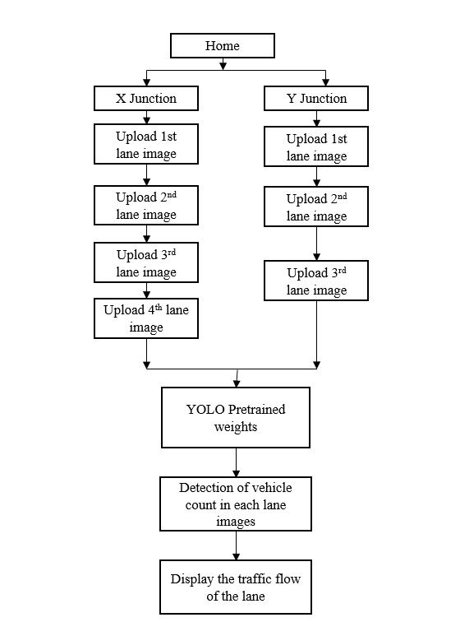
Advantages FLOW DIAGRAM

Slide 17
HARDWARE AND SOFTWARE REQUIREMENTS:
H/W SPECIFICATIONS:
Processor - I3/Intel Processor
RAM - 4GB (min)
Hard Disk - 128 GB
Key Board - Standard Windows Keyboard
Mouse - Two or Three Button Mouse
Monitor - Any

Slide 18
S/W SPECIFICATIONS:
Operating System : Windows 7+
Server side Script : Python 3.6+
IDE : PyCharm
Libraries Used : Pandas, Numpy, PILLOW, Keras,Yolo

Slide 19
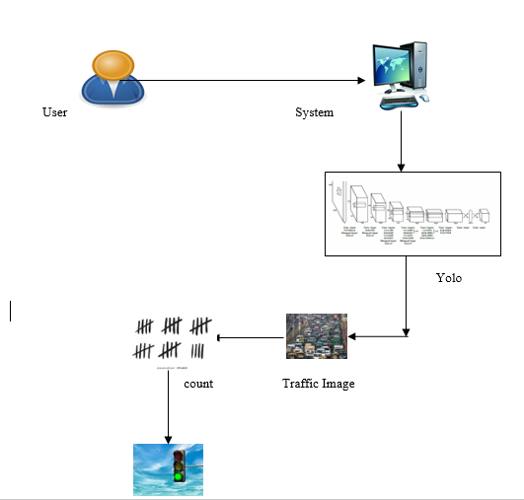
ADVANTAGES ARCHITECTURE

Slide 20
MODULES
1. System
1.1 Receive Images:
The system will receive images from user.
1.2 Pre-processing:
The system will perform pre-processing on the uploaded images.
1.3 Detects Vehicles count:
The system will detect the vehicle counts

Slide 21
1.4 Gives green signal:
The system then clears the traffic by giving green signal.
2. User
2.1 Upload Images:
Upload image-1
Upload image-2
Upload image-3
Upload image-4
2.2 View Results: Clear the lane which has highest vehicle count by simply giving green signal.

Slide 22
UML DIAGRAMS
CLASS DIAGRAM:
In software engineering, a class diagram in the Unified Modeling Language (UML) is a type of static structure diagram that describes the structure of a system by showing the system's classes, their attributes, operations (or methods), and the relationships among the classes. It explains which class contains information.

Slide 23
USE CASE DIAGRAM:
A use case diagram in the Unified Modeling Language (UML) is a type of behavioral diagram defined by and created from a Use-case analysis. Its purpose is to present a graphical overview of the functionality provided by a system in terms of actors, their goals (represented as use cases), and any dependencies between those use cases.

Slide 24
SEQUENCE DIAGRAM:
A sequence diagram in Unified Modeling Language (UML) is a kind of interaction diagram that shows how processes operate with one another and in what order. It is a construct of a Message Sequence Chart. Sequence diagrams are sometimes called event diagrams, event scenarios, and timing diagrams.

Slide 26
Collaboration Diagram:
In collaboration diagram the method call sequence is indicated by some numbering technique as shown below. The number indicates how the methods are called one after another. We have taken the same order management system to describe the collaboration diagram. The method calls are similar to that of a sequence diagram. But the difference is that the sequence diagram does not describe the object organization whereas the collaboration diagram shows the object organization.

Slide 27
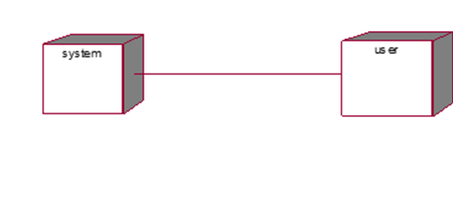
DEPLOYMENT DIAGRAM
Deployment diagram represents the deployment view of a system. It is related to the component diagram. Because the components are deployed using the deployment diagrams. A deployment diagram consists of nodes. Nodes are nothing but physical hardware’s used to deploy the application.

Slide 28
ACTIVITY DIAGRAM:
Activity diagrams are graphical representations of workflows of stepwise activities and actions with support for choice, iteration and concurrency. In the Unified Modelling Language, activity diagrams can be used to describe the business and operational step-by-step workflows of components in a system. An activity diagram shows the overall flow of control.

Slide 30
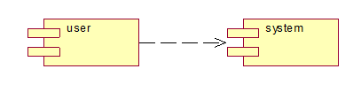
Component diagram,
A component diagram, also known as a UML component diagram, describes the organization and wiring of the physical components in a system. Component diagrams are often drawn to help model implementation details and double-check that every aspect of the system's required functions is covered by planned development.

Slide 31
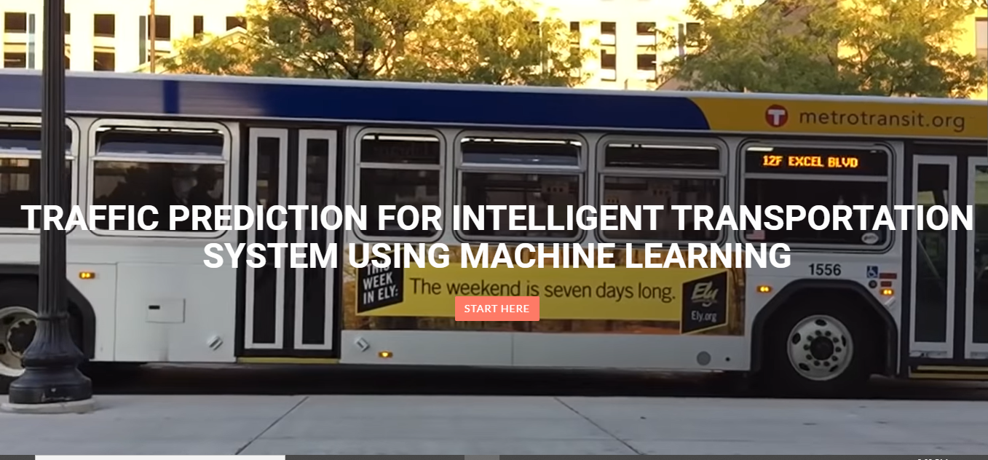
RESULTS AND OUTPUT SCREENS:
Home Page:

Slide 32
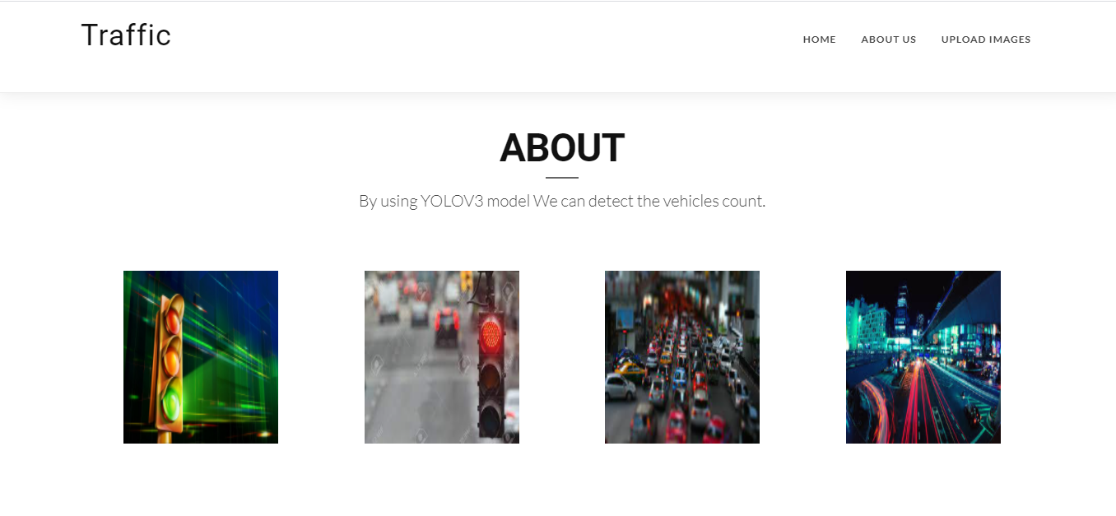
About:

Slide 33
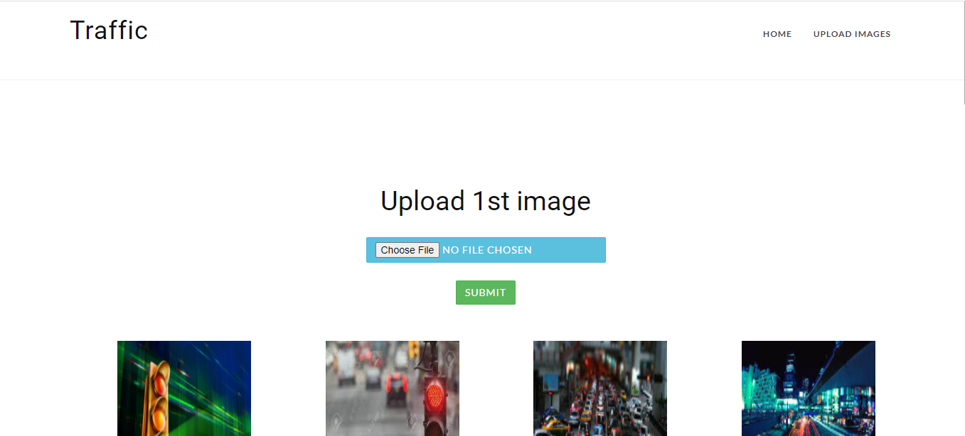
Upload 1st image:

Slide 34
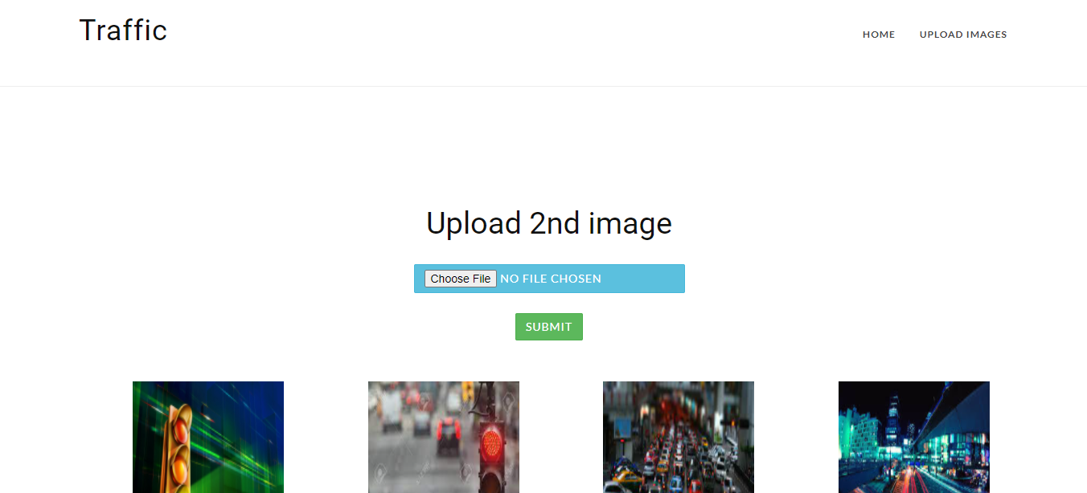
Upload 2nd image:

Slide 35

Upload 3rd image:

Slide 36
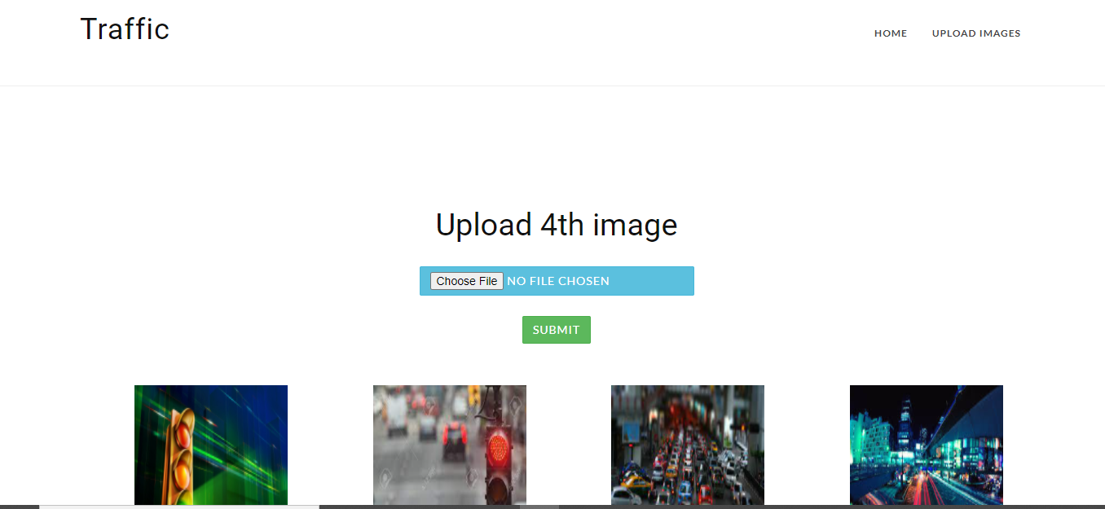
Upload 4th image:

Slide 37
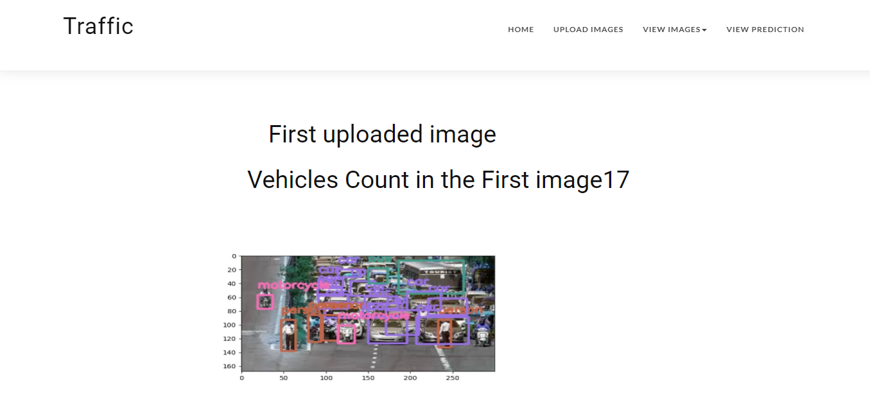
View First uploaded image and count:

Slide 38
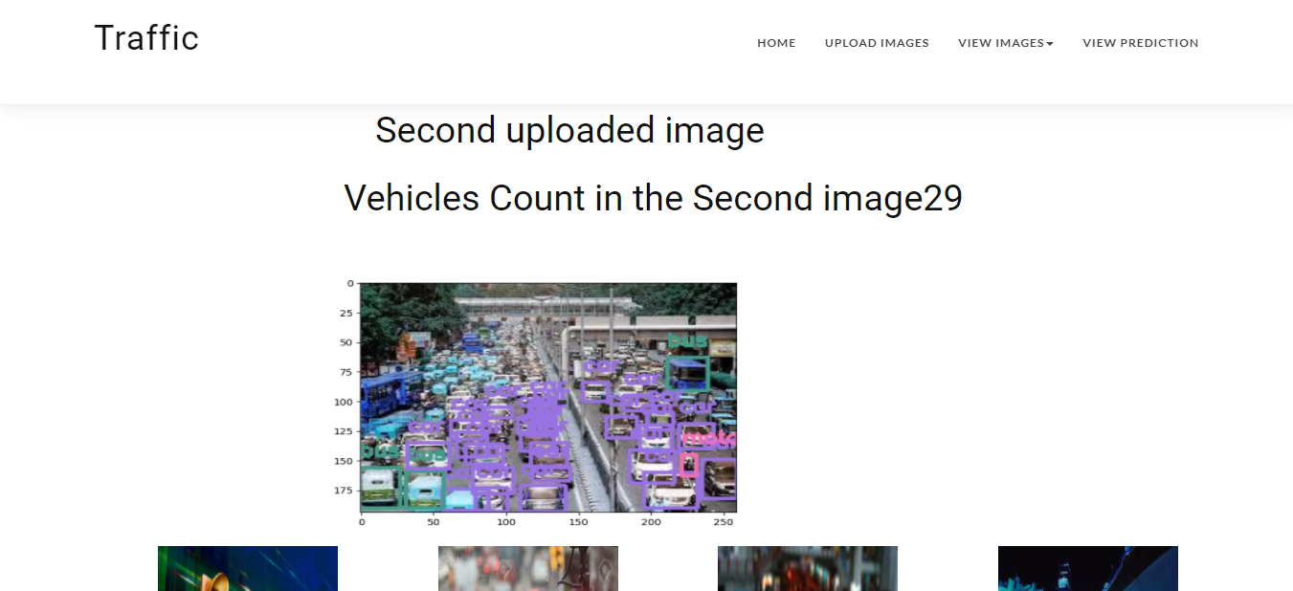
View 2nd uploaded images and count:

Slide 39
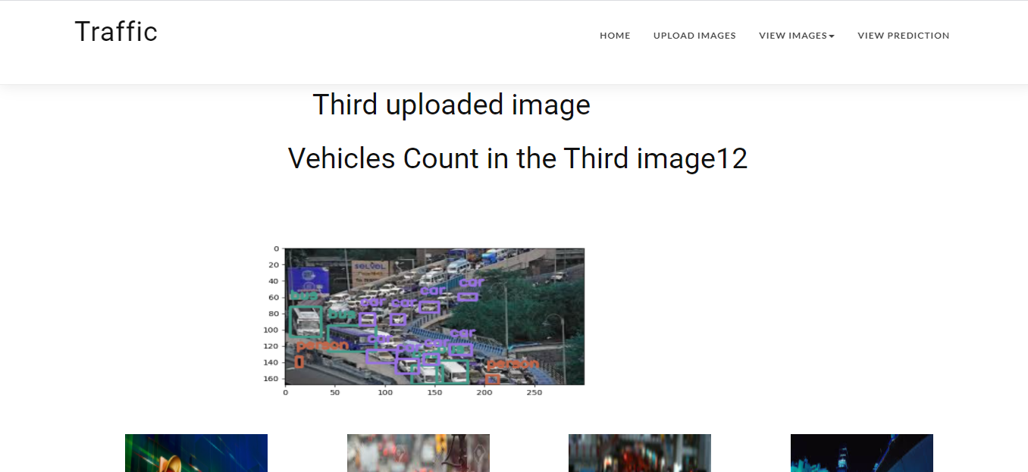
View 3rd uploaded image:

Slide 40
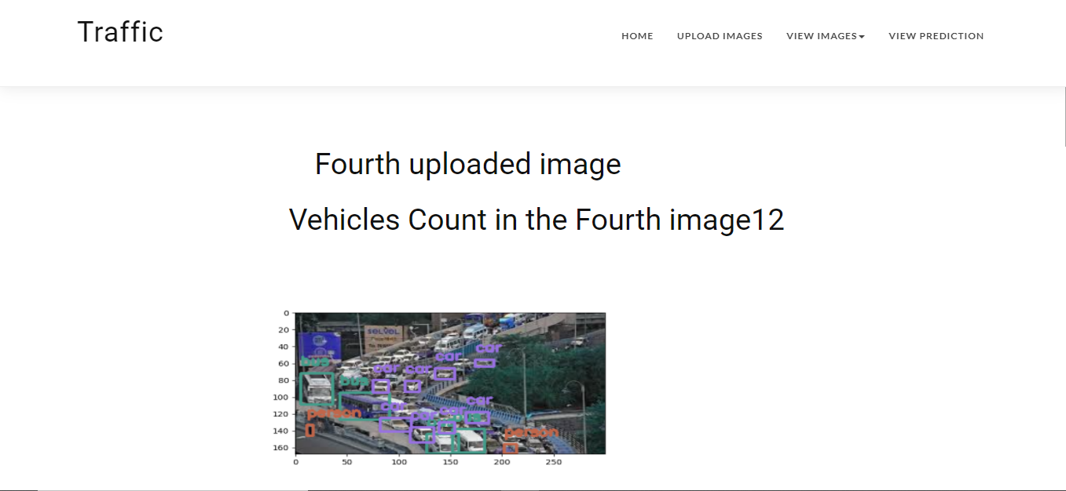
View 4th uploaded image and counts:

Slide 41
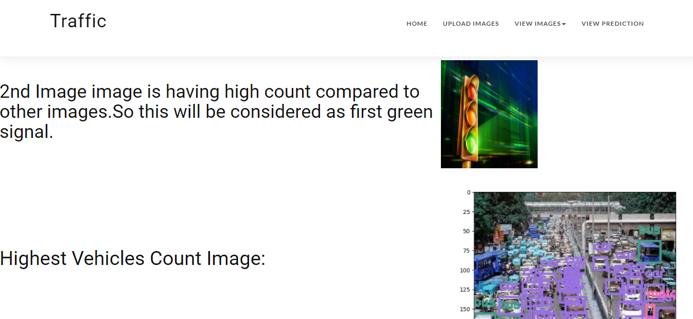
View Prediction:

Slide 42
CONCLUSION:
In this application, we have successfully created a system that controls traffic signals manually. This is developed in a user-friendly environment using Flask via Python programming. The system is likely to collect images from the user to clear signals for the lanes which has highest count of vehicles.

Slide 43
FUTURE ENHANCEMENT
Future enhancements in traffic prediction for intelligent transportation systems using deep learning may involve integrating multi-modal data sources such as weather, event schedules, and urban development plans to create more comprehensive predictive models. Implementing reinforcement learning techniques can enhance adaptability to dynamic traffic conditions, enabling the system to learn and optimize traffic signal control in real-time. Additionally, exploring the fusion of deep learning with edge computing could facilitate quicker decision-making at the local level, improving responsiveness and overall traffic flow management for smarter and more efficient transportation networks.

Slide 44
REFERENCES
[1] Rutger Claes, Tom Holvoet, and Danny Weyns. A decentralized approach for anticipatory vehicle routing using delegate multiagent systems. IEEE Transactions on Intelligent Transportation Systems, 12(2):364–373, 2011.
[2] Mehul Mahrishi and Sudha Morwal. Index point detection and semantic indexing of videos - a comparative review. Advances in Intelligent Systems and Computing, Springer, 2020.
[3] C. Zhang, P. Patras, and H. Haddadi. Deep learning in mobile and wireless networking: A survey. IEEE Communications Surveys Tutorials, 21(3):2224–2287, third quarter 2019.
[4] Chun-Hsin Wu, Jan-Ming Ho, and D. T. Lee. Travel-time prediction with support vector regression. IEEE Transactions on Intelligent Transportation Systems, 5(4):276–281, Dec 2004.

Slide 45
5. Zhang, X., Zhu, L., Lei, Z., & Shi, H. (2017). Traffic Sign Detection and Classification in the Wild. In Proceedings of the IEEE Conference on Computer Vision and Pattern Recognition (CVPR).
6. Geiger, A., Lenz, P., Stiller, C., & Urtasun, R. (2013). Vision meets Robotics: The KITTI Dataset. The International Journal of Robotics Research, 32(11), 1231-1237.
7. Wang, X., & Ma, J. (2020). Traffic Sign Detection and Recognition in Street View Images Using YOLO. Journal of Advanced Transportation, 2020.
8. Kurnianggoro, L., Tanty, O., & Abdullah, A. (2018). Traffic Sign Recognition Using YOLO Convolutional Neural Network. Procedia Computer Science, 135, 124-131.
9. Geiger, A., Lenz, P., Stiller, C., & Urtasun, R. (2012). Are we ready for Autonomous Driving? The KITTI Vision Benchmark Suite. In Proceedings of the IEEE Conference on Computer Vision and Pattern Recognition (CVPR).
10. Yang, C., Zhang, Y., & Lu, C. (2020). Traffic Sign Detection and Recognition Using YOLOv4 in the Wild. Electronics, 9(2), 276.

Slide 46


