Slide 1

AI & ML Laboratory Project on Chess playing using AI and it’s Analysis
B. Sharvani (2203A51557)
A. Varshini (2203A51830)
S. Nandini (2203A51092)
Samreen (2203A51829)
Y. Pragathi (2203A51099)
- UNDER THE GUIDANCE OF
Dr .Soumik Podder
School of Computer Science & Artificial Intelligence
SR University
2024
/

Slide 2
Plan of Talk
ABSTRACT
INTRODUCTION
PROPOSED SOLUTION
FLOW CHART
RESULT AND DISCUSSION
CONCLUSION

Slide 3
ABSTRACT
In this study, we analyze the centipawn loss, inaccuracies, mistakes, and blunders of White and Black players in a dataset of chess games.
Our analysis reveals that White players have higher centipawn loss than Black players.
This difference can be attributed to factors such as different opening moves, better moves in the opening phase, and different playstyles.'
Furthermore, White players make fewer inaccuracies and mistakes compared to Black players.
These findings suggest that there might be differences in the way White and Black players approach the game, which could have implications for chess strategies and the training of chess players.

Slide 4
INTRODUCTION
Chess is a strategic board game played between two players, usually referred to as White and Black.
It is played on an 8x8 board with 16 pieces for each player.
The object of the game is to checkmate the opponent's king, which is to say, the king is in checkmate if it is in a position where it cannot escape an immediate capture.

Slide 5
PROPOSED Solution
The popularity of chess has led to the development of numerous algorithms and models to predict the outcome of chess games.
These algorithms and models aim to analyze the position of the pieces on the board, the player's strategies, and the likelihood of making inaccuracies, mistakes, and blunders.
In this study, we aim to analyze the centipawn loss, inaccuracies, mistakes, and blunders of White and Black players in a dataset of chess games.
We will use machine learning techniques to analyze the data and predict the outcome of each game.
Our analysis will provide insights into the factors contributing to the difference in centipawn loss between White and Black players and the differences in inaccuracies, mistakes, and blunders for both White and Black players.

Slide 6
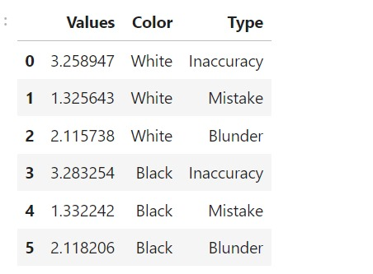
Results and Discussion

Slide 7
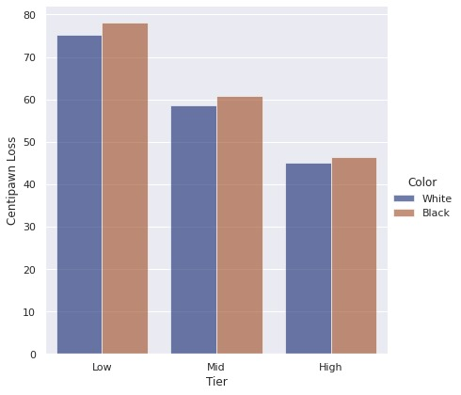
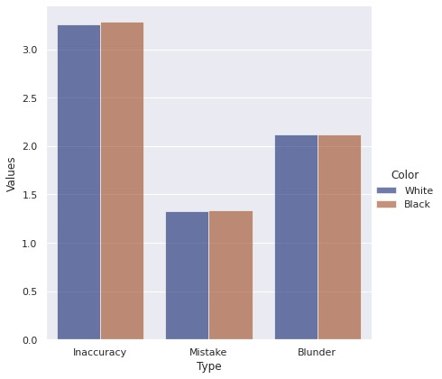
GRAPHES:

Slide 8
FLOW CHART
start
Order of preference
Playing chess by ai
Playing chess by player
Select the best chess point
Renew the chessboard

Slide 9
Game over
Results Output
End

Slide 10
CONCLUSION
our study aims to provide insights into the factors contributing to the difference in centipawn loss between White and Black players in a dataset of chess games.
We will use machine learning techniques to analyze the data and predict the outcome of each game.
Our analysis will provide insights into the factors contributing to the difference in centipawn loss between White and Black players and the differences in inaccuracies, mistakes, and blunders for both White and Black players.
The findings of this study can have implications for chess strategies and the training of chess players.

Slide 11
GIT HUB Link and LINKDIN LINK
2203A51557-aiml-batch-16/chess_dataset_analysis.ipynb at main · SharvaniBaggani/2203A51557-aiml-batch-16 (github.com)
AIML-batch16/chess_dataset.ipynb at main · pragathiyelagam05/AIML-batch16 (github.com)
https://github.com/Nandinisiddeshuni/2203A51092-aiml-batch-16/blob/main/chess_dataset_analysis.ipynb
2203a51830-aiml-batch-16/chess_dataset_analysis_ipynb_1830.ipynb at main · AnnamVarshini/2203a51830-aiml-batch-16 (github.com)
https://github.com/SamreenMohamme/lab-1/blob/main/chess_dataset_analysis.ipynb

Slide 12
References
Lichess: Python Chess Games Statistics (kaggle.com)

