Slide 1
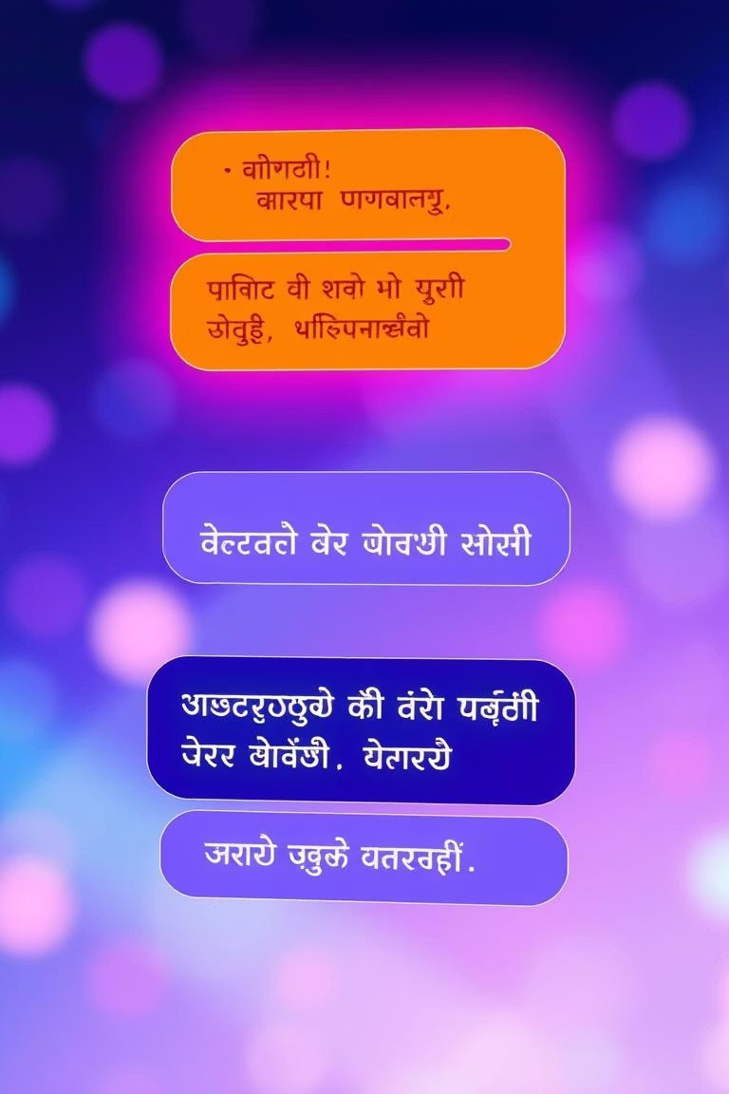
Indian-language Community Chatbot
Presented by Siddeshuni Nandini from SR University, June 2025.
Nandini Siddeshuni

Slide 2
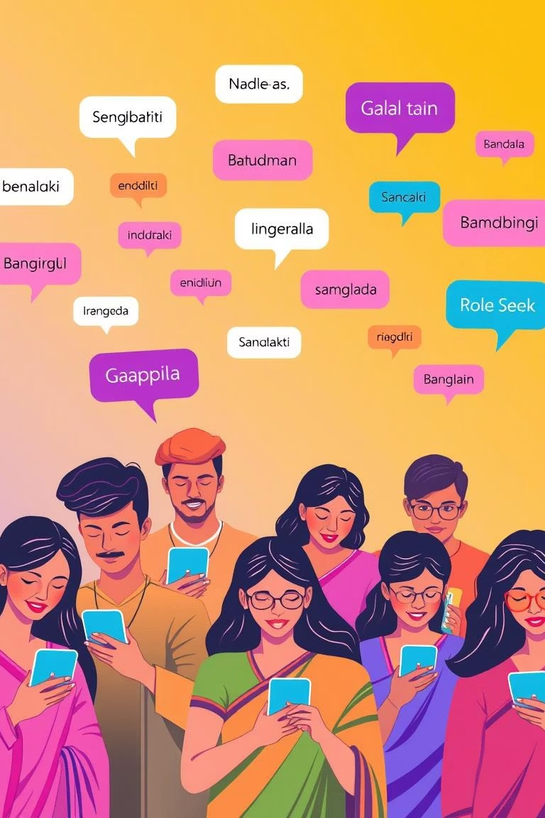
Project Objective
Community Assistance
Develop a multilingual chatbot for diverse Indian communities.
NLP Leverage
Utilise advanced NLP techniques for understanding.
Language-Specific Datasets
Integrate relevant datasets for accuracy.

Slide 3
Architecture
User Interface
1
Language Processor
2
NLP Model
3
Response Generator
4
User
5
This modular design ensures efficient and scalable processing.

Slide 4
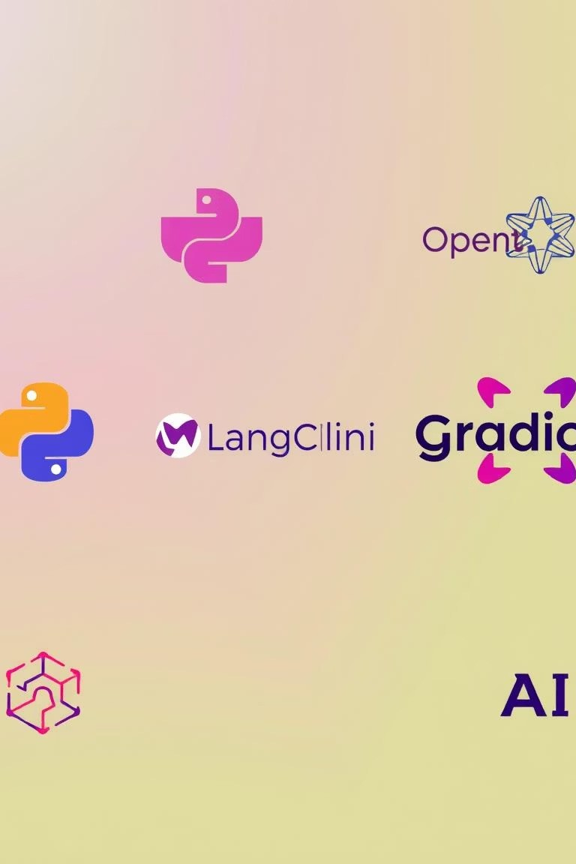
Technology Stack
Python & LangChain
Core programming and LLM orchestration.
Streamlit or Gradio
For interactive web interfaces.
OpenAI API
Powers the large language models.
Indian-language Datasets
Crucial for linguistic accuracy.

Slide 5
Code Modules
main.py
Entry point for the application.
utils.py
Collection of helper functions.
chatbot.py
Contains core chatbot logic.
lang_support/
Directory for language- specific files.
assets/
Stores UI elements and static resources.

Slide 6
Workflow
User Sends Message
Initiates the conversation.
Language Detected
Identifies the input language.
Query Processed via LLM
Understands intent and context.
Response Generated
Crafts a relevant answer.
Sent Back to User
Completes the interaction cycle.

Slide 7





Multilingual Support
Hindi
Widely spoken in Northern India.
Telugu
Prominent in Andhra Pradesh and Telangana.
Tamil
Spoken in Tamil Nadu and Puducherry.
Kannada
Primary language of Karnataka.
Bengali
Used in West Bengal and Bangladesh.
The chatbot is designed to cater to a diverse linguistic landscape across India.

Slide 8
Testing Strategy
Input/Output Validation
Verifying data integrity and format.
2
Unit Tests for Logic
Ensuring individual components
function correctly.
1
Edge Case Handling
Using Pytest for robust test coverage.
3
Rigorous testing guarantees reliability and performance.

Slide 9
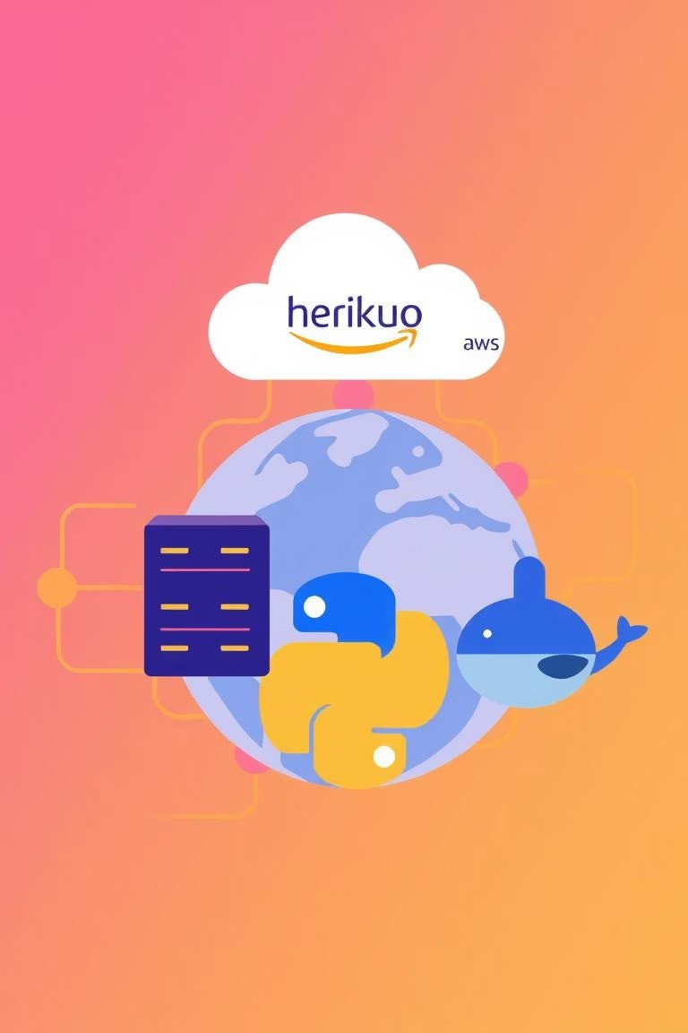
Deployment
1
2
3
Frontend & API
Managed via Streamlit or Flask framework.
Cloud Hosting
Hosted on Heroku or AWS platforms.
Containerization
Utilising Docker for consistent environments.
This setup ensures scalability and accessibility.

Slide 10
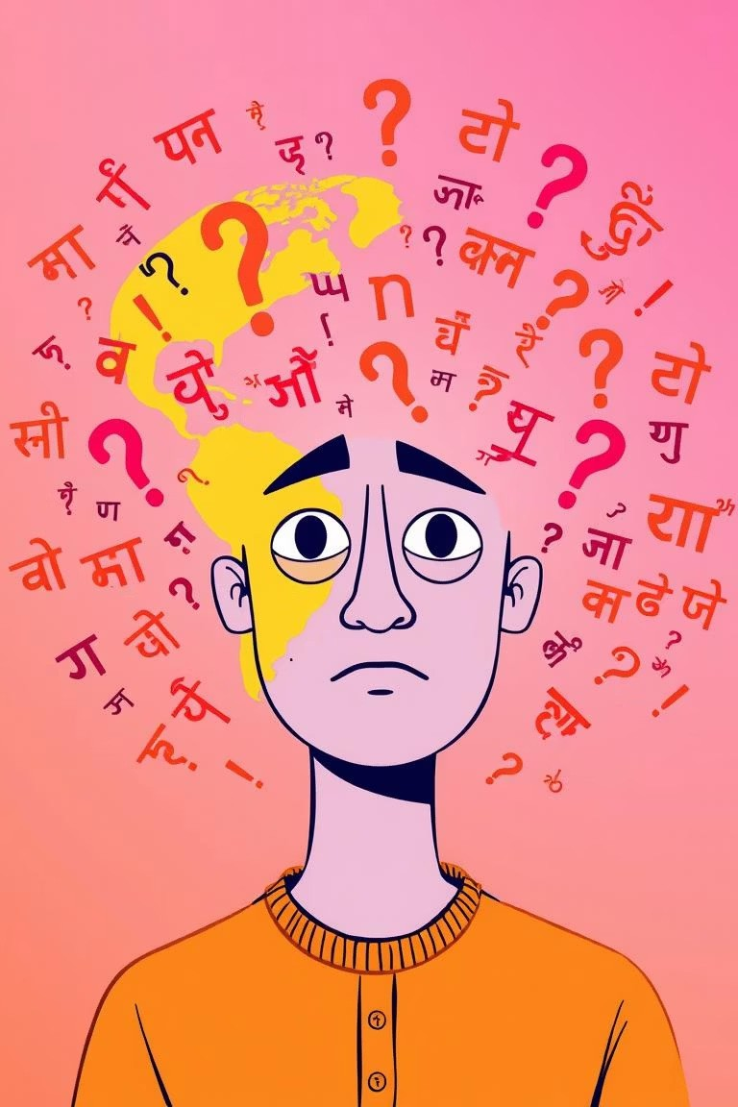
Challenges & Learnings
1
Regional Tokenization
Overcoming complexities of diverse Indian language structures.
2
Response Latency
Optimising for faster and real-time interactions.
3
Diverse Dialects
Ensuring accurate comprehension across various dialects.
These challenges drove significant improvements and knowledge gain.

