Slide 1
RESTAURANT RECOMMENDATION SYSTEM

Slide 2
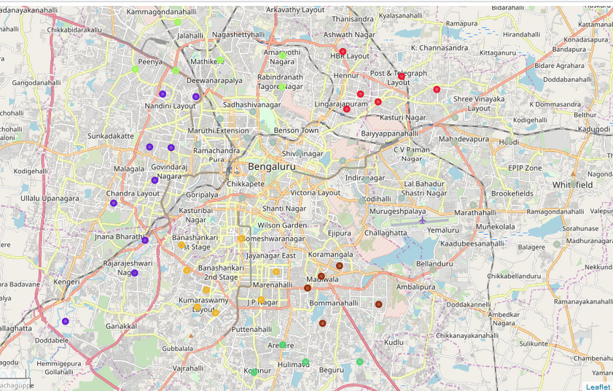
Bangalore map

Slide 3
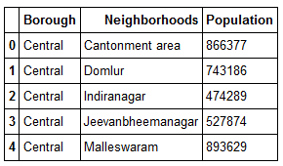
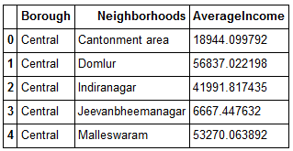
Data Frames showing Population And Average income for locations in Bangalore

Slide 4
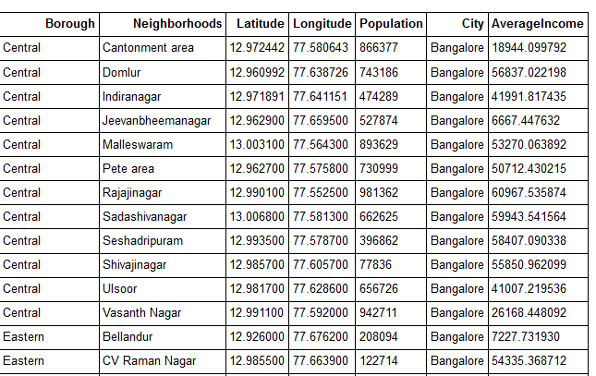
Dataframe showing Longitudes and latitudes for Different locations in Bangalore

Slide 5
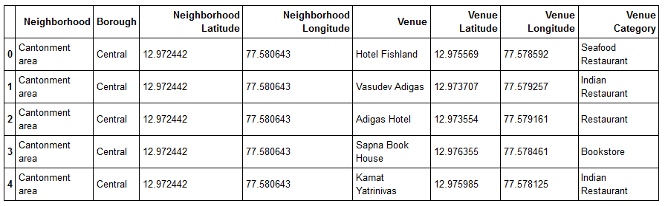
DataFrame Showing Venue details, Category For Locations in Bangalore Accessed through FourSquare API

Slide 6
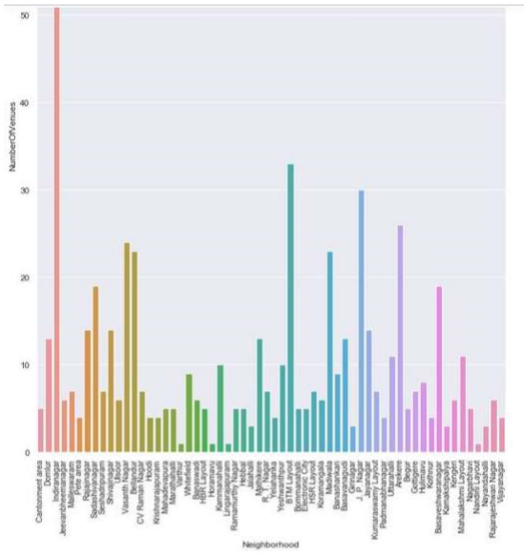
Graph Showing Number of Venues For Locations In Bangalore

Slide 7
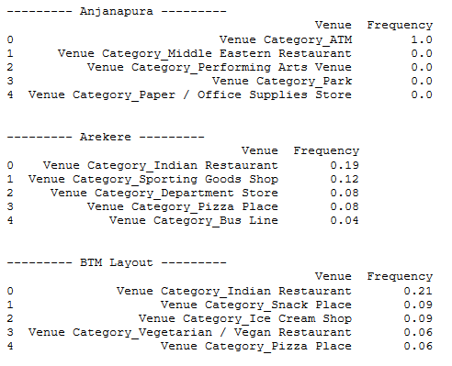
Venues Datails and Category of Different Location In Bangalore

Slide 8
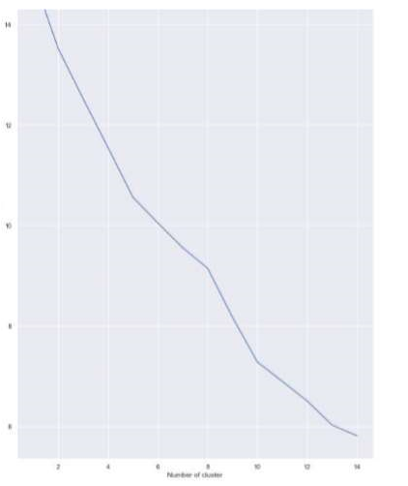
Graph showing Number of Clusters

Slide 9
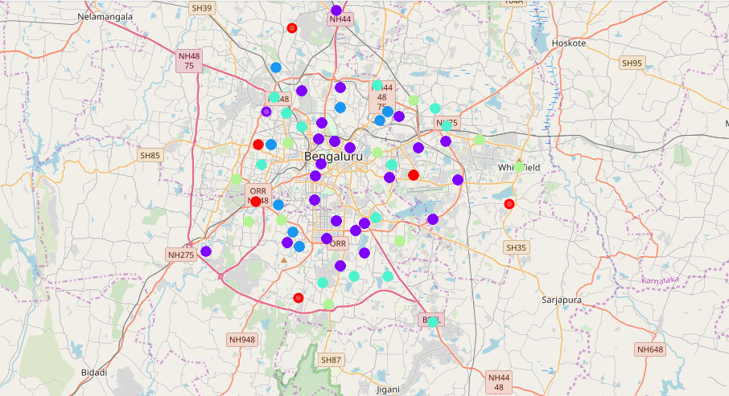
Map showing Clustered Venues For Locations In Bangalore

Slide 10
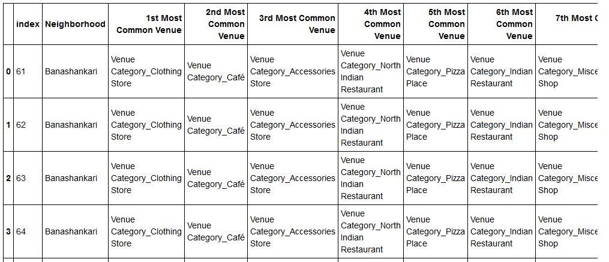
DataFrame showing Most Common Venues In different Location In Bangalore

Slide 11
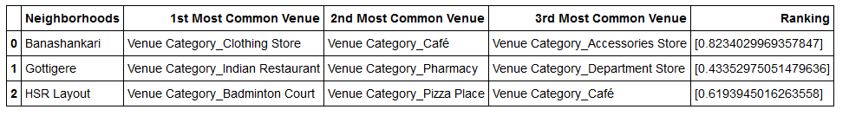
DataFrame Showing Results loactions which has Similar type of restaurants as “Whitefield”

