Slide 1
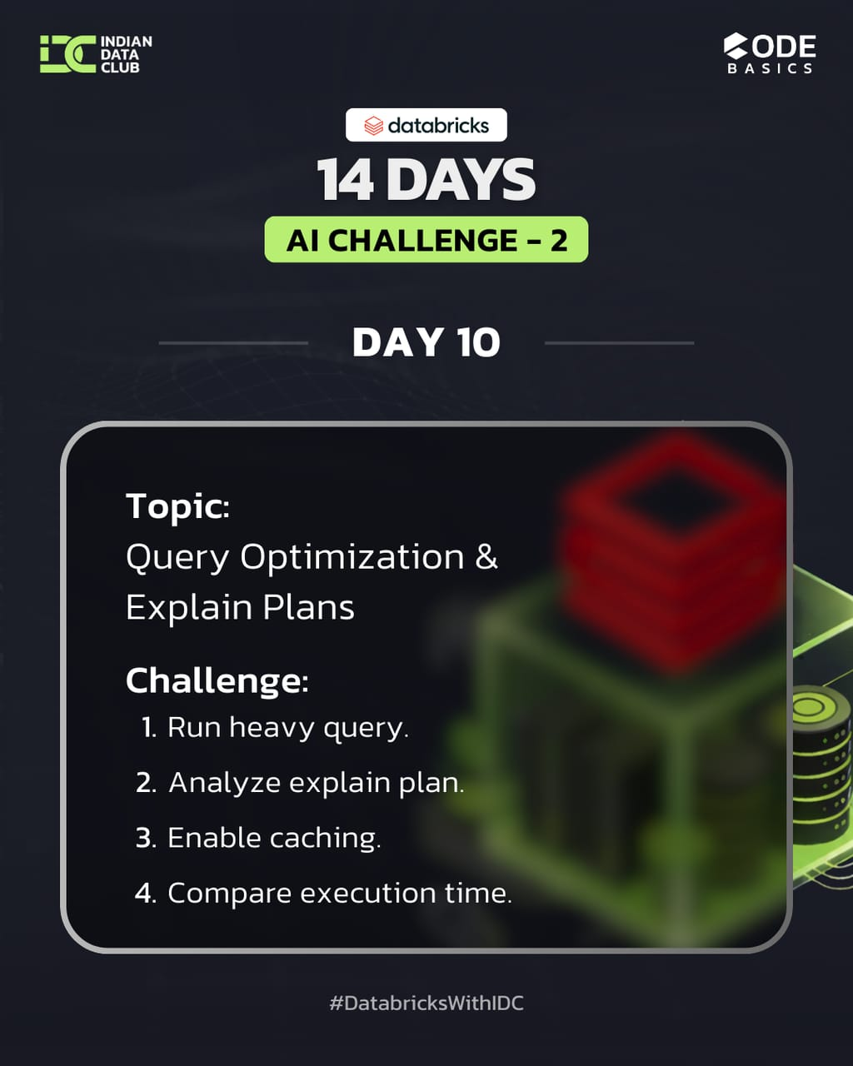
DAY 10 – Query Optimization & Explain Plans
14 Days AI Challenge – 2 (Advance)
Notebook file : https://github.com/Nandiniwadile
Learn:
explain()
Partition pruning
Caching
Tasks:
1. Run heavy query.
2. Analyze explain plan.
3. Enable caching.
4. Compare execution time.

Slide 2
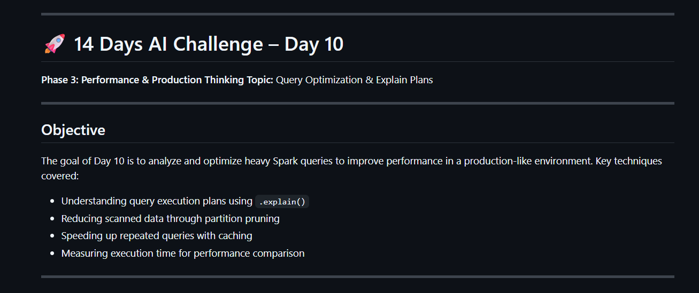

Slide 3
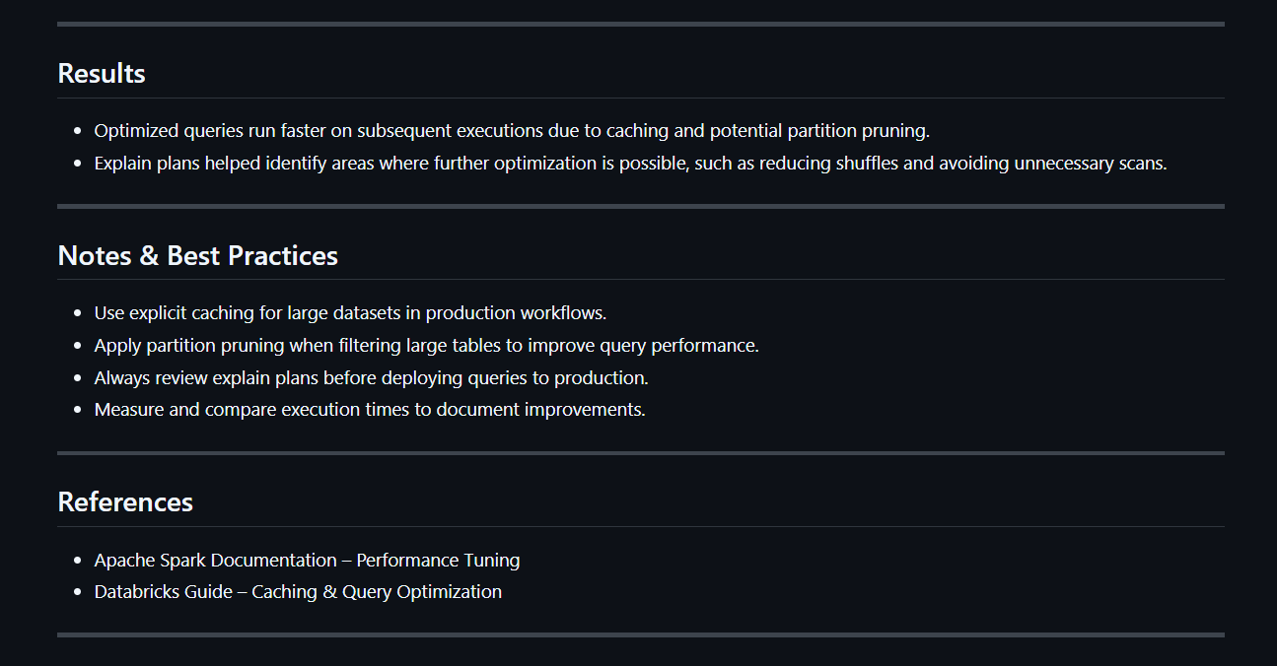

Slide 4
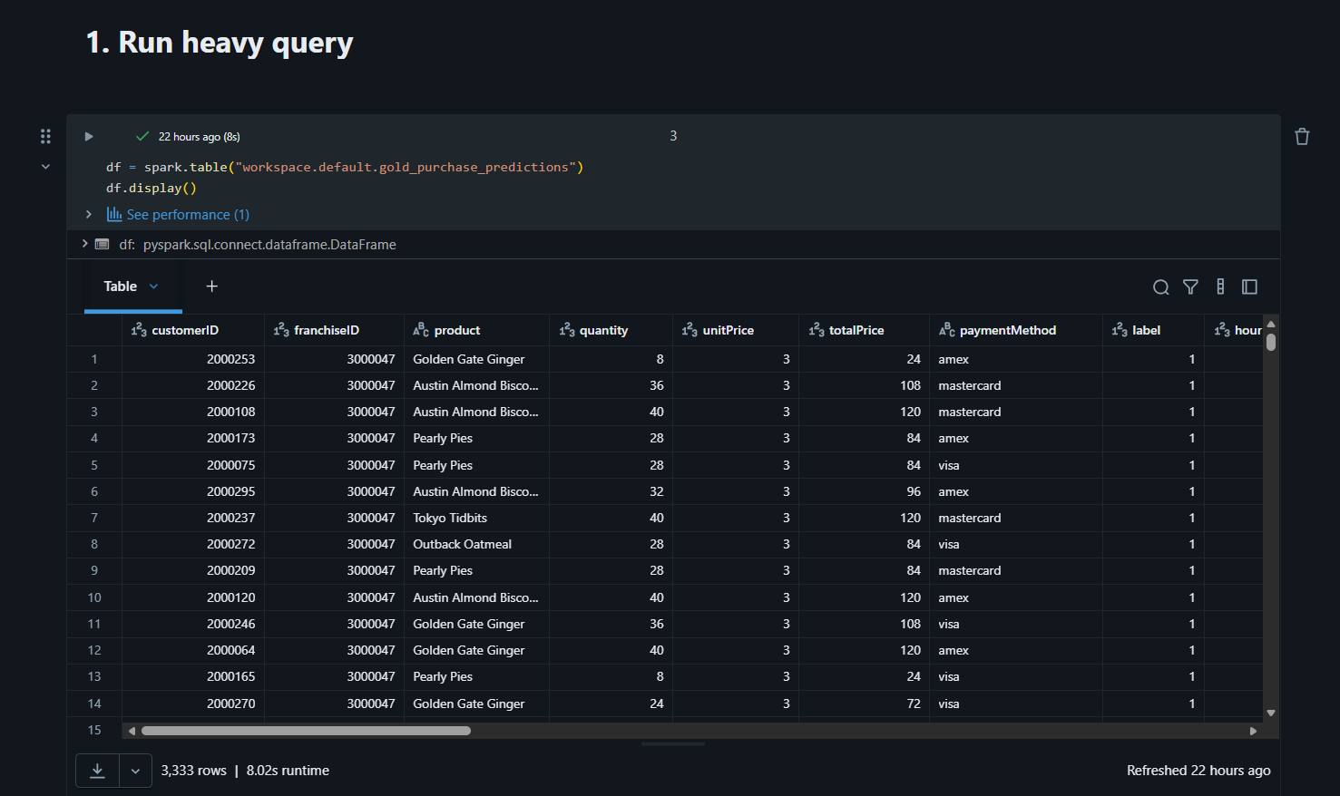
1. Run Heavy Query
Concept Importance:
Simulates a real production workload; helps
test system performance under realistic conditions.
Necessary before any optimization; you can’t
improve what you haven’t measured.
2 Key Points:
Aggregation queries like groupBy().agg()
show how Spark handles large data computations.
Sets the baseline execution time to
compare optimizations later.

Slide 5
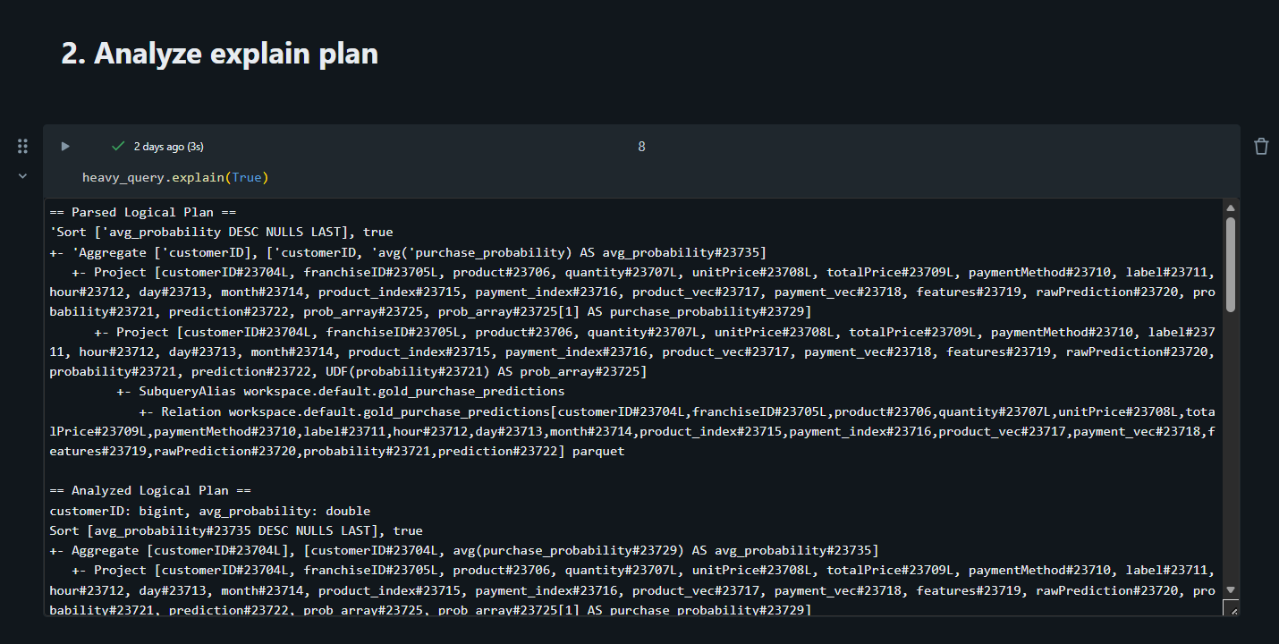
2. Analyze Explain Plan
Concept Importance:
Reveals how Spark executes your query
internally: logical plan vs physical plan.
Identifies bottlenecks like unnecessary
shuffles, scans, or expensive operations.
2 Key Points:
Helps understand where query optimization
can save time or resources.
2. Essential for production-ready workflows;
avoids costly inefficiencies on large datasets.

Slide 6
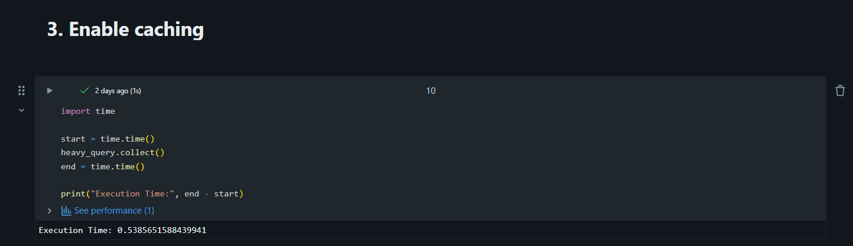
3. Enable Caching
Concept Importance:
Stores intermediate results in memory to avoid recomputation.
Speeds up repeated queries and iterative workflows.
2 Key Points:
Improves performance significantly when queries are
repeated on the same dataset.
2. Reduces cluster computation cost, which is crucial in
production environments.

Slide 7
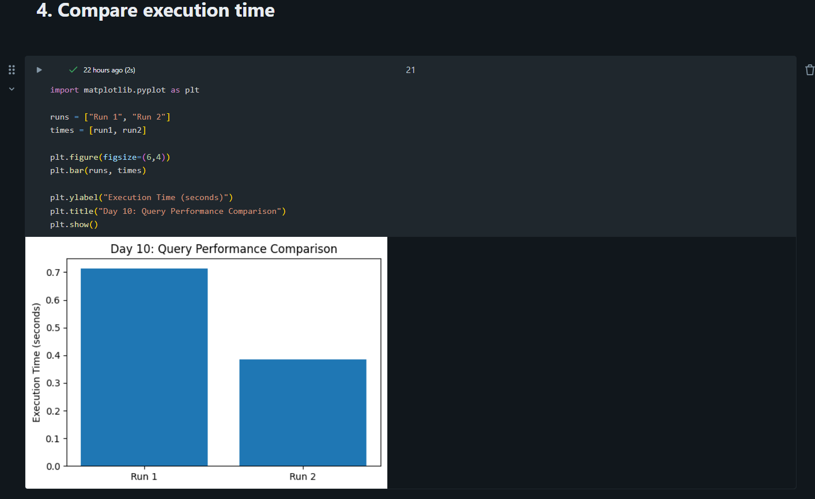
4. Compare Execution Time
Concept Importance:
Quantifies the effectiveness of optimizations like
caching or partition pruning.
Helps document and visualize performance gains for
stakeholders or reports.
2 Key Points:
Shows concrete improvement after optimization; e.g., Run
faster than Run 1.
Useful for performance monitoring and making data-driven optimization decisions.

Slide 8
Conclusion :
Analyzing the explain plan identifies bottlenecks like shuffles, scans, and expensive operations.
Caching significantly improves performance for repeated queries and reduces computation cost.
Comparing execution times provides quantifiable evidence of optimization benefits.
Running heavy queries helps simulate real production workloads and set a performance baseline.
Overall, these techniques are essential for efficient, production-ready Spark workflows.

