Slide 1
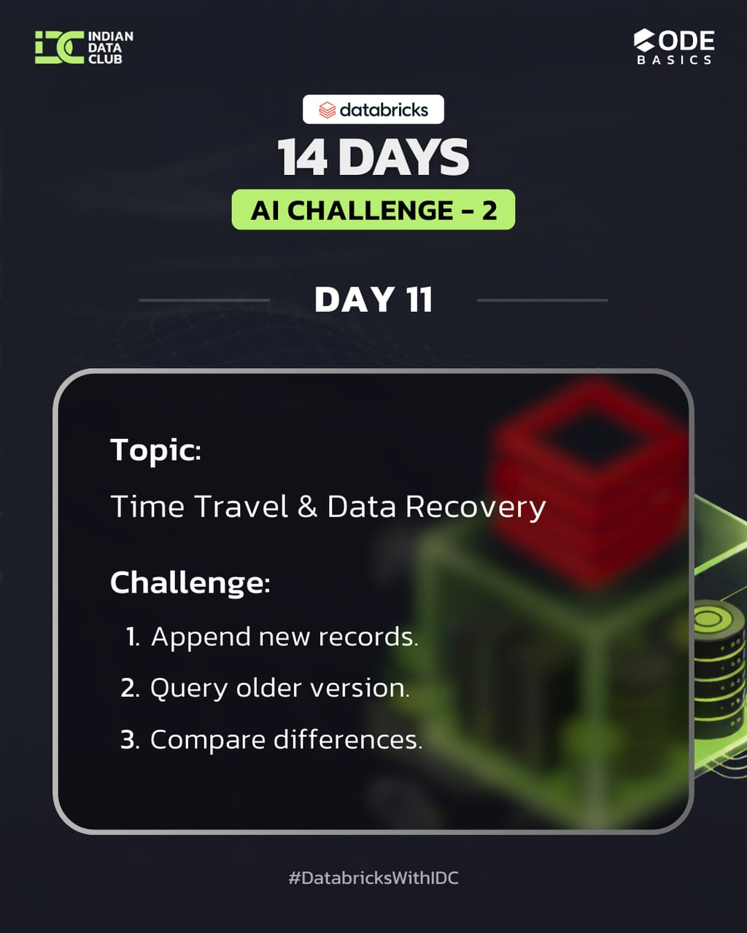
DAY 11– Time Travel & Data Recovery
14 Days AI Challenge – 2 (Advance)
Notebook file : https://github.com/Nandiniwadile
Learn:
Versioning
Rollback
Data recovery
Tasks:
1. Append new records.
2. Query older version.
3. Compare differences.

Slide 2
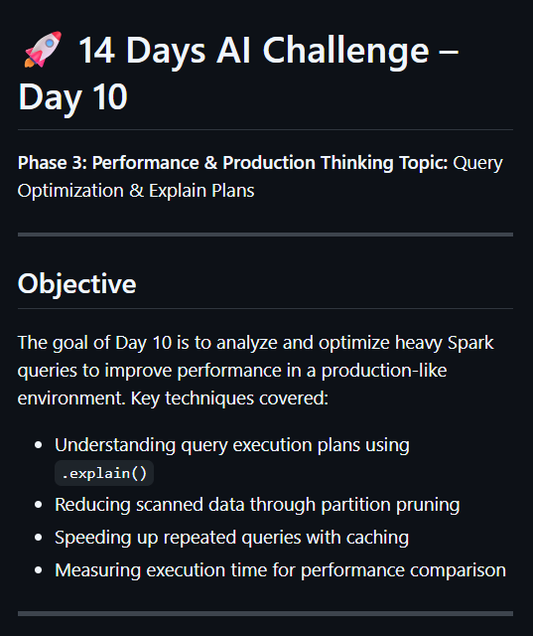
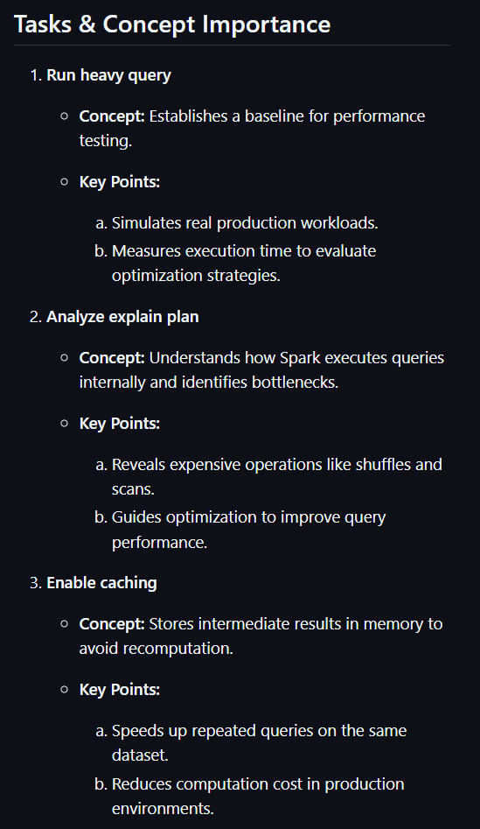
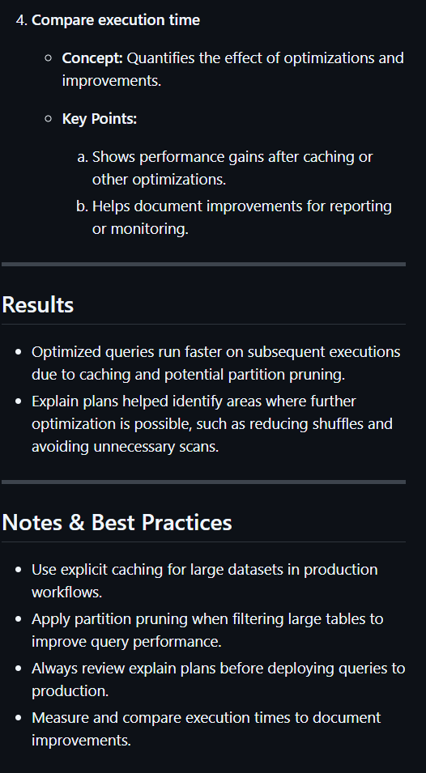

Slide 3
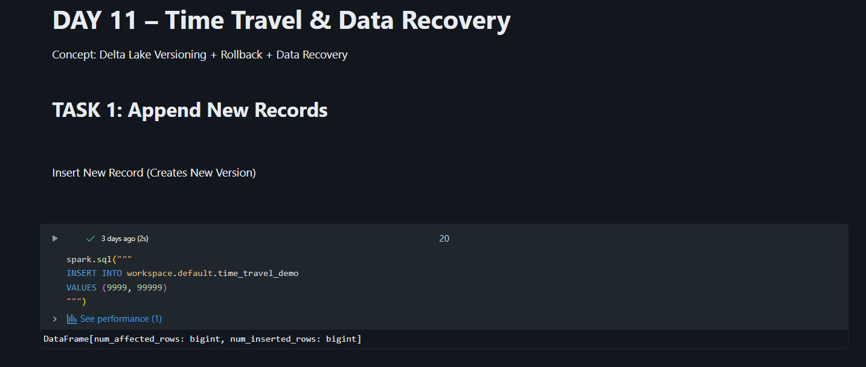
Important Points:
Appending data creates a new Delta
table version automatically.
2. Every insert operation is tracked in
table history.
3. It simulates real-time production data
updates.
This proves how Delta maintains version
control automatically.

Slide 4
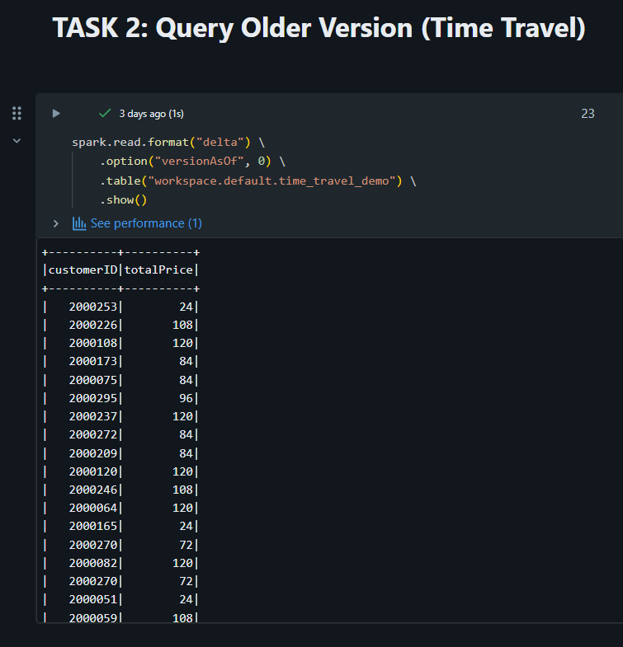
Important Points:
Using version as Of allows access to historical
data.
2. No need for backup files — Delta stores
previous versions internally.
3. Useful for auditing, debugging, and error
investigation.
This demonstrates the power of Time
Travel feature.

Slide 5
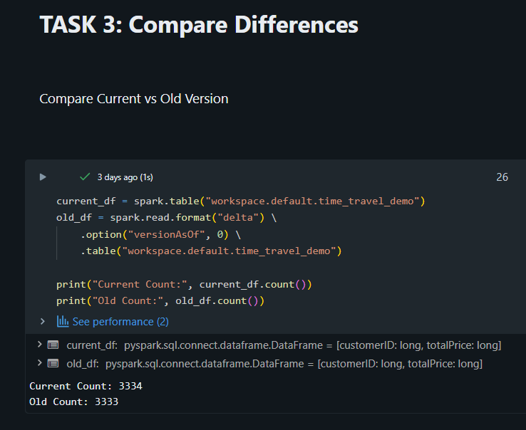
Important Points:
Comparing counts helps detect
newly inserted records.
2. Enables validation of data
changes.
3. Supports data quality checks before
production release.
This ensures data accuracy and transparency.

Slide 6
Conclusion :
In Day 11, I successfully implemented Delta Lake versioning by appending new records, accessing historical versions using Time Travel, comparing data changes, and demonstrating rollback capability. This ensures reliable data management, audit tracking, and recovery from accidental modifications in production systems.

