Slide 1
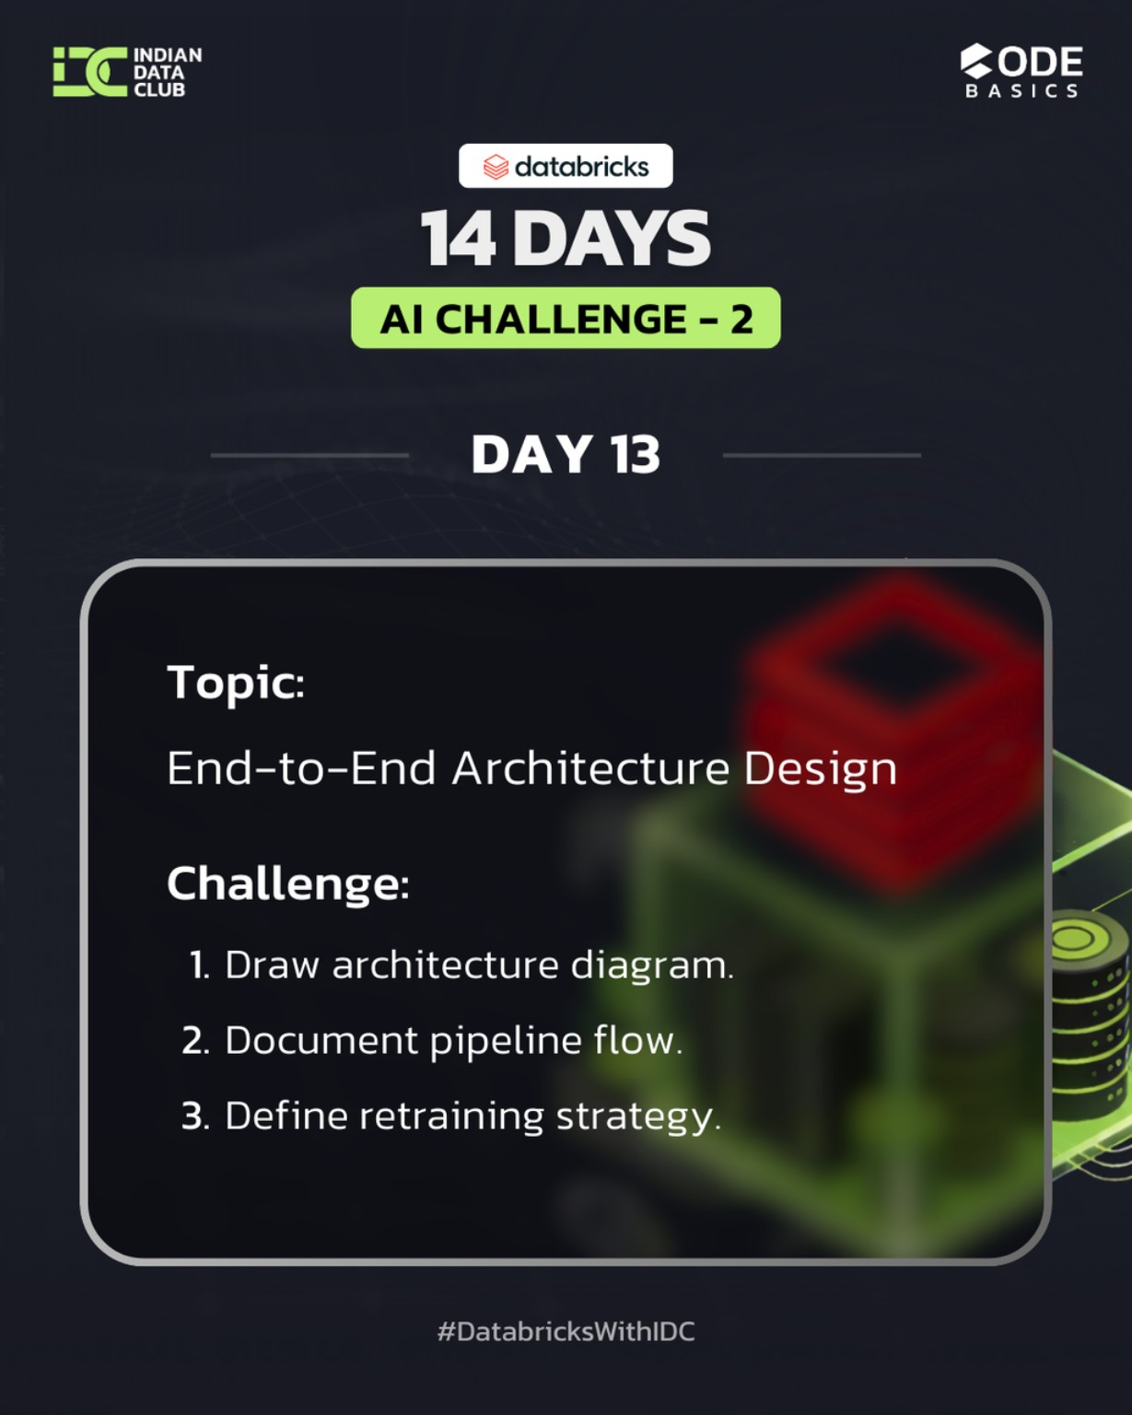
DAY 13 – End-To-End Architecture Desing
14 Days AI Challenge – 2 (Advance)
Notebook file : https://github.com/Nandiniwadile
Learn:
Data flow design
Broze -> Silver -> Gold
ML lifecycle integration
Tasks:
Draw Architecture Diagram
Document Pipeline Flow
Define Retraining Strategy

Slide 2
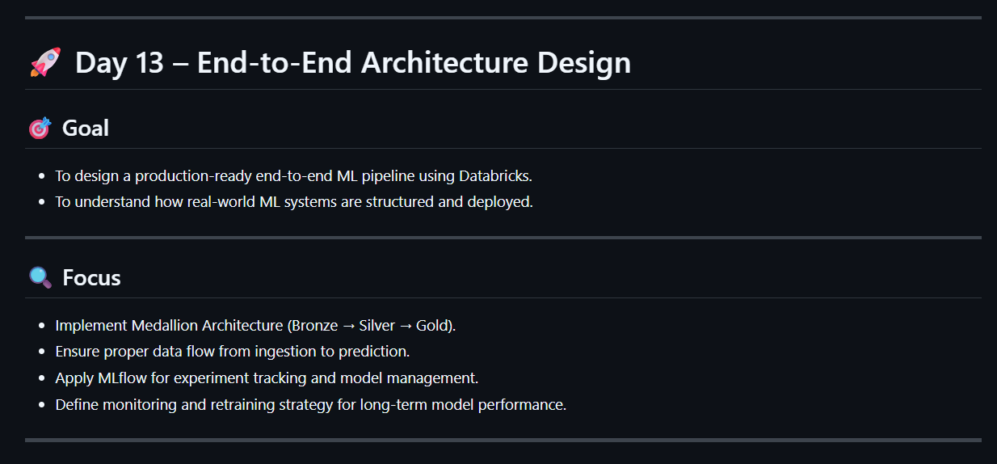

Slide 3
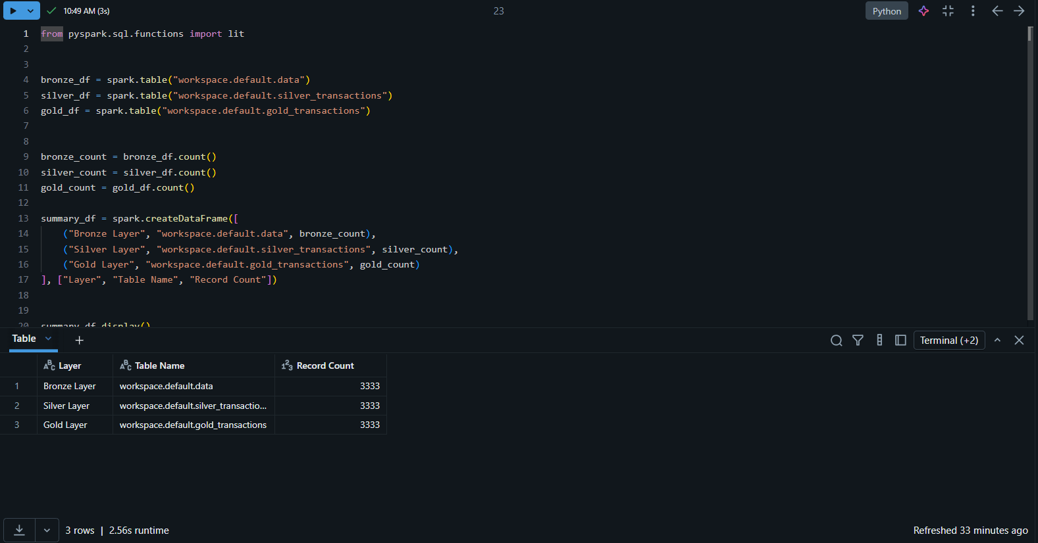

Slide 4
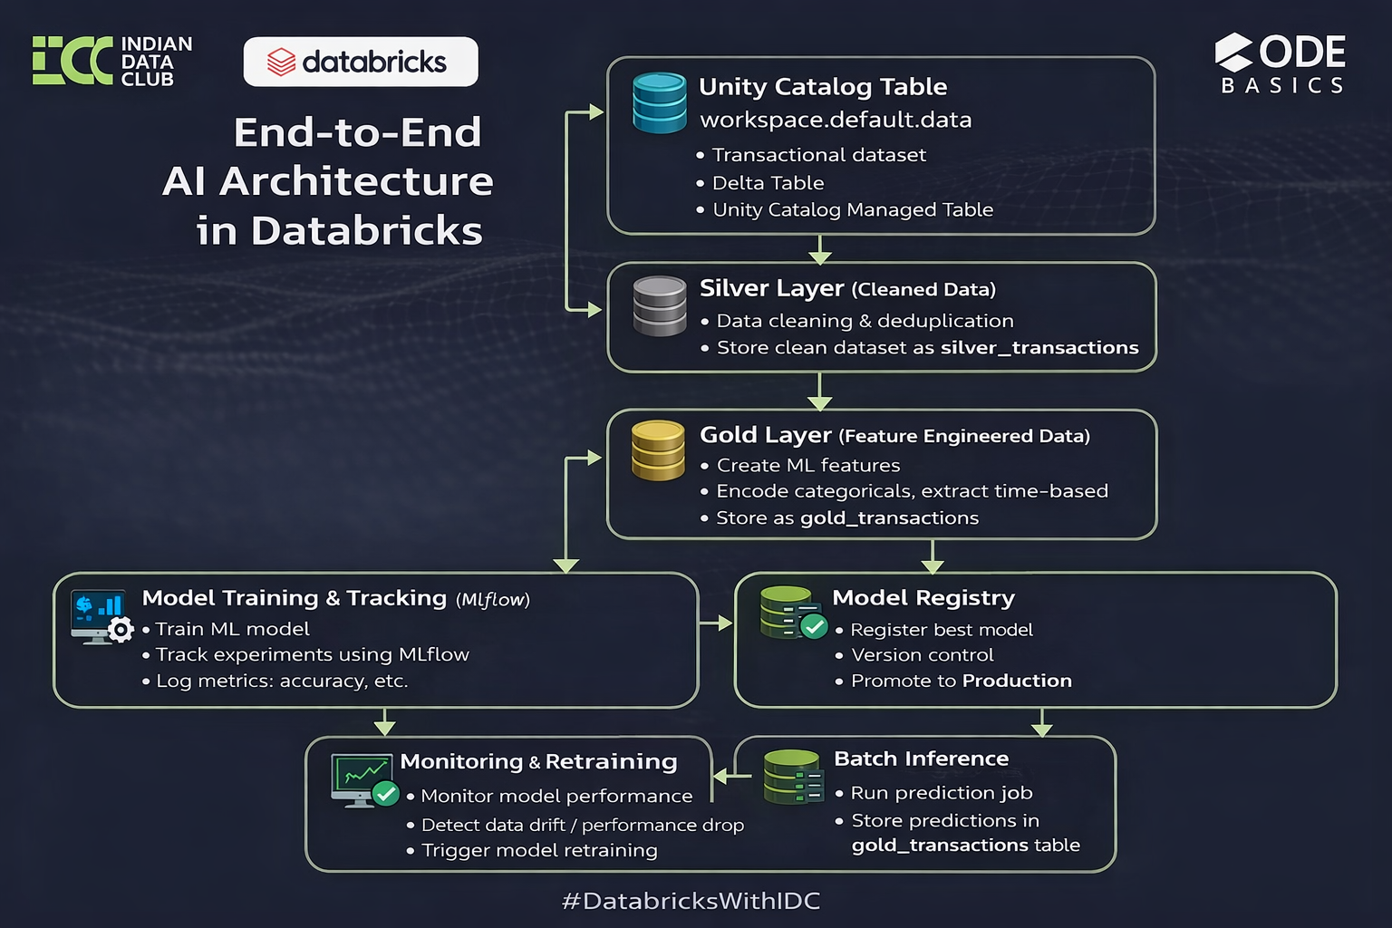
Architecture Diagram

Slide 5
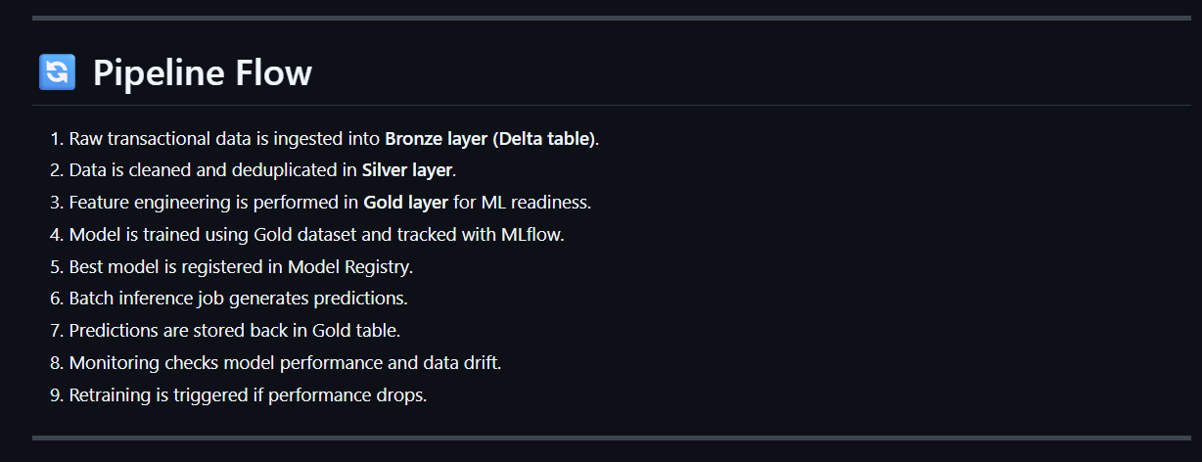
2. Pipeline Flow Documentation

Slide 6
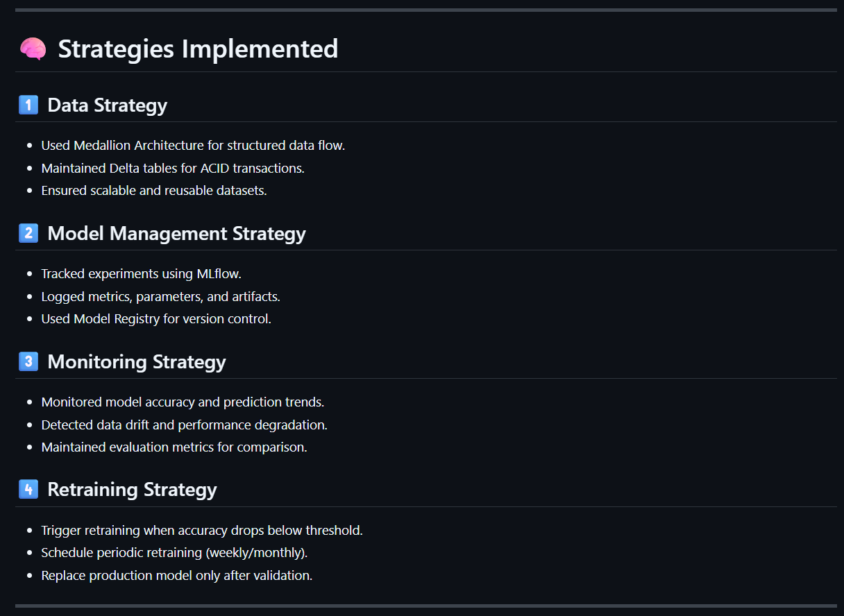
3. Retraining Strategy

Slide 7
Conclusion :
Day 13 helped me understand that building a machine learning model is only one part of the journey — designing a scalable, structured, and production-ready architecture is what truly makes a solution industry-ready.
From data ingestion to monitoring and retraining, this task strengthened my understanding of the complete ML lifecycle and system design thinking.
Excited to keep building and learning beyond just model accuracy.

