Slide 1
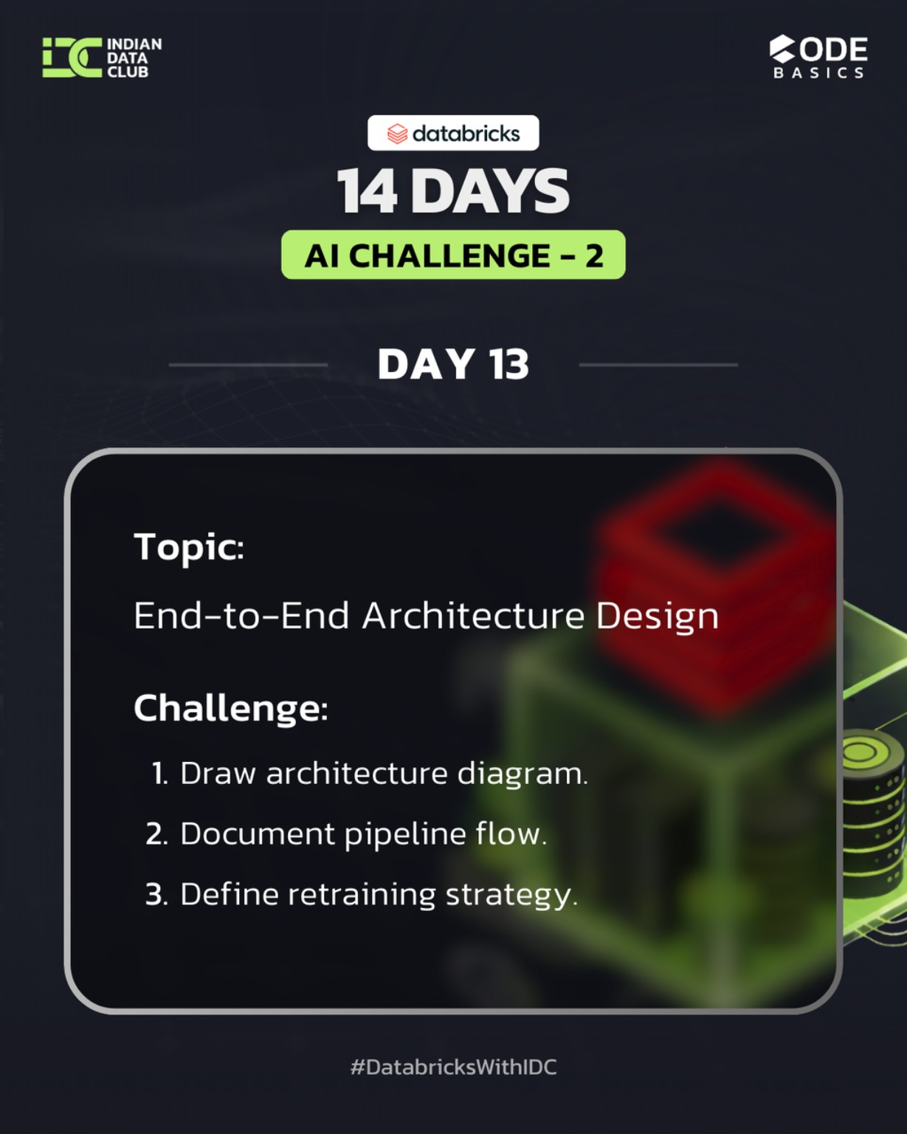
DAY 13 – End-To-End Architecture Desing
14 Days AI Challenge – 2 (Advance)
Notebook file : https://github.com/Nandiniwadile
Learn:
Data flow design
Broze -> Silver -> Gold
ML lifecycle integration
Tasks:
Draw Architecture Diagram
Document Pipeline Flow
Define Retraining Strategy

Slide 2
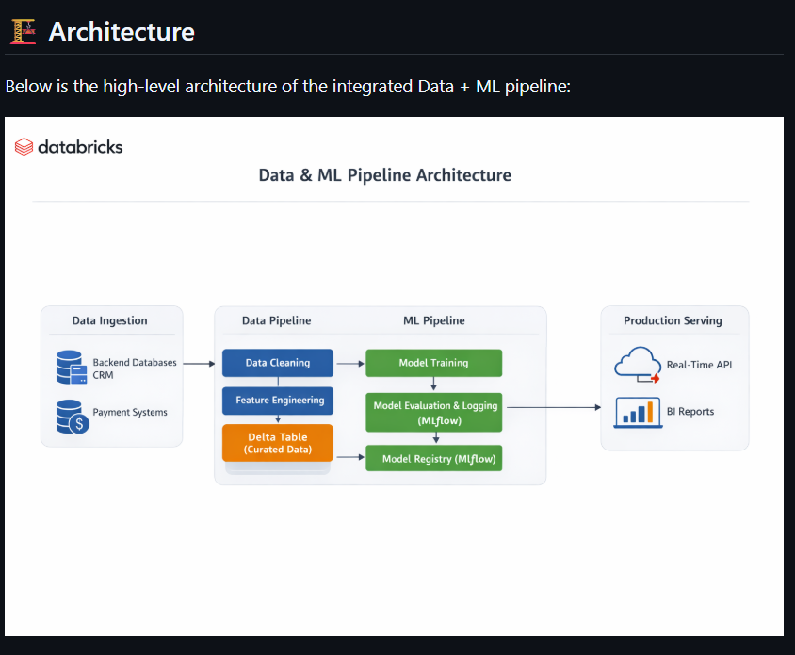

Slide 3
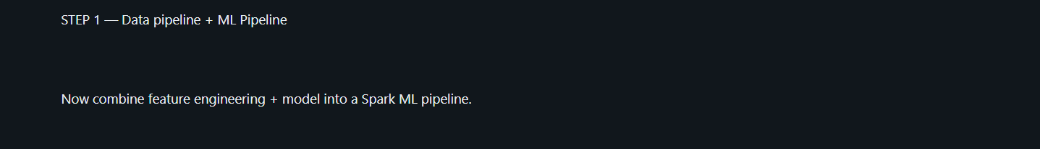
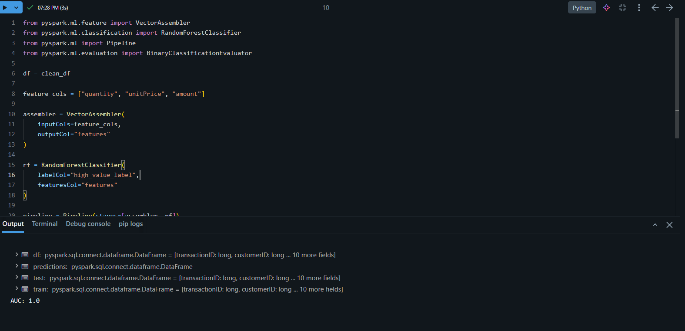

Slide 4
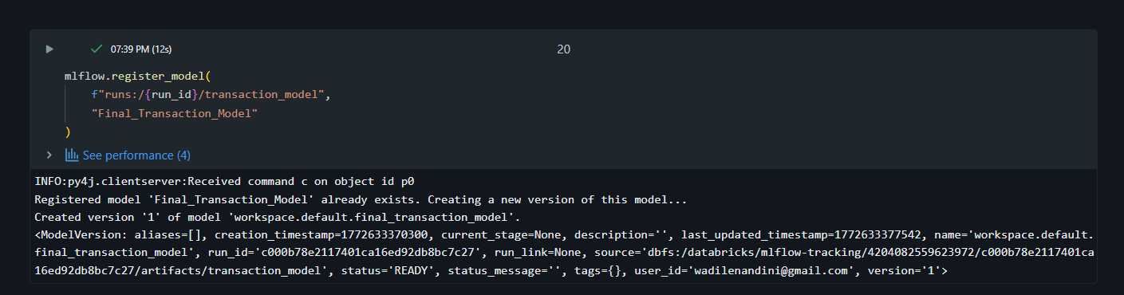

Slide 5
Conclusion :
Completing the 14 Days AI Challenge strengthened my understanding of building production-ready ML systems — from data engineering to model deployment. This journey improved not only my technical skills but also my problem-solving mindset in real-world AI workflows.

