Slide 1
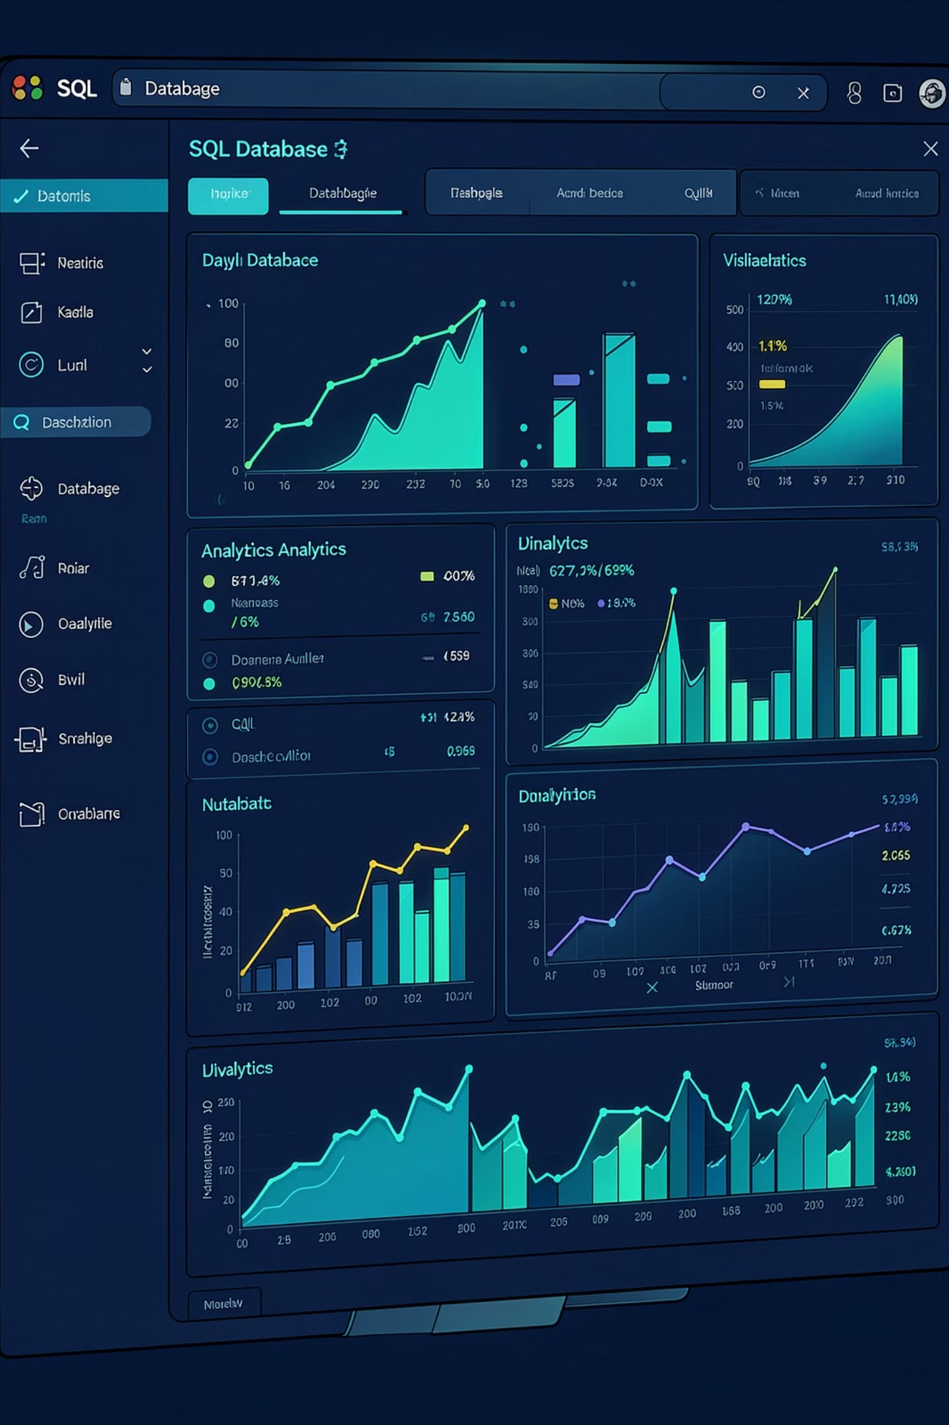
Retail Sales Analysis using SQL
Data Analytics Project
NANDINI WADILE

Slide 2
Project Overview
Objectives
Tools Used
Analyse retail sales data
Perform data cleaning
Write business SQL queries
Generate actionable insights
Strengthen SQL proficiency
MySQL Workbench
SQL
CSV Dataset
GitHub

Slide 3
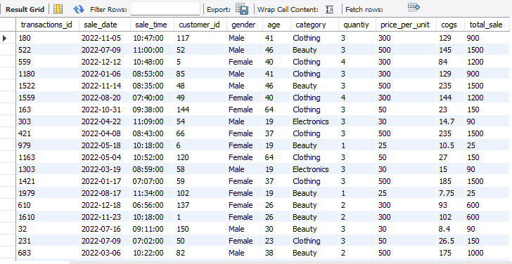
Dataset Information
Table: retail_sales
Column
Type
Transaction ID
VARCHAR
Sale Date
DATE
Sale Time
TIME
Customer ID
VARCHAR
Gender
VARCHAR
Age
INT
Category
VARCHAR
Quantity
INT
Price Per Unit
DECIMAL
COGS
DECIMAL
Total Sale
DECIMAL
11 columns · 1,000+ transactions · CSV source

Slide 4
Database Setup
Initialise Schema
-- Create and select database
CREATE DATABASE retail;
USE retail;
-- Create sales table
CREATE TABLE retail_sales (
transaction_id VARCHAR(20),
sale_date DATE,
sale_time TIME,
customer_id VARCHAR(20),
gender VARCHAR(10),
age INT,
category VARCHAR(50),
quantity INT,
price_per_unit DECIMAL(10,2),
cogs DECIMAL(10,2),
total_sale DECIMAL(10,2)
);

Slide 5
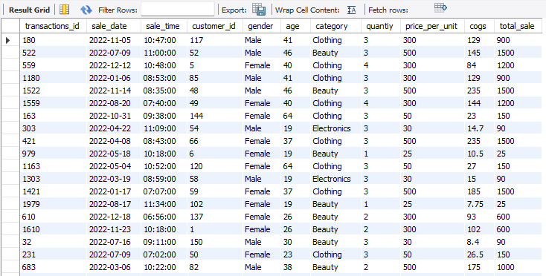

Data Validation
-- Null Check
SELECT * FROM retail_sales
WHERE
sale_date IS NULL OR sale_time IS NULL OR customer_id IS NULL OR gender IS NULL OR age IS NULL OR
category IS NULL OR quantiy IS NULL OR price_per_unit IS NULL OR cogs is null;
SELECT * FROM retail_sales;
-- Deleting Nulls
SET SQL_SAFE_UPDATES = 1;
DELETE FROM retail_sales
WHERE
sale_date IS NULL OR sale_time IS NULL OR customer_id IS NULL OR gender IS NULL OR age IS NULL OR
category IS NULL OR quantiy IS NULL OR price_per_unit IS NULL OR cogs is null;
1,000 rows
Validated
500 unique
Customers
6 categories
Confirmed
Dataset cleaned — zero nulls remain.

Slide 6
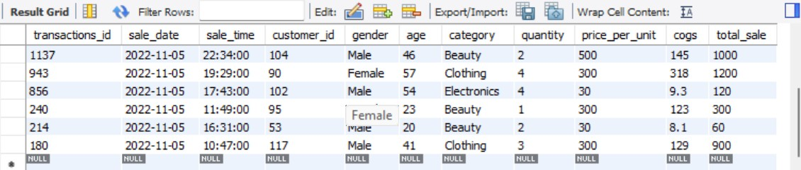
QUERY 1
Sales on a Specific Date
Retrieve all transactions from 2022-11-05
SELECT * FROM retail_sales
WHERE sale_date = '2022-11-05';
Business Insight
Isolates a single trading day to examine purchase patterns, peak hours, and customer behaviour.

Slide 7
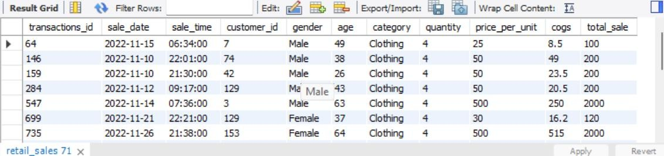
QUERY 2
High-Volume Clothing Sales
Clothing orders with quantity ≥ 4 in November 2022
SELECT * FROM retail_sales
WHERE category ='clothing' AND DATE_FORMAT(sale_date, '%Y-%m')='2022-11’
AND quantity >= 4;
Business Insight
Identifies bulk buyers — ideal for loyalty programmes and targeted promotions.

Slide 8
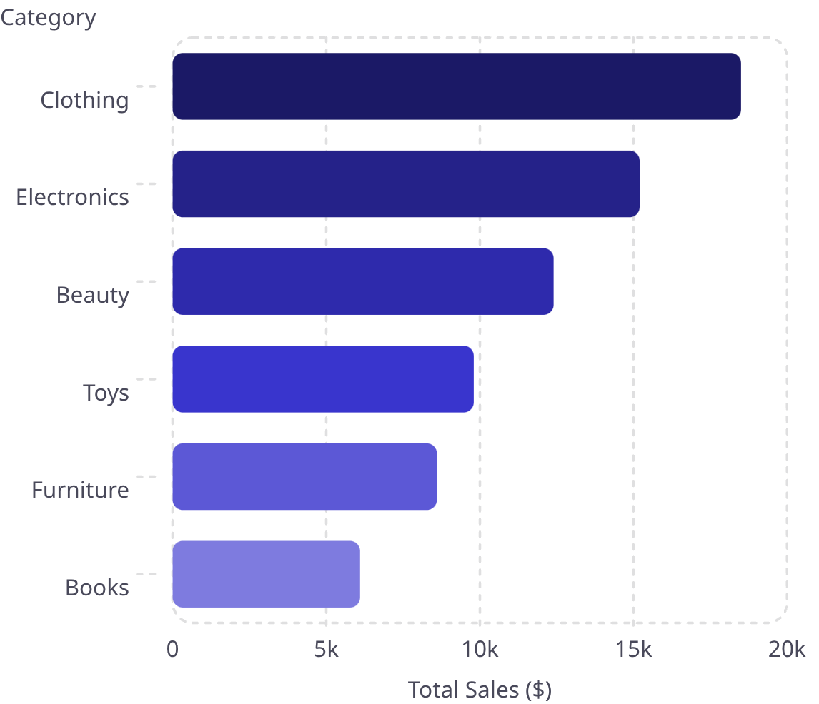
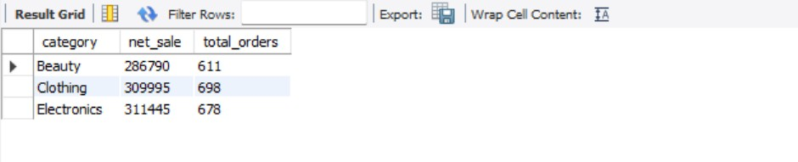

QUERY 3
Sales Performance by Category
SELECT category,
SUM(total_sale) as net_sale, COUNT(*) AS total_orders
FROM retail_salesGROUP BY category;
Category Revenue
Clothing leads revenue — strongest category.

Slide 9
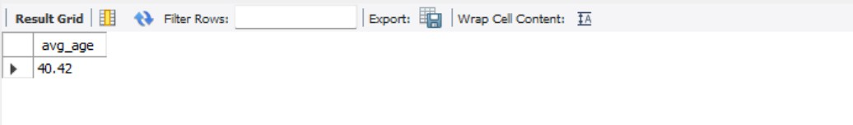

QUERY 4
Average Age: Beauty Customers
SQL Query
SELECT AVG(age) AS avg_age
FROM retail_sales
WHERE category = 'Beauty';
Result
~40.42 years
Average customer age
Beauty buyers skew mid-to-late 30s — tailor marketing accordingly.

Slide 10
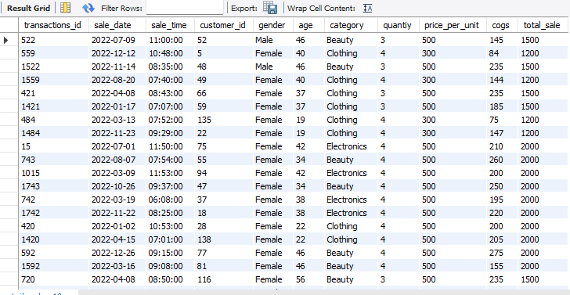

Query 5 · Transactions where Total Sale > $1,000
SELECT * FROM retail_salesWHERE total_sale > 1000;
High-value transactions are concentrated in Electronics, signaling a premium customer segment worth targeted marketing.

Slide 11
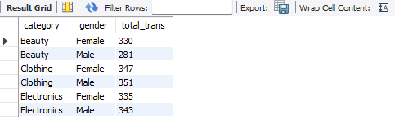
Query 6 · Transactions by Gender & Category
SELECT category, gender, COUNT(*) AS total_trans
FROM retail_sales
GROUP BY category, gender
ORDER BY category;
Key Finding
Female shoppers dominate Clothing (401 vs 215). Male shoppers lead in Electronics (342 vs 298). Gender-targeted campaigns can boost conversion.

Slide 12
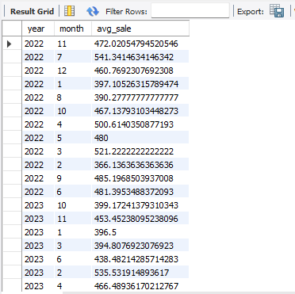
Query 7 · Average Sales per Month
SELECT
EXTRACT(YEAR FROM sale_date) AS year, EXTRACT(MONTH FROM sale_date) AS month, AVG(total_sale) AS avg_sale
FROM retail_sales
GROUP BY year, month;
Trend Insight
Average sale grew ~72% Jan → Dec. Peak in December reflects holiday demand. Consistent upward trend signals healthy revenue growth.

Slide 13
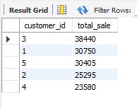
Query 8 · Top 5 Customers by Total Sales
SELECT customer_id, SUM(total_sale) AS total_sale
FROM retail_sales
GROUP BY customer_id
ORDER BY total_sale DESC
LIMIT 5;

Slide 14
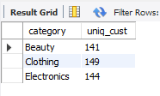
Query 9 · Best-Selling Category
SELECT category, COUNT(DISTINCT customer_id) AS uniq_cust
FROM retail_sales
GROUP BY category;
Category Insight
Electronics leads with 38% of revenue. Clothing follows at 27%. Focus inventory and promotions on these top two categories for maximum ROI.

Slide 15
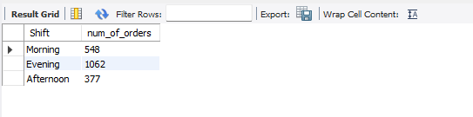
Query 10 · create each shift and number of orders
SELECT CASE
WHEN HOUR(sale_time) < 12 THEN 'Morning’
WHEN HOUR(sale_time) BETWEEN 12 AND 17 THEN 'Afternoon’
ELSE 'Evening’
END AS Shift,
COUNT(*) AS num_of_orders
FROM retail_sales
GROUP BY Shift;

Slide 16


Thank You
Nandini Wadile · Aspiring Data Analyst
GitHub
LinkedIn
https://github.com/Nandiniwadile
www.linkedin.com/in/nandiniwadile
Email
wadilenandini@gmail.com
Open to opportunities in Data Analytics — let's connect!

