Slide 1
Google Cloud AI Builder Cup 2026 · Sustainability & Social Impact
60 %+
of Karnataka 108 cardiac, stroke, respiratory calls missed the 10-minute target
Emergency Green Corridor
Warning the junction constable before the siren arrives.
Source: CAG audit of Karnataka 108 EMS, 2014–19
Nandish · green-corridor-2026.web.app

Slide 2
Google Cloud AI Builder Cup 2026 · Sustainability & Social Impact
Team details
A solo entry, built end to end by one contributor.
Team name
Team leader
Contributors
Green Corridor
Nandish
Sole contributor
Problem statement
Sustainability & Social Impact: emergency vehicles stuck at red signals while the junction constable is never told.
Green Corridor · Team details
2 / 16

Slide 3
Google Cloud AI Builder Cup 2026 · Sustainability & Social Impact
Brief about the idea
Warn the junction constable early, sized to the queue
≈ 7.9 min
saved for the critical ambulance
4 vs 1 min
warning at a 400 m queue vs a 100 m queue
16.5 min
three-vehicle total, simulated baseline
Scripted scenario and synthetic voices, not field results.
Green Corridor · Brief about the idea
3 / 16

Slide 4
Google Cloud AI Builder Cup 2026 · Sustainability & Social Impact
Opportunities (how it differs / how it solves / USP)
Not a fixed radius, and not waiting for new hardware
≠
✓
★
How it differs
How it solves
USP
Warning sized to the queue
Queue cleared before the siren
Rules decide, Gemini explains; no hardware
vs fixed-radius alerts
vs manual green corridors
vs IR/GPS preemption
Green Corridor · Opportunities
4 / 16

Slide 5


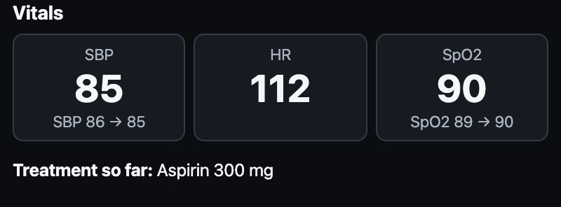
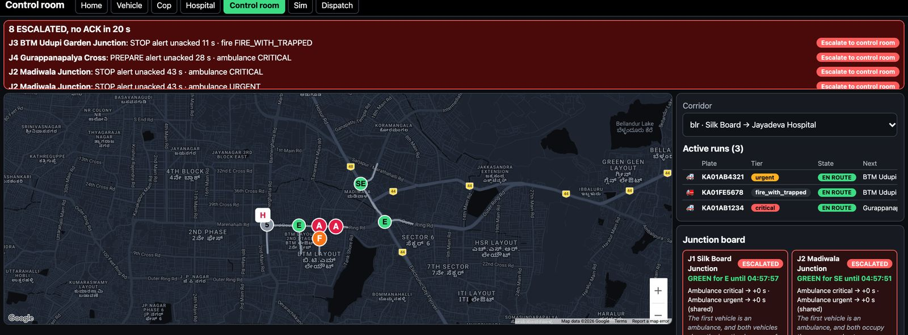
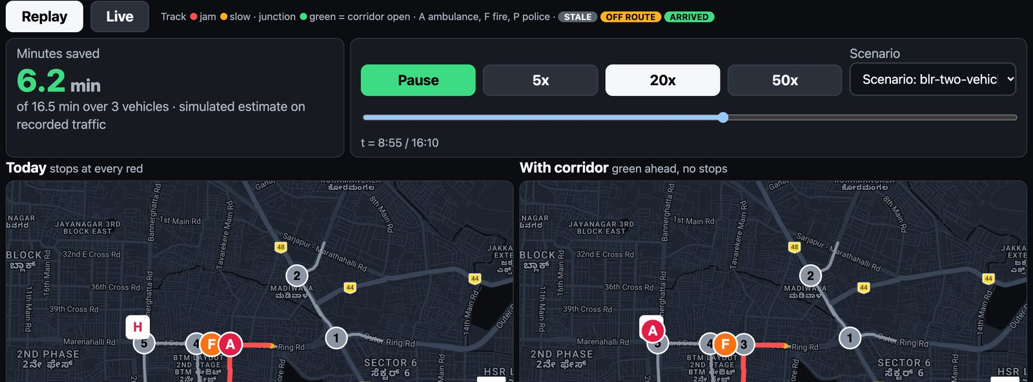
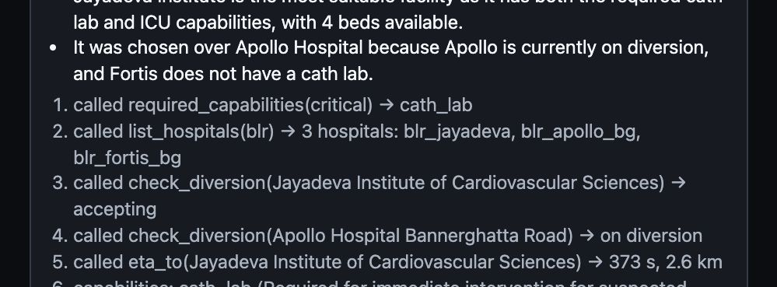
Google Cloud AI Builder Cup 2026 · Sustainability & Social Impact
List of features
Six screens and the engines behind them
Voice triage
Spoken cop alert
Hospital live brief
Control room board
With-vs-without replay
Routing agent trace
Lead time
Sequencing
Cop voice
ATMIST
After-action
Eval harness
Green Corridor · List of features
5 / 16

Slide 6
Google Cloud AI Builder Cup 2026 · Sustainability & Social Impact
Process flow
From the crew’s words to the constable’s phone
Road
1
Crew speaks
2
Gemini extracts
3
Crew confirms tier
4
Queue sizes alert
5
Cop hears, ACKs
6
SignalAdapter (simulated)
Hospital
7
Hospital brief at ETA−5
Amber seam: simulated today.
Green Corridor · Process flow
6 / 16

Slide 7
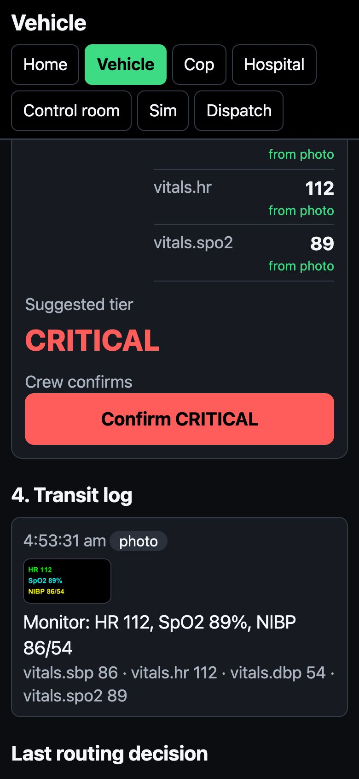
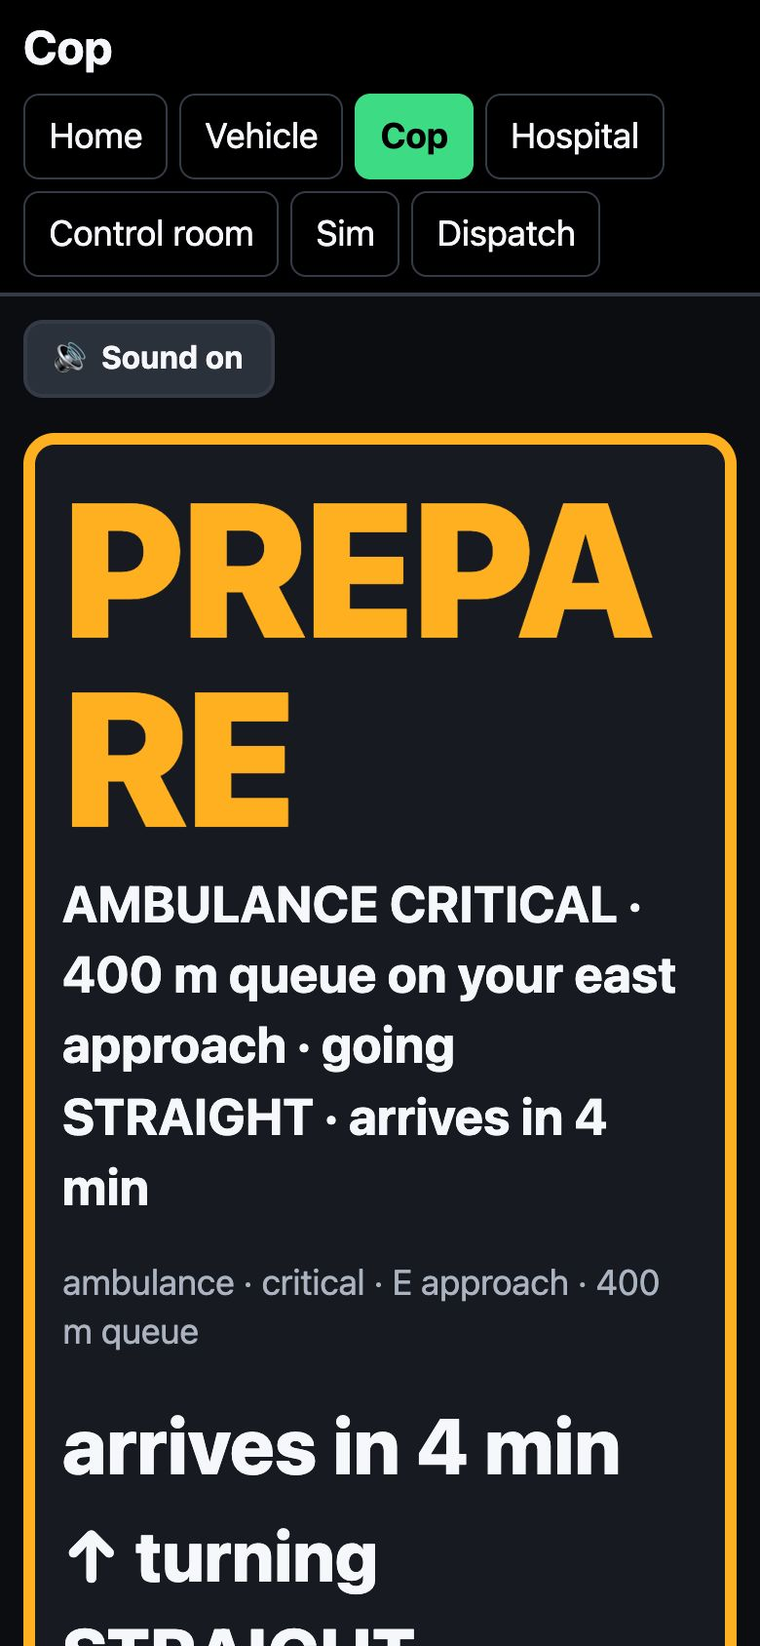
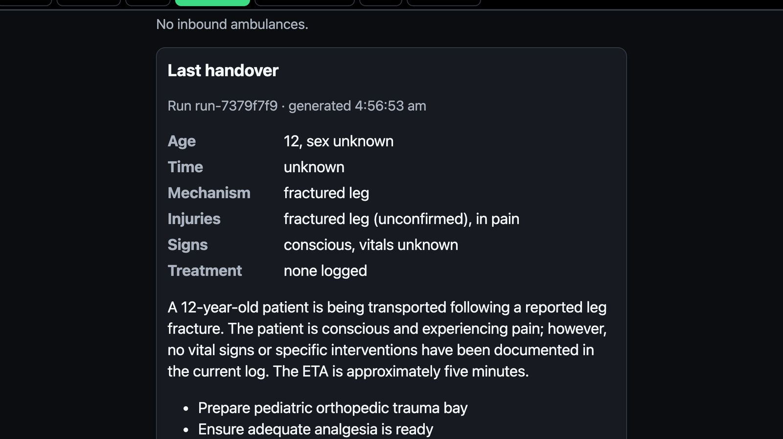
Google Cloud AI Builder Cup 2026 · Sustainability & Social Impact
Wireframes
Real screens from the running prototype
Voice triage
PREPARE alert
Hospital handover
Live rehearsal captures; synthetic patients.
Green Corridor · Wireframes
7 / 16

Slide 8
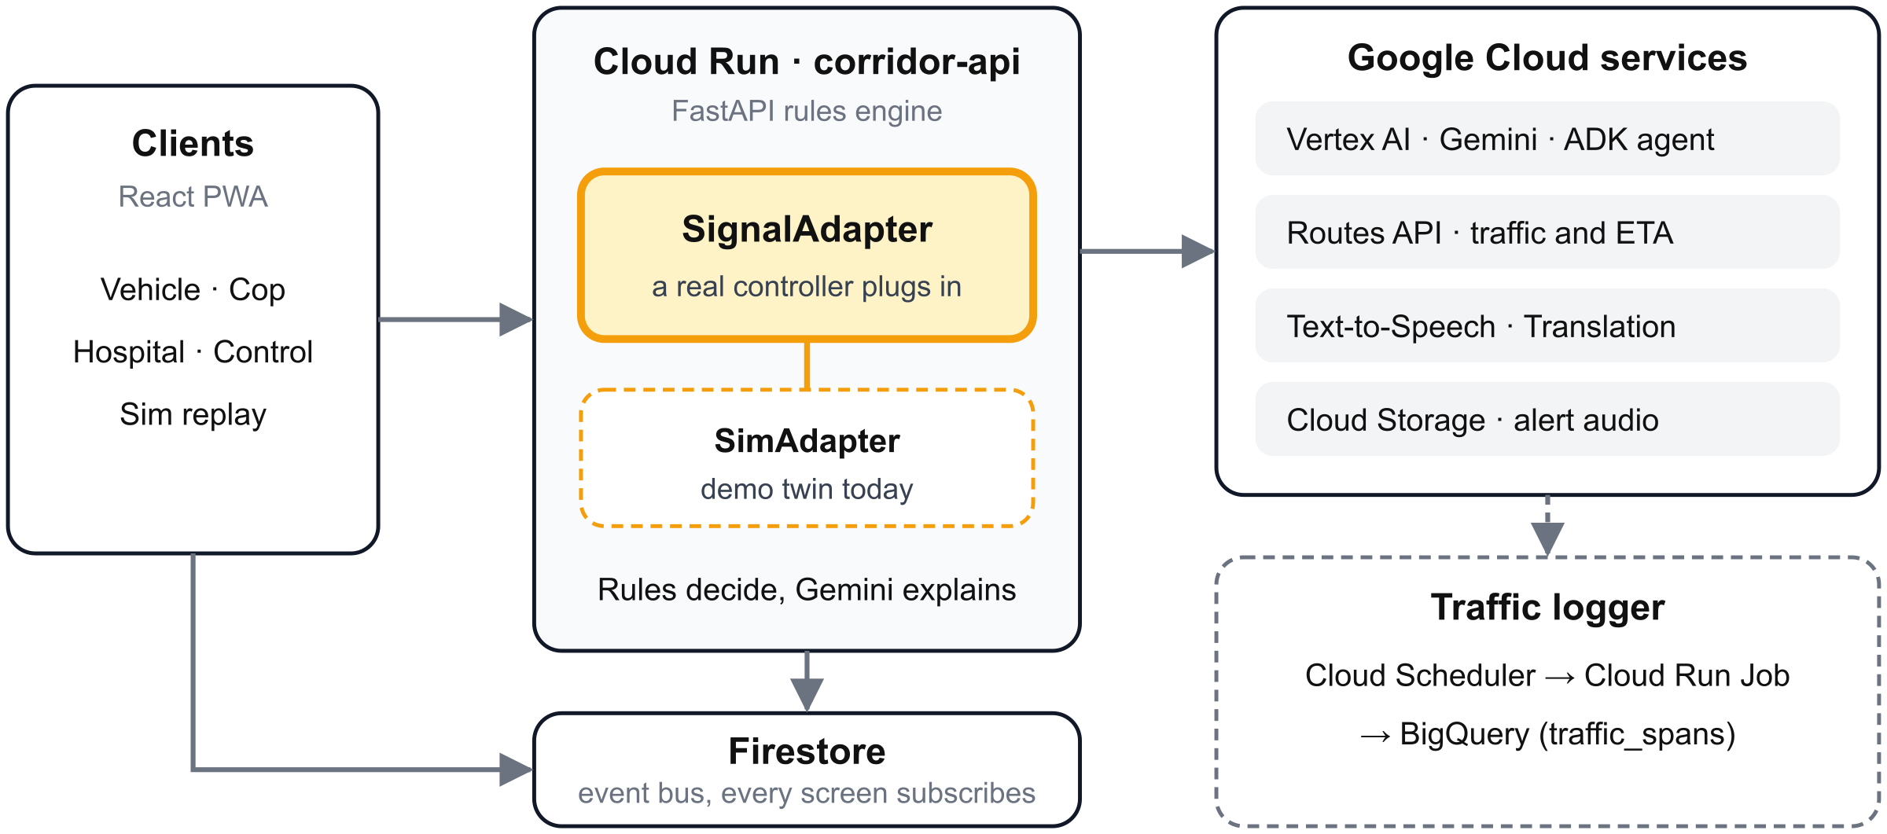
Google Cloud AI Builder Cup 2026 · Sustainability & Social Impact
Architecture
Rules decide; Google Cloud services extract and explain
Rules engine on Cloud Run, Firestore event bus; the amber SignalAdapter seam is where a real controller plugs in.
Green Corridor · Architecture
8 / 16

Slide 9
Google Cloud AI Builder Cup 2026 · Sustainability & Social Impact
Technologies (Google Cloud)
A Google Cloud stack, from model to delivery
AI & language
Gemini on Vertex AI
Google ADK
Cloud Translation
Maps & speech
Routes API
Text-to-Speech
Cloud Storage
Run & data
Cloud Run
Firestore
BigQuery
Delivery
Firebase Hosting
Cloud Build
Secret Manager
BigQuery ML pipeline in place; model retrained on peak rows before submission
Green Corridor · Technologies
9 / 16

Slide 10
Google Cloud AI Builder Cup 2026 · Sustainability & Social Impact
Estimated implementation cost
About ₹155 per vehicle-hour, almost all of it Routes
≈ ₹155
per vehicle-hour (estimate)
≈ ₹50
per 20-min run
≈ ₹5,000
city-month at 100 runs (illustrative)
Routes
3/min × 60 × ₹0.85
₹153
Lever: cache Routes beyond today's 20 s
Gemini
17 × ₹0.02
₹0.34
Text-to-Speech
₹1.30
Green Corridor · Estimated implementation cost
10 / 16

Slide 11
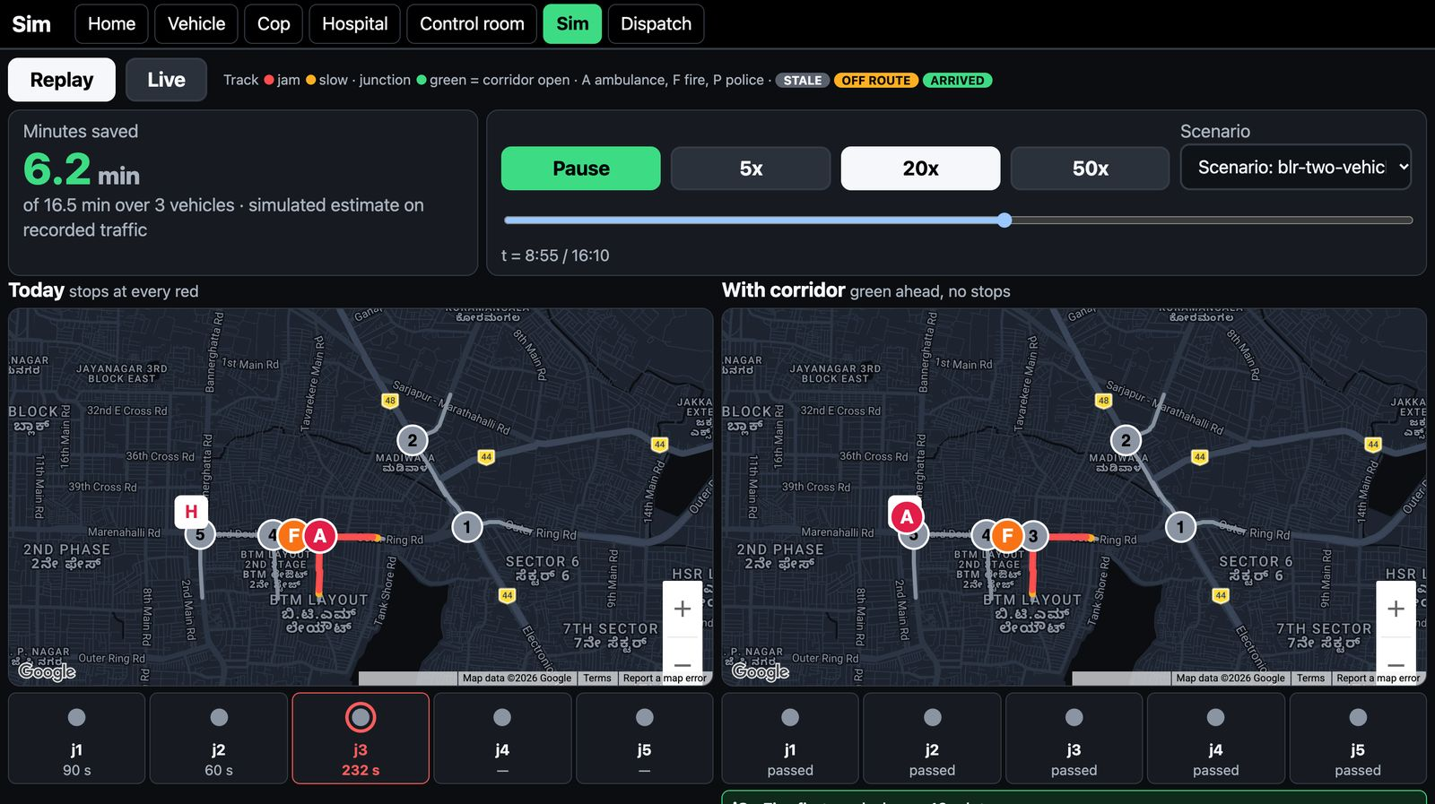
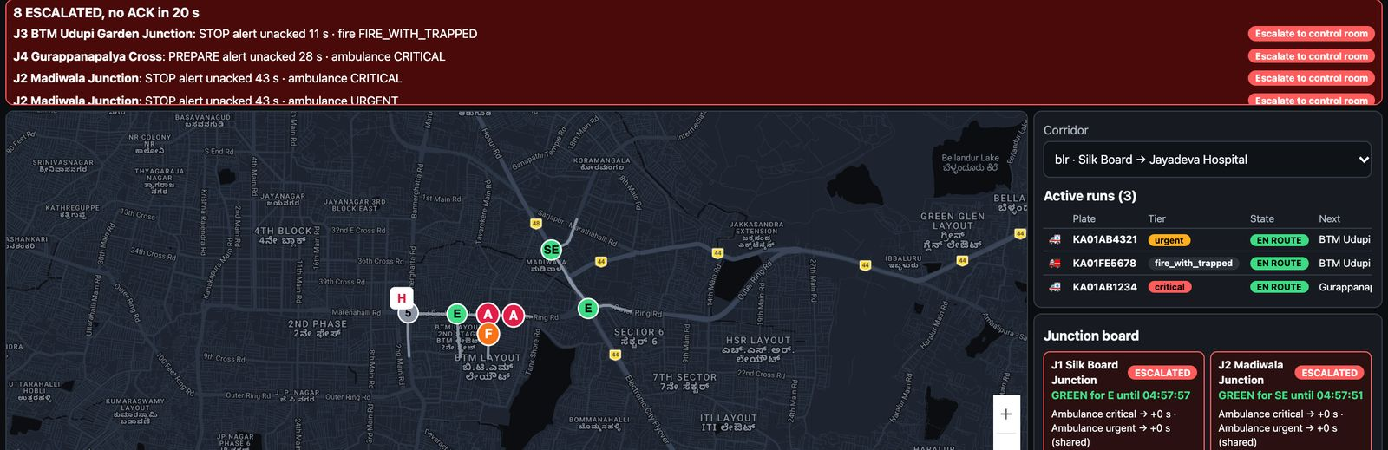

Google Cloud AI Builder Cup 2026 · Sustainability & Social Impact
Snapshots of the prototype
The loop, mid-run, from the live rehearsal
Control room
Replay simulator
STOP alert, spoken
Green Corridor · Snapshots of the prototype
11 / 16

Slide 12
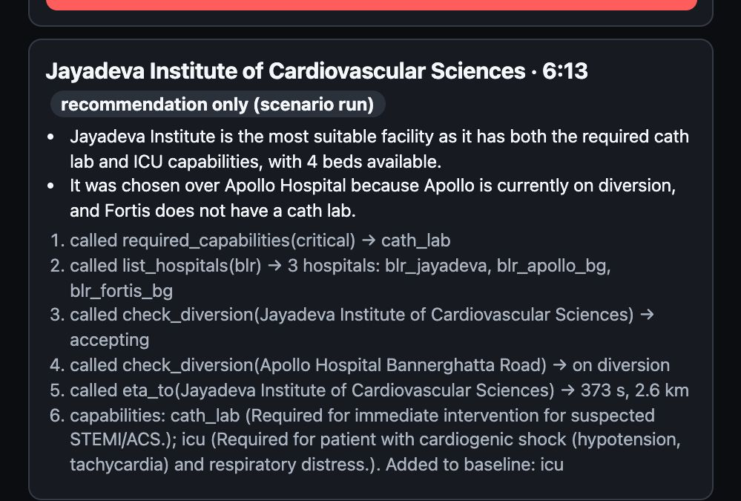
Google Cloud AI Builder Cup 2026 · Sustainability & Social Impact
Snapshots of the prototype (routing agent)
Live routing trace: Jayadeva chosen, two alternatives rejected
1 required_capabilities(critical) -> cath_lab
2 list_hospitals(blr) -> 3 hospitals
3 check_diversion(Jayadeva) -> accepting
4 check_diversion(Apollo) -> on diversion
5 eta_to(Jayadeva) -> 373 s, 2.6 km
6 Added to baseline: icu
Destination Jayadeva, confidence 1.0
The trace as shown in /vehicle.
Green Corridor · Snapshots of the prototype
12 / 16

Slide 13
Google Cloud AI Builder Cup 2026 · Sustainability & Social Impact
Performance report / benchmarking
Synthetic-voice results, scripted-run timings
90 %
field accuracy
100 %
tier accuracy
3.5 s
mean extraction
11 synthetic clips, the ones the fix targeted; real clips pending. Before the fix: 87 % / 73 %.
17 / 37 ms
/location p50 / p95, offline
344 Python · 138 web tests
98 % coverage
Green Corridor · Performance report / benchmarking
13 / 16

Slide 14
Google Cloud AI Builder Cup 2026 · Sustainability & Social Impact
Additional details / future development
From constable to controller, in three steps
Today
Constable alerts
Spoken alert, one ACK.
Phase 2
Signal controllers
Constables no longer clear queues by hand.
Phase 3
Learning controller
Peak-hour spans already logged.
Signals simulated, patients synthetic, minutes saved estimated.
Green Corridor · Additional details / future development
14 / 16

Slide 15



Google Cloud AI Builder Cup 2026 · Sustainability & Social Impact
Links
Try it, read the code, watch the demo
GitHub Public Repository
Demo Video (3 minutes)
Final Product
Submission deck
[link + QR at submission]
github.com/Nandish3010/ideal-disco
green-corridor-2026.web.app
green-corridor-2026.web.app/deck.pdf
Green Corridor · Links
15 / 16

Slide 16
Google Cloud AI Builder Cup 2026 · Sustainability & Social Impact
Warn the constable
before the siren arrives.
Try it: green-corridor-2026.web.app
Read it: github.com/Nandish3010/ideal-disco
Built by Nandish
Green Corridor · Thank you
16 / 16

