Slide 1


Google Cloud AI Builder Cup 2026 · Sustainability & Social Impact
Warning the junction constable before the siren arrives.
Team Details
  Team name: Green Corridor
  Team leader name: Nandish
  Problem Statement: Sustainability & Social Impact — emergency vehicles stuck at red signals; the junction constable is never told

Slide 2
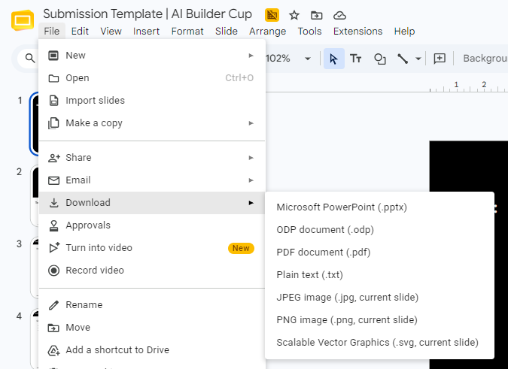
Note: Please download this template to make your edits and submit the final version.
To download, go to File > Download > Microsoft PowerPoint (.PPTX). Kindly refrain from sending edit requests.

Slide 3
Brief about the idea
Warn the junction constable early, sized to the queue
16.5 min
saved on the scripted scenario
4 min
warning at a 400 m queue
100 %
tier accuracy on 11 synthetic clips
Scripted scenario and synthetic voices, not field results.

Slide 4
Opportunities
Not a fixed radius, and not waiting for new hardware
≠
✓
★
How it differs
How it solves
USP
Warning sized to the queue, not a fixed radius
The constable clears the queue before the siren
Rules decide, Gemini explains; no hardware needed

Slide 5
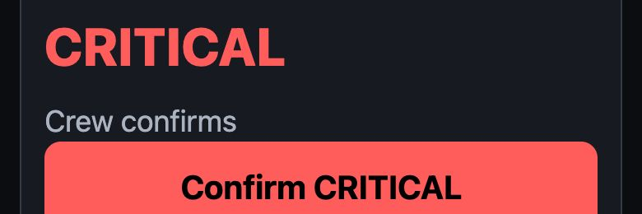

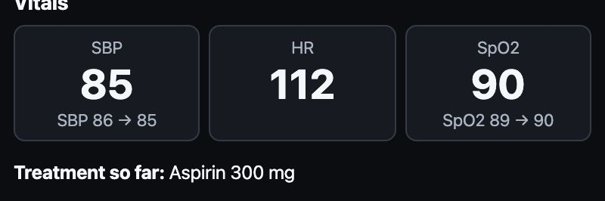
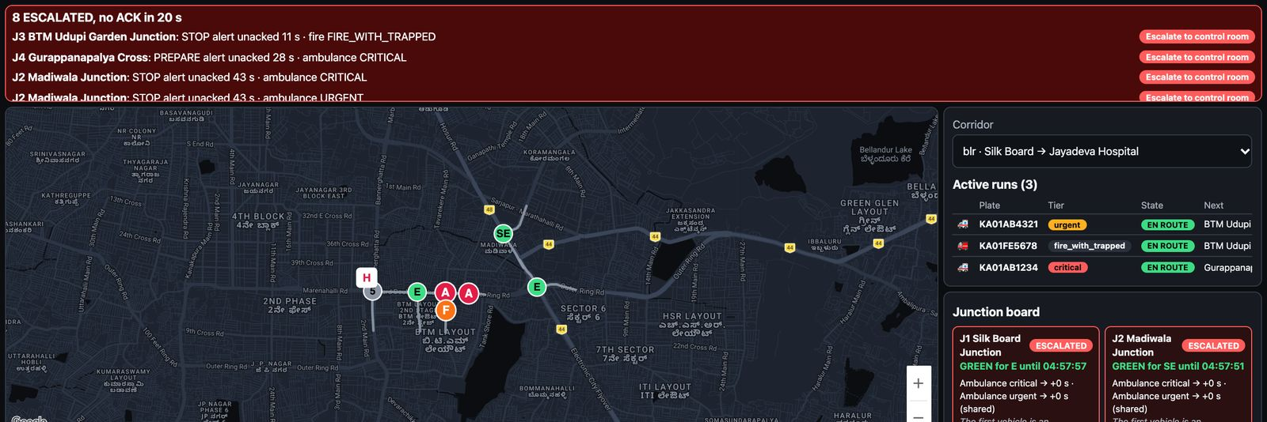
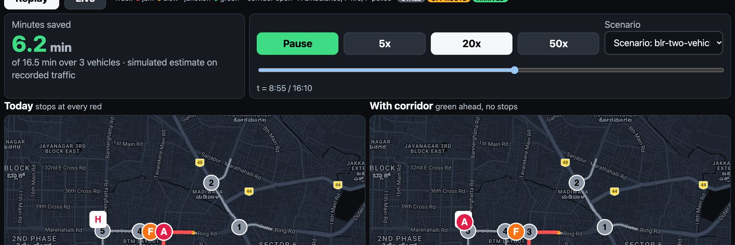
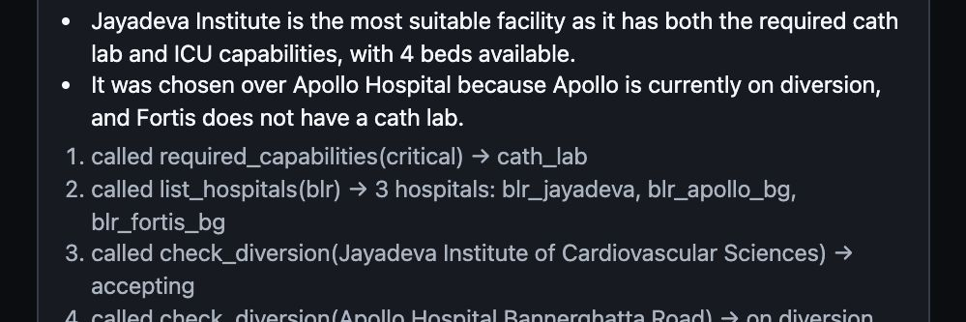
List of features offered by the solution
Six screens and the engines behind them
Voice triage
Spoken cop alert
Hospital live brief
Speak, confirm the tier
PREPARE, then STOP
Live log, ATMIST
Control room board
With-vs-without replay
Routing agent trace
Junctions and escalations
Minutes saved
Tool-call trace
Lead time
Sequencing
Cop voice
ATMIST
After-action
Eval harness

Slide 6
Process flow diagram or Use-case diagram
From the crew’s words to the constable’s phone
Road
1
Crew speaks
2
Gemini extracts
3
Crew confirms tier
4
Queue sizes alert
5
Cop hears, ACKs
6
SignalAdapter (simulated)
Hospital
7
Hospital brief at ETA−5
Amber seam: simulated today.

Slide 7
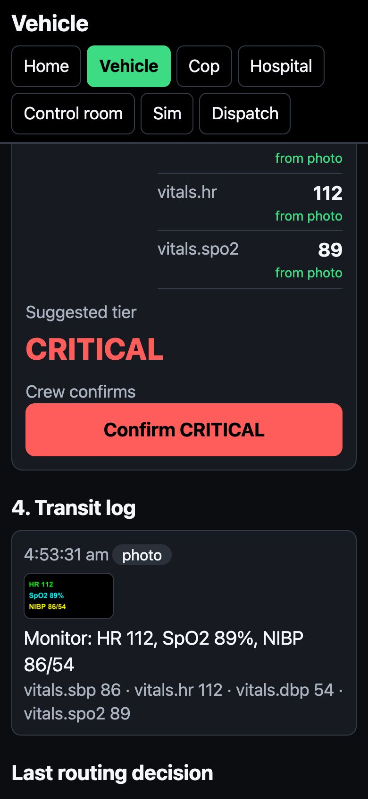
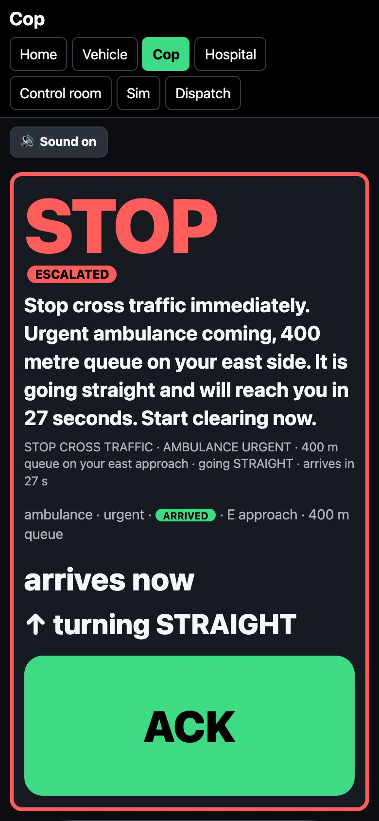
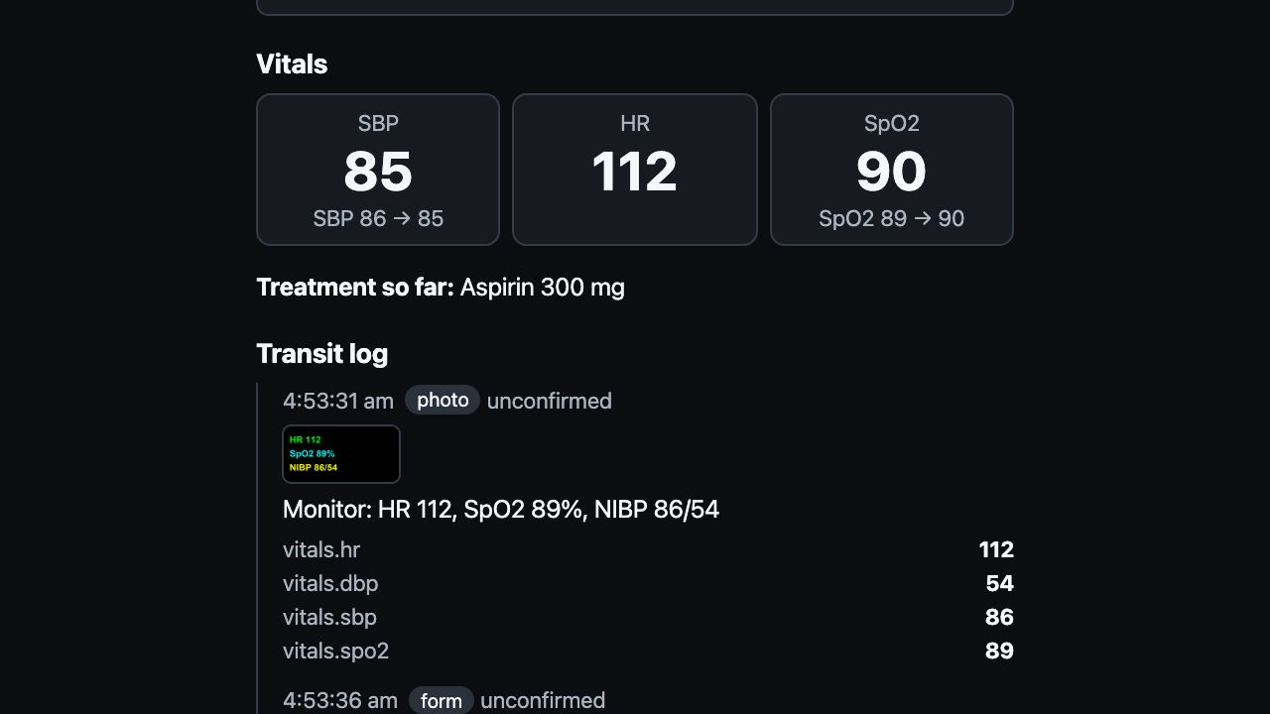
Wireframes/Mock diagrams of the proposed solution (optional)
Real screens from the running prototype
Voice triage
Spoken alert
Hospital brief
Live rehearsal captures; synthetic patients.

Slide 8
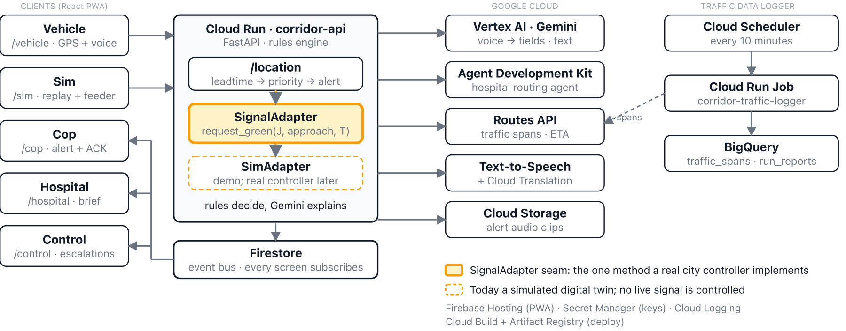
Architecture diagram of the proposed solution
Rules decide; Google Cloud services extract and explain
Rules engine on Cloud Run, Firestore event bus; the amber SignalAdapter seam is where a real controller plugs in.

Slide 9
Technologies to be used in the solution
A Google Cloud stack, from model to delivery
AI
Gemini on Vertex AI
Google ADK
BigQuery ML
Run & data
Cloud Run
Firestore
BigQuery
Maps & speech
Routes API
Text-to-Speech
Translation
Delivery
Firebase Hosting
Cloud Build
Secret Manager
Also: Storage, Scheduler, Logging

Slide 10
Estimated implementation cost (optional)
About ₹155 per vehicle-hour, almost all of it Routes
Service | Basis | ₹ per hour
Routes | 3 calls/min | ₹153
Gemini | 17 calls | ₹0.34
Text-to-Speech | ~1,000 chars | ₹1.30
≈ ₹155
per vehicle-hour (estimate)
List prices; Routes is ~98 % of the bill.

Slide 11
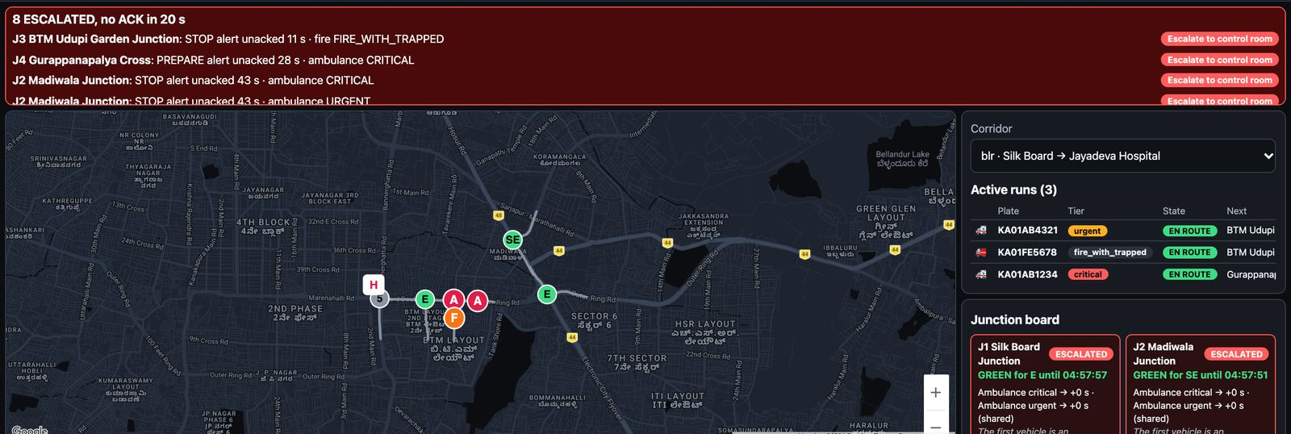

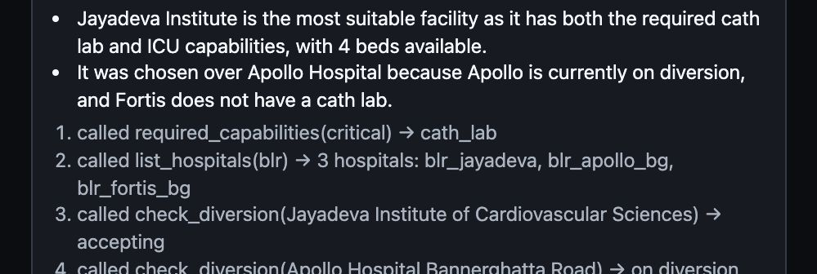
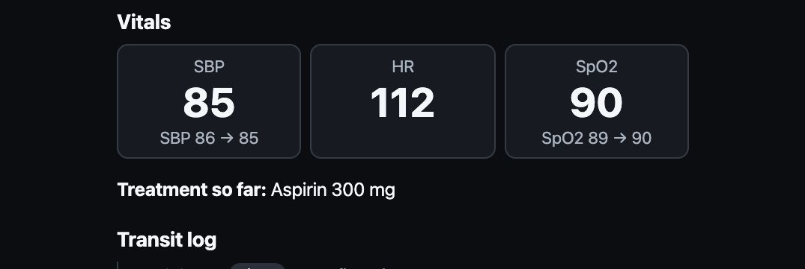
Snapshots of the prototype
The loop, mid-run, from the live rehearsal
Control room
Replay simulator
Routing trace
Hospital log

Slide 12
Prototype Performance report/Benchmarking
Synthetic-voice results, scripted-run timings
90 %
field accuracy
100 %
tier accuracy
3.5 s
mean extraction
4 vs 1
min alert lead, long vs short queue
11 synthetic clips; not field recordings.
17 / 37 ms
/location p50 / p95, offline single instance
412 Python, 161 web tests; 98 % API coverage

Slide 13
Additional Details/Future Development (if any)
From constable to controller, in three steps
Today
Constable alerts
Spoken alert, one ACK.
Phase 2
Signal controllers via the adapter
Constables no longer clear queues by hand.
Phase 3
Learning controller on logged junction data
Peak-hour spans already logged.

Slide 14


Provide links to your:
Try it, read the code, watch the demo
GitHub Public Repository
Demo Video (3 minutes)
Final Product
[link]
github.com/Nandish3010/ideal-disco
green-corridor-2026.web.app

Slide 16


