Slide 1


Image Captioning with CNN & RNN – A Computer Vision & Deep Learning Approach
NEIL NEMI SHAH A20500775
NANDISH PRATIKBHAI BHAGAT A20490179

Slide 2
Problem Statement
The challenge offers a captioning job, which necessitates a computer vision system that can both locate and define significant regions in pictures in normal language.
Need?

Slide 3
Solution
We are going to create a system where we won't be using any activation method.
We will start with using the pretrained VGG16 model however we will remove the last layer as classification is not needed.
Text input will be functioning as a word embedding layer. The embedded layer is made up of rules that extract the appropriate text characteristics and a mask that ignores padded values. After that, the network is linked to an LSTM for the last stage of picture captioning.
Using an additional operation (the decoder), the model's final phase combines the input from the Image extractor phase and the sequence processor phase.

Slide 4
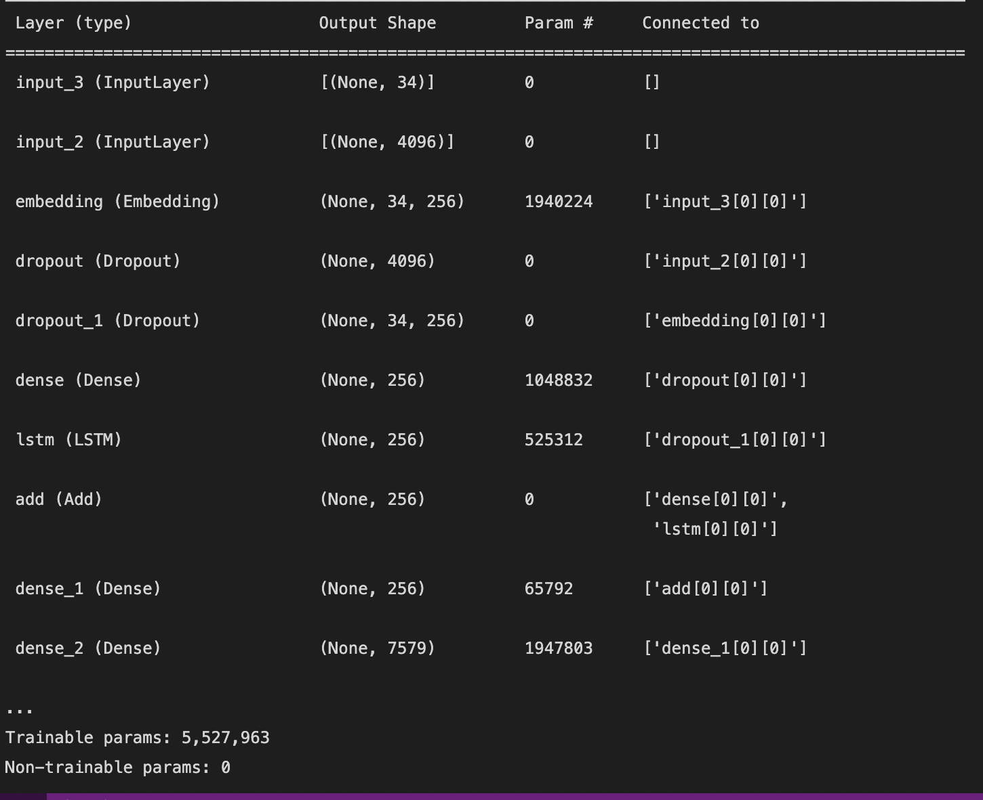
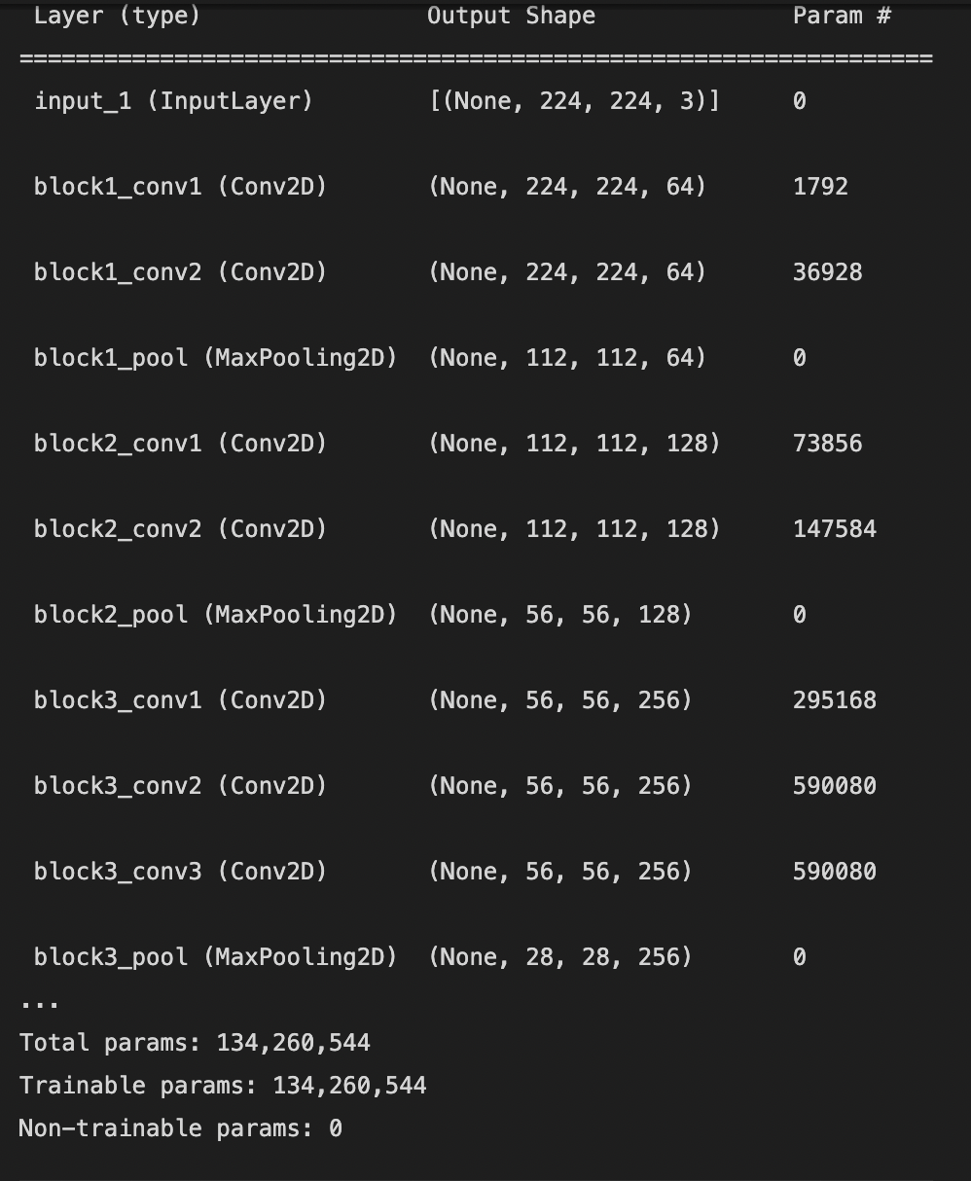
Training
The VGG model has been trained to recognize all potential entities in a picture.
While the LSTM element of the model is trained to predict every word in the sentence after seeing the picture and all preceding words. We add two more symbols to each caption to indicate the beginning and conclusion of the series. When a stop word is found, the sentence generation is halted and the end of the string is marked.
We have used RELU for the first dense layer and then we have used SoftMax in the last dense layer. Our optimizer is Adam and the loss function is categorical Coss entropy.

Slide 5
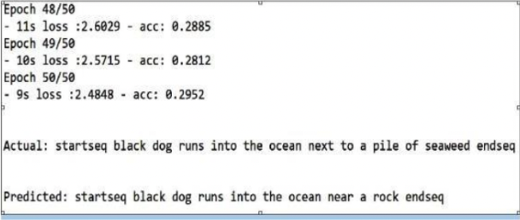
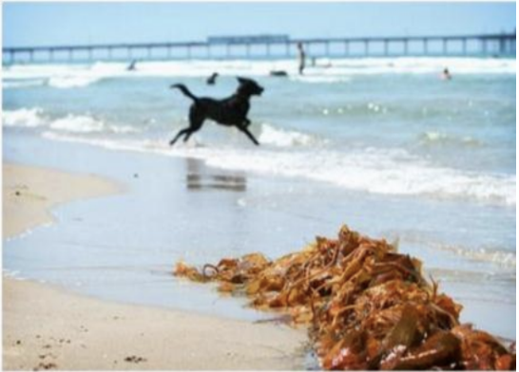
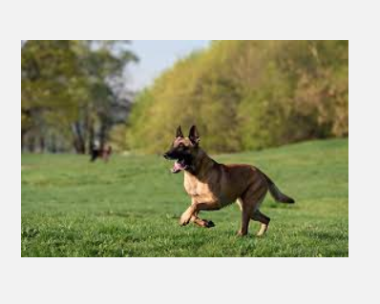
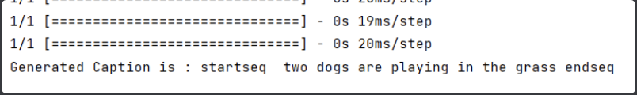
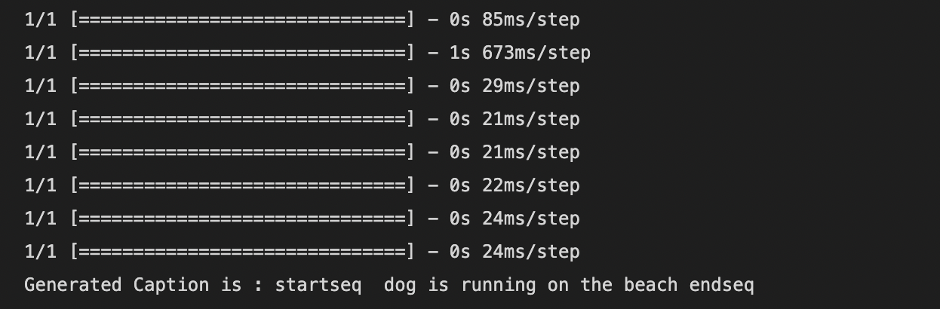
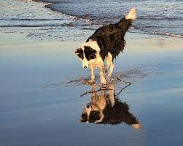
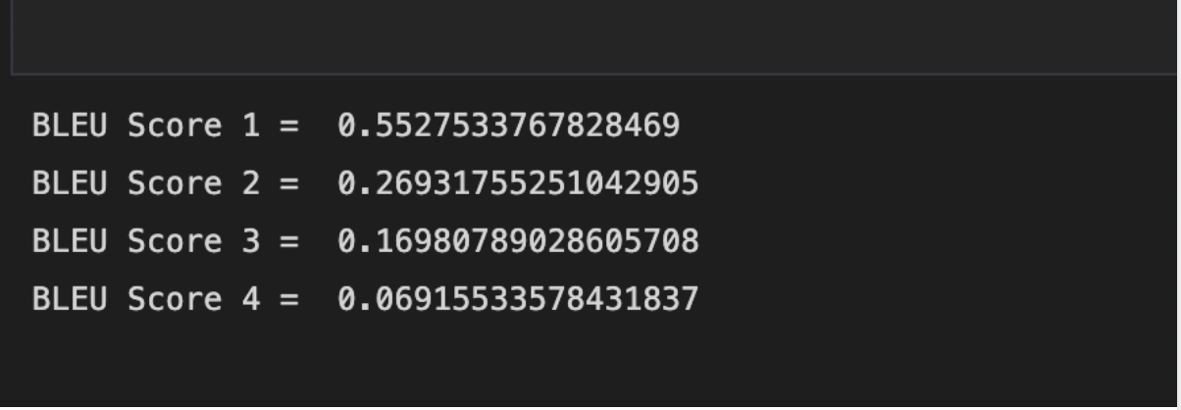
REsults
The results that we have gathered are very similar to the research paper.
Research Paper
Our Implementation

Slide 6
Future Scope
The image captioning model are now ubiquitous in our community and seldom we realize the importance of things whose nature is such.
Computer Vision is now applied in every type of industry and hence image captioning has the ability to itself become a base upon which multidisciplinary projects can be made.

Slide 7
Thank you

